Slide 1



Healthcare Workforce
Mental Health Dashboard Stress, Burnout, Job Satisfaction and Workforce Retention Analytics Prepared By: Mfoniso Isaac Udo
Tools Used: Microsoft Excel SQL Server Power BI

Slide 2

Healthcare Workforce Mental Health Dashboard
Project Overview & Objectives
The healthcare industry is highly demanding and can significantly affect employee mental health and workplace performance. This project analyzes healthcare workforce data to identify patterns related to stress, burnout, job satisfaction, mental health absences, employee assistance program access, and turnover intention.
Project Objectives
Analyze employee stress levels across departments.
Identify major workplace factors contributing to stress.
Examine burnout frequency among healthcare workers.
Assess employee job satisfaction levels.
Evaluate mental health absence trends.
Analyze workforce retention and turnover intention.
Provide recommendations to improve employee wellbeing.

Slide 3

Healthcare Workforce Mental Health Dashboard
DATASET OVERVIEW
The dataset contains information on 5,000 healthcare employees from multiple healthcare professions and departments.
Key Variables
Employee Type & Employee ID
Department
Workplace Factor
Stress Level
Burnout Frequency
Job Satisfaction
Access to Employee Assistance Programs (EAPs)
Mental Health Absences
Turnover Intention
Dataset Size
Total Employees: 5,000
Multiple Healthcare Professions
Multiple Clinical Departments

Slide 4


Healthcare Workforce Mental Health Dashboard
Methodology
Excel :
Cleaned and prepared the healthcare workforce dataset.
Conducted preliminary analysis using Pivot Tables and charts.
SQL :
Explored workforce trends and calculated key metrics.
Analyzed stress, burnout, absenteeism, and retention indicators.
Power BI :
Created DAX measures and KPIs.
Built interactive dashboards to visualize workforce mental health insights.
This is much cleaner and more suitable for a single presentation slide.

Slide 5

Healthcare Workforce Mental Health Dashboard
SQL Analysis & Key Findings
Structured Query Language (SQL) was used to explore and analyze the dataset before visualization.
Key Analysis Performed
Total number of healthcare employees
Employee distribution by profession
Average stress levels by department
Burnout frequency analysis
Job satisfaction assessment
Mental health absence analysis
Employee Assistance Program access analysis
Turnover intention analysis
Outcome
The SQL analysis provided valuable insights that guided the Power BI dashboard development process.

Slide 6
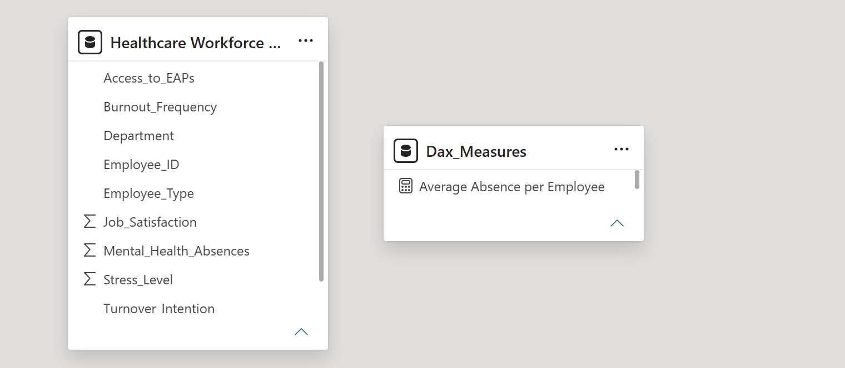
Healthcare Workforce Mental Health Dashboard
Power BI Data Model
A single-table healthcare workforce dataset was imported into Power BI for analysis. A dedicated DAX Measures table was created to store calculated measures and KPIs.
Measures Created
Total Employees
Average Stress Level
Average Job Satisfaction
Total Mental Health Absences
Average Mental Health Absences
Frequent Burnout Cases
Employees with Turnover Intention
EAP Access Rate
Average Absence per Employee
Model Structure
The project uses a flat-file structure; therefore, no table relationships were required.

Slide 7
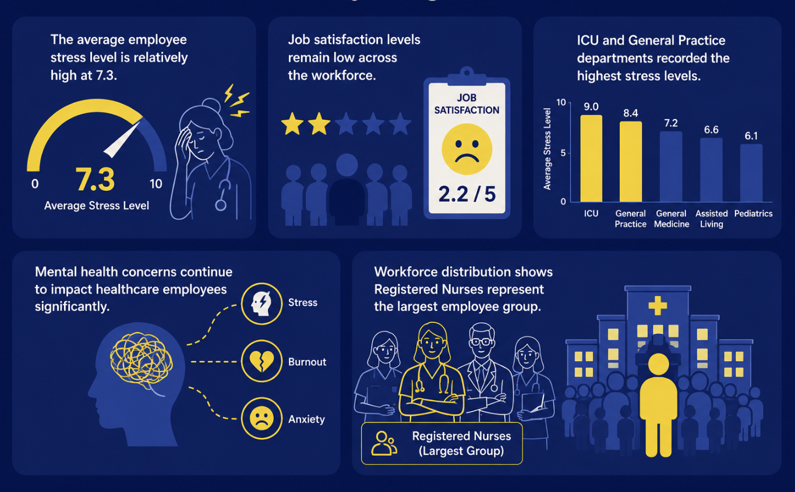
Healthcare Workforce Mental Health Dashboard
Workforce Overview Dashboard
Key Insights
The average employee stress level is relatively high at 7.3.
Job satisfaction levels remain low across the workforce.
ICU and General Practice departments recorded the highest stress levels.
Mental health concerns continue to impact healthcare employees significantly.
Workforce distribution shows Registered Nurses represent the largest employee group.

Slide 8
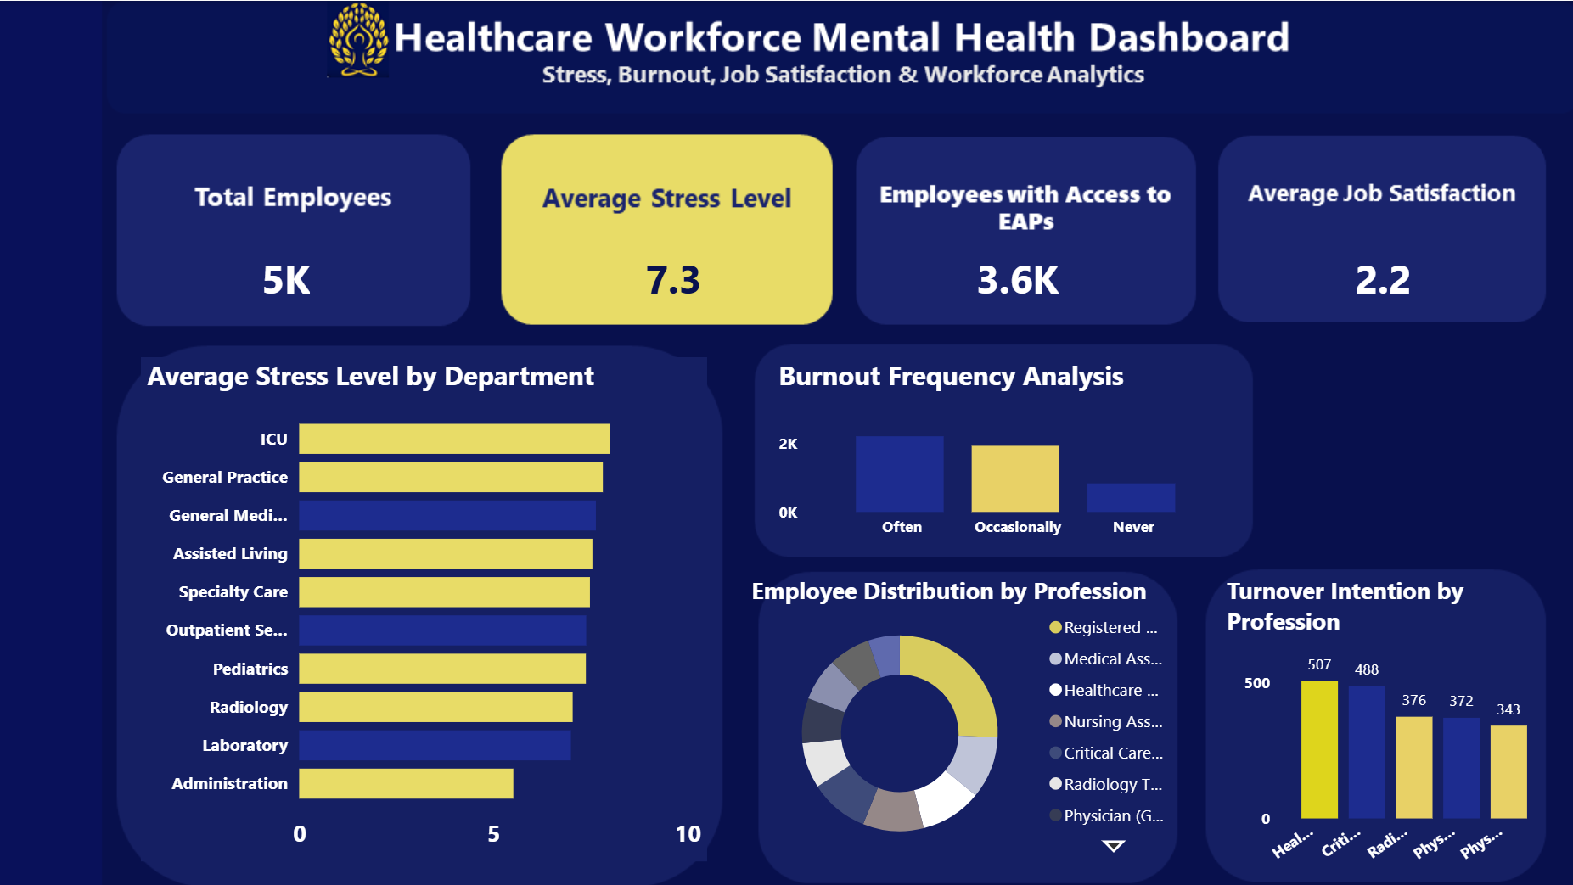
Healthcare Workforce Mental Health Dashboard
Stress & Burnout Analysis Dashboard
Key Insights
Heavy workload emerged as the most significant workplace stress factor.
Burnout occurs frequently among healthcare employees.
High stress levels are consistently observed across several professions.
Workplace factors such as workload, work-life imbalance, and safety concerns contribute significantly to employee stress.
Stress management interventions may help reduce burnout levels.

Slide 9
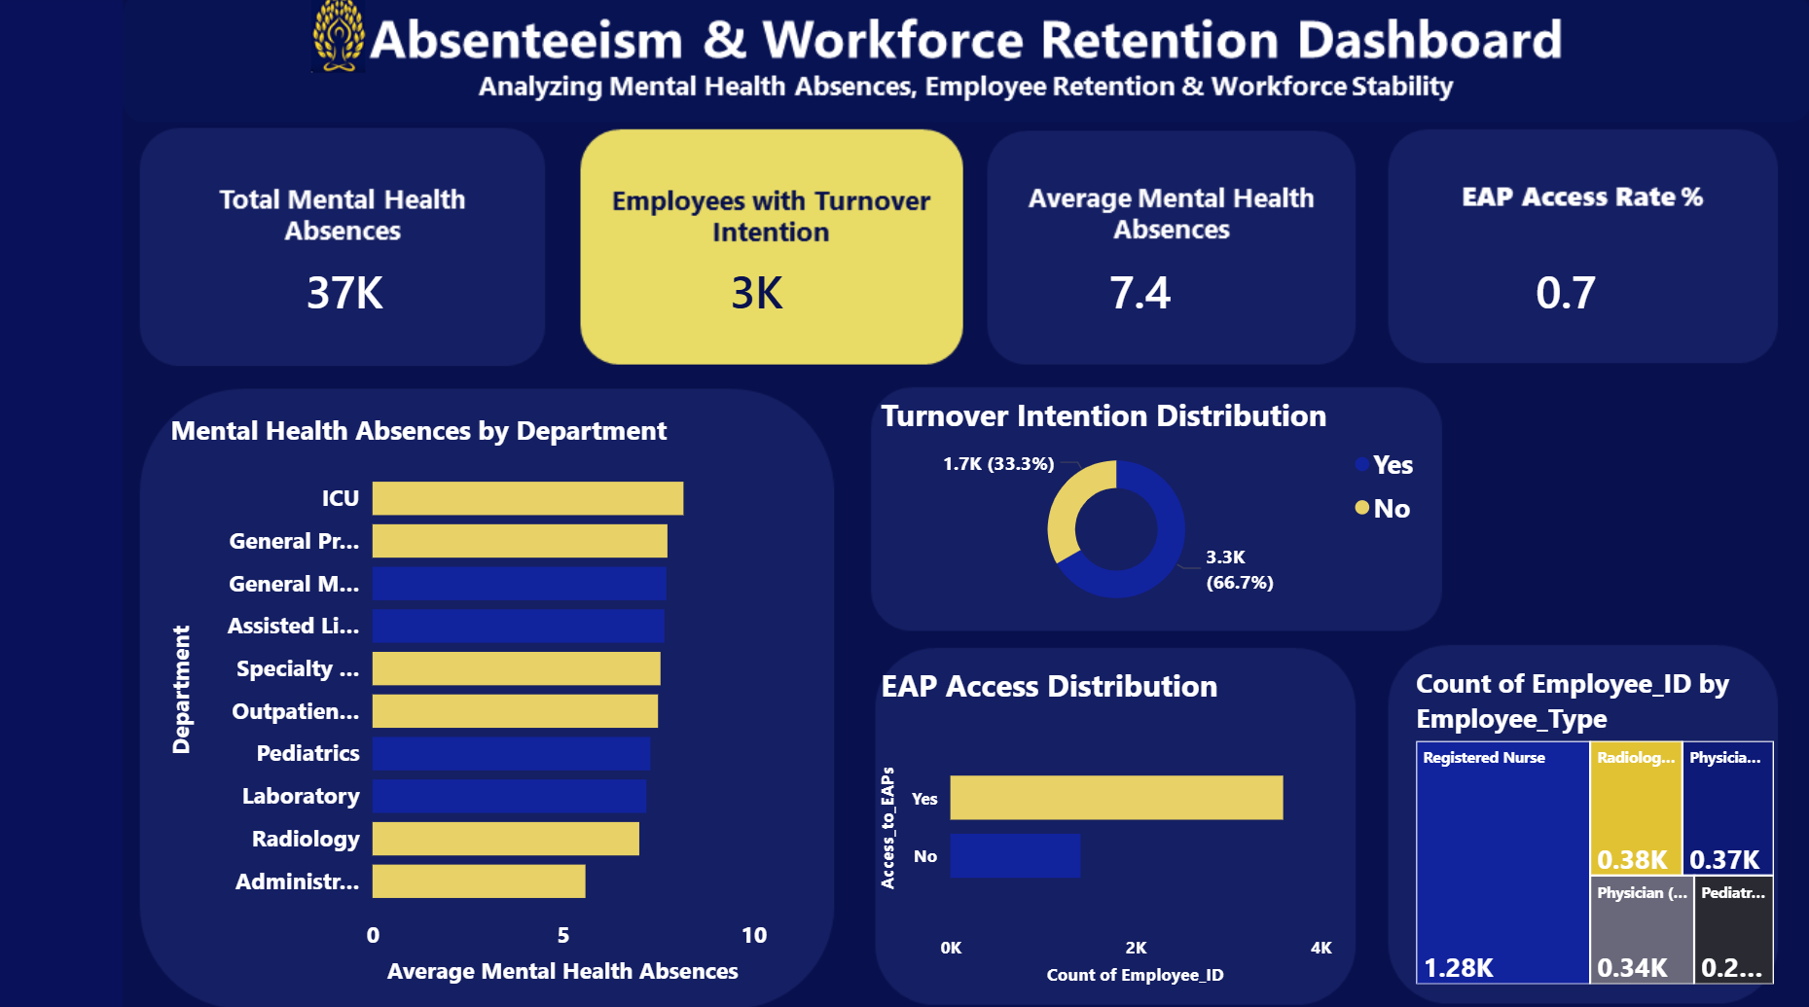
Healthcare Workforce Mental Health Dashboard
Absenteeism & Retention Dashboard
Key Insights
Total mental health absences exceed 37,000 recorded absence days.
Approximately 66.7% of employees indicated turnover intention.
Employees experience an average of 7.4 mental health absence days.
Most employees have access to Employee Assistance Programs (EAPs).
Certain departments experience higher absence levels than others.

Slide 10

Healthcare Workforce Mental Health Dashboard
Recommendations
Improve Employee Mental Health Support
Expand Employee Assistance Programs (EAPs).
Increase access to mental health counseling services.
Reduce Workplace Stress
Address heavy workload concerns.
Improve staffing levels in high-pressure departments.
Strengthen Burnout Prevention Programs
Introduce wellness initiatives.
Promote work-life balance policies.
Improve Employee Retention
Increase employee engagement programs.
Enhance career development opportunities.
Conduct regular employee satisfaction assessments.

Slide 11
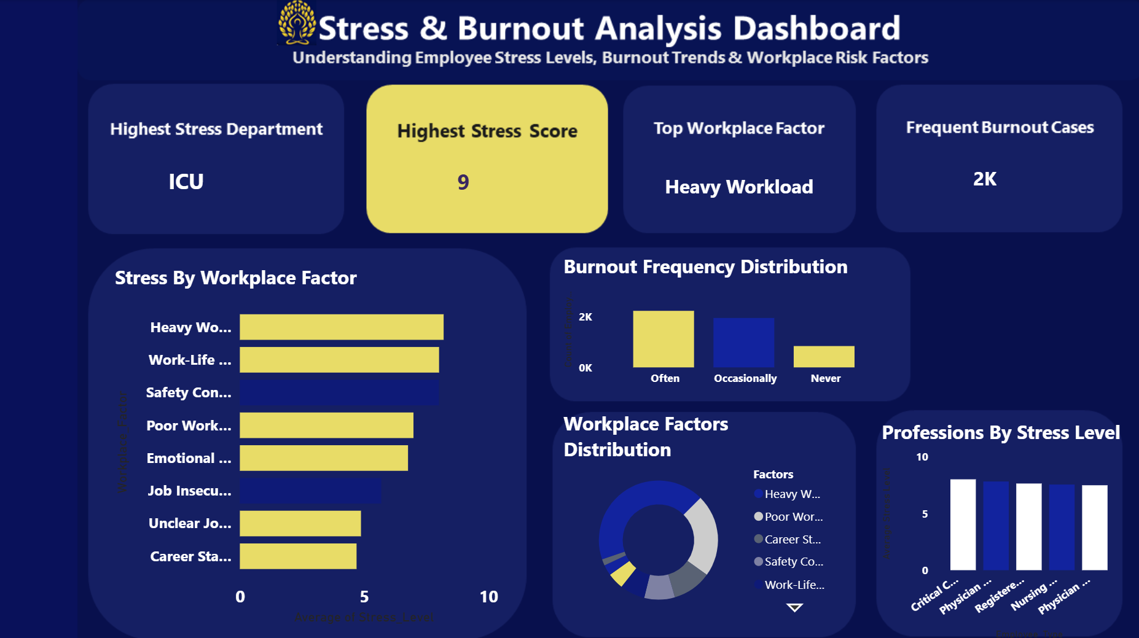
Healthcare Workforce Mental Health Dashboard
Conclusion
This project successfully analyzed healthcare workforce mental health indicators using SQL and Power BI.
The findings reveal elevated stress levels, frequent burnout cases, significant mental health absences, and notable turnover intention among healthcare employees.
Organizations can improve employee wellbeing and workforce stability by implementing targeted mental health support programs, reducing workplace stressors, and strengthening employee retention strategies.

