Slide 1
Predicting a Country’s Region from Data – A Health & Economy Driven Approach
Machine Learning on Global Development Indicators
By Marcel Gössl, Simon Marek, Dominik Schrenk & Miriam Unger

Slide 2
“Can you guess the region of this country?”
PICTURE (welche Features ?)
Notes:
“Let’s build a model that can.”

Slide 3
(Goal)
.... (vermutlich nicht notwendig)

Slide 4
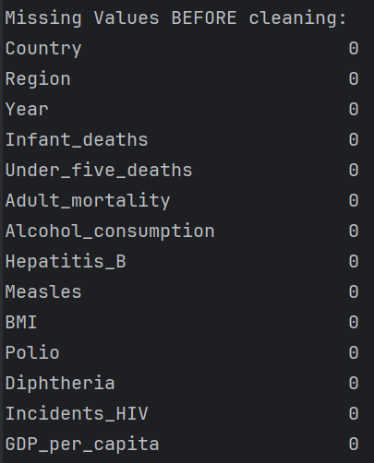
Data Cleaning - Overview
Missing Values
Data-Types & Categories
Duplicates
Class Distribution
… (as in exercise „Data Handling“)

Slide 5
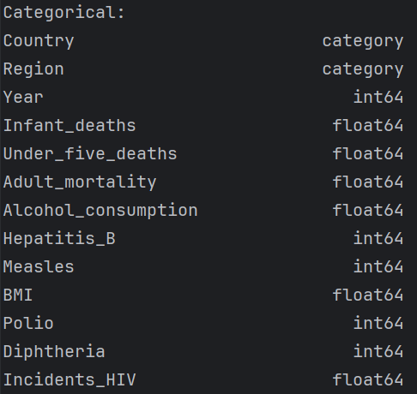
Data Cleaning - Overview
Missing Values
Data-Types & Categories
Duplicates
Class Distribution
… (as in exercise „Data Handling“)

Slide 6

Data Cleaning - Overview
Missing Values
Data-Types & Categories
Duplicates
Class Distribution
… (as in exercise „Data Handling“)

Slide 7
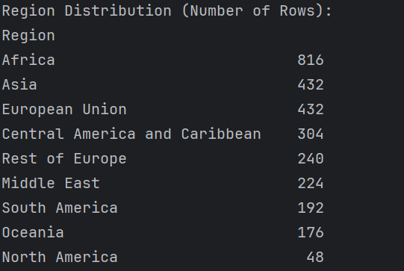
Data Cleaning - Overview
Missing Values
Data-Types & Categories
Duplicates
Class Distribution
… (as in exercise „Data Handling“)

Slide 8
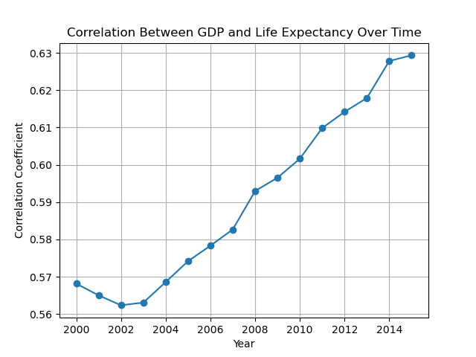
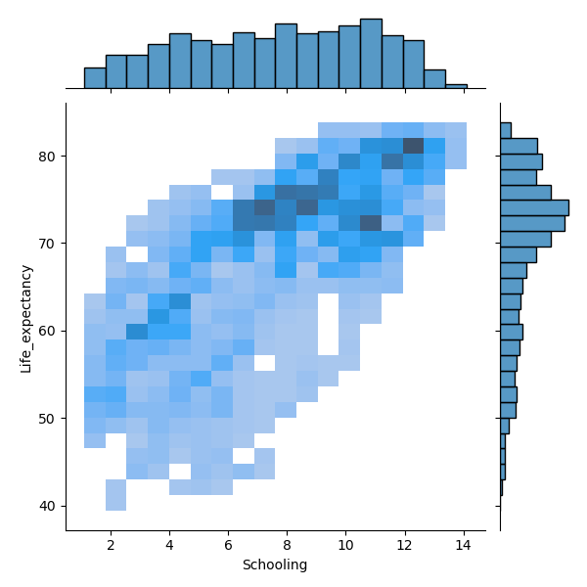
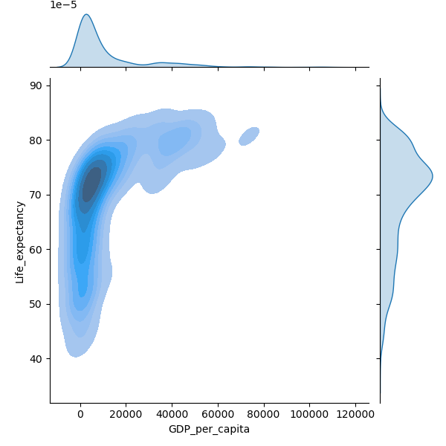
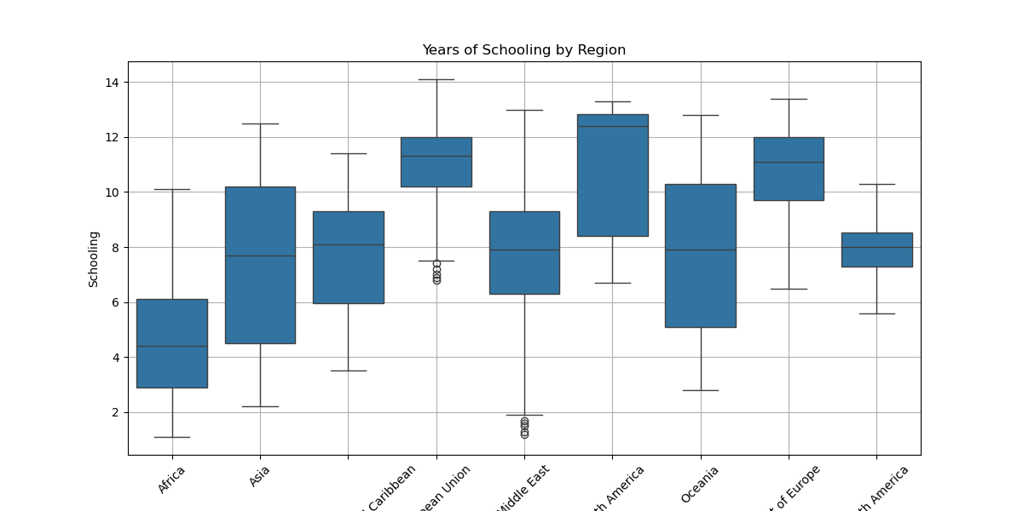
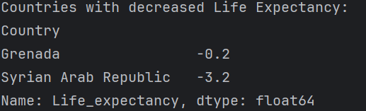
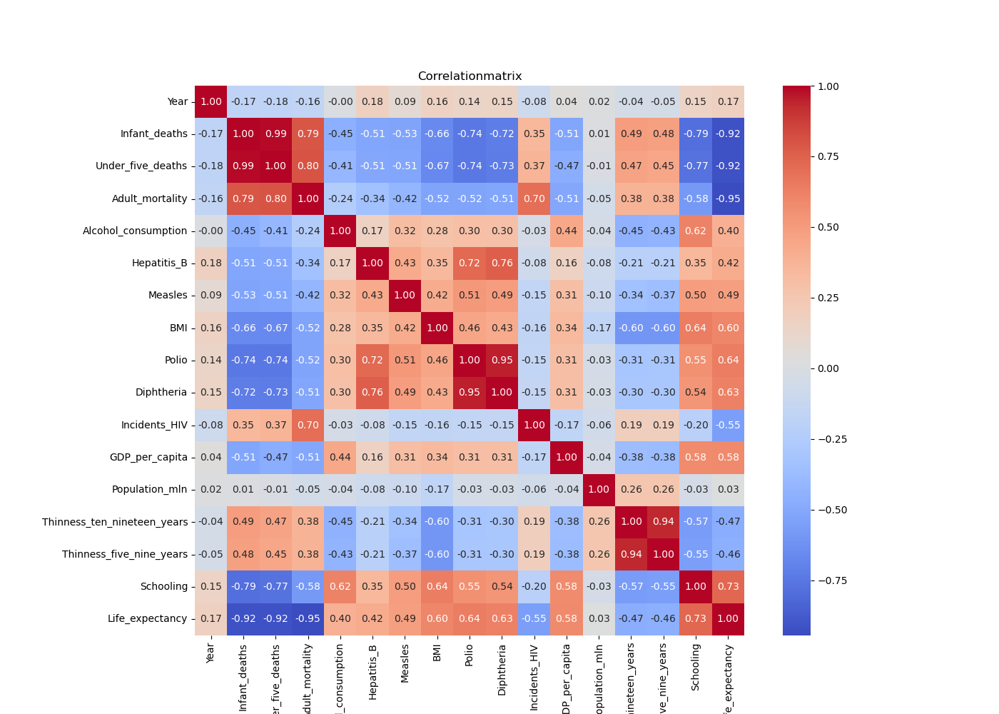
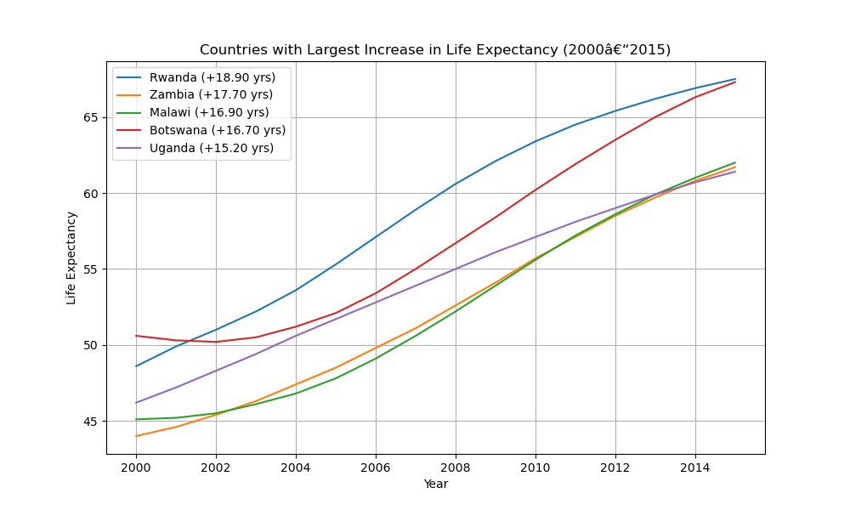
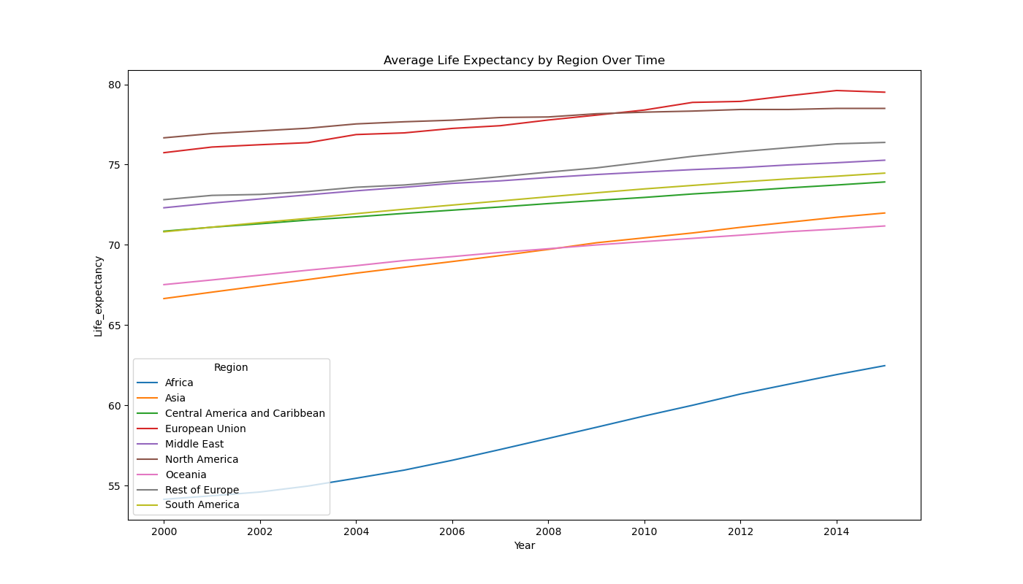
Data Exploration – Overview
Notes:
Done a lot of Visualizations and Outputs…. This is just a short excerpt About:
Outliers
Regional Trends
Feature Change Over Time
Redundances and Low-Variance
Correlations (-> drop some features)

Slide 9
Data Exploration - Examples
-> drop features
Notes:
Done a lot of Visualizations….

Slide 10
Data Exploration - Examples
Additional Insight
Notes:
Done a lot of Visualizations….

Slide 11
Modeling Overview

Slide 12
Decision Tree

Slide 13
KNN

Slide 14
Clustering

Slide 15
Key Insights

Slide 16
Wrap-Up & Discussion

