Slide 1
Predicting a Country’s Region from Data – A Health & Economy Driven Approach
Machine Learning on Global Development Indicators
By Marcel Gössl, Simon Marek, Dominik Schrenk & Miriam Unger

Slide 2
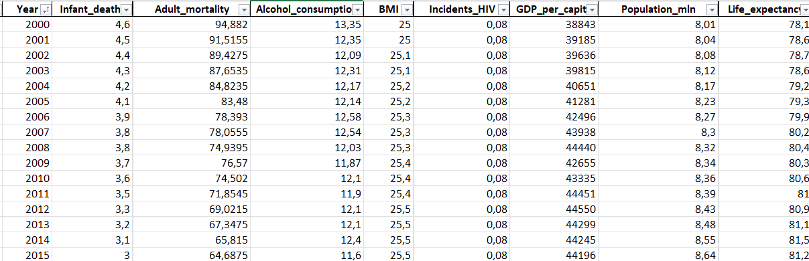
“Can you guess the region of this country?”
Notes:
“Let’s build a model that can.”

Slide 3
(Goal)
.... (vermutlich nicht notwendig)

Slide 4
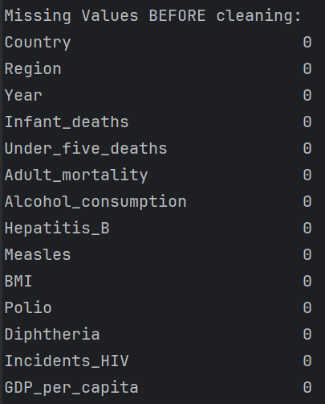
Data Cleaning - Overview
Missing Values
Data-Types & Categories
Duplicates
Class Distribution
… (as in exercise „Data Handling“)

Slide 5
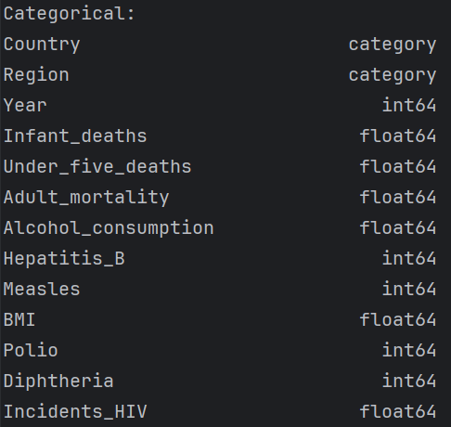
Data Cleaning - Overview
Missing Values
Data-Types & Categories
Duplicates
Class Distribution
… (as in exercise „Data Handling“)

Slide 6

Data Cleaning - Overview
Missing Values
Data-Types & Categories
Duplicates
Class Distribution
… (as in exercise „Data Handling“)

Slide 7
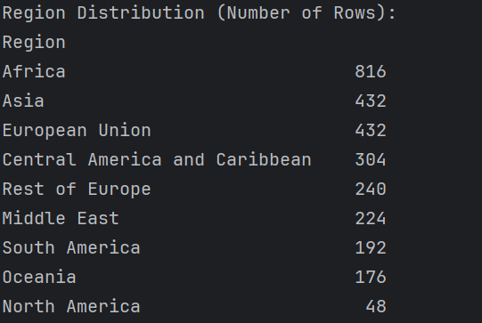
Data Cleaning - Overview
Missing Values
Data-Types & Categories
Duplicates
Class Distribution
… (as in exercise „Data Handling“)

Slide 8
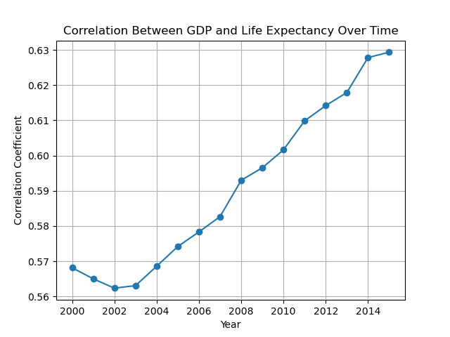
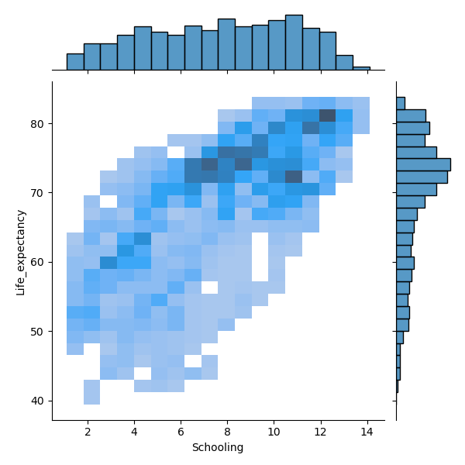
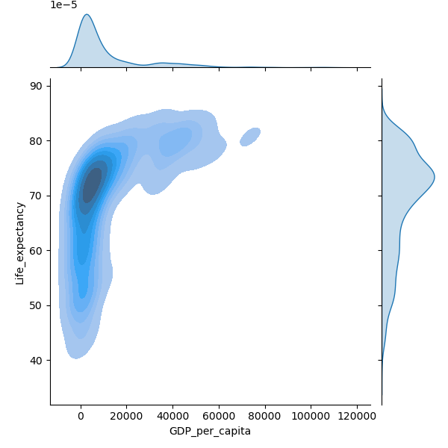
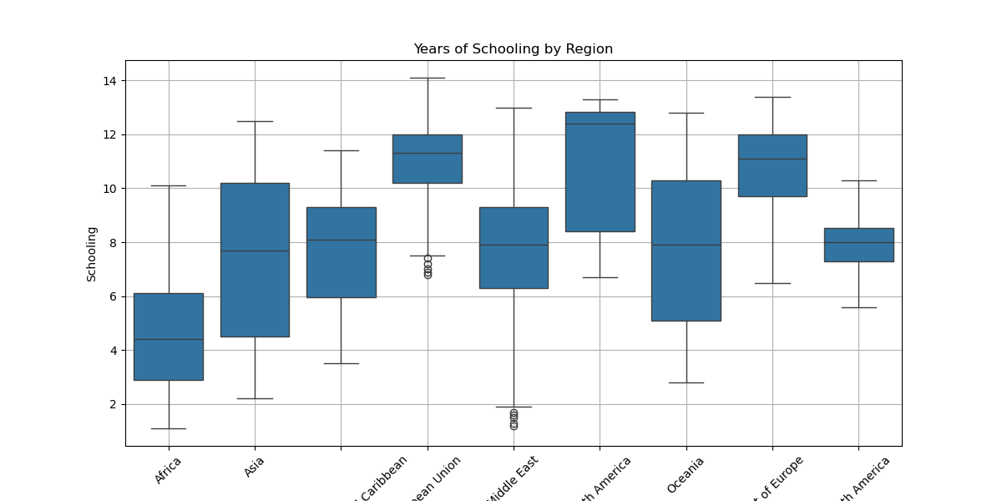
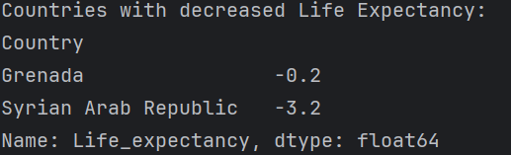
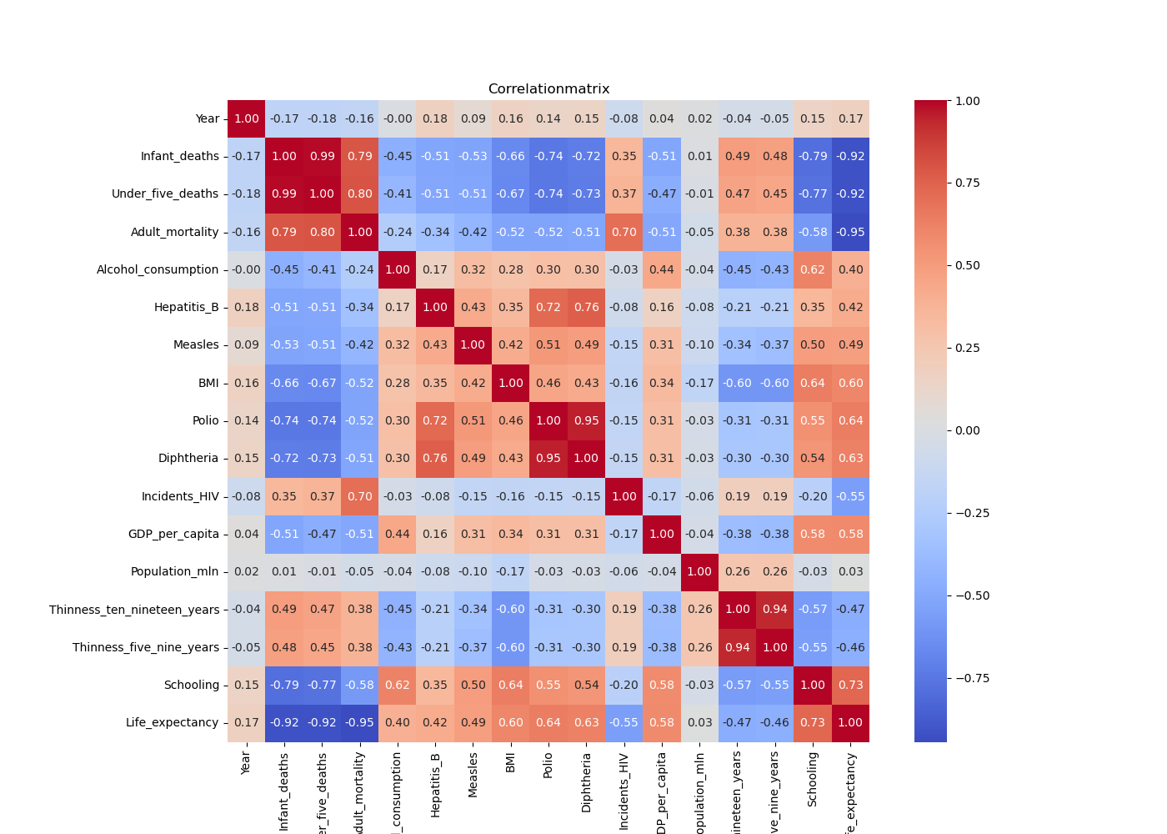
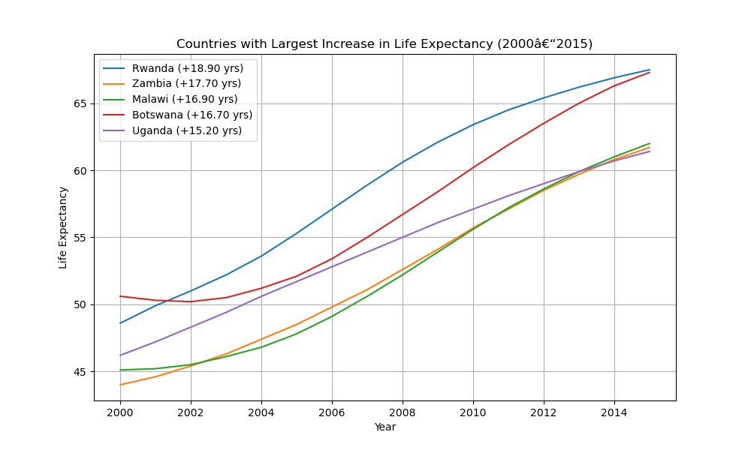
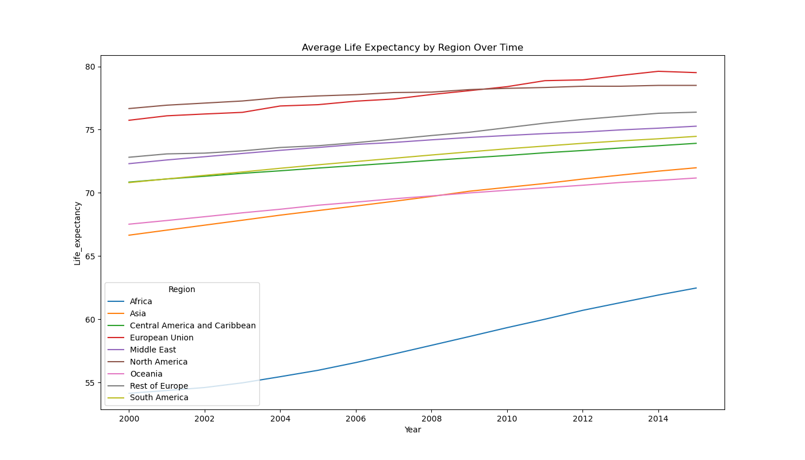
Data Exploration – Overview
Notes:
Done a lot of Visualizations and Outputs…. This is just a short excerpt About:
Outliers
Regional Trends
Feature Change Over Time
Redundances and Low-Variance
Correlations (-> drop some features)

Slide 9
Data Exploration - Examples
-> drop features
Notes:
Done a lot of Visualizations….

Slide 10
Data Exploration - Examples
Additional Insight
Notes:
Done a lot of Visualizations….

Slide 11
Modeling Overview
K-Nearest-Neighbour:
Decision Tree:
Clustering:

Slide 12
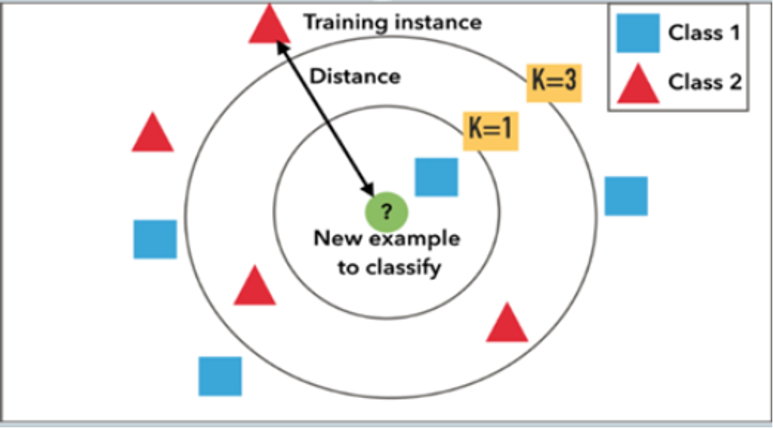
KNN

Slide 13
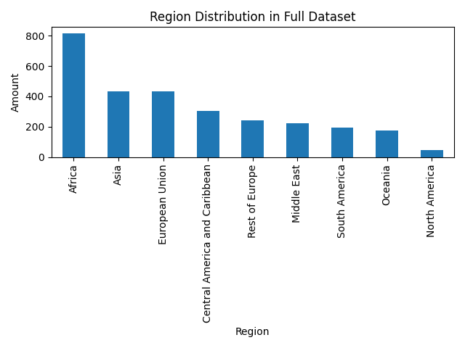
Distribution of the target variable (Region)

Slide 14
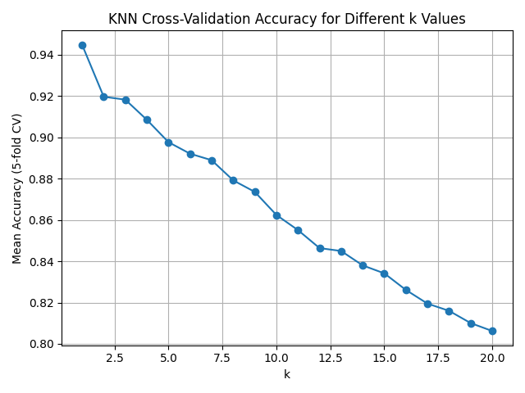
Picking hyperparameter k

Slide 15
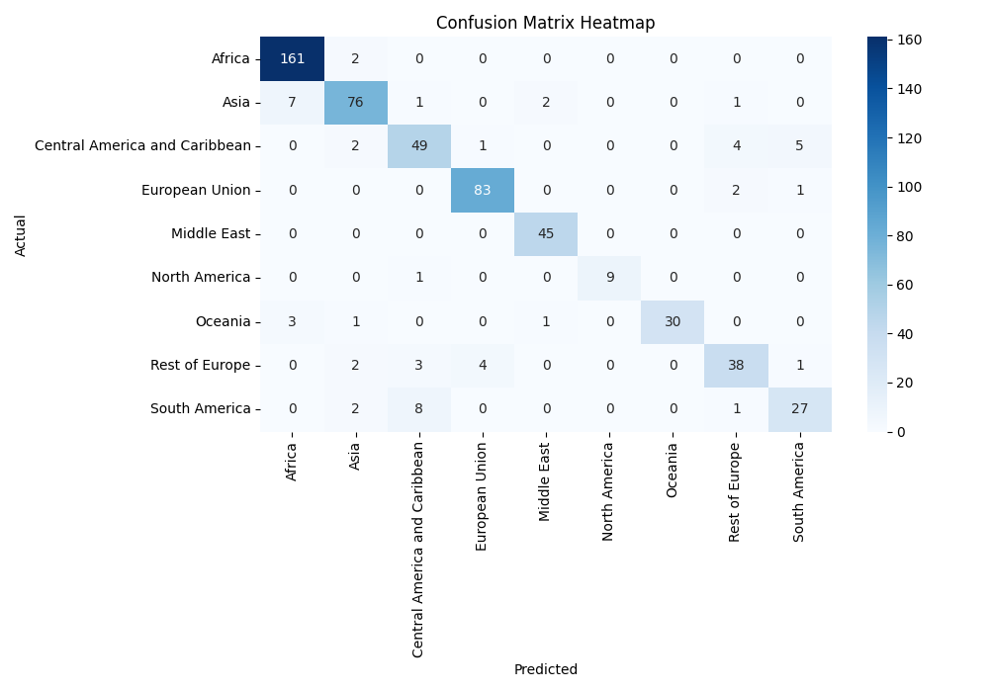
Overall accuracy and Confusion Matrix

Slide 16
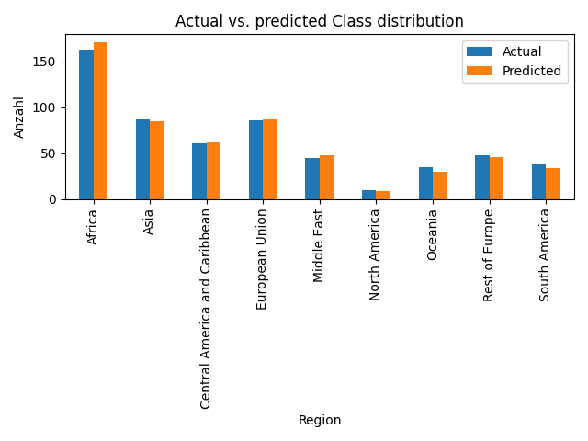
Class distributions

Slide 17
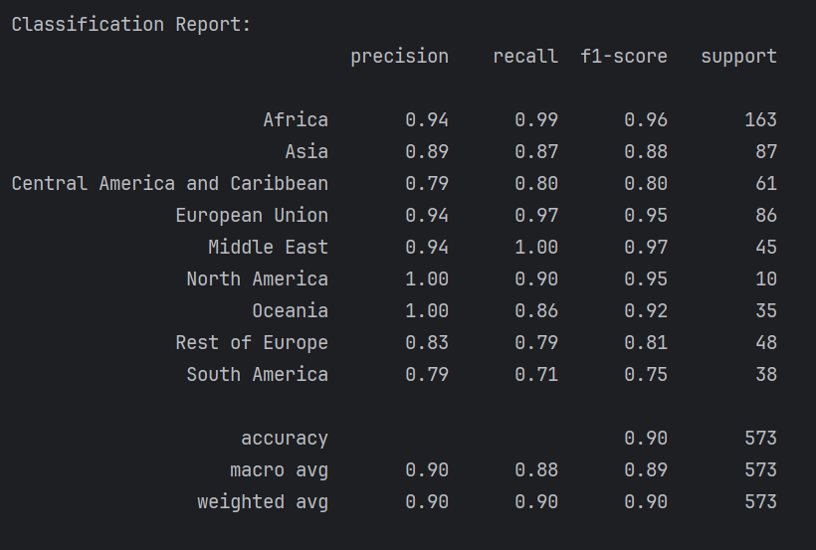
Classification Report

Slide 18
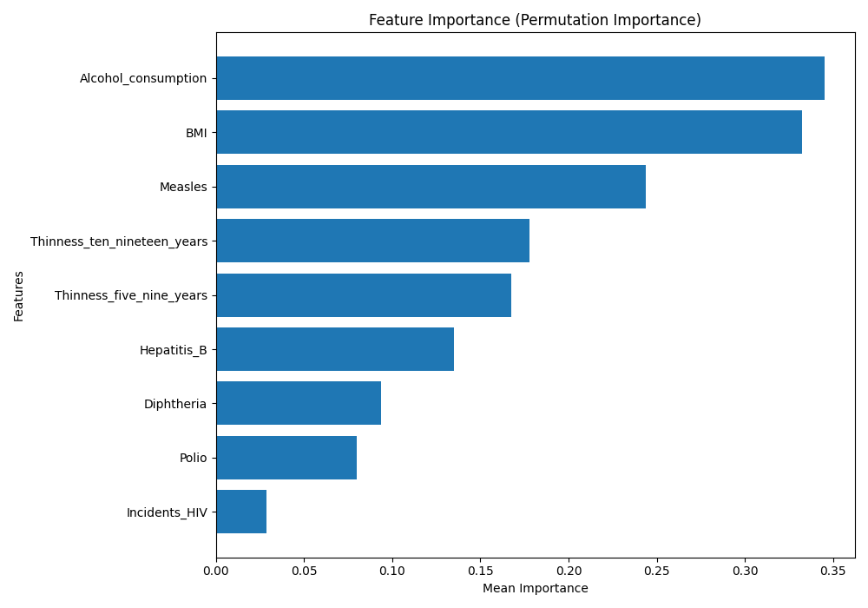
Feature Importance

Slide 19
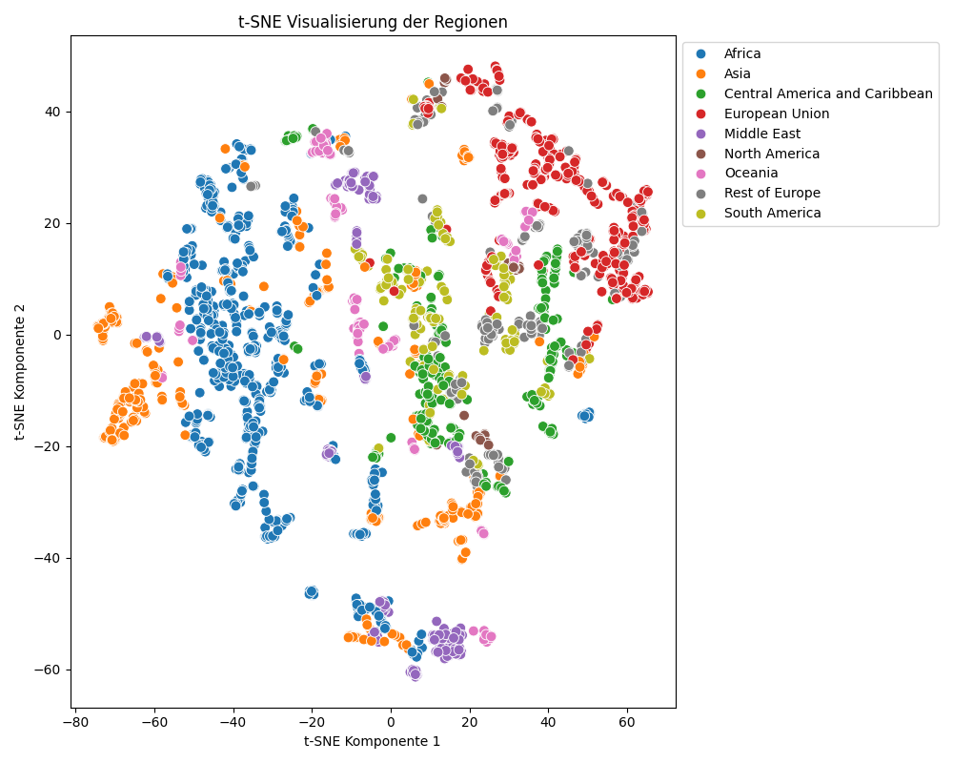
T-SNE Visualization

Slide 20
Decision Tree

Slide 21
Clustering

Slide 22
Key Insights

Slide 23
Wrap-Up & Discussion

