Slide 1
Predicting a Country’s Region from Data – A Health & Economy Driven Approach
Machine Learning on Global Development Indicators
By Marcel Gössl, Simon Marek, Dominik Schrenk & Miriam Unger
Notes:
Welcome to our presentation. In this project, we explore how health, economic, and demographic indicators can be used to predict the region a country belongs to — without knowing the country’s name. Our goal was to uncover hidden patterns in global development data using machine learning.

Slide 2
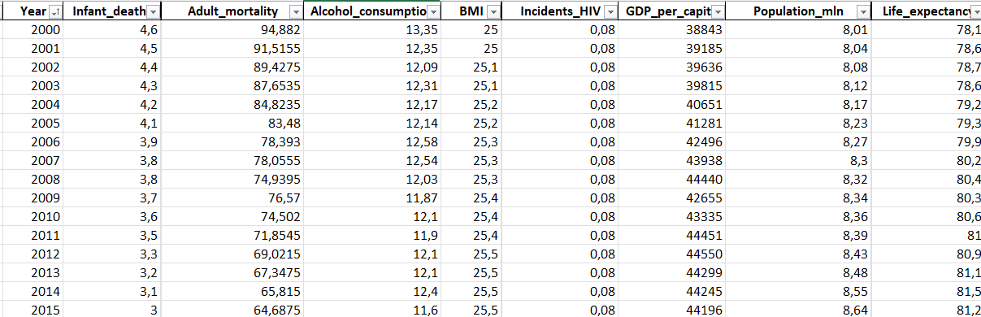
“Can you guess the region of this country?”
Notes:
Let’s start with a question: If we hide the country name but show you statistics like life expectancy, schooling, or GDP — could you guess which region it belongs to? That’s exactly the challenge we tackle in this project.

Slide 3
(Goal)
.... (vermutlich nicht notwendig)

Slide 4
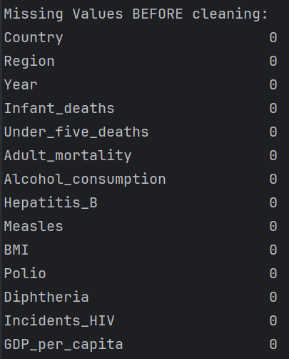
Data Cleaning - Overview
Missing Values
Data-Types & Categories
Duplicates
Class Distribution
… (as in exercise „Data Handling“)
Notes:
To ensure clean and consistent input data, we performed several preprocessing steps:
- We handled missing values and replaced invalid entries. (As you can see, there were no missing values but we checked just to be sure)

Slide 5
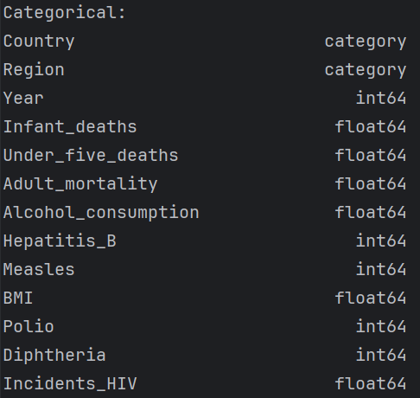
Data Cleaning - Overview
Missing Values
Data-Types & Categories
Duplicates
Class Distribution
… (as in exercise „Data Handling“)
Notes:
- We verified data types and defined categorical features.

Slide 6

Data Cleaning - Overview
Missing Values
Data-Types & Categories
Duplicates
Class Distribution
… (as in exercise „Data Handling“)
Notes:
- We checked for and removed duplicates.

Slide 7
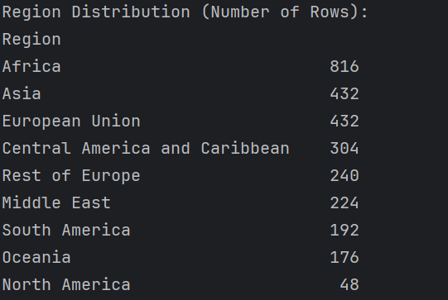
Data Cleaning - Overview
Missing Values
Data-Types & Categories
Duplicates
Class Distribution
… (as in exercise „Data Handling“)
Notes:
- Finally, we examined class distribution to ensure balanced representation.
That was just a small overview

Slide 8
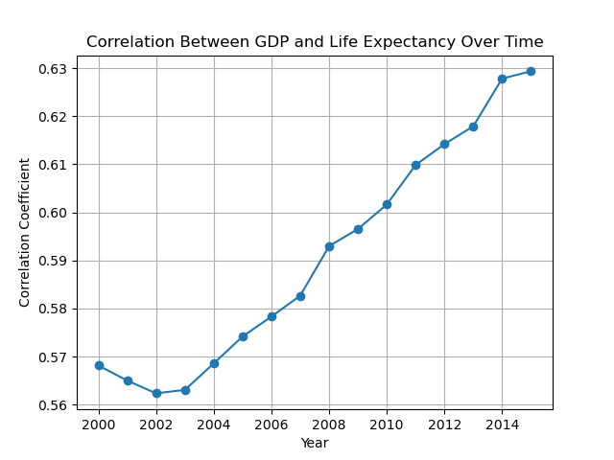
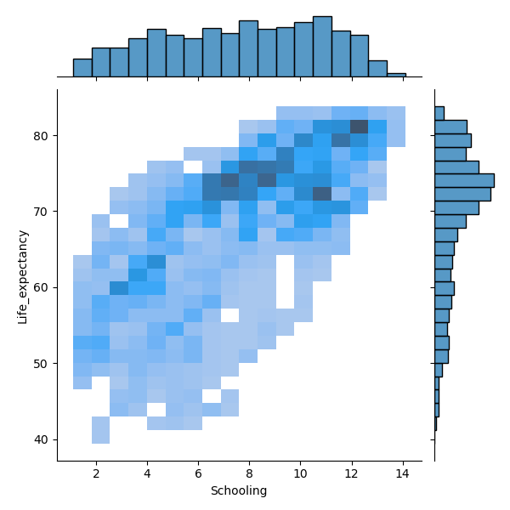
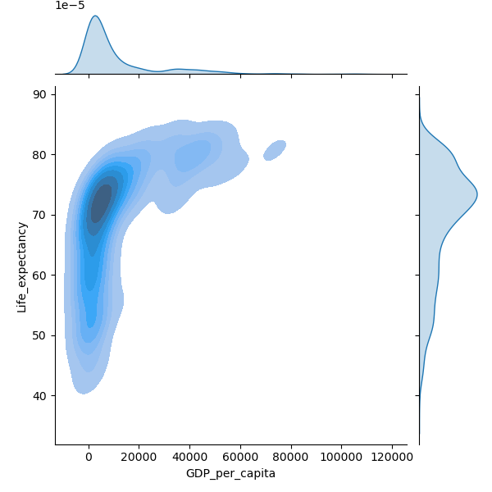
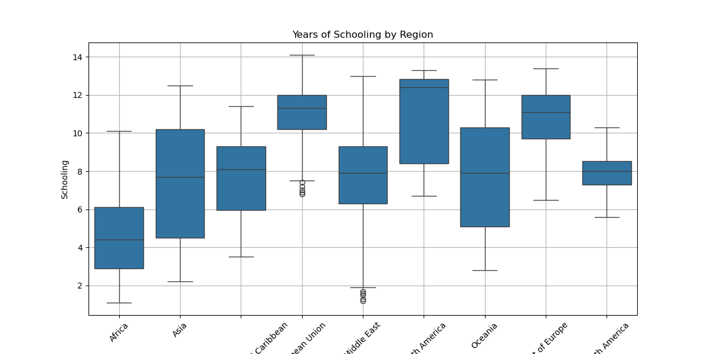
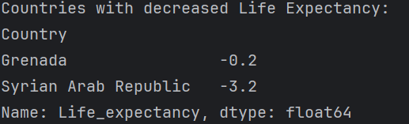
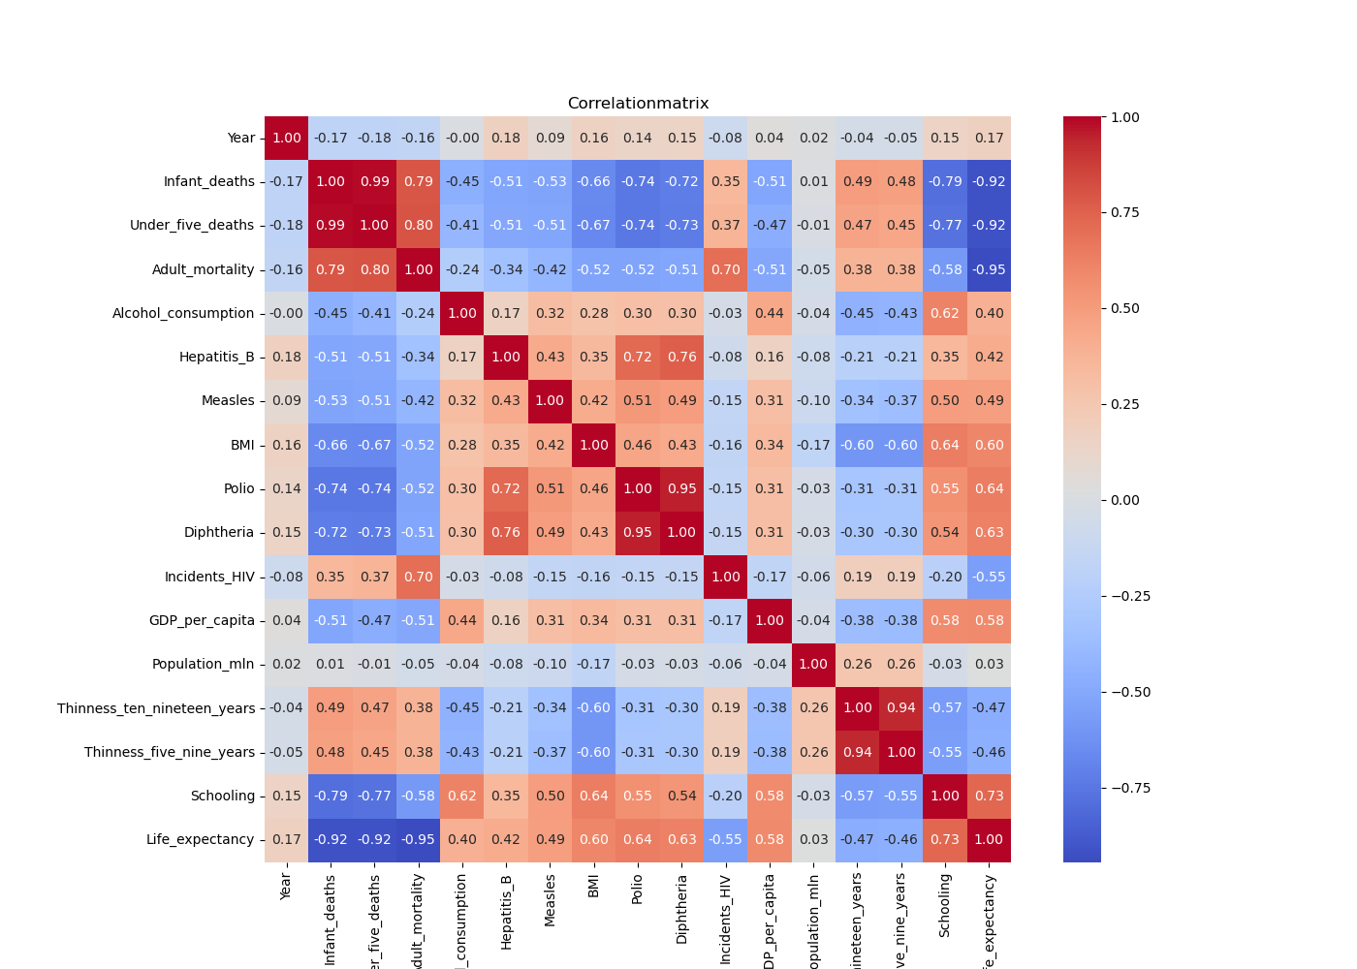
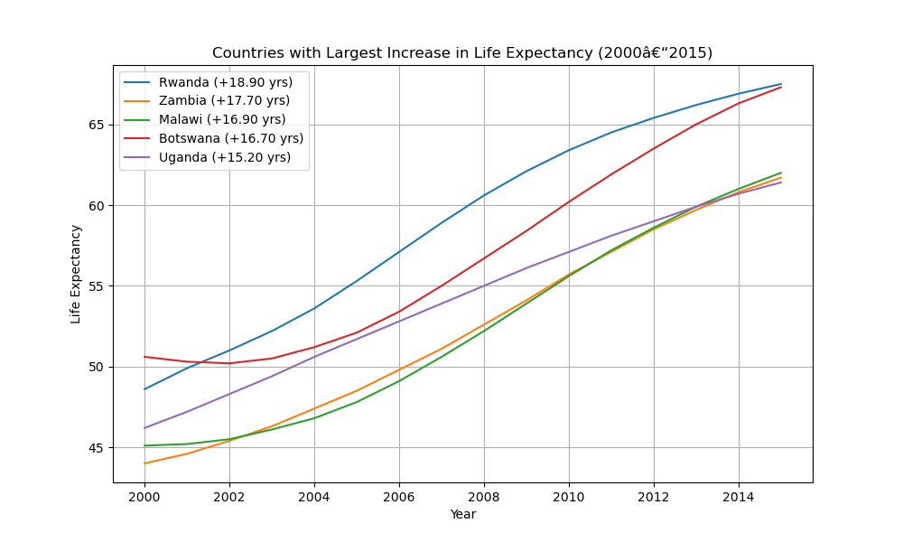
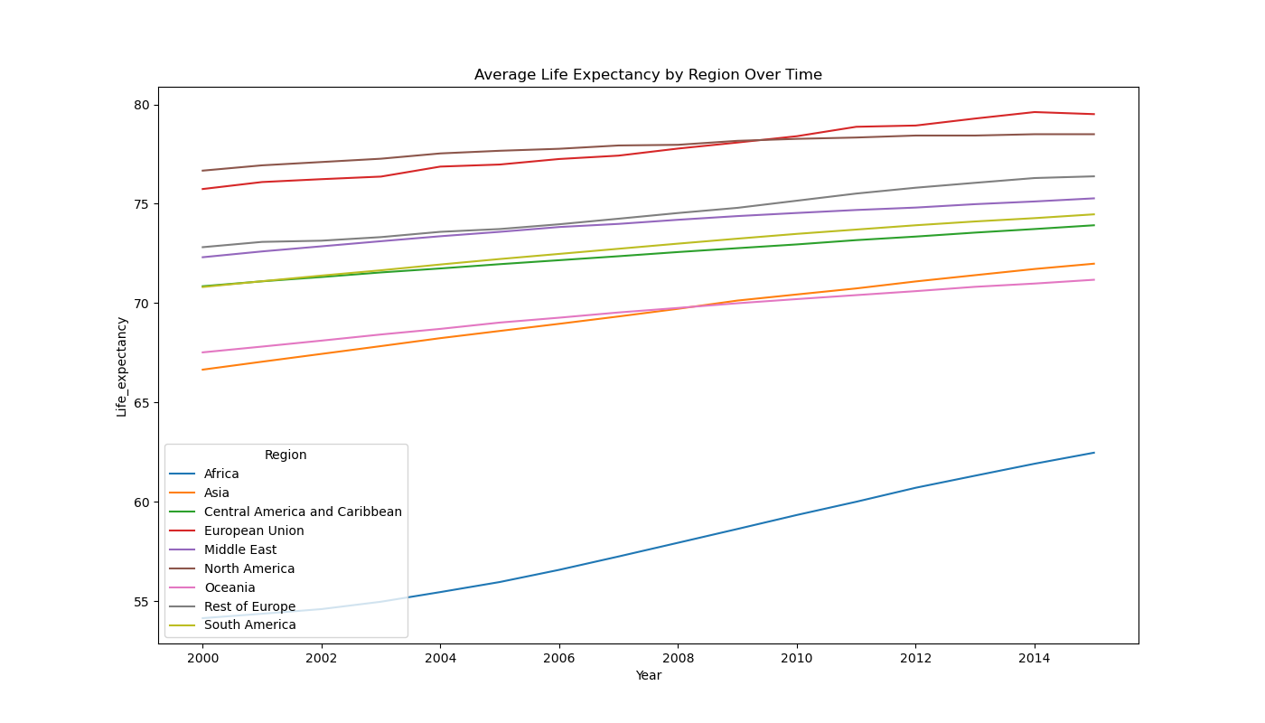
Data Exploration – Overview
Notes:
Done a lot of Visualizations and Outputs…. This is just a short excerpt About:
Outliers
Regional Trends
Feature Change Over Time
Redundances and Low-Variance
Correlations (-> drop some features)
And a lot of more

Slide 9
Data Exploration - Examples
-> drop features
Notes:
To go into more detail:
We created a correlation matrix to identify strong relationships between variables. This helps us detect multicollinearity and uncover which features may be redundant or especially important for prediction — like GDP, schooling, or HIV incidence.

Slide 10
Data Exploration - Examples
Additional Insight
Notes:
But we also created some rather useless visualizations — just out of curiosity.

Slide 11
Modeling Overview
K-Nearest-Neighbour:
Decision Tree:
Clustering:

Slide 12
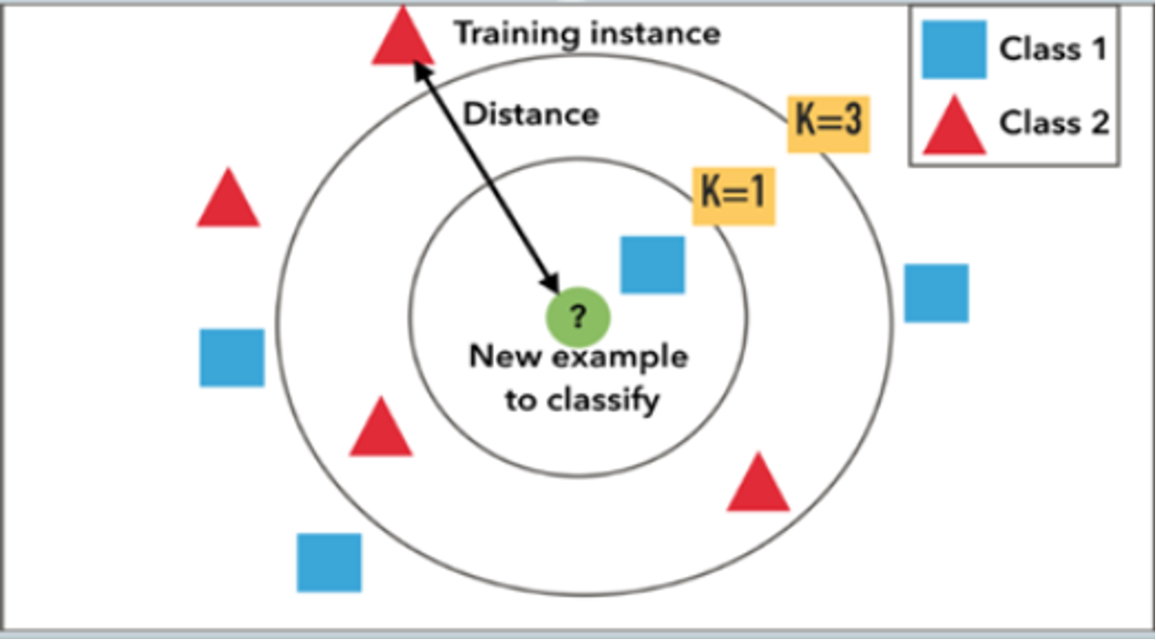
KNN

Slide 13
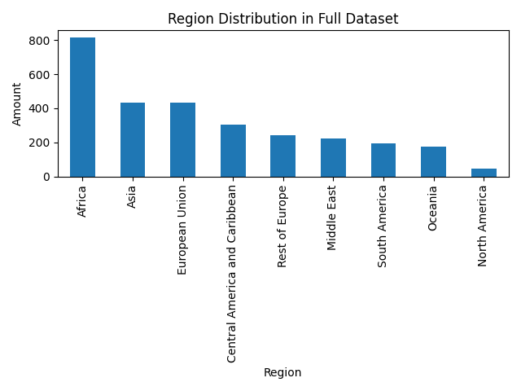
Distribution of the target variable (Region)

Slide 14
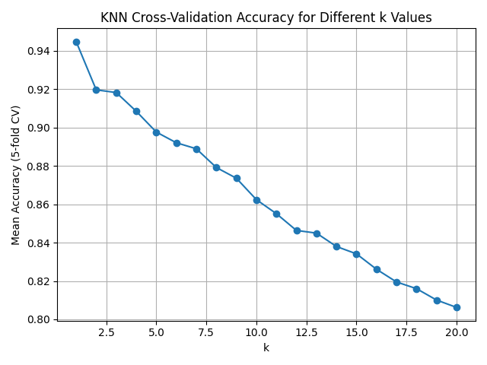
Picking hyperparameter k

Slide 15
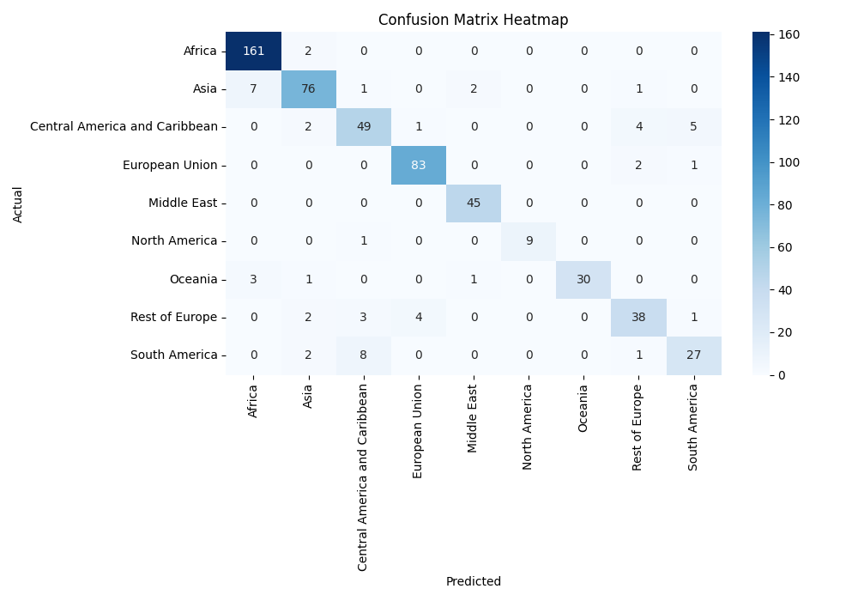
Overall accuracy and Confusion Matrix

Slide 16
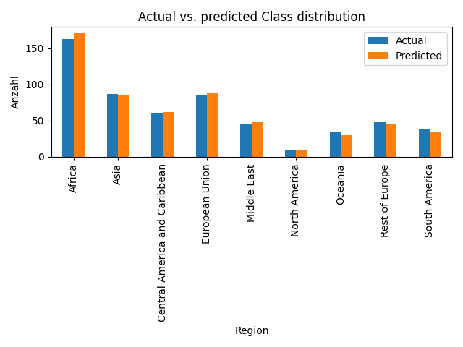
Class distributions

Slide 17
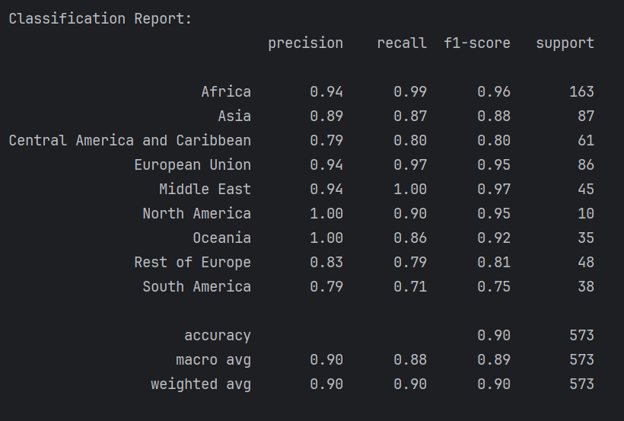
Classification Report

Slide 18
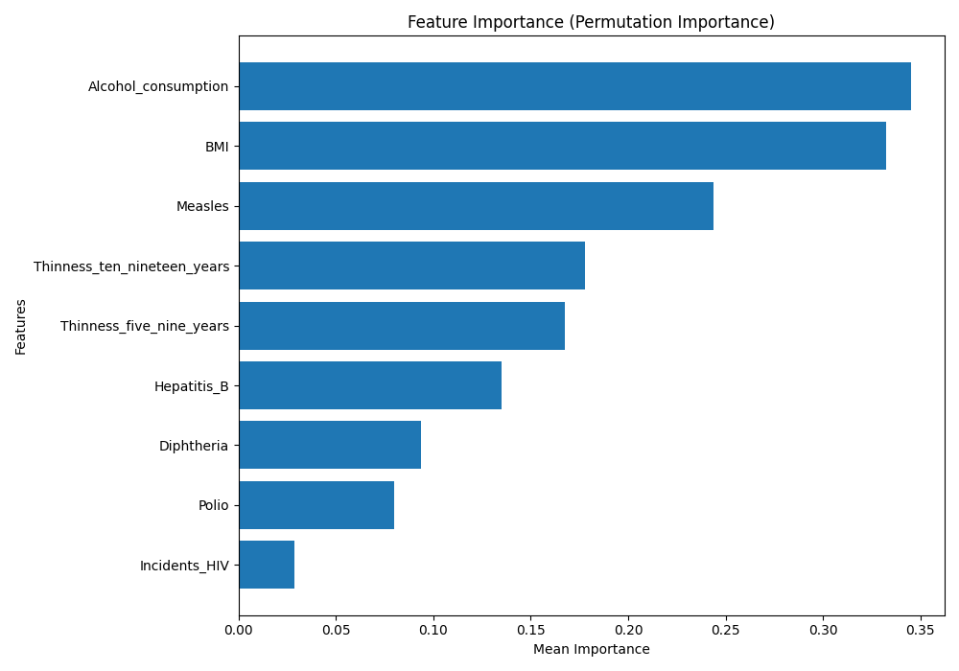
Feature Importance

Slide 19
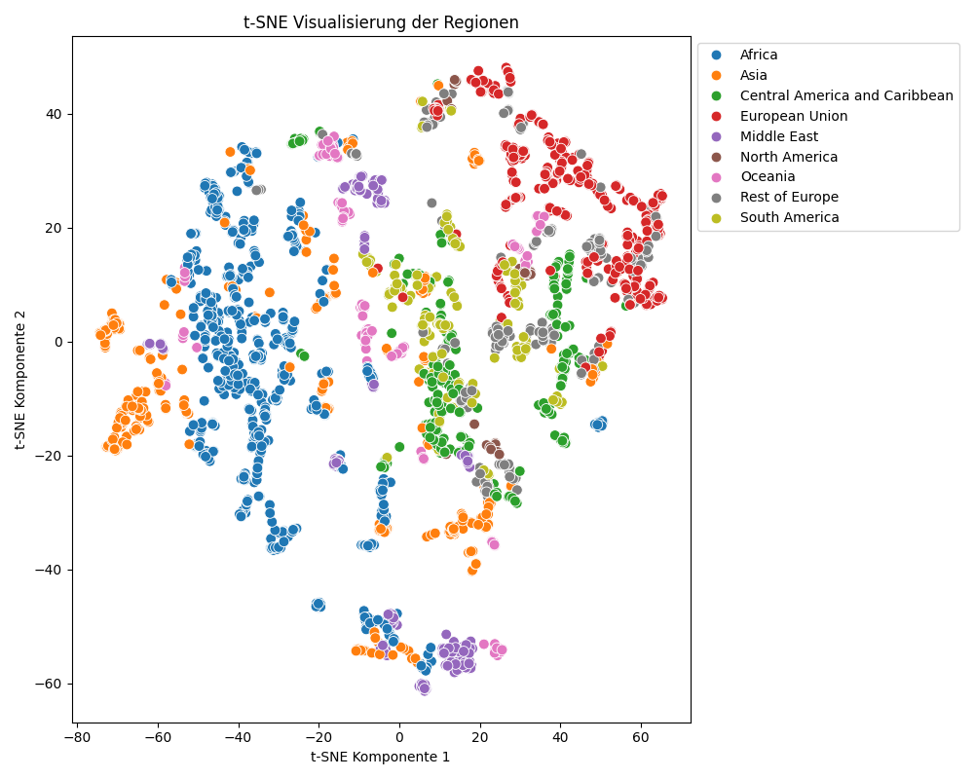
T-SNE Visualization

Slide 20
Decision Tree
DecisionTreeClassifier from sklearn was used
Different Hyperparameters were tested via grid approximation
Holdout, k-Fold CV and Monte Carlo CV were compared
Very similar results
CV used since more of the data is tested
Notes:
We also trained a classification tree to predict the regions and we tried out grid approximation for different hyperparameters. For performance evaluation and comparison, k-Fold cross validation was used.

Slide 21
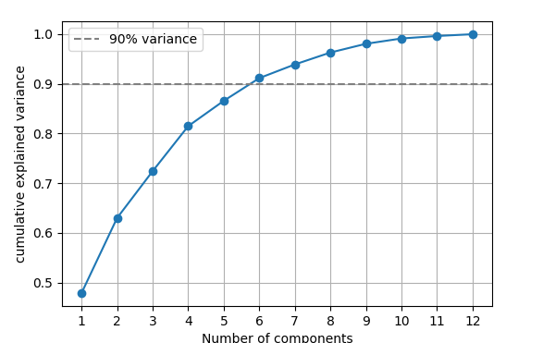
Principal Component Analysis
Resulted in major drop of performance
Balanced Accuracy (with 12 features): 0.96
Balanced Accuracy (with 12! PC): 0.88
11 PC‘s: 0.86
10 PC‘s: 0.85
09 PC‘s: 0.82
Notes:
We tried a principal component analysis but the accuracy dopped even with a high number of principal components.

Slide 22
Feature Selection
Various features were dropped until only health related data was left
Development status of economy:
Africa and South America improved
European Union and Rest of Europe got worse
-> Regions where the economy status is the same benefit from dropping
-> Europe has differenty developed countries
Notes:
Therefore, feature selection was done manually. What was intersting to see was that the development status of the economy is only useful for regions where the development state is very differnt. For example, after dropping this feature, the performance of Europe decrased but it improved for Africa because all of the countries there have the same development status.

Slide 23
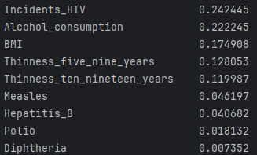
Most important features
Notes:
The most important features in the final model are the HIV incidents and alcohol consumption. And this is very differnt for the kNN Algorithm because there, the HIV incidents played the least important role.

Slide 24
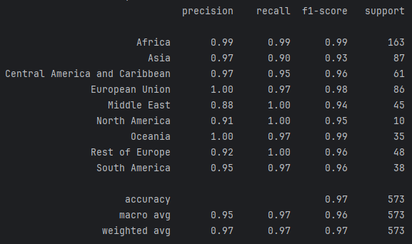
Results Final Model
Notes:
We observed that the precision for most of the regions was very high. The middle east had the highest error rate.

Slide 25
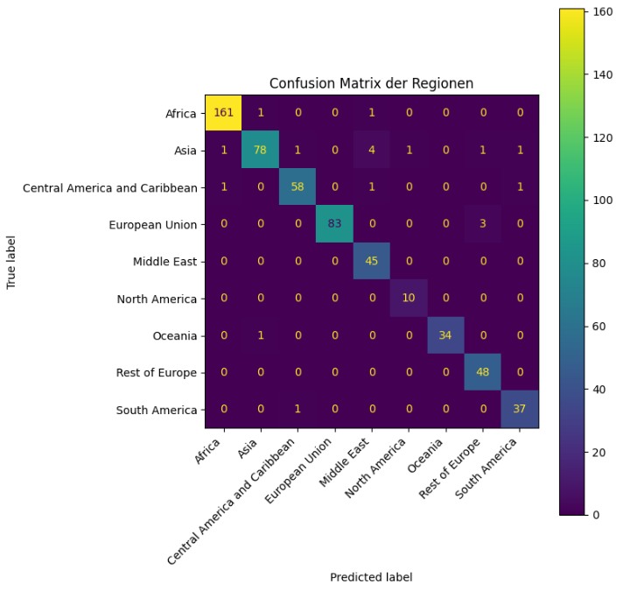
Notes:
As is got confused with Asia several times: Pakistan, Brunei Darussalam, Azerbaijan, Brunei Darussalam
Finland and Latvia were identified as European Union but they belong to the class Rest Of Europe but that actually makes sense as these countries are similar to the EU based on their health access. Our assumption was that Switzerland would also be classified as European Union but surprisingly, it was correctly identified.
The overall balanced Accuracy is 94% which is higher compared to kNN but only for this set of features.
When using more features, the difference in accuracy gets very small which shows the performance of an algorithm highly depends on the training data

Slide 26
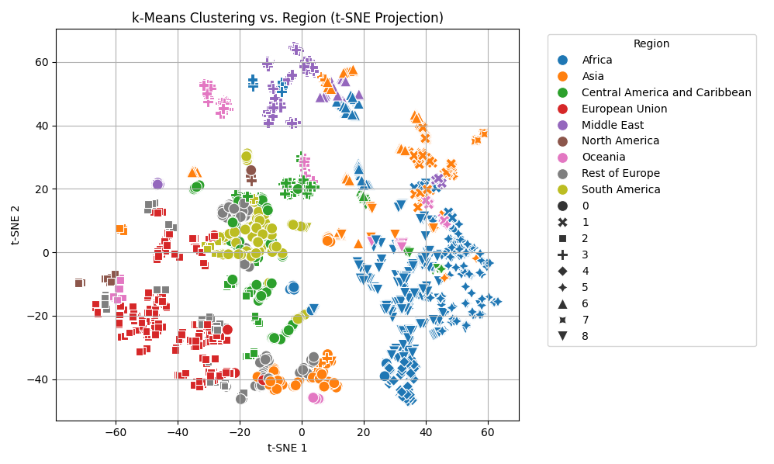
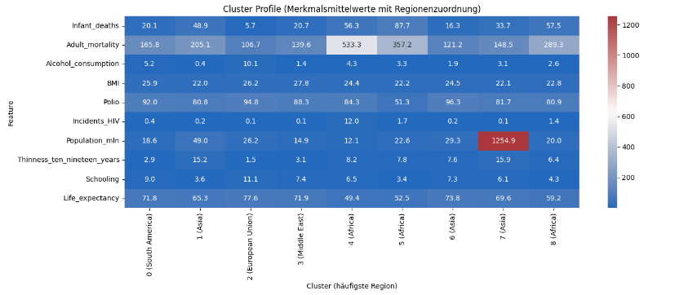
Clustering
Started with clustering to replicate country regions using socio-health indicators
Shifted focus toward discovering structural similarities between countries

Slide 27

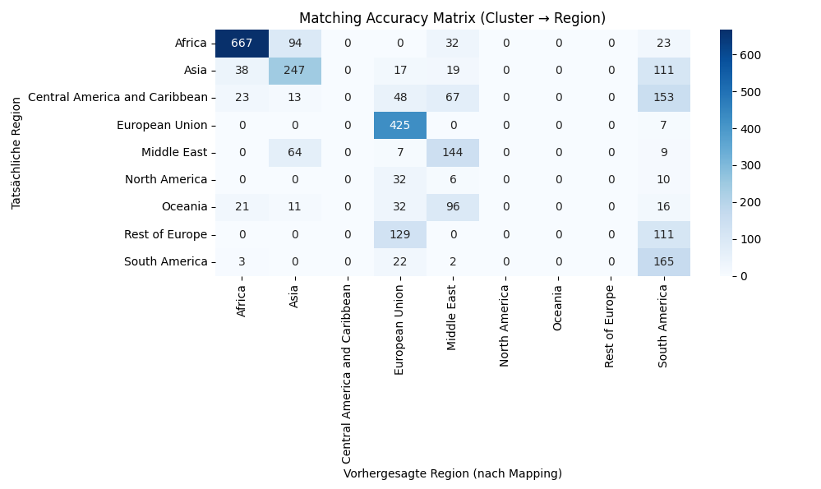
Region-Based Clustering (k= num_regions)
Good Evaluation | Bad Evaluation
Africa | Oceania
Europe | North America
Asia | Central America and Caribbean
 | Rest of Europe

Slide 28
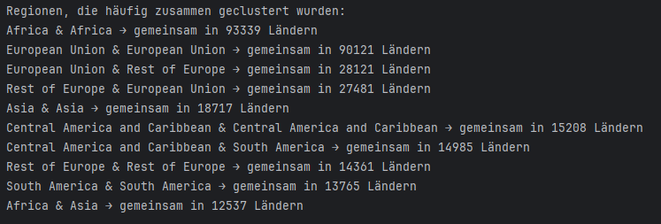

Slide 29

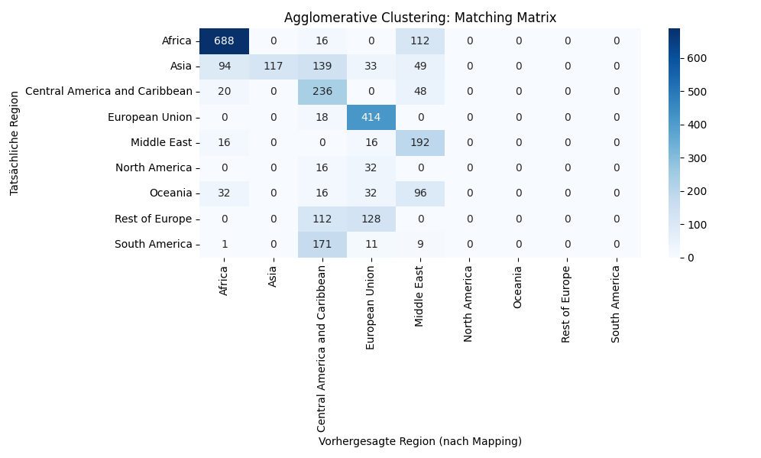
Hierachical Clustering: No real gain
Good Evaluation | Bad Evaluation
Africa | Oceania
Europe | North America
Central America and Caribbean | South America
 | Rest of Europe

Slide 30
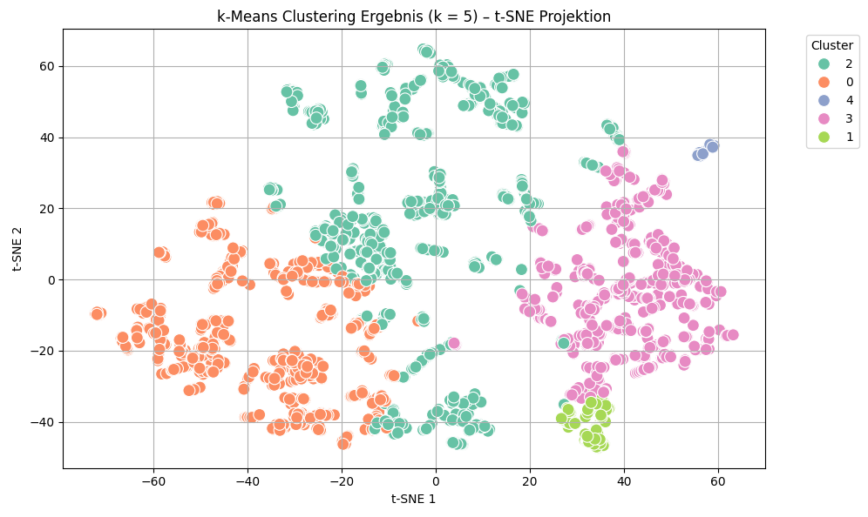
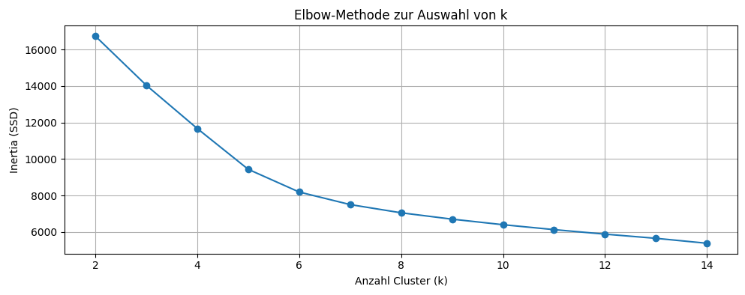
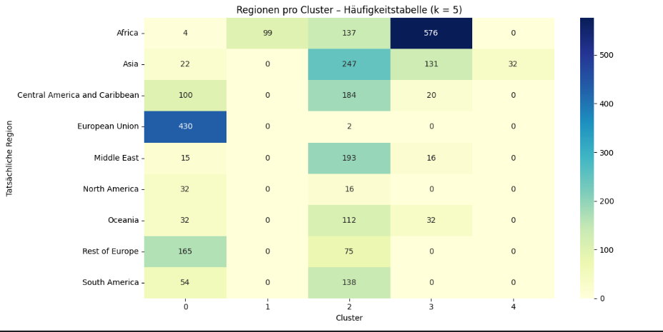
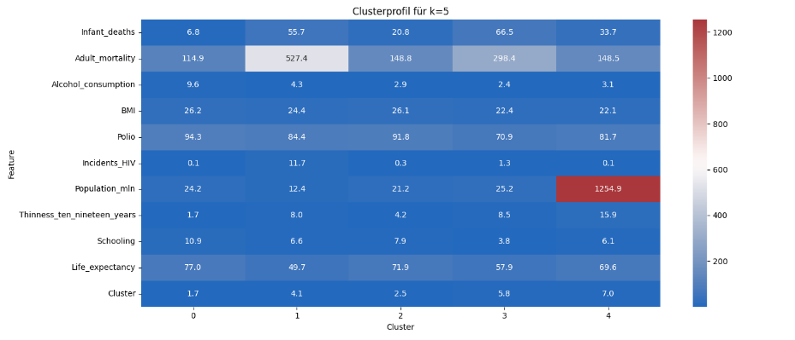
Clustering with k=5

