Slide 1
Water Quality Project
Sensing lead in residential pipelines

Slide 2
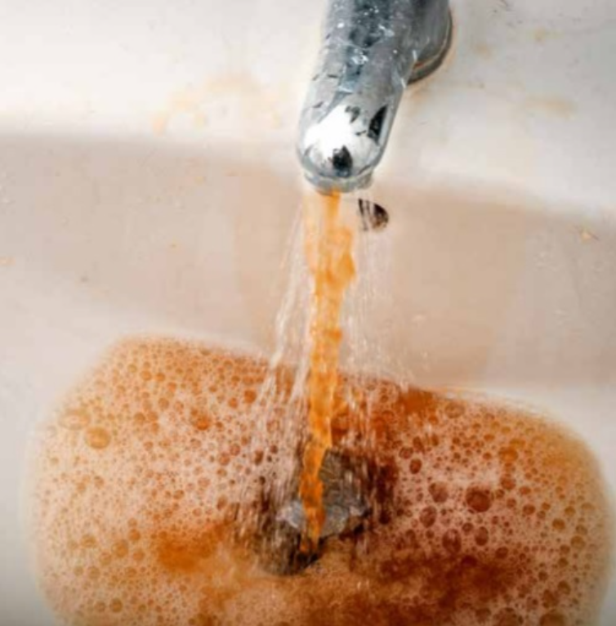
Agenda
Motivation - The problem we are trying to solve
Proposed Idea - Our approach to the problem
Tech arquitecture
Next steps

Slide 3
Motivation - Why this matters?
Lead can enter drinking water when plumbing materials that contain lead corrode. The most common sources of lead in drinking water are lead pipes, faucets, and fixtures in buildings built before 1985.
There is no acceptable level of lead in drinking water, according to the Centers for Disease Control and the U.S. Environmental Protection Agency. Boiling water actually makes it worse.
In the US alone, the Centre for Disease Control estimates that 2.5 percent of small children have elevated levels. [1]
Lead affects children development as it prevents calcium absorption
Lead contamination is a slow moving disaster

Slide 4
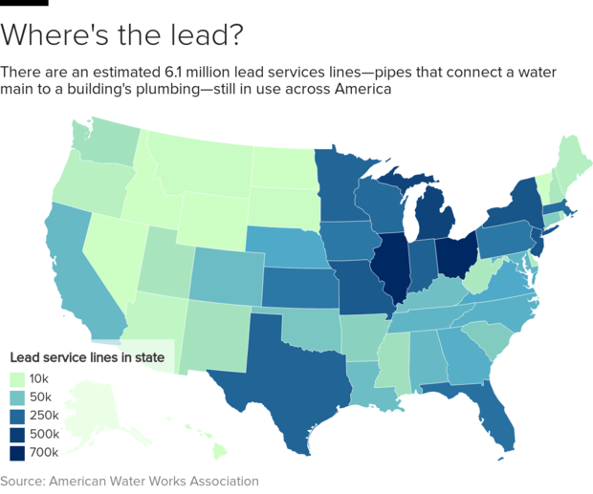

Slide 5
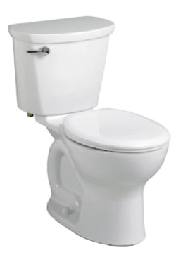
Our Approach
Monitor for lead content in water sources at the point of use. By placing a sensor in a toilet tank, the sensor will have a fresh tank of water to sample with every flush.
Our proposal is superior to existing solutions because:
> It minimises the human intervention
> It uploads the information automatically to a centralized database, therefore it can be used to advocate for residents.

Slide 6
Tech Architecture
Backend Server
DB
Lead Sensor
The Things Network
LoRaWAN
MQTT
Twilio Notifications

Slide 7
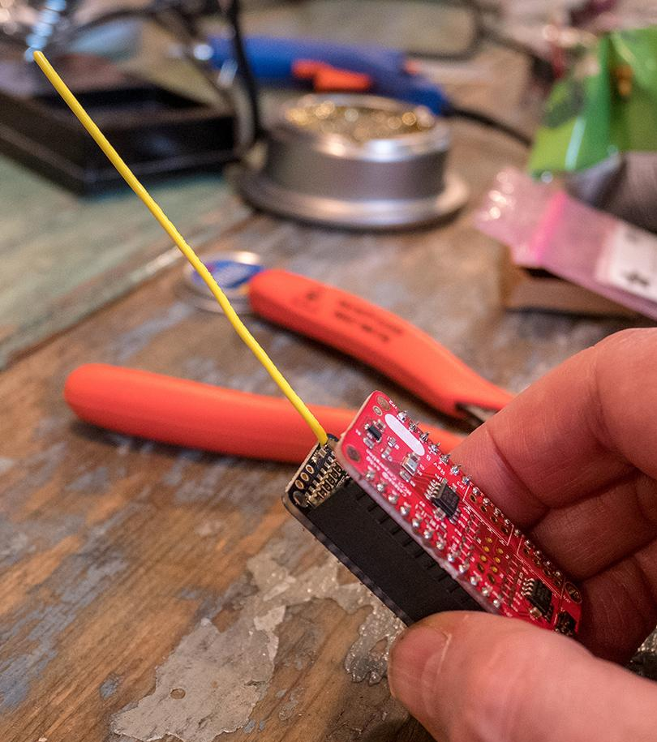
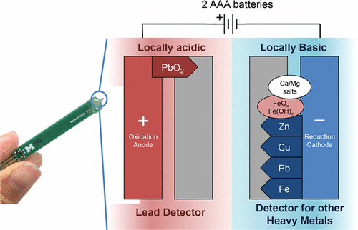
Tech Stack - Lead Sensor
LoRaWAN radio
UMich lead sensor
Microcontroller
Battery

Slide 8
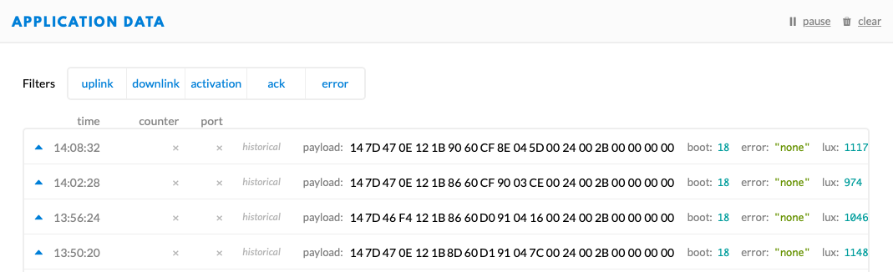
Tech Stack - The Things Network
Aggregate data through The Things Network and emit formatted data via MQTT.
Multiple applications can subscribe to live MQTT data to store, notify, and or analyze the data.

Slide 9
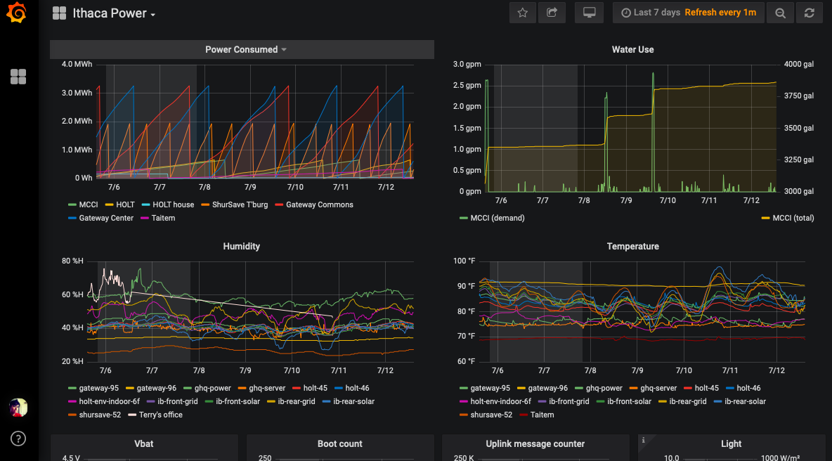
Data storage and visualization
Node-RED, Grafana, and InfluxDB via this Docker config

Slide 10
Next Steps
Research suitable and inexpensive sensors
Outreach grant writing
Reach out for potential partnerships for funding and human resources
Build a working prototype
Contribute to coding into our GitHub Repo [2]

Slide 11
References
[1] https://www.scientificamerican.com/article/thousands-of-u-s-areas-afflicted-with-lead-poisoning-beyond-flints/
[2] Github Repo:
https://github.com/mimiflynn/water-quality-sensing/
Additional Information:
https://news.umich.edu/affordable-lead-sensor-for-home-city-water-lines/

