Slide 1
Rockbuster Stealth
Analytics Presentation

Slide 2
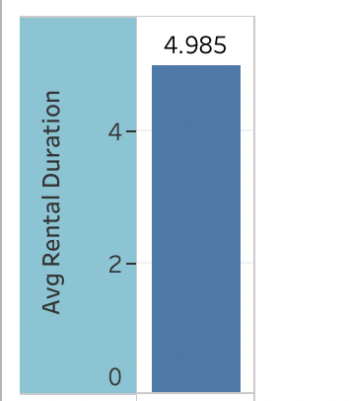
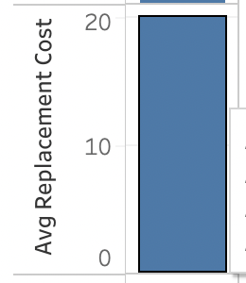
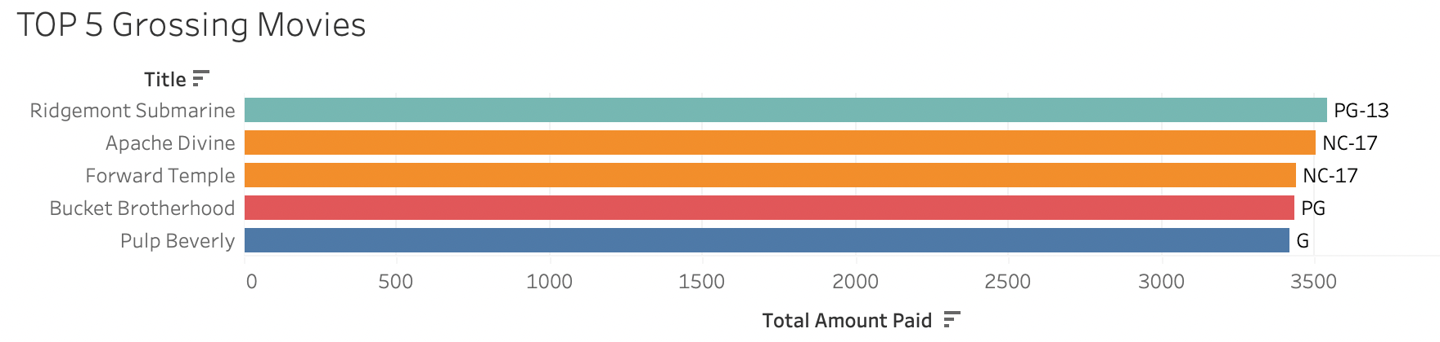
RENTALS at-a-glance
Average Rental Duration is about 5 days.
Average Replacement Cost is about $20.00.

Slide 3
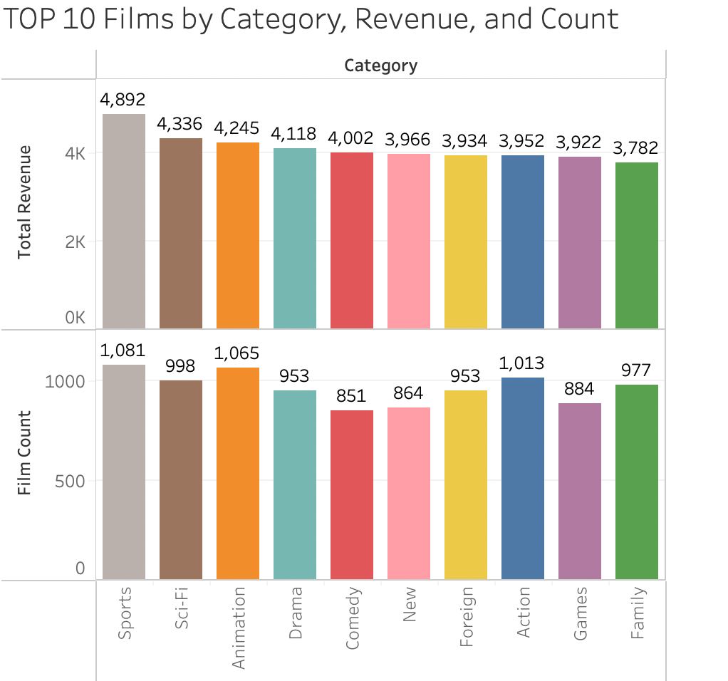
RENTAL RATES
We see here that Sports, Sci-Fi, and
Animation films are the highest
earning categories.
Interestingly, Comedy and New Films
account for a large share of the
total revenue, but do not have very
high counts in inventory.
It might be worth buying more films in
these categories as they are reliably
popular.

Slide 4

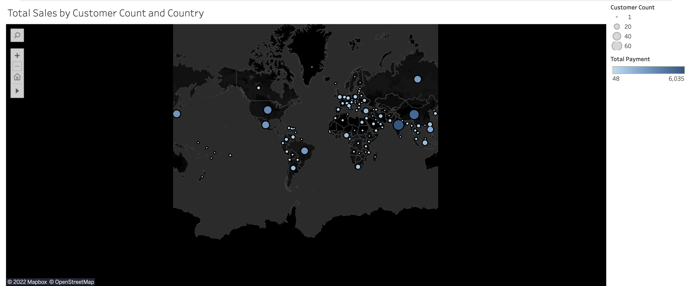
LOCATING OUR CUSTOMERS ACROSS THE GLOBE

Slide 5
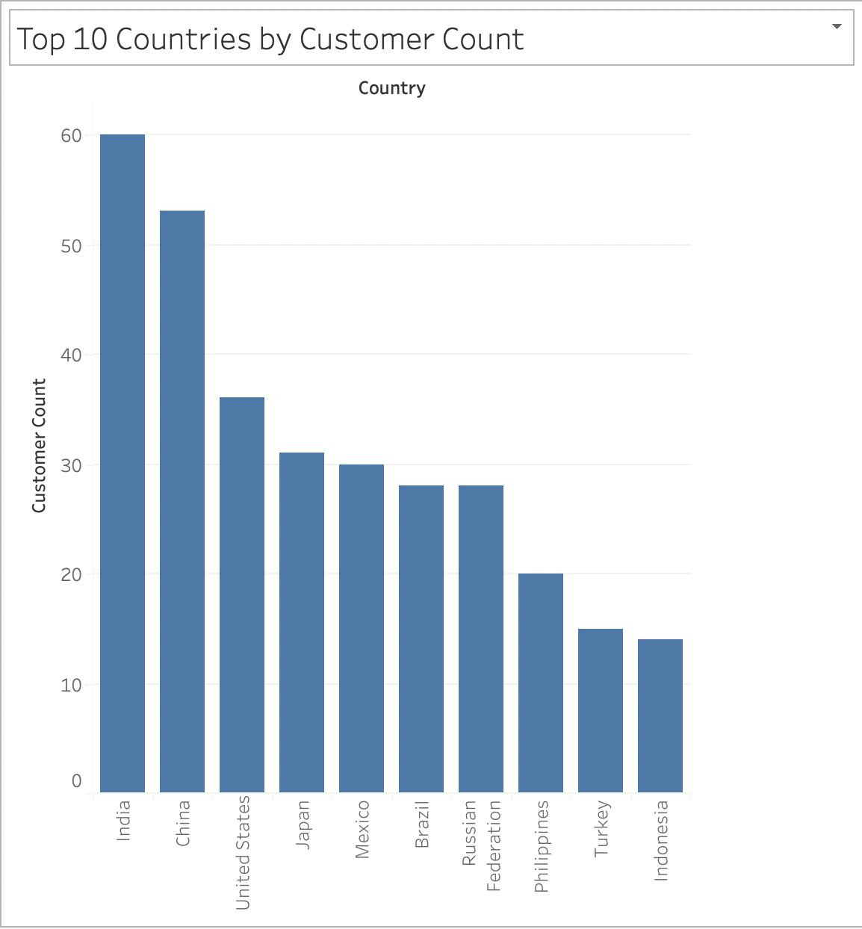
TOP 10 COUNTRIES by CUSTOMER
COUNT
As we can see here and in the
Map on the previous page, there are high volumes of customers in the most populous countries of the world, with markets in India and China being particularly important.

Slide 6
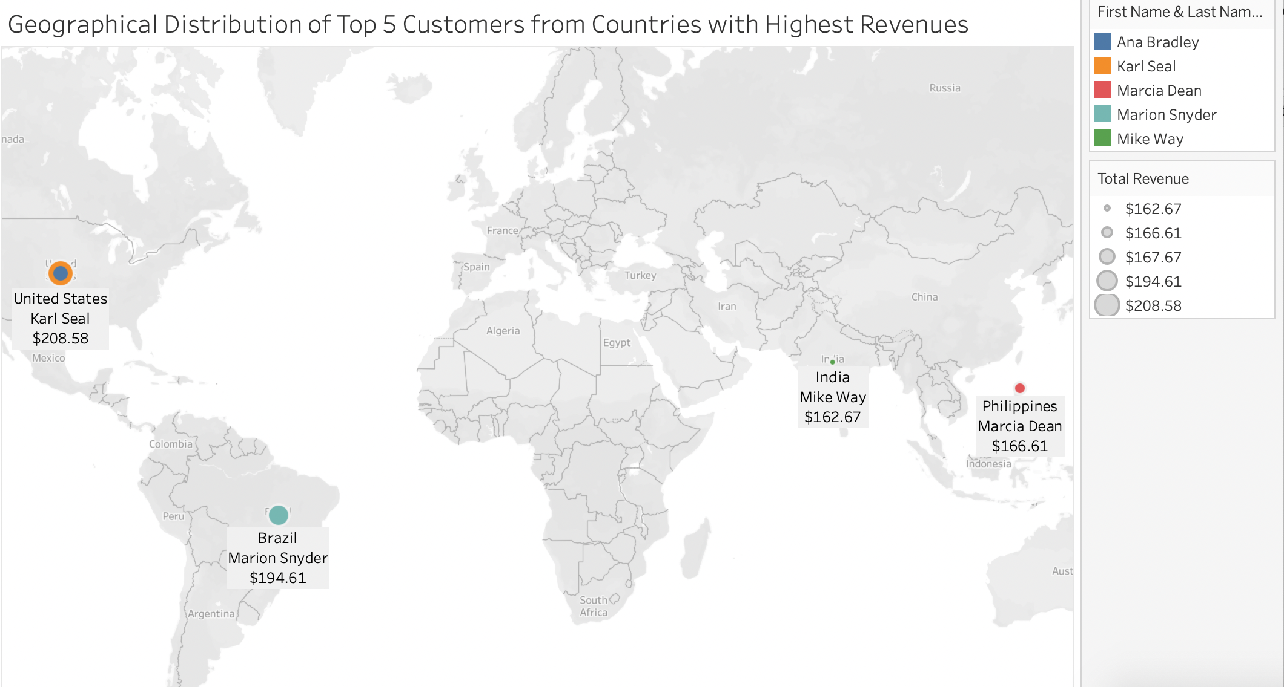
TOP CUSTOMERS at-a-glance
Rockbuster’s top 5 customers
from the top 10 countries are shown here. Average spending for all customers is about $107.00

Slide 7
INSIGHTS and RECOMMENDATIONS
Rockbuster customers are located across the globe. Markets in India, China, United States, Japan and Mexico are particularly robust and it would be worth it to consider expansion in these regions, and acquiring films in the languages of those countries.
Customers spend an average of $107.00 a year on rentals, and we could develop a rewards
program that packages more films together when one hits the annual rental rate of $100/year.
Top types of films rented out included Sports, Sci-Fi, and Animation, so it will be worth it to continue expanding collections of those films, as well as Comedy and New films, which perform very well but are underrepresented in our inventory.
If you have any further questions, do not hesitate to reach out!

