Slide 1
PROJECT REPORT ON COMPANY’S EMPLOYEE ATRRITION CASE
BY ONYEMMA MIRIAN

Slide 2
OVERVIEW AND OBJECTIVES
OVERVIEW
The data is for company X which is trying to control attrition. There are two sets of data: "Existing employees" and "Employees who have left".
OBJECTIVES
What type of employees are leaving?
Determine which employees are prone to leave next.
Present your results in the presentation sheet's presentation area.

Slide 3
Importing the libraries and loading the datasets.
I imported the various python libraries that are required for this analysis as follows;
import numpy as np
import pandas as pd
import matplotlib.pyplot as plt
import seaborn as sns
I copied the two dataset and pasted and saved it in two different excel file and named them ExistingEmployee.xlsx and EmployeeWhoLeft.xlsx respectively. Loading my datasets into two different dataframes as follows;

Slide 4
Importing the libraries and loading the datasets.
def existingEmployee():
existingEmployees = pd.read_excel("ExistingEmployee.xlsx")
existingEmployees_count = len(existingEmployees["Emp ID"])
leftCompany = []
while existingEmployees_count != 0:
leftCompany.append("YES")
existingEmployees_count -= 1
print("Before adding the new leftCompany column")
print(existingEmployees.head)
existingEmployees["leftCompany"] = leftCompany
print("After adding the new leftCompany column")
return existingEmployees
dataExist = existingEmployee()
dataExist
This prints out the dataframe of the Existing Employees in the company.

Slide 5
Importing the libraries and loading the datasets.
def leftEmployee():
leftEmployees = pd.read_excel('Employee_who_left.xlsx')
leftEmployees_count = len(leftEmployees["Emp ID"])
leftCompany = []
while leftEmployees_count != 0:
leftCompany.append("NO")
leftEmployees_count -= 1
leftEmployees["leftCompany"] = leftCompany
print(leftEmployees.head())
return leftEmployees
dataLeft = leftEmployee()
dataLeft
This prints out the dataframe of the Employees who have left the company.

Slide 6
DATA INSIGHT
This will help us get more information about our dataframe. I will be using the head(),tail(), describe() and the info() function to get insight of our dataframe as follows;
dataExist.head()
This prints out the first five rows of the dataframe.
dataExist.tail()
This prints out the last five rows of the dataframe.
dataExist.describe()
This function prints out the count, mean, standard deviation, minimum and maximum values and the quantiles of the dataframe.

Slide 7
DATA VISUALIZATION
Firstly I plotted a bar plot of Salary vs Monthly hours spent, using number_project as the value as follows;
plt.figure(figsize=(20,10))
plt.title("Salary vs Monthly hours spent")
sns.barplot(x=dataLeft['salary'],y=dataLeft['average_montly_hours'],hue='number_project',data=dataLeft)
plt.show()
This prints out a bar plot, from the barplot I observed that 50% of Low salary employees has high monthly hours and the average monthly hours is low for employees who has less number of project for all salary level.

Slide 8
DATA VISUALIZATION
The second plot I plotted was a scattered plot of last evaluation vs Satisfication level using number_project as the value. The code is as foolows;
plt.figure(figsize=(20,10))
plt.title("last evaluation vs Satisfication level")
sns.scatterplot(x=dataLeft['satisfaction_level'],y=dataLeft['last_evaluation'],hue='number_project',data=dataLeft, palette=('YlGnBu_r'))
plt.show()
This prints out a scattered plot , from the plot I observed that the above plot is that last evaluation for employee who have less number of project is very low, and the satisfaction level for employees who have number of projects greater than 4 is very low.
Lastly, I plotted a cat plot of dept vs count. The code is as follows;
plt.figure(figsize=(20,10))
sns.catplot('dept',data=dataLeft,kind='count',aspect=2)
plt.show()
This printed out a cat plot . From the plot I discovered that most employees leaving the company are from sales, technical and support department.

Slide 9
JOINING THE DATAFRAMES
To know the employees that are prone to leave the company, I have to merge the two dataframe that I will use to develop the model and make the necessary predictions. The code is as follows;
datasets =[ dataExist, dataLeft]
employees=pd.concat(datasets)
employees.to_excel('employees.xlsx')
Employees
This prints out the a new dataframe of the merged datasets.
Then I import my dataset as follows;
X=employees[["satisfaction_level","last_evaluation","average_montly_hours","time_spend_company","Work_accident","promotion_last_5years","dept","salary"]]
y = employees["leftCompany"]

Slide 10
BUILDING THE PREDICTION MODEL
Firstly I converted the string into number by encoding the categorical data and independent variable
X = pd.get_dummies(X)
from sklearn.preprocessing import LabelEncoder
le = LabelEncoder()
y = le.fit_transform(y)
y
Secondly I split the dataset into test and train set as follows;
from sklearn.model_selection import train_test_split
X_train, X_test, y_train, y_test = train_test_split(X,y,test_size=0.30,random_state=0)
Then I Fitting Random Forest Regression to dataset as follows;
from sklearn.ensemble import RandomForestClassifier
classifier = RandomForestClassifier(n_estimators=11, criterion='entropy', random_state=0)
classifier.fit(X_train, y_train)

Slide 11
BUILDING THE PREDICTION MODEL
Predict result as follows;
y_pred = classifier.predict(X_test)
y_pred
OUTPUT: array([1, 0, 1, ..., 1, 1, 1])
After which I Calculated and printed the model Accuracy and Precision as follows;
from sklearn.metrics import accuracy_score,precision_score
print(f'Accuracy:{accuracy_score(y_pred,y_test)*100}%')
print(f'Precision: {precision_score(y_test, y_pred)*100}%')
And the result shows that the model has 99% accuracy score and 99% precision score.
I also visualized the result as follows;
featImportances = pd.Series(classifier.feature_importances_, index=X.columns)
featImportances = feat_importances.nlargest(15)
featImportances.plot(kind='barh')

Slide 12
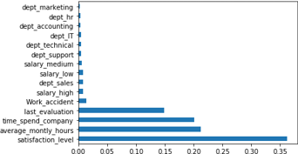
BUILDING THE PREDICTION MODEL
This plots a graph as follows;
The graph shows that the satisfaction_level, average_monthly hours, time_spend_company and last_evaluation are the main factors that determine why the employees are leaving the company.
After this I Reselected the feature dataset in order to predict employee that are prone to leave as follows;
X1 =employees.drop(['Emp ID','leftCompany'],axis=1)
y1 = employees["leftCompany"]
X_train1, X_test1, y_train1, y_test1 = train_test_split(X1,y1,test_size=0.30,random_state=0)
EmployeesProneToLeave = pd.DataFrame(X_test1)
EmployeesProneToLeave["leftCompany"] = y_test1
EmployeesProneToLeave["predicted"] = y_pred

Slide 13
BUILDING THE PREDICTION MODEL
# Predicting employees that will leave the company
leaving = EmployeesProneToLeave[(EmployeesProneToLeave["predicted"] == 1) & (EmployeesProneToLeave["leftCompany"] != "YES") ]
leaving.to_excel("EmployeesProneToLeave.xlsx")
leaving

Slide 14
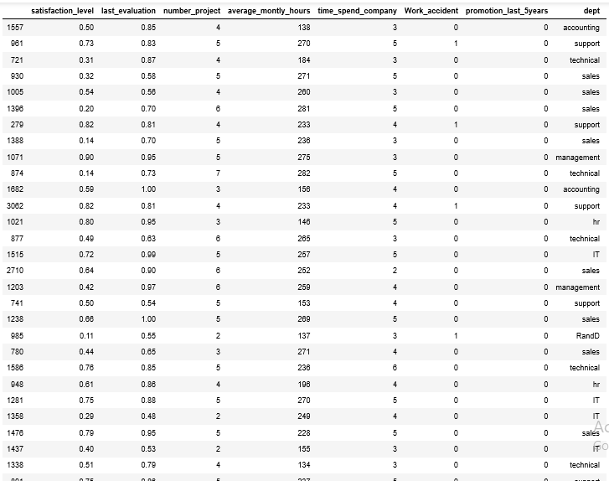
This prints out a number of 41 employees the out put is as follows;

Slide 15
SOLUTION
There should be increase in salary for those who spend time at work and those who have high number o f Projects.
Let Promotion be given to the Employees who earned it.
High salary earners should be allocated more number of projects in order to increase their satisfaction level.
The Support department has high number of work accident, they need to be given the necessary care to reduce this.

