Slide 1
Introduction to Programming(II) Week 10: C++ Inheritance
李哲榮

Slide 2
Object-oriented design
Encapsulation (封裝): Data and methods to manipulate data (function) are tightly coupled, and others should not change them arbitrarily.
Inheritance (繼承): Data and functions should have a hierarchy so that the common part of data or actions (functions) can be reused.
Polymorphism (多型): which actions to take depends on which object (data) is involved in the runtime.

Slide 3
Inheritance: idea

Slide 4
Inheritance
Inheritance allows you to create a class that absorbs an existing class’s data and behaviors and enhances them with new capabilities.
You can designate that the new class should inherit the members of an existing class.
This existing class is called the base class, and the new class is referred to as the derived class.

Slide 5
Relations among objects
We distinguish between the is-a relationship and the has-a relationship.
The is-a relationship represents inheritance.
In an is-a relationship, an object of a derived class also can be treated as an object of its base class.
By contrast, the has-a relationship represents composition.
Example: a triangle has three vertices.
Notes:
Mammal is animal
Triangle is a shape

Slide 6
Class hierarchy
Inheritance relationships form class hierarchies.
Base classes tend to be more general and derived classes tend to be more specific.
Because every derived-class object is an object of its base class, and one base class can have many derived classes, the set of objects represented by a base class typically is larger than the set of objects represented by any of its derived classes.

Slide 7
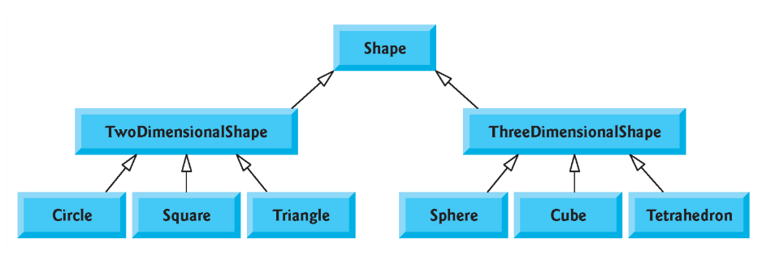
Example: geometry shapes

Slide 8
Example: students

Slide 9
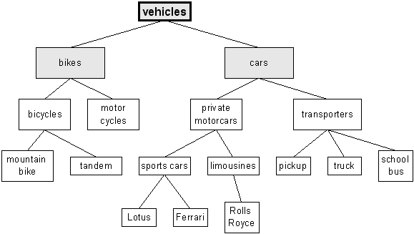
Example: Vehicles

Slide 10
Is-a relation and class hierarchy
Class hierarchy shows the is-a relationship:
“a triangle is a 2D shape” and “a 2D shape is a shape.”
Shape is the direct base class of 2D shapes and 3D shapes.
Shape is an indirect base class of all the other classes.
An triangle is a 2D shape, is a shape.

Slide 11
Inheritance: practices

Slide 12
Example: List
List
Array
Resizable List
Vector
Linked List

Slide 13
Object Oriented Design
There are many ways to organize your classes.
List
Linked List
Continuous Storage
Array
Vector

Slide 14
Another way
List
Linked List
Array
Vector

Slide 15
Base class : Array
class Array {
int size;
int *data;
public:
Array();
Array(int);
~Array();
void setSize(int);
int getSize() const;
void setElementAt(int, int);
int getElementAt() const;
void print() const;
}; // end class Array

Slide 16
Derived class: Vector
class Vector : public Array {
private:
int capacity; // storage size
public:
Vector();
Vector(int size);
~Vector();
int getCapacity() const;
void setSize(int);
void print() const;
}; // end class Vector

Slide 17
Base and derived classes
Vector is an Array. Therefore, a vector has everything that an array has.
But a vector has an extra data member: capacity
So it has some extra functions.
Some of the functions exist in base class and derived class, such as setSize, print, but have different implementations.

Slide 18
Constructor implementation
The Vector constructor is almost identical to that of Array.
base-class initializer syntax
Vector(): Array(){
capacity = 0;
} // end Vector constructor
Vector(const int &size): Array(3*size){
this->size = size;
capacity = 3*size;
} // end Vector constructor

Slide 19
Constructors and destructors
Base-class constructors, destructors and overloaded assignment operators are not inherited by derived classes.
Derived-class constructors, destructors and overloaded assignment operators, however, can call base-class versions explicitly.

Slide 20
Problem of Private Data
It will cause an error
(recall the this pointer.)
because size is private member data, which cannot be accessed even by derived classes.
How to fix it?
You can call base class Array::setSize(n), but it will change the storage size
this->size = size;

Slide 21
Protected
To enable class Vector to directly access Array data members, we can declare those members as protected in the base class.
class Array {
...
protected:
int size;
int *data
}; // end class Array

Slide 22
Accessibility of privilege control
Accessbility | private | protected | public
Accessible from own class ? | yes | yes | yes
Accessible from dervied class ? | no | yes | yes
Accessible outside dervied class ? | no | no | yes

Slide 23
Inheritance: deeper look

Slide 24
The calling seq. of constructors
Instantiating a derived-class object begins a chain of constructor calls
Base class’s constructor
Derived-class constructor
If the base class is derived from another class, the base-class constructor is required to invoke the constructor of the next class up in the hierarchy, and so on.

Slide 25
The calling seq. of destructors
This begins a chain (or cascade) of destructor calls in which the derived-class destructor and the destructors of the direct and indirect base classes and the classes’ members execute in reverse of the order in which the constructors executed.
This process repeats until the destructor of the final base class at the top of the hierarchy is called.

Slide 26
protected and private Inheritance
The base class may be inherited through public, protected or private inheritance.
Their differences are summarized in the next page.
The protected and private inheritances are rare.
A base class’s private members are never accessible directly from a derived class, but can be accessed through calls to the public and protected members of the base class.

Slide 27
Types of inheritance
There are three types of inheritance: public, protected, and private.
Type of inheritance | Public | Protected | Private
Public data/ functions in the base class | Public in the derived class | Protected in the derived class | Private in the derived class
Protected data/ functions in the base class | Protected in the derived class | Protected in the derived class | Private in the derived class
Private data/fun in the base class | Not accessible in the derived class | Not accessible in the derived class | Not accessible in the derived class

