Slide 1
Introduction to Programming(II) Week 11: C++ Polymorphism
李哲榮

Slide 2
Announcement
Week 11 | 4/30 | Quiz 3: C++ | 5/3 | C++ polymorphism
Week 12 | 5/7 | C++: Iterator | 5/10 | Midterm 2 review
Week 13 | 5/14 | Midterm 2 | 5/17 | Mini-project 2: window programming
Week 14 | 5/21 | C++: template and STL | 5/24 | Problems using STL
Week 15 | 5/28 | AI search using STL | 5/31 | Mini-project 3: AI games
Week 16 | 6/4 | Quiz 4: STL and search problem | 6/7 | 端午節放假
Week 17 | 6/11 | Mini-project 2 demo | 6/14 | Review of final
Week 18 | 6/18 | Final (由中午12考) | 6/21
 | 6/25 | Mini-project 3 demo

Slide 3
Object-oriented design
Encapsulation (封裝): Data and methods to manipulate data (function) are tightly coupled, and others should not change them arbitrarily.
Inheritance (繼承): Data and functions should have a hierarchy so that the common part of data or actions (functions) can be reused.
Polymorphism (多型): which actions to take depends on which object (data) is involved in the runtime.

Slide 4
polymorphism

Slide 5
Inheritance hierarchy
An object of a derived class can be treated as an object of its base class.
However, we cannot treat a base-class object as an object of any of its derived classes.
The is-a relationship applies only from a derived class to its direct and indirect base classes.

Slide 6
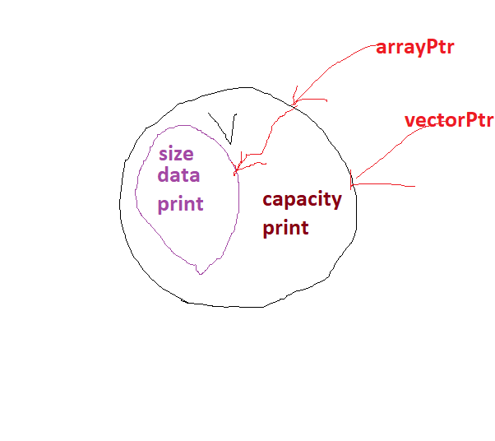
Example: Vector
Base class
Recall that
Array
Vector
Derived class
Vector v; // derived-class object
Array *arrayPtr; // base-class pointer
Vector *vectorPtr; // derived-class pointer
arrayPtr = &v; // point to v
arrayPtr ->print(); // call array print
vectorPtr = &v;
vectorPtr->print(); // call vector print
Notes:
Array->vector (o) 動物>哺乳動物>人類 ====人類也是種動物 動物可以指向人類
Vector->array (x)
Ex. Array a; Vector *p = &a (x)
Vector->vector (o)
Pic::用arrayPtr 看是指到裡面的array
用vectorPtr看是指到vector

Slide 7
Why?
This “crossover” is allowed because an object of a derived class is an object of its base class.
Which function is invoked depends on the type of the pointer (or reference) used to invoke the function, not the type of the object for which the member function is called.
The inverse (D->B) is not allowed
Notes:
*ps.
arrayPtr->getCapacity (x)
Since arrayPtr can only see array

Slide 8
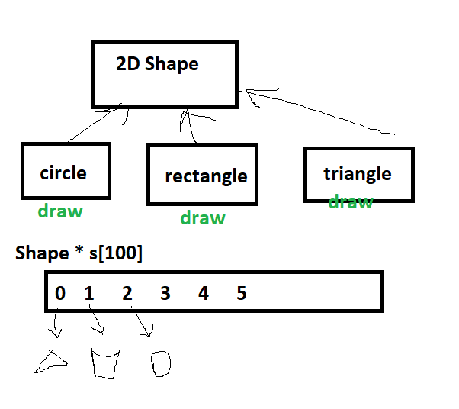
Function override
Can the base class pointer, pointing to a derived object, invoke the functions defined in the derived class? (function override)
Notes:
Base class pointer can point to derive class object
But in the example, we want to call derived class draw instead of base class draw.
只有在執行時(for loop)才知道要呼叫哪個function ->dynamic
Shape *S[100]; S[0](指向圓形) S[1](rectangle)………….
for (i=0; i<5; i++)
s[i]->draw(); 要寫一大堆if判斷???

Slide 9
Virtual function
Yes, if the function defined in the base class is a virtual function.
If we declare a base-class function as virtual, we can override that function to enable polymorphic behavior.

Slide 10
Polymorphism
If a program invokes a virtual function through a base-class pointer to a derived-class object (or a base-class reference to a derived-class object), the program will choose the correct derived-class function dynamically (i.e., at execution time) based on the object type—not the pointer or reference type.
Also called dynamic binding or late binding.

Slide 11
Example: Array and Vector
class Array{
public:
...
virtual void setSize(int, int);
virtual void print() const;
}; // end class Array
class Vector : public Array {
public:
...
virtual void setSize(int, int) override;
virtual void print() const override;
}; // end class Vector

Slide 12
Example: driver program
/* aim base-class pointer at derived-class object and print */
arrayPtr = &v;
/* polymorphism; invokes Vector's print*/
arrayPtr->print();

Slide 13
Why adding override?
To make polymorphism more safe!!
With override, compiler will check if the function really overrides base class’s function
What can go wrong?
Forget adding virtual in the base class
The interfaces are different in base and derived classes, which often happens when the interface is changed in the base class

Slide 14
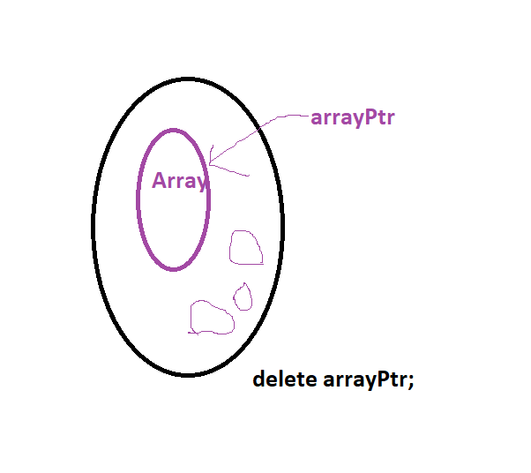
Virtual destructor
Using polymorphism to process dynamically allocated objects of a class hierarchy can cause problems.
Ex: If Array’s destructor is not virtual Array *pa = new Vector(3); delete pa; // only Array’s destructor is called
A simple solution to this problem is to create a public virtual destructor in the base class.
Notes:
會刪不乾淨所以要virtual

Slide 15
Final member function
A base-class virtual function that’s declared final in its prototype, as in
virtual someFunction( parameters ) final;
CANNOT be overridden in any derived class.
This guarantees that the base class’s final member function definition will be used by all base-class objects and by all objects of the base class’s direct and indirect derived classes.

Slide 16
Final class
As of C++11, you can declare a class as final to prevent it from being used as a base class
class MyClass final {
// class body
};
Attempting to override a final member function or inherit from a final base class results in a compilation error.

Slide 17
Abstract classes
Abstract classes define the function interfaces without some implementations of them.
Abstract classes cannot be used to instantiate objects, because they are incomplete. But an abstract class is a base class from which other classes can inherit.
Classes that can be used to instantiate objects are called concrete classes, which define every member function they declare.
Notes:
How to write Shape(base class) draw? --→so abstract
But is needs to exist then (circle, rectangle….)can call it

Slide 18
Example: Continuous List
We can define setSize function in Continuous List without any concrete implementations.
Array and Vector need to implement setSize.
Continuous List
Array
Vector

Slide 19
Pure virtual function
A class is made abstract by declaring one or more pure virtual functions.
A pure virtual function is specified by placing “= 0” in its declaration, as in
virtual void setSize(int) const=0;
The “= 0” is a pure specifier.
Pure virtual functions typically do not provide implementations, though they can.
Notes:
No implementation

Slide 20
Virtual and concrete functions
A pure virtual function does not have an implementation and requires the derived class to override the function for that derived class to be concrete; otherwise the derived class remains abstract.
Each concrete derived class must override all base-class pure virtual functions with concrete implementations of those functions; otherwise the derived class is also abstract.
Notes:
If one pure virtual function then it is abstract class

Slide 21
Abstract classes and polymorphism
Although we cannot instantiate objects of an abstract base class, we can use the abstract base class to declare pointers and references that can refer to objects of any concrete classes derived from the abstract class.
Programs typically use such pointers and references to manipulate derived-class objects polymorphically.

Slide 22
Summary
Normal member functions after inheritance
Based on the type of pointer or references
Virtual function
Based on the real data type, not the type of pointer or references
Final virtual function: cannot be overridden
Abstract class and pure virtual function
Only interface, no implementation.
Cannot be instantiated, but can be inherited.

Slide 23
Dynamic cast

Slide 24
explicit type conversion
Four casts in C++. Use them as few as possible.
const_cast
Want to modify a const object?
static_cast
When there is a implicit conversion sequence.
dynamic_cast
How do I know a type is my derived class?
reinterpret_cast
Types? I do not care.
Notes:
(in c)
Int *a;
a = (int*) malloc(4); -→type casting

Slide 25
const_cast
When you want to modify an object which cannot be modified (because it is const).
You have to ensure objects can really be modified.
int i(0);
const int &j(i);
*j=10; //error: j is a constant reference to integer
const_cast<int&>(j)=10; //fine
cout<<i<<endl; //print 10
const int *p(&i);
*const_cast<int*>(p)=20; //fine
cout<<i<<endl; //print 20
Notes:
Integer vs. const integer

Slide 26
static_cast
Implicit conversion sequence.
unsigned long l(0);
unsigned short s(l);
//warning: conversion from 'unsigned long' to 'unsigned short'
float f(0);
unsigned int i(f);
//warning: conversion from 'float' to 'unsigned short'
min(l,i);
//error: no matching function
// because l and i are different types

Slide 27
static_cast
static_cast has more usage other than type conversions.
unsigned long l(0);
unsigned short s(static_cast<unsigned short>(l));
//I am pretty sure the value of l
// can be represented in unsigned short
float f(0);
unsigned int i(static_cast<unsigned int>(f));
//I am pretty sure the value of f
// can be represented in unsigned int
min(l, static_cast<unsigned long>(i));
//OK. The arguments have same type

Slide 28
dynamic_cast
In object-oriented programming, sometimes you may want to do some special operations on some types. To do this, use dynamic_cast.
Only polymorphic class can be casted by dynamic_cast.

Slide 29
dynamic_cast
struct B{virtual ~B(){}};
struct D:B{};
void do_D_operations(const B &b)
{
if(dynamic_cast<const D*>(&b))
...
}
struct B{};
//B do not have a virtual function
struct D:B{};
B b;
D *d(dynamic_cast<D*>(&b));
//error: B is not a polymorphic class
struct B{virtual ~B(){}};
//B has a virtual function
struct D:B{};
B b;
D *d(dynamic_cast<D*>(&b));
//OK. B is a polymorphic class

Slide 30
dynamic_cast
Unlike static_cast, dynamic_cast provides a mechanism for you to determine whether the type can really be converted.
Return nullptr (for pointer) or throw an exception (for reference) if the conversion fails.

Slide 31
Dynamic cast
struct B{
virtual ~B(){}};
struct D:B{};
B b;
D d;
if(dynamic_cast<B*>(&b))
cout<<"success"<<endl;
else
cout<<"failure"<<endl;
if(dynamic_cast<D*>(&b))
cout<<"success"<<endl;
else
cout<<"failure"<<endl;
if(dynamic_cast<B*>(&d))
cout<<"success"<<endl;
else
cout<<"failure"<<endl;
if(dynamic_cast<D*>(&d))
cout<<"success"<<endl;
else
cout<<"failure"<<endl;

Slide 32
dynamic_cast
Of course, dynamic_cast can also check other types.
dynamic_cast may do runtime check.
struct B{virtual ~B(){}};
struct A{};
B b;
if(dynamic_cast<A*>(&b)) //you can do this, cout<<"success"<<endl;
else
cout<<"failure"<<endl; //<-

Slide 33
Runtime type information
Runtime type information allows programmer to get the exact type (class) of an object during the runtime.
Two useful mechanisms can be used to obtain the runtime type information
Dynamic casting
Typeid

Slide 34
Downcasting
Based class pointer, pointing to a derived object, cannot invoke the derived class specific functions,
unless it uses downcasting.
Dynamic casting (動態型別轉換) can be used to achieve downcasting.
arrayPtr->getCapacity ();

Slide 35
Dynamic casting
The phrase dynamic_cast <derived class> tries to cast a base class to a derived class
If arrayPtr does NOT point to a vector, vectorPtr will return a Null pointer.
Vector *vectorPtr =
dynamic_cast <Vector *> (arrayPtr);

Slide 36
reinterpret_cast
When you do NOT care type-safety and cross-platform issue.
int i(1073741824);
float *d(reinterpret_cast<float*>(&i));
cout<<*d<<endl; //"may" print 2

Slide 37
reinterpret_cast
When you want to temporarily store an object into an different type object.
int *p1(new int);
void *p2(reinterpret_cast<void*>(p1));
//the value of p1 may not equal to p2
int *p3(reinterpret_cast<int*>(p2));
//the value of p1 always equals to p3

