Slide 1
Introduction to Programming(II) Week 15: Problem Solving
李哲榮

Slide 2
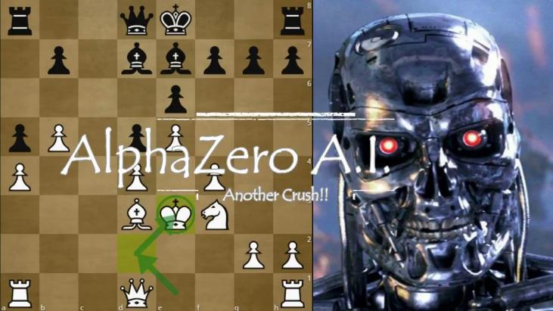
Alpha Zero

Slide 3
Water Pouring

Slide 4
A
B
4-gallon water?
5-gallon jug
3-gallon jug
scale
05:00

Slide 5
Write a program to solve it
State: how to represent the state?
Initial state: what is the initial state?
Operations: actions that change states.
Solution: how to identify the solution?
Final state: characters of final states
After finding a solution, the program needs to output the steps of solve the problem. How to store the path?

Slide 6
State representations
Capacities of the jugs
(CA, CB) = (5, 3)
The capacity of jug A is 5 gallons.
The capacity of jug B is 3 gallons.
State: how much water in the jug now?
For example, (A, B) = (3, 2) means that
jug A has 3 gallons of water, and
jug B has 2 gallons of water.

Slide 7
Three possible operations
Empty a jug
2. Fill a jug
3. Pour from a jug to another until the first one is empty or the other is full

Slide 8
Operations
Empty some_jug: State ➔ State
Given a jug and the current state, empty the jug and update the state
Empty A (5, 2) ➔ (0, 2)
Fill some_jug: State ➔ State
Fill A (0, 2) ➔ (5, 2)
Pour one_jug another_jug: State ➔ State
Pour A B (5, 0) ➔ (2, 3)
(CA, CB) = (5, 3)

Slide 9
Operations
From state (A, B), six possible transitions that update the state (A, B) ➔ { (A’, B’) }
Ex: (5, 0) ➔ {(0, 0), (5, 0), (5, 0), (5, 3), (2, 3), (5, 0) }
Representation
Empty A Fill A Pour A B
Empty B Fill B Pour B A

Slide 10
Solution representation
1. Fill A ➔ (A, B) = (5, 0)
2. Pour from A to B ➔ (A, B) = (2, 3)
3. Empty B ➔ (A, B) = (2, 0)
4. Pour from A to B ➔ (A, B) = (0, 2)
5. Fill A ➔ (A, B) = (5, 2)
6. Pour from A to B ➔ (A, B) = (4, 3)
Solution: list of states
(0, 0)➔(5, 0)➔(2, 3)➔(2, 0)➔(0, 2)➔(5, 2)➔(4, 3)

Slide 11
5, 0
2, 3
5, 3
2, 0
4, 3
0, 0
0, 2
0, 3
5, 2
0, 1
5, 1
3, 3
3, 0
0,0
5,0
0,3
5,3
2,3
3,0
2,0
3,3
0,2
5,1
5,2
0,1
4,3

Slide 12
Tree search
Find a path that connects the initial state to the target state
(0, 0)
(0, 0)
(0, 0)
(5, 0)
(0, 3)
(0, 0)
(0, 0)
(0, 0)
(5, 0)
(5, 0)
(5, 3)
(2, 3)
(5, 0)
(0, 3)
(0, 0)
(5, 3)
(0, 3)
(0, 3)
(3, 0)
Extend a path and explore new states
Ignore visited states

Slide 13
Tree search
Find a path that connects the initial state to the target state
(0, 0)
(0, 0)
(0, 0)
(5, 0)
(0, 3)
(0, 0)
(0, 0)
(0, 0)
(5, 0)
(5, 0)
(5, 3)
(2, 3)
(5, 0)
(0, 3)
(0, 0)
(5, 3)
(0, 3)
(0, 3)
(3, 0)
Extend a path and explore new states
Ignore visited states

Slide 14
Search algorithms
Modeling the transitions of states as a graph or a tree
Traversing a graph to explore the entire graph to check all possible states
General methods
Breadth first search (BFS), Depth first search (DFS)
Smarter search methods
A* search algorithm, Heuristic search or stochastic search, Dynamic programming, …

Slide 15
BFS and DFS
Recall last semester we used recursion to implement DFS (Depth First Search)
BFS
DFS

Slide 16
BFS vs DFS
When to use DFS and when to use BFS?
DFS: the depth of the tree is limited.
Ex: the problem size will shrink each level. (recursion)
BFS: level by level tree traversal.
Implementation:
DFS uses stack and BFS uses queue. (preferable)
Recursion has a stack behind the system
We need a queue (or something similar) to implement BFS

Slide 17
BFS implementation
Put the root or a node to the container
While the container is not empty
Get an element from the container
Generate its child nodes
For each child node x, if x has not been visited, put it to the container
Ex:

Slide 18
Back to the pouring problem
Given a fixed number k, returns all the solutions whose number of steps is less than k.
Ex: Solve(4,8) finds all possible ways to have 4 Gallon waters within 8 steps.

Slide 19
Checking the visited states
For this problem, you can use a 2D array, (5+1)x(3+1), to represent all possible states, and mark the (i,j) element if the state (i,j) has been visited.
Problems
Most elements are not used.
For more water jars, the space grows rapidly.
Use Set to stored the visited states.

Slide 20
When to mark visited states?
Think: why to mark visited states?
For this problem, if we mark the visited states immediately, what would happen?
Hint: We need to find ALL the solutions whose number of steps is less than k.
So when to mark visited states for this problem.

Slide 21
(0,0) ➔(0,3)
(0,0) ➔(5,0)
(0,0) ➔(0,3)
extract
(0,0) ➔(5,0)
extend
(5,0) ➔ { (0,0), (5,0), (5,0), (5,3), (2,3), (5,0) }
(0,0) ➔(5,0)➔(5,3)
(0,0) ➔(5,0)➔(2,3)
new paths

Slide 22
(0,0) ➔(0,3)
extract
(0,0) ➔(0,3)
extend
(0,3) ➔ { (0,3), (0,0), (5,3), (0,3), (0,3), (3,0) }
(0,0) ➔(5,0)➔(5,3)
(0,0) ➔(5,0)➔(2,3)
new paths
(0,0) ➔(0,3)➔(5,3)
(0,0) ➔(0,3)➔(3,0)

Slide 23
Other similar search problems
River-crossing problems
Missionaries and cannibals problem
http://en.wikipedia.org/wiki/Missionaries_and_cannibals_problem
Fox, goose, and bag of beans puzzle
http://en.wikipedia.org/wiki/Fox,_goose_and_bag_of_beans_puzzle
Bridge and torch problem
http://en.wikipedia.org/wiki/Bridge_and_torch_problem

Slide 24
Missionaries and cannibals
Three missionaries and three cannibals are on the left bank of a river. There is one canoe which can hold one or two people.
Get everyone to the right bank, without ever leaving a group of missionaries in one place outnumbered by cannibals in that place.

Slide 25
Missionaries and cannibals
States: three numbers (i,j,k) representing the number of missionaries, cannibals, and canoes on the left bank of the river.
Initial state: (3, 3, 1)
Operators: take one missionary, one cannibal, two missionaries, two cannibals, one missionary and one cannibal across the river in a given direction (I.e. ten operators).
Goal Test: reached state (0, 0, 0)
Path Cost: Number of crossings.

Slide 26
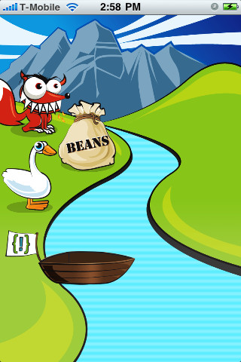
Fox, goose, and bag of beans
A farmer has a fox, a goose, and a bag of beans. He wants to bring them cross the river. The farmer can carry only himself and a single one of the fox, the goose, or the bag of beans.
If left unattended together, the fox would eat the goose, or the goose would eat the beans.

Slide 27
Fox, goose, and bag of beans
States: four numbers (i, j, k, l) representing the location (0 means left; 1 means right) of the fox, the goose, the bag of beans, and the boat.
Initial state: (0, 0, 0, 0)
Goal state: reached state (1, 1, 1, 1)
Operators: change the states of one element from 0 to 1 or 1 to 0 with the boat.
Path Cost: Number of crossings.

Slide 28
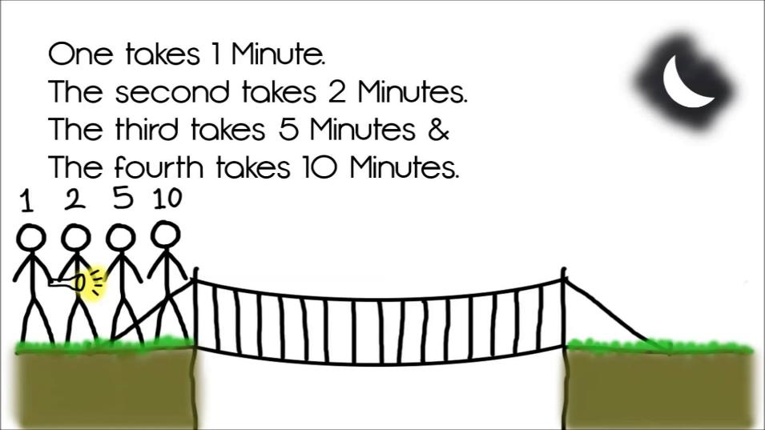
Bridge and torch problem

Slide 29
Bridge and torch problem
Four people come to a river in the night. There is a narrow bridge, which can only hold two people at a time. They have only one torch.
Person A can cross the bridge in 1 minute, B in 2 minutes, C in 5 minutes, and D in 10 minutes.
When two people cross the bridge together, they must move at the slower person's pace.
The question is, can they all get across the bridge in 17 minutes or less?

Slide 30
Bridge and torch problem
States: six numbers (a, b, c, d, f, t) representing a, b, c, d, and torch’s location (0 means left; 1 means right) and the time t.
Initial state: (0, 0, 0, 0, 0, 0)
Goal state: reached state (1, 1, 1, 1, 1, <=17)
Operators: change the states of one or two element from 0 to 1 or 1 to 0 with the torch, and add the time to t.

