Slide 1
Music Bar
Software Studio Final Project
Group 1
陳煜翔、王子文、廖黃汝

Slide 2
Main Feature
Sharing songs in a room
Create room
Join room
Add song

Slide 3
Other Feature
Instant update using socket.io
All list and my list
Delete song
Media control
Cookie
Vote system
RWD design
Music source: Youtube and Spotify

Slide 4
Completness

Slide 5
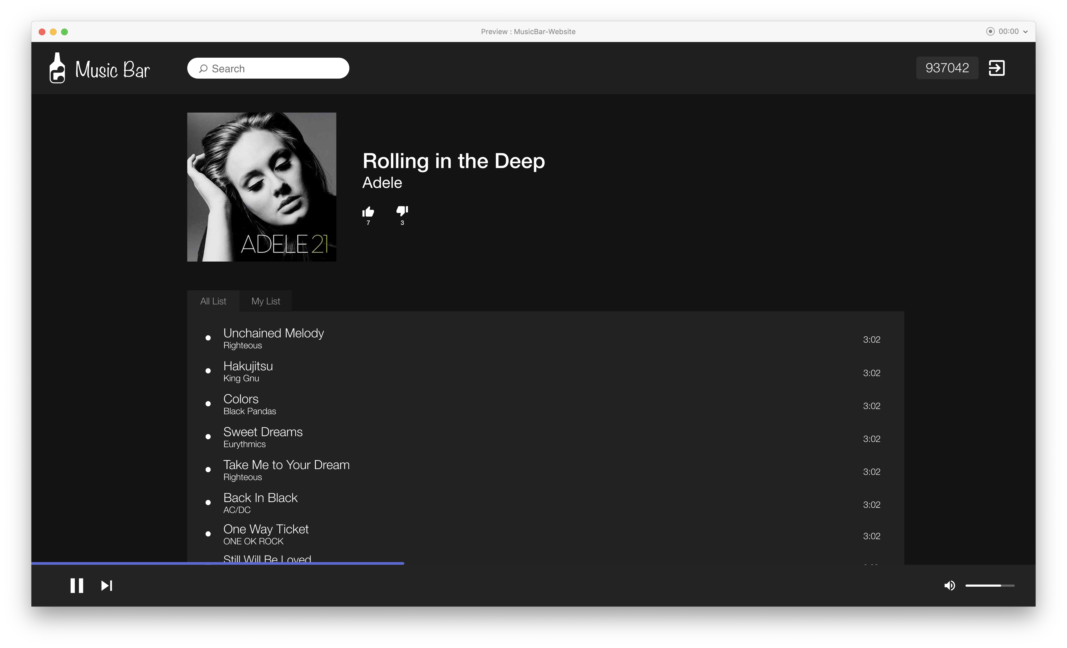

Slide 6
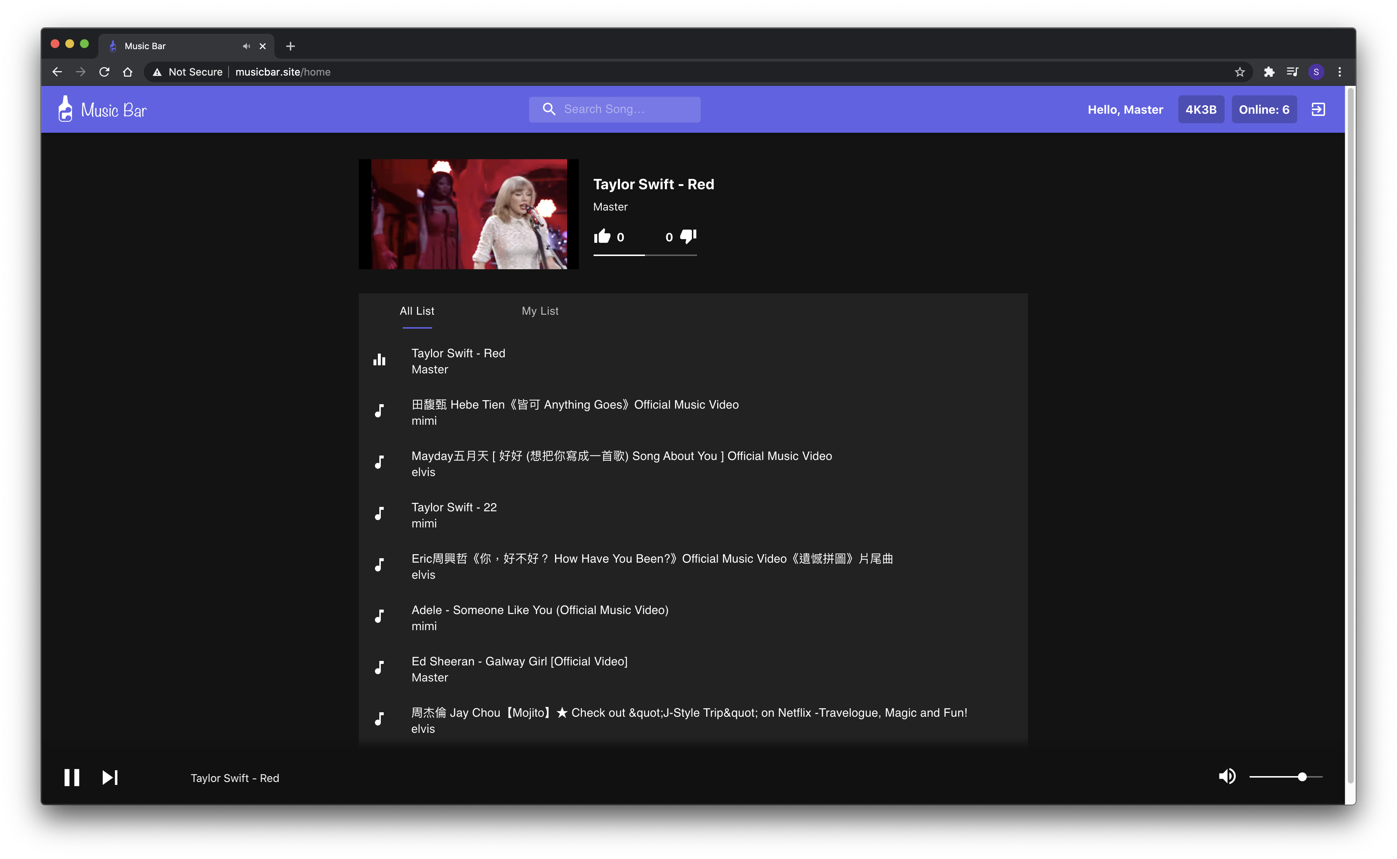

Slide 7
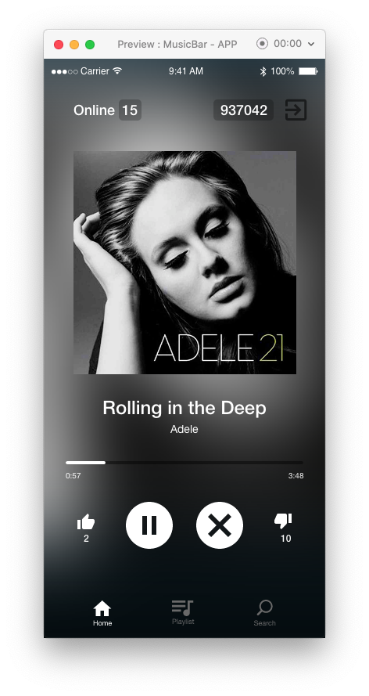
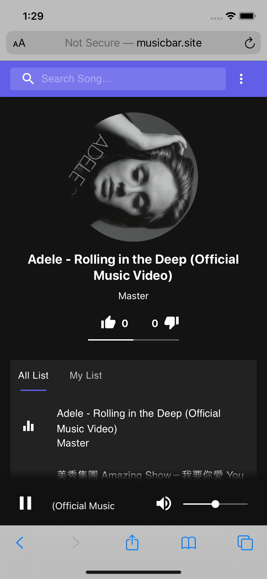

Slide 8
Complexity
API defining
Socket.io
Database design

Slide 9
Design
Material-UI
Swipe view
Rotate cover
marquee

