Slide 1
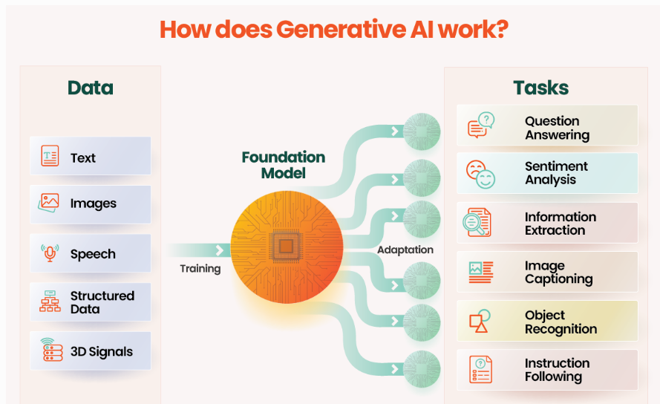
Generative AI
Generative AI (GenAI) is a type of artificial intelligence that can create new, original content, such as text, images, code, audio, and video, by learning patterns from vast amounts of existing data

Slide 2
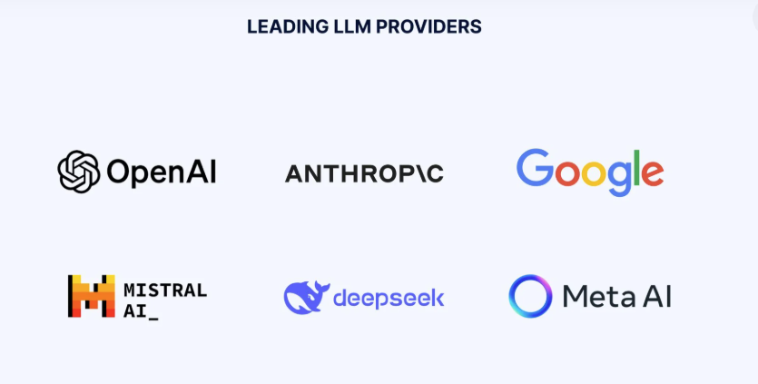
LLM – Large Language Models
A type of AI model trained on massive text datasets to understand and generate human-like language
Built using deep learning (Transformer architecture).
Learns facts, and reasoning patterns from data.
Powers tools like ChatGPT, Gemini, Claude
Used for text generation, summarization, coding, and Q&A.

Slide 3
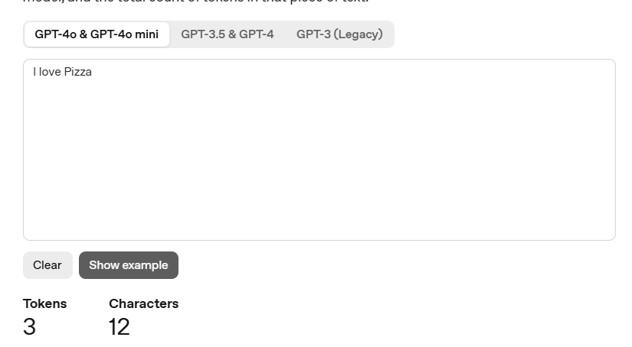
Tokens
Tokens are the smallest units of text an AI model reads or generates.
They can be a word, part of a word, or punctuation mark
Models don’t see whole words — they see tokens (subwords or symbols)
On average, 1 token ≈ ¾ of a word (e.g., 100 tokens ≈ 75 words)
Eg: "I love pizza" → ["I", " love", " pizza"] - Total tokens = 3
Play here: Tokenizer - OpenAI API

Slide 4
Generative AI Workflow and Prompts
1️⃣ Data Collection → 2️⃣ Training → 3️⃣ Fine-tuning → 4️⃣ Inference
During inference, models predict the next token to form coherent outputs.
AI Prompts
A prompt is the input or instruction given to a generative AI model.
It guides the model on what to do or generate (text, code, image, etc.).
Can include questions, examples, or context
Effective prompting = better results.
Example: “Summarize Kubernetes in 3 bullet points.”

Slide 5
Training Data
Training data is the collection of text, images, or other information used to teach an AI model how to understand and generate content.
It includes things like books, websites, articles, code, and conversations.
The model learns patterns, grammar, facts, and context from this data
The model keeps fine-tuning itself again and again until it learns to predict the next word correctly.
The more diverse and high-quality the training data, the smarter and more accurate the model becomes.
Example: ChatGPT was trained on a mix of internet text, coding examples, and documents.

Slide 6
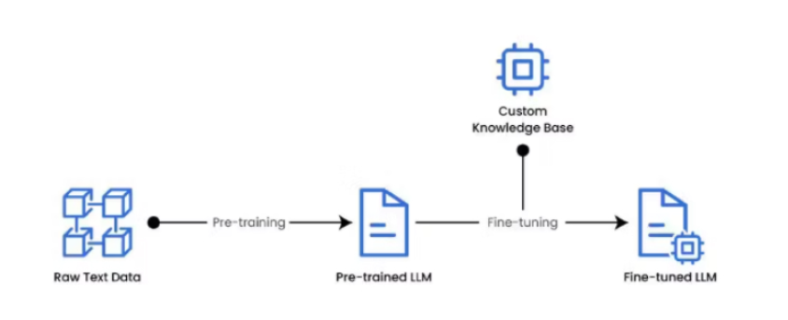
Fine Tuning in AI
Fine-tuning means training a pre-trained model on a smaller, specific dataset
It helps the model adapt to a particular task or domain (like healthcare, finance, or chatbots).
Note: Fine Tuning can be expensive, and here’s why:
It requires powerful GPUs or cloud compute, which cost money.
Large models have billions of parameters that need updating.

Slide 7
Type of Models
🧠Text Generation models:
Predict the next word in a sequence.
Ideal for chatbots, writing, and reasoning tasks.
Use Cases: Chatbots · Summarization · Content creation · Coding
🖼️Multimodal LLMs:
Handle multiple input types — text, images, audio, video.
Combine visual and language understanding
Use Cases: Image captioning · Visual reasoning · Video Q&A · Text–image generation
🌫️Diffusion Models:
A generative AI model that creates new data (images, audio, text)
Learns to convert random noise into structured, realistic data.
Use Cases: Image generation · Art creation · Text-to-image AI (e.g., Stable Diffusion)
🧩 Domain-Specific LLMs:
Trained or fine-tuned for specific industries or fields.
Examples: BioGPT (medical) · BloombergGPT (finance) · Code Llama / Codex (programming)
Use Cases: Healthcare insights · Financial analysis · Code generation
Note: BioGPT was pre-trained using a distributed training setup with 8 NVIDIA V100 GPUs, each with 32GB of memory

Slide 8
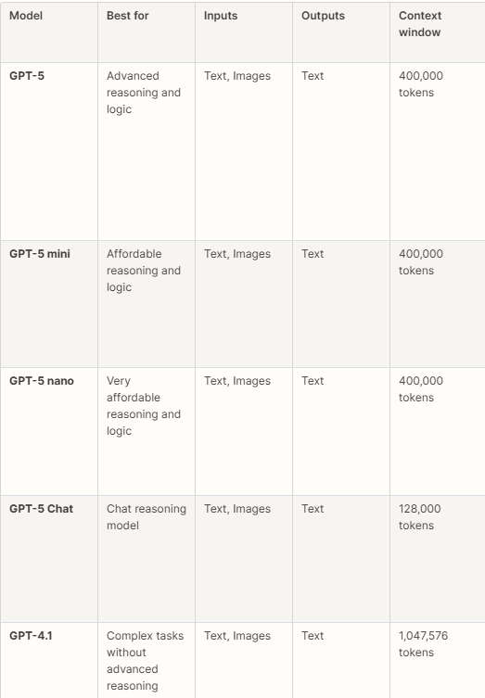
OpenAI models at a glance
.

Slide 9
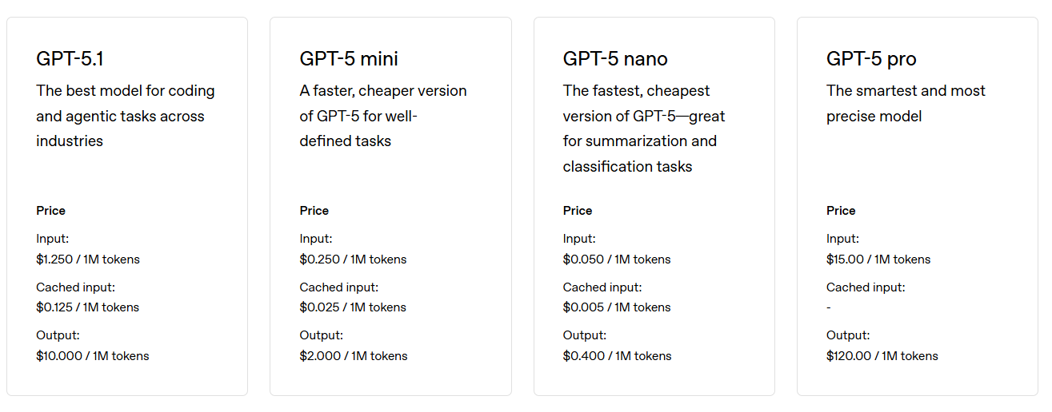
OPEN AI Model Cost

Slide 10
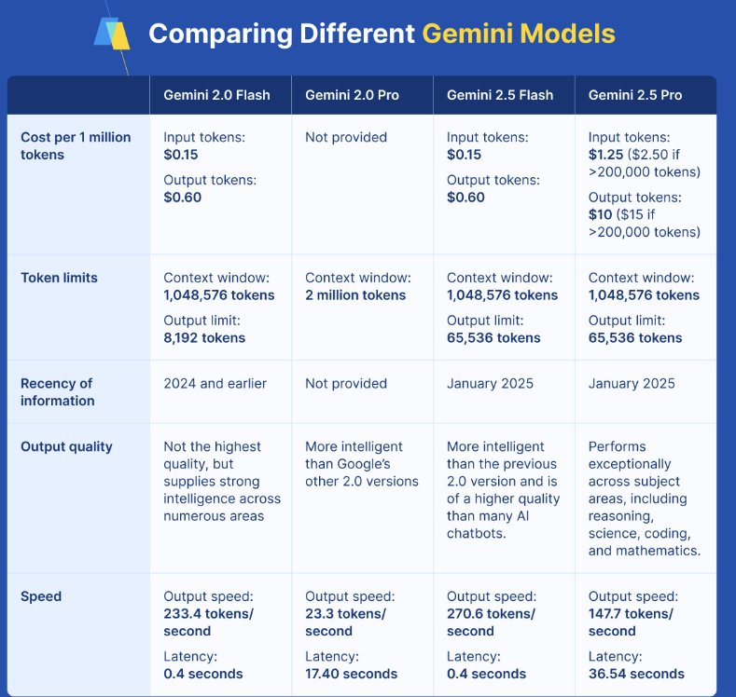

Slide 11
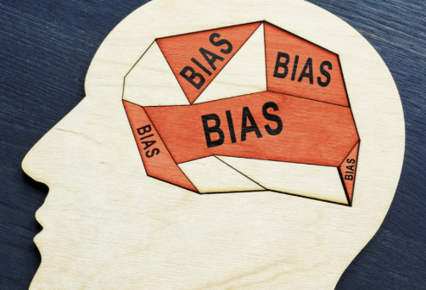
Model Bias
Model bias refers to systematic errors in an AI model that cause unfair, inaccurate, or unbalanced outputs.
It happens when the model learns biased patterns from training data, such as stereotypes or uneven representation
Bias can lead to unfair decisions, reduced accuracy, and ethical issues in real-world applications.
Mitigation requires diverse data, continuous monitoring, and responsible AI practices.

Slide 12
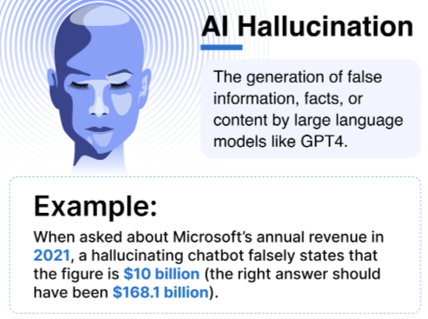

Slide 13
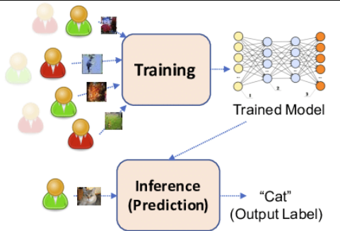
Inference
Inference is the process where an AI model uses what it has learned during training to generate outputs, such as predictions, answers, or classifications
It is the runtime phase of AI when the model is actually used by end users
Example: Giving a prompt to ChatGPT and receiving a response is an inference.

Slide 14
Temperature
Controls randomness of the model’s output.
Low temperature (0–0.3): More deterministic, focused answers.
High temperature (0.7–1+): More creative, diverse answers
Top-P
Controls randomness by choosing from the smallest group of tokens whose combined probability = P.
Example: Top-P = 0.9 → Model picks from tokens that together make up 90% probability.
Top-K
Model chooses from the top K most likely tokens every step.
Example: Top-K = 50 → Only the 50 highest-probability tokens are considered.
Fixed-size selection
Note: Temperature, Top-P, and Top-K are collectively known as sampling/decoding parameters, which control the randomness and style of text generation in AI models

Slide 15
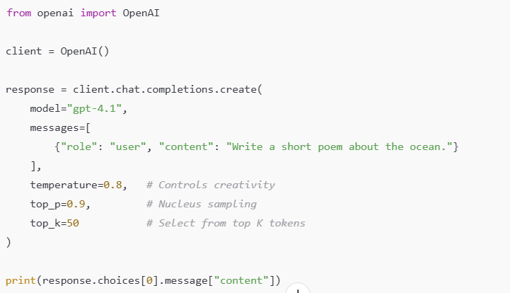
Here is a simple, clean code example showing how Temperature, Top-P, and Top-K are used together when generating text

Slide 16
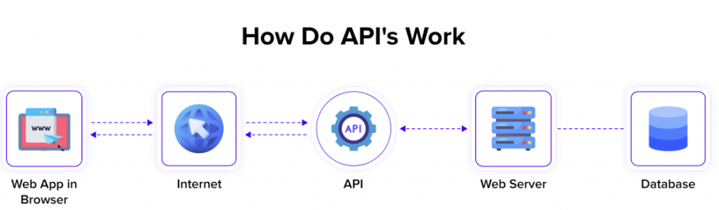
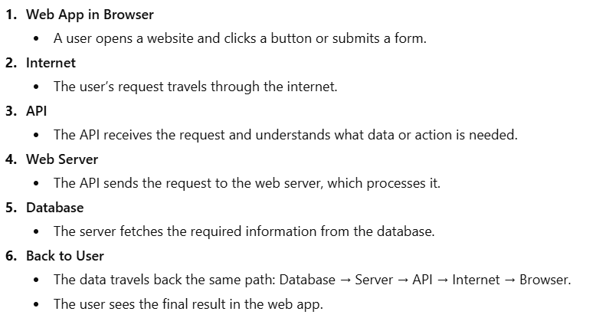

Slide 17
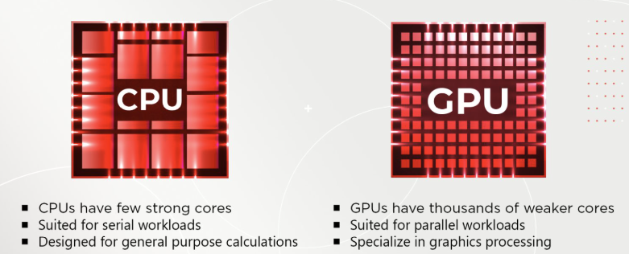
What is a GPU?
A GPU is a special computer chip built to handle many calculations at the same time
Modern GPUs are widely used in AI, machine learning, data processing, and scientific computing
They can process large amounts of data very quickly
GPUs are faster than CPUs for tasks that require parallel processing.
GPUs have thousands of smaller cores, while CPUs have only a few powerful cores
Because GPUs can split a big task into thousands of small jobs, they finish parallel workloads much faster.

Slide 18
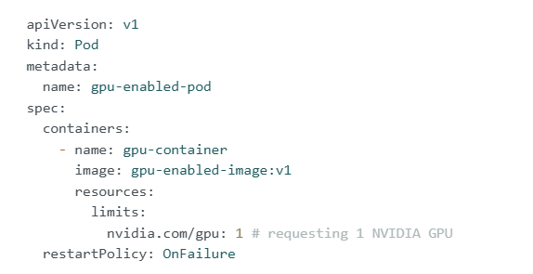
In Kubernetes, CPUs, and memory resources involve setting both requests and limits. With Kubernetes GPU, however, you can only define them in the limits section, meaning you cannot request a GPU without setting a limit. This ensures that each pod requesting a GPU has dedicated access to it.

