Slide 1
Introduction to RAG (Retrieval-Augmented Generation)

Slide 2
What is RAG?
RAG is an AI framework that combines information retrieval with text generation.
A generator (LLM) then creates answers using both the query and retrieved documents.
Helps produce more accurate and fact-based responses.
It uses a retriever to fetch relevant documents from a knowledge base.
Reduces hallucinations common in standalone LLMs.
Allows models to stay up-to-date without retraining.
Useful for Q&A systems, chatbots, research assistants, and enterprise search.

Slide 3
How RAG Works ?
User asks a question.
Retriever fetches relevant documents from a knowledge base.
Generator (LLM) combines user query and retrieved docs.
Produces a grounded and context-aware response.
1. User Query
2. Retriever
3. Generator (LLM)
4. Response

Slide 4
Components of RAG
Embeddings → Convert text into vector form so similarity search is possible (e.g.,OpenAI Embeddings , LangChain Embedding Wrappers, Hugging Face / Sentence Transformers)
Retriever → Finds the most relevant information from the knowledge base (e.g., FAISS, Pinecone, Weaviate)
Generator → The language model that creates responses using both the query and retrieved info (e.g., GPT, LLaMA, Falcon)
Knowledge Base → The source of truth containing documents, PDFs, databases, or websites
Documents → A document is a source of information the model can retrieve to respond accurately

Slide 5
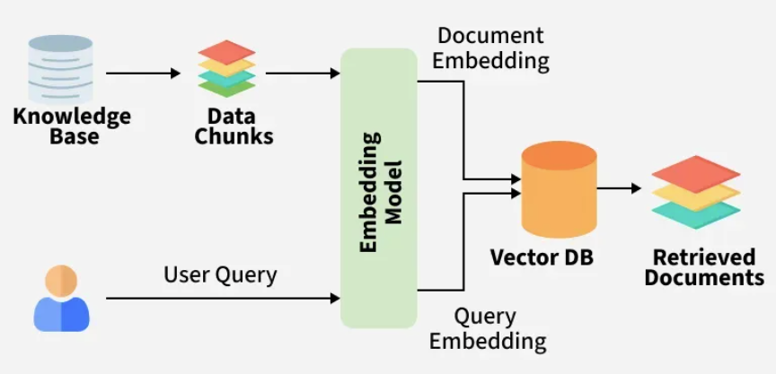
Documents in RAG
A document is a source of information the model can retrieve to respond accurately Examples:
PDFs, Word files, text files
Web pages or knowledge base articles
Database entries or FAQs
Role in RAG:
Split into smaller chunks for easier retrieval
Converted into embeddings to find relevant information quickly

Slide 6
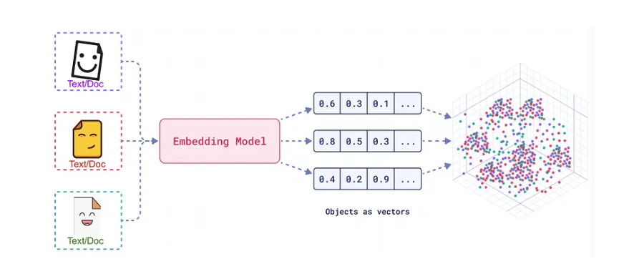
Embeddings
Embeddings represent words, sentences, or entire documents as dense vectors in a high-dimensional space.
Embeddings are numeric representations of words, sentences, or documents
The purpose of embeddings is to capture the semantic meaning of text.
Words or phrases with similar meanings are located closer to each other in this vector space. e.g. “King” and “Queen” are close in embedding space because both relate to royalty.
Each embedding is a vector (e.g., `[0.12, -0.45, 0.33, ...]`), where each number (dimension) captures some aspect of the semantic meaning of the text.

Slide 7
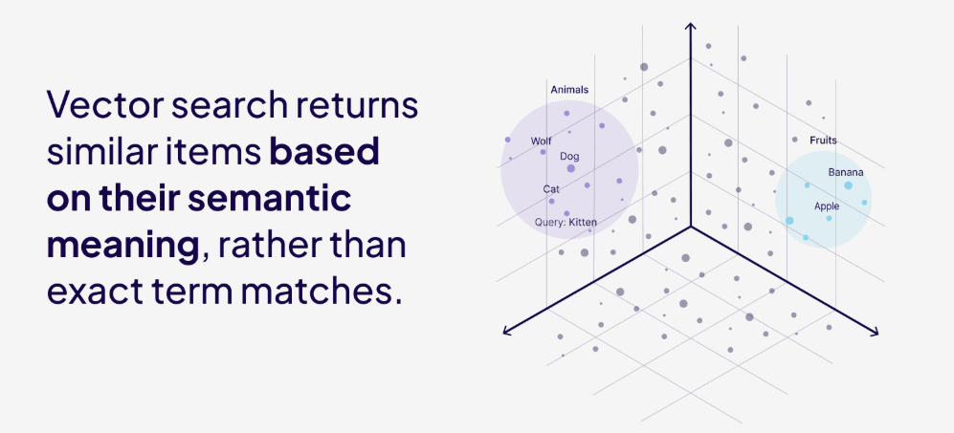
What are Vectors?
Vector embeddings are an array of numbers, which can be used as coordinates in a high-dimensional space

Slide 8
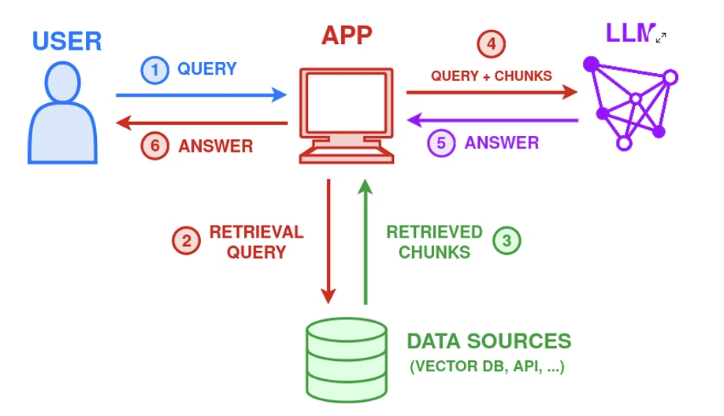
Retrievals
Retrieval is the process of finding relevant information from documents.
Helps the model access external knowledge beyond its training data.
Uses embeddings to measure similarity between a query and document chunks.
Returns the most relevant chunks to guide the answer generation.
Ensures answers are accurate, up-to-date, and context-aware.

Slide 9
Cosine Similarity Search
Cosine Similarity:
Purpose: Measure how similar two text vectors are.
It calculates the angle between two vectors.
If the angle is small → high similarity.
Value ranges from –1 to +1:
+1 → exactly similar
0 → no similarity
–1 → completely opposite
In RAG it used to find which document embeddings are closest in meaning to the query embedding.
Example: If user asks “What is AI?” → the system finds documents whose vectors have highest cosine similarity to the query vector

Slide 10
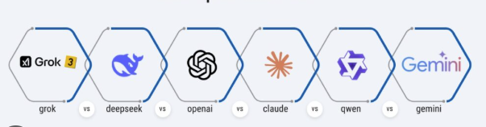
LLMs
LLM (Large Language Model) generates answers using both its internal knowledge and retrieved information.
Receives context from the retrieval step to produce accurate and relevant answers.
Combines query and retrieved documents to create a prompt for generation.
Can summarize, explain, or reason over retrieved knowledge.
Ensures answers are more precise and grounded compared to using the LLM alone.

Slide 11
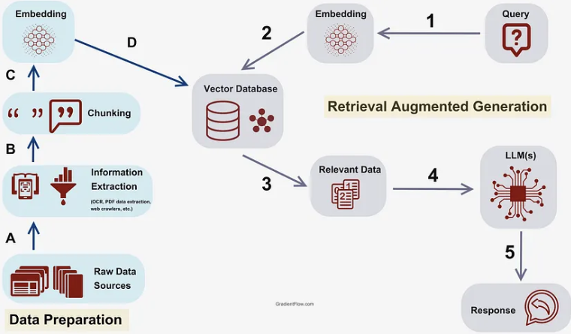
Overall Working of RAG

Slide 12
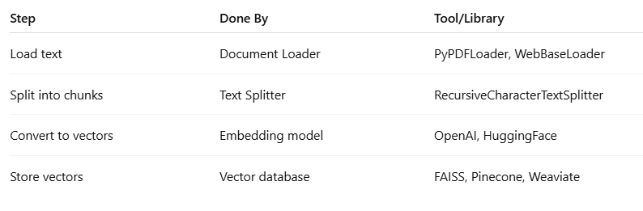
RAG Steps and few Important Python Library

Slide 13
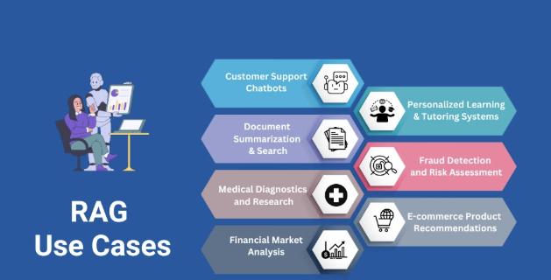

Slide 14
Questions
What is the main difference between a standard LLM response and a response generated using RAG?
How does RAG use embeddings and vector databases to improve answer relevance?
What are the key steps involved in building a RAG pipeline for a document corpus?
In which scenarios is RAG particularly more effective than a pure generative model?
What are common challenges or pitfalls when implementing RAG systems, and how can they be mitigated?

