Slide 1
TENSOR.BY ML-course 4. Forecasting for Time Series in Python
Kate Miniukovich (Data Scientist),
miniukovich@rocketscience.ai

Slide 2

Reference
Бизнес-прогнозирование
7-е издание
Джон Э. Ханк, Дин У. Уичерн, Артур Дж. Райтс

Slide 3
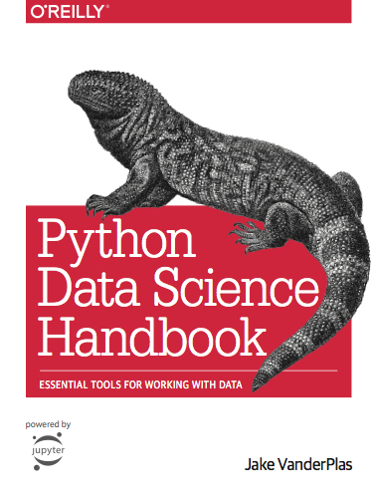
Reference
Jake VanderPlas
Python Data Science Handbook
https://jakevdp.github.io/PythonDataScienceHandbook/
03.11-Working-with-Time-Series.ipynb

Slide 4
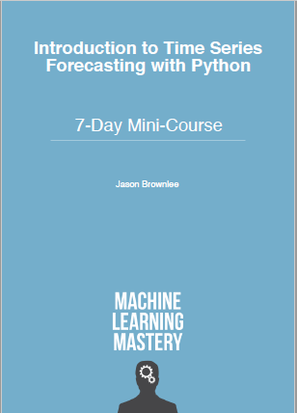
Reference
Jason Brownlee How to Create an ARIMA Model for Time Series Forecasting with Python
https://machinelearningmastery.com/arima-for-time-series-forecasting-with-python/

Slide 5
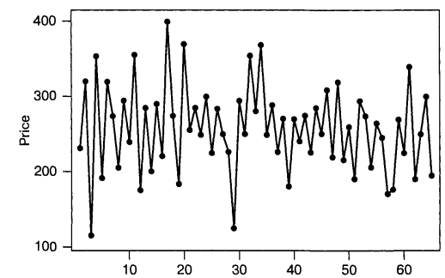
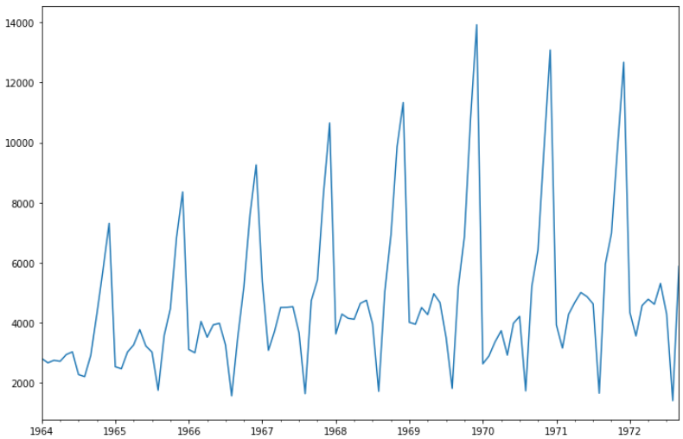
Definition
Time Series (TS) - the value represented by a set of observations that were collected at successive intervals of time.
Closing Prices for ISC Corporation Stock
Monthly sales of champagne Perrin Freres label from January 1964 to September 1972

Slide 6
Stationary and non stationary TS
Stationary TS - mean and variance don't change over time.
Non stationary TS
Trend
A long-term increase or decrease in the data.
Seasonality
There are periodic changes in the data, uniformly repeated from year to year.
Cyclicity
There are rises and falls in the data, that do not have a fixed period.

Slide 7
Forecasting for TS
Naïve methods (stationary, trend, seasonality),
Box-Jenkins methods (stationary, trend, seasonality, cyclicity),
Other methods.

Slide 8
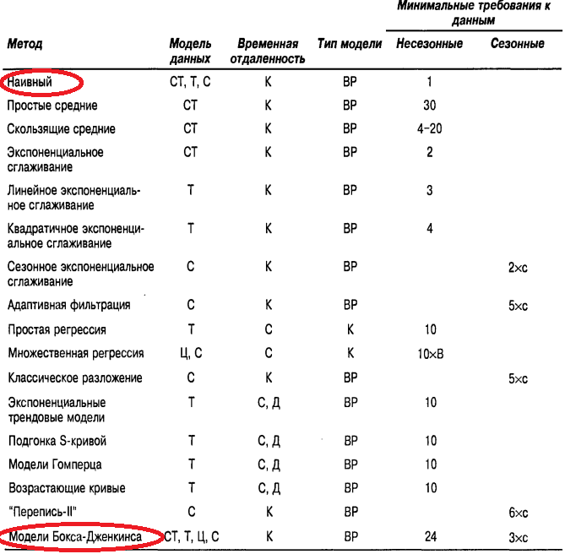
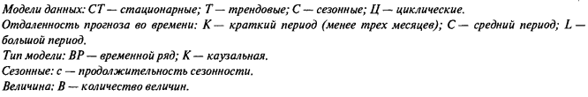
Джон Э. Ханк «Бизнес-прогнозирование» (с.108)

Slide 9

Denotes
$Y_{1}, …, Y_{t}$ – real data in time 1,…, t;
$\overline{Y}$ – mean of $Y_{1}, …, Y_{t}$;
${\hat{Y}}_{t+1}$ – forecast in time t+1

Slide 10
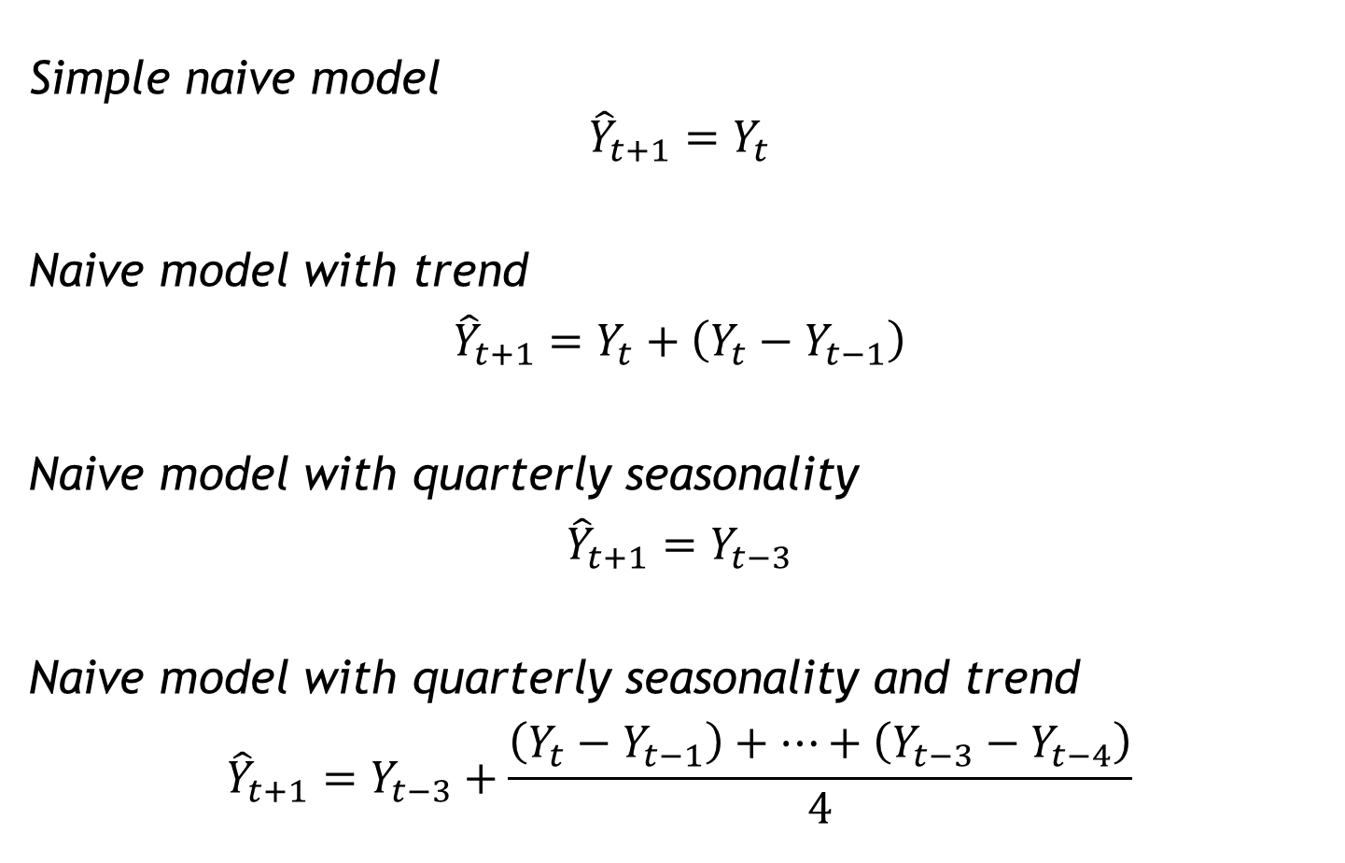
Naïve models
Simple naive model
$${\hat{Y}}_{t+1}=Y_{t}$$
Naive model with trend
$${\hat{Y}}_{t+1}=Y_{t}+\left(Y_{t}−Y_{t−1}\right)$$
Naive model with quarterly seasonality
$${\hat{Y}}_{t+1}=Y_{t−3}$$
Naive model with quarterly seasonality and trend
$${\hat{Y}}_{t+1}=Y_{t−3}+\frac{\left(Y_{t}−Y_{t−1}\right)+…+\left(Y_{t−3}−Y_{t−4}\right)}{4}$$

Slide 11
Box-Jenkins methods
Autocorrelation ???

Slide 12
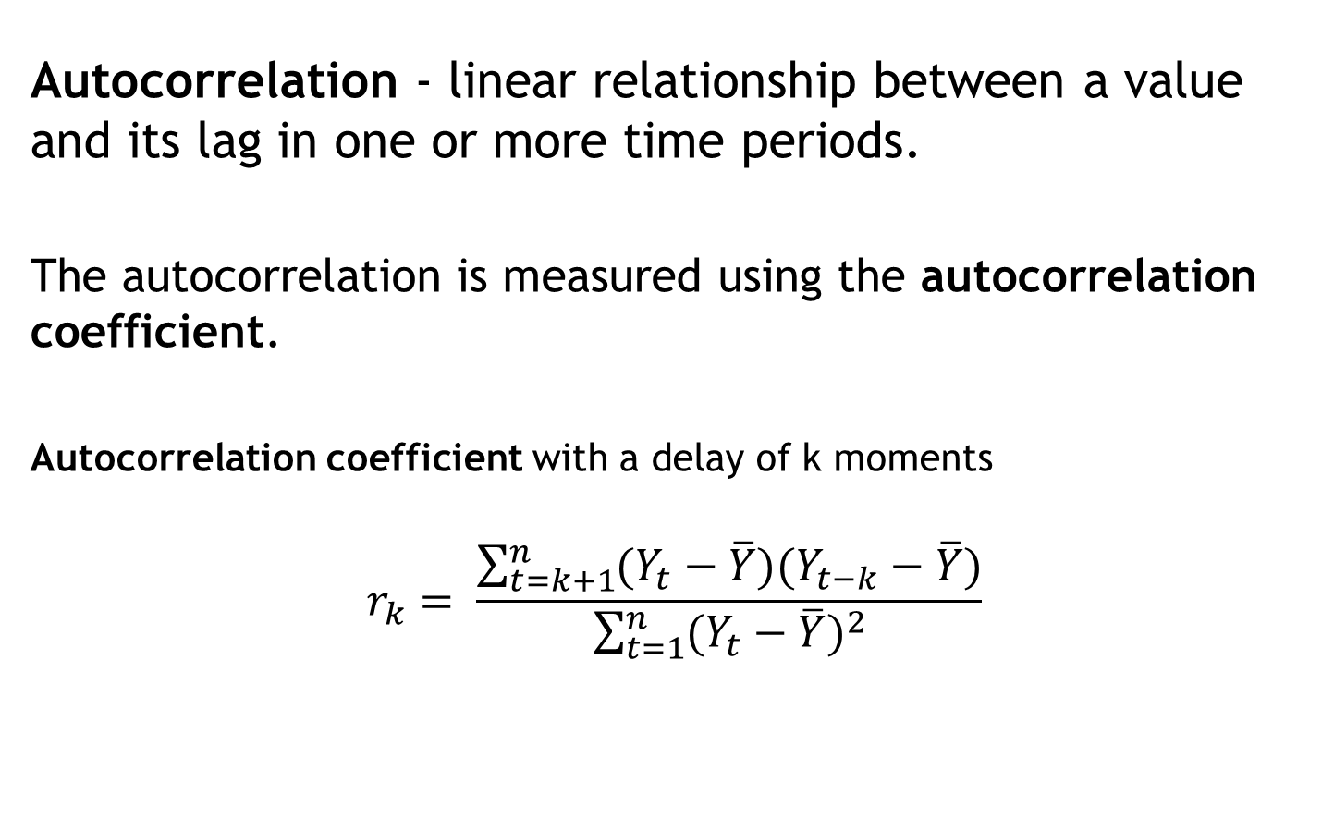
Autocorrelation
Autocorrelation - linear relationship between a value and its lag in one or more time periods.
The autocorrelation is measured using the autocorrelation coefficient.
Autocorrelation coefficient with a delay of k moments
$$r_{k}= \frac{\sum_{t=k+1}^{n}{(Y_{t}−\overline{Y})(Y_{t−k}−\overline{Y})}}{\sum_{t=1}^{n}{{(Y_{t}−\overline{Y})}^{2}}}$$

Slide 13
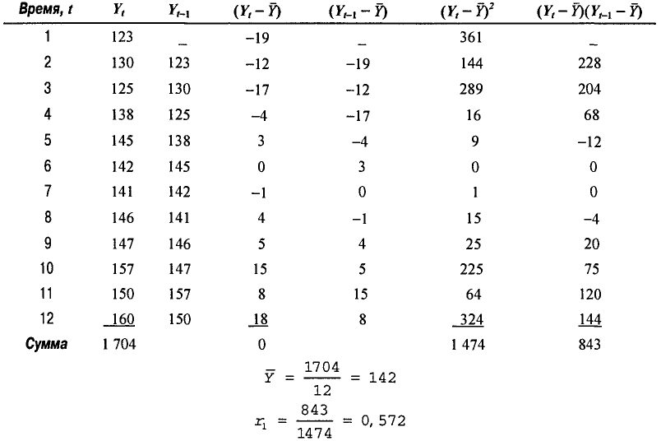
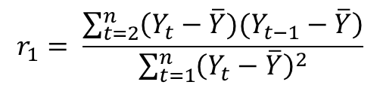
Example
$$r_{1}= \frac{\sum_{t=2}^{n}{\left(Y_{t}−\overline{Y})(Y_{t−1}−\overline{Y}\right)}}{\sum_{t=1}^{n}{{\left(Y_{t}−\overline{Y}\right)}^{2}}}$$

Slide 14
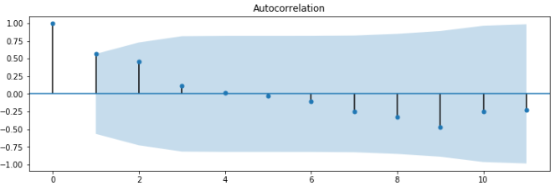
Autocorrelation plot

Slide 15
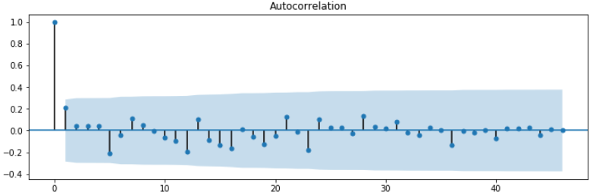
Autocorrelation plot analysis
1. If the autocorrelation coefficients for any lag k are close to zero, then there is no autocorrelation, i.e. TS is random.

Slide 16
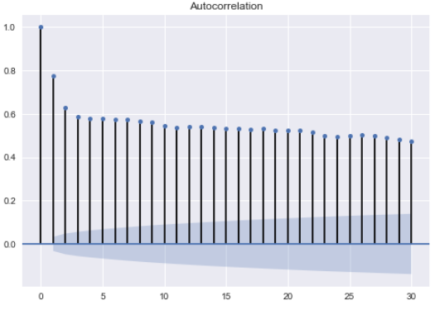
Autocorrelation plot analysis
2. If the autocorrelation coefficients for the first few periods of delay are significantly different from zero, and with the increase of the period gradually decrease to zero, then TS has a trend.

Slide 17
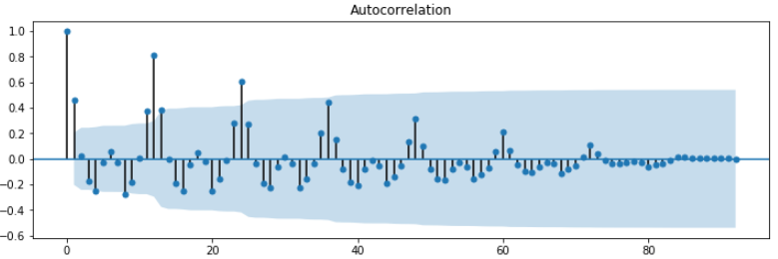
Autocorrelation plot analysis
3. If a significant coefficient of autocorrelation is observed for periods of lag equal to the seasonal period or multiples of it, then the series has seasonality.
The seasonal lag period is 4 for quarterly data and 12 for monthly.

Slide 18
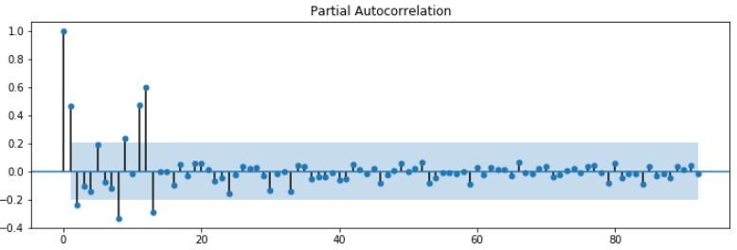
Partial Autocorrelation plot

Slide 19
Box-Jenkins methods
For stationary TS
AutoRegressive model of the order p, AR(p)
Moving Average model of the order q, MA(q)
Models with AutoRegression and Moving Average, ARMA(p, q)
For stationary and non-stationary TS
AutoRegressive Integrated Moving Average, ARIMA(p,d,q) – for stationary TS d=0

Slide 20
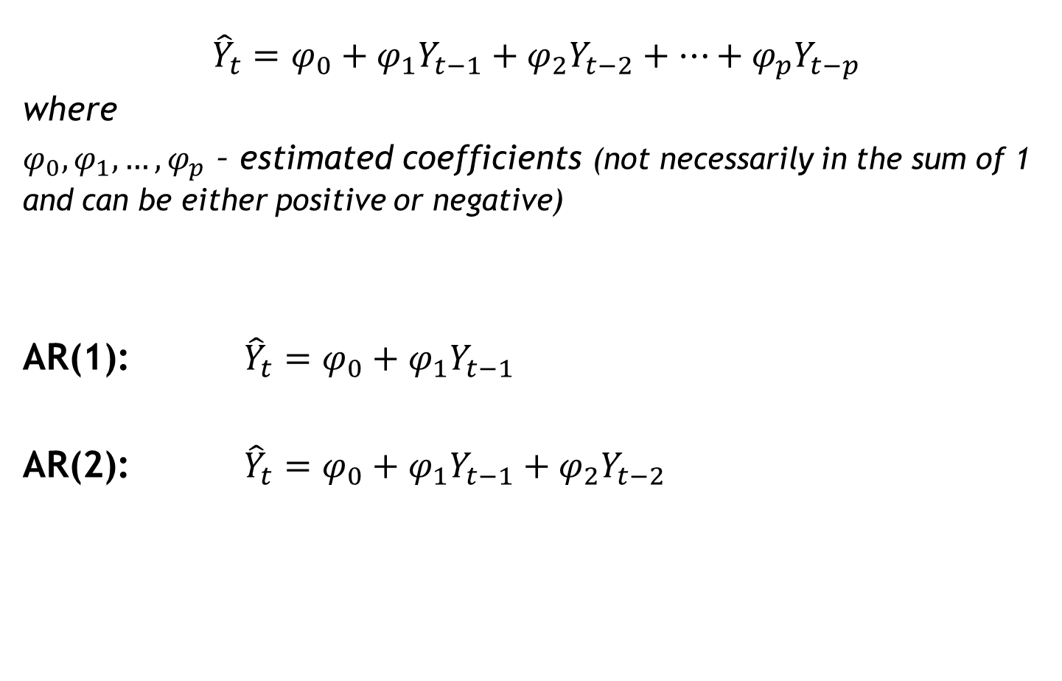
AutoRegressive model of the order p, AR(p)
$${\hat{Y}}_{t}=φ_{0}+{φ_{1}Y}_{t−1}+{φ_{2}Y}_{t−2}+…+{φ_{p}Y}_{t−p}$$
where
$φ_{0}, φ_{1}, …, φ_{p}$ – estimated coefficients (not necessarily in the sum of 1 and can be either positive or negative)
AR(1): ${\hat{Y}}_{t}=φ_{0}+{φ_{1}Y}_{t−1}$
AR(2): ${\hat{Y}}_{t}=φ_{0}+{φ_{1}Y}_{t−1}+{φ_{2}Y}_{t−2}$

Slide 21
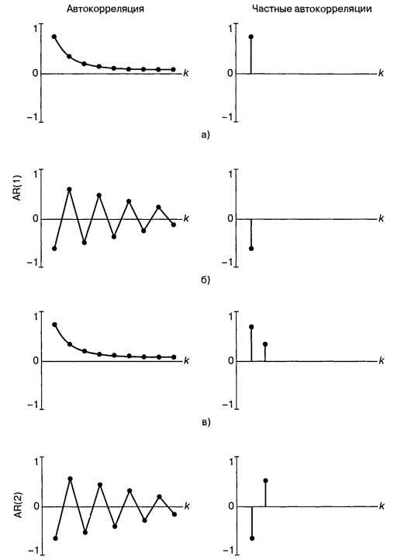
Autocorrelation and Partial Autocorrelation plots for AR(1) and AR(2)

Slide 22
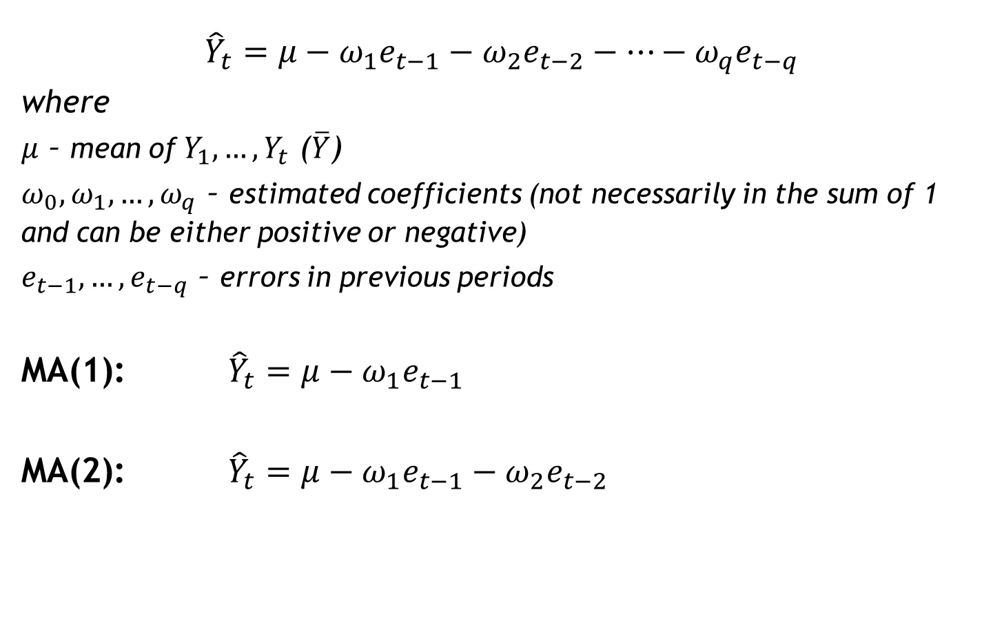
Moving Average model of the order q, MA(q)
$${\hat{Y}}_{t}=μ−{ω_{1}e}_{t−1}−{ω_{2}e}_{t−2}−…−{ω_{q}e}_{t−q}$$
where
$μ$ – mean of $Y_{1}, …, Y_{t}$ ($\overline{Y}$)
$ω_{0}, ω_{1}, …, ω_{q}$ – estimated coefficients (not necessarily in the sum of 1 and can be either positive or negative)
$e_{t−1}, …, e_{t−q}$ – errors in previous periods
MA(1): ${\hat{Y}}_{t}=μ−{ω_{1}e}_{t−1}$
MA(2): ${\hat{Y}}_{t}=μ−{ω_{1}e}_{t−1}−{ω_{2}e}_{t−2}$

Slide 23
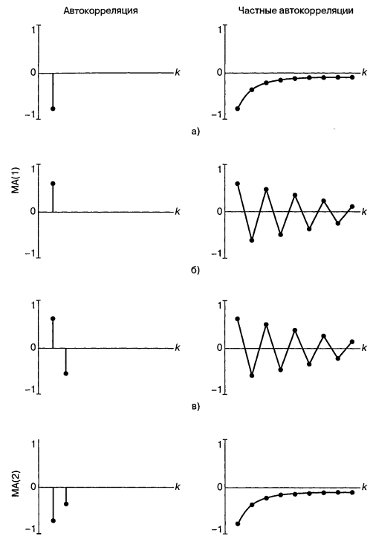
Autocorrelation and Partial Autocorrelation plots for MA(1) and MA(2)

Slide 24

Models with AutoRegression and Moving Average, ARMA(p, q)
$${\hat{Y}}_{t}=φ_{0}+{φ_{1}Y}_{t−1}+{φ_{2}Y}_{t−2}+…+{φ_{p}Y}_{t−p}+μ−{ω_{1}e}_{t−1}−{ω_{2}e}_{t−2}−…−{ω_{q}e}_{t−q}$$
ARMA(1,1): ${\hat{Y}}_{t}=φ_{0}+{φ_{1}Y}_{t−1}+μ−{ω_{1}e}_{t−1}$

Slide 25
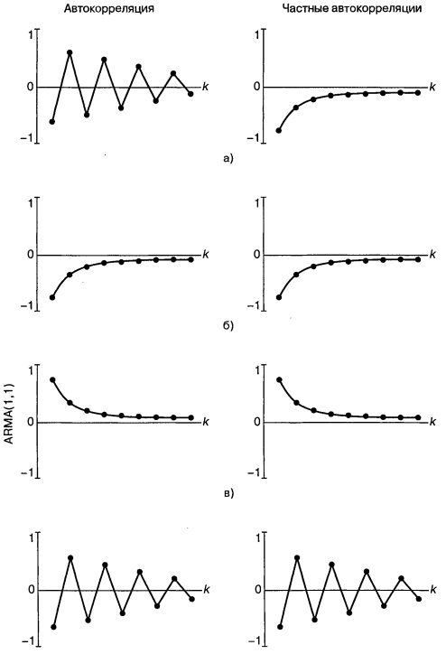
Autocorrelation and Partial Autocorrelation plots for ARMA(1,1)

Slide 26
Autocorrelation and Partial Autocorrelation plots for MA(q), AR(p), ARMA(p,q)
Model | Autocorrelation | Partial Autocorrelation
MA(q) | Terminates at step q | Smoothly tends to zero
AR(p) | Smoothly tends to zero | Terminates at step p
ARMA(p,q) | Smoothly tends to zero | Smoothly tends to zero

Slide 27
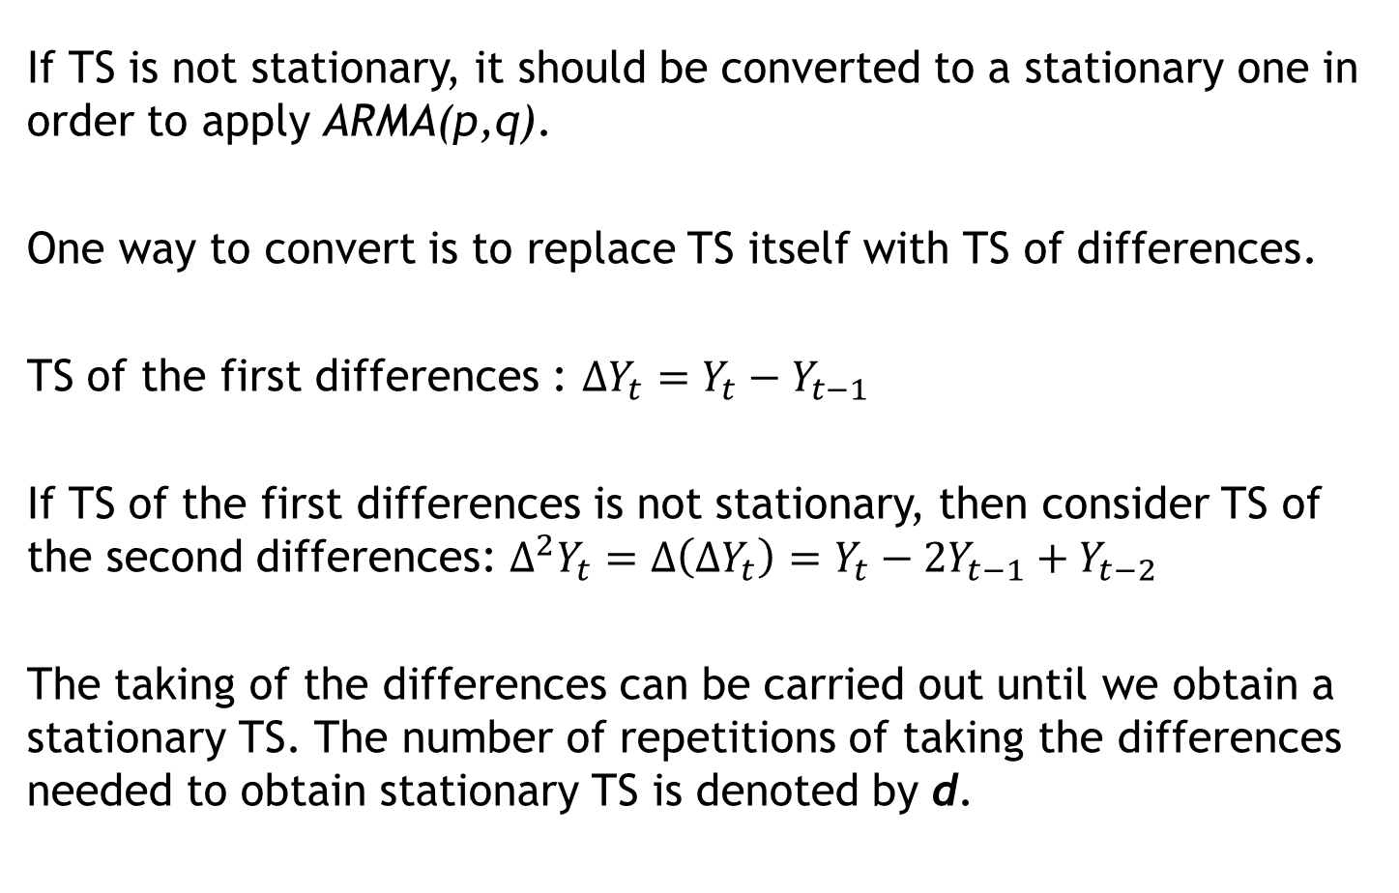
AutoRegressive Integrated Moving Average, ARIMA(p,d,q)
If TS is not stationary, it should be converted to a stationary one in order to apply ARMA(p,q).
One way to convert is to replace TS itself with TS of differences.
TS of the first differences : $∆Y_{t}=Y_{t}−Y_{t−1}$
If TS of the first differences is not stationary, then consider TS of the second differences: $∆^{2}Y_{t}=∆\left(∆Y_{t}\right)=Y_{t}−2Y_{t−1}+Y_{t−2}$
The taking of the differences can be carried out until we obtain a stationary TS. The number of repetitions of taking the differences needed to obtain stationary TS is denoted by d.

Slide 28
How to understand that TS is not stationary?
TS plot demonstrates trend or seasonality or cyclicity in data.
Autocorrelation and Partial Autocorrelation plots demonstrate the absence of a rapid disappearance of coefficients.
Augmented Dickey–Fuller test

Slide 29
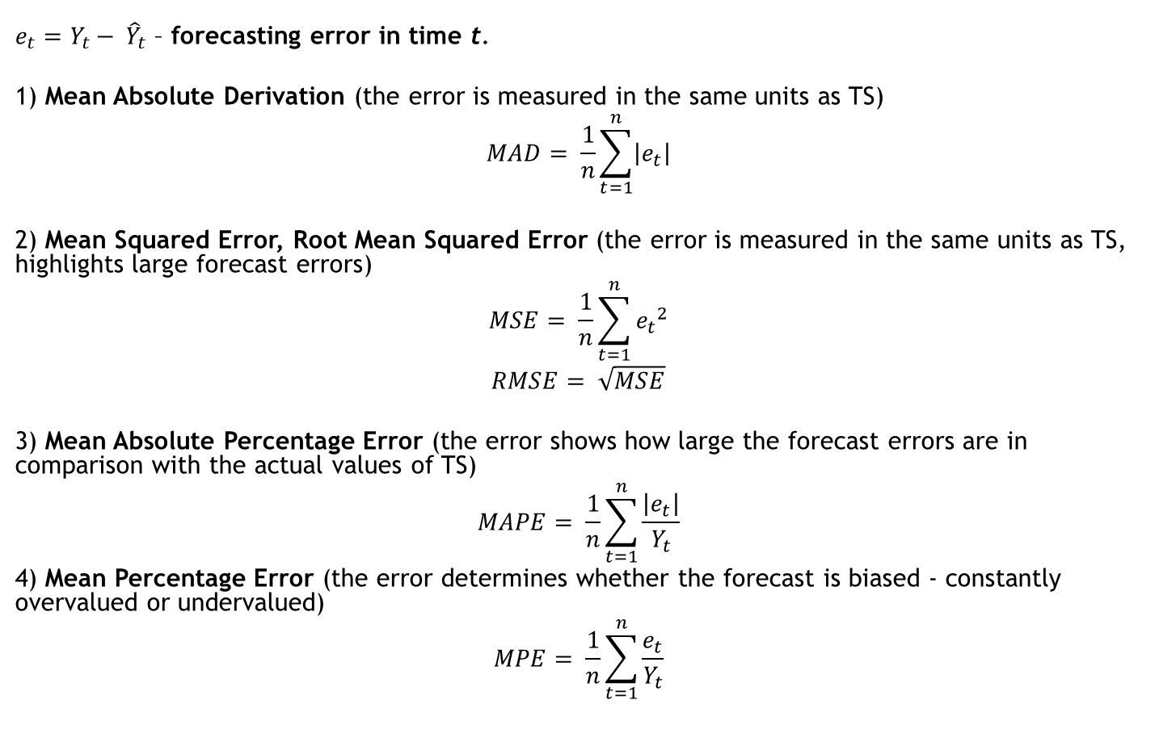
Forecasting errors. Models performance
$e_{t}=Y_{t}− {\hat{Y}}_{t}$ – forecasting error in time t.
1) Mean Absolute Derivation (the error is measured in the same units as TS)
$$MAD= \frac{1}{n}\sum_{t=1}^{n}{\left|e_{t}\right|}$$
2) Mean Squared Error, Root Mean Squared Error (the error is measured in the same units as TS, highlights large forecast errors)
$$MSE= \frac{1}{n}\sum_{t=1}^{n}{{e_{t}}^{2}}$$
$$RMSE= \sqrt{MSE}$$
3) Mean Absolute Percentage Error (the error shows how large the forecast errors are in comparison with the actual values of TS)
$$MAPE= \frac{1}{n}\sum_{t=1}^{n}{\frac{\left|e_{t}\right|}{Y_{t}}}$$
4) Mean Percentage Error (the error determines whether the forecast is biased - constantly overvalued or undervalued)
$$MPE= \frac{1}{n}\sum_{t=1}^{n}{\frac{e_{t}}{Y_{t}}}$$

Slide 30
Building ARIMA(p,d,q)
Step 1. Determining p, d, q
Step 2. Finding model coefficients using train data, prediction on valid data, check performance (e.g. RMSE)
Step 3. Verifying model based on prediction errors analysis
If a model isn’t adequate, go to step 1, otherwise model is ready to use.
?! Hyperparameters Gridsearch instead of step 1

Slide 31
Forecasting for TS
Example: models for Champagne dataset
Models comparison based on RMSE
Model | Valid
Simple naive | 3186.501
Naive with trend
Naive with seasonality
Naive with trend and seasonality
ARIMA(1,1,1) | 951.260
Best grid result – ARIMA(0,0,1)

Slide 32
Q & A Thank you!

