Slide 1
TENSOR.BY ML-course 2. Regression in Python Scikit-learn
Kate Miniukovich (Data Scientist),
miniukovich@rocketscience.ai

Slide 2
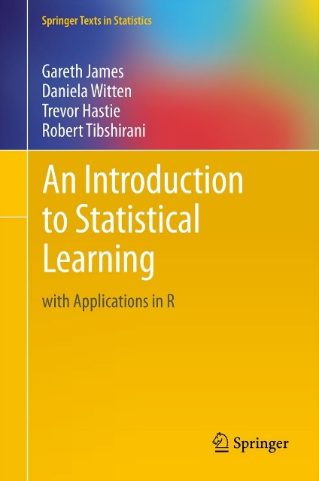
Reference
An Introduction to Statistical Learning by Gareth James, Daniela Witten, Trevor Hastie, and Robert Tibshirani, http://www-bcf.usc.edu/~gareth/ISL/ (available online for free)

Slide 3
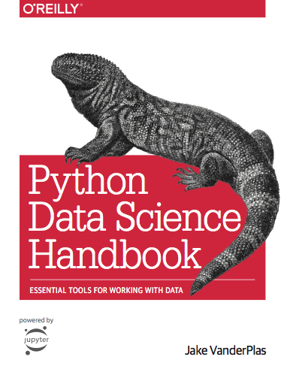
Reference
Jake VanderPlas
Python Data Science Handbook
https://jakevdp.github.io/PythonDataScienceHandbook/
Video
https://www.youtube.com/watch?v=L7R4HUQ-eQ0&t=6033s

Slide 4
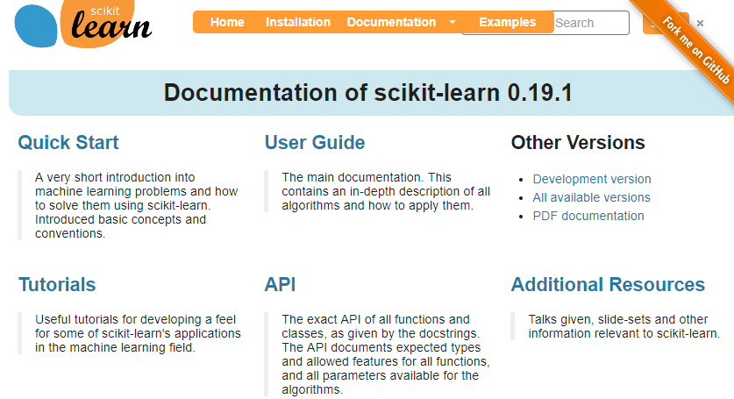
Reference
http://scikit-learn.org

Slide 5
Supervised vs. Unsupervised Learning
Supervised Data: 1) n observations; 2) p variables X1, X2, . . .,Xp, measured on each observation; 3) response Y measured on same n observations Y Continuous Discrete Regression Classification | Unsupervised Data: 1) n observations; 2) p variables X1, X2, . . .,Xp, measured on each observation Clustering…

Slide 6
Regression / Classification Problem
Steps to solve
Working with data
Modeling
ML-course. Regression

Slide 7
Representation of data in Scikit-learn
X
two-dimensional numpy arrays
shape – (n_samples, n_features)
Y
one-dimensional numpy arrays
shape – (n_samples, )
ML-course. Regression

Slide 8
Modeling
Choose a class of model
Fit the model to data
Validate the model and optimize hyperparameters
Predict for unknown data
ML-course. Regression

Slide 9


Mathematical model
f is some fixed but unknown function of X1, . . . , Xp, and e is a random error term, which is independent of X and has mean zero. In this formulation, f represents the systematic information that X provides about Y .
We can predict Y using our estimate for f
ML-course. Regression

Slide 10
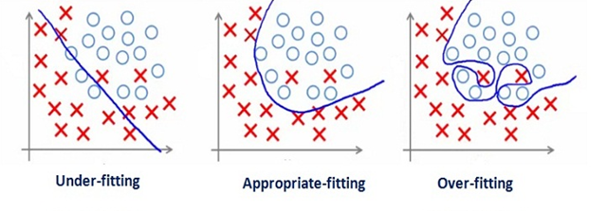
Bias-Variance Trade-Off
Underfitting (high bias) - algorithm is missing the relevant relations between features and target outputs
Overfitting (high variance) - modeling the random noise in the training data, rather than the intended outputs.
ML-course. Regression

Slide 11
Model validation
Data
train + test (e.g. 75% + 25%)
train + valid + test (e.g. 60% + 20% + 20%)
train with cross-validation + test (e.g. 80% + 20% )
Metrics
Regression: R^2, MSE, MAE,…
http://scikit-learn.org/stable/modules/classes.html#sklearn-metrics-metricsmodel.score()
ML-course. Regression

Slide 12
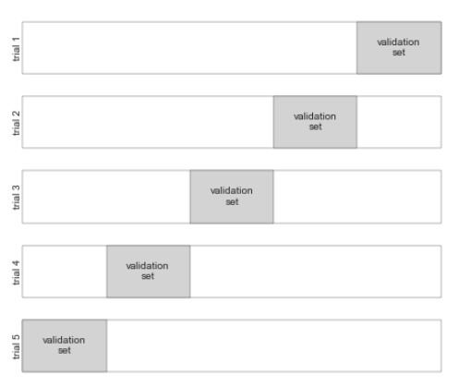
Model validation via cross-validation
ML-course. Regression

Slide 13
Some models for Regression in Python scikit-learn
Generalized Linear Models
Linear Regression
Ridge regression
Lasso regression
example of Linear, Ridge and Lasso Regressions in regression.ipynb
Ensemble methods
Random Forests
Gradient Tree Boosting
ML-course. Regression

Slide 14
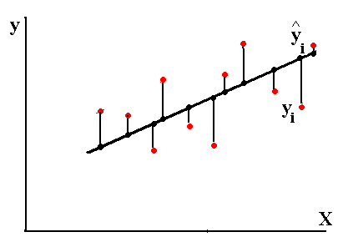
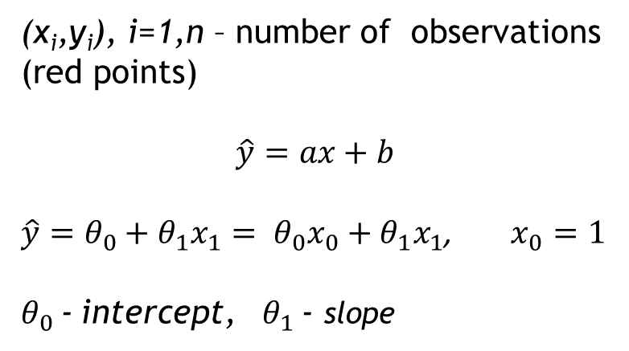
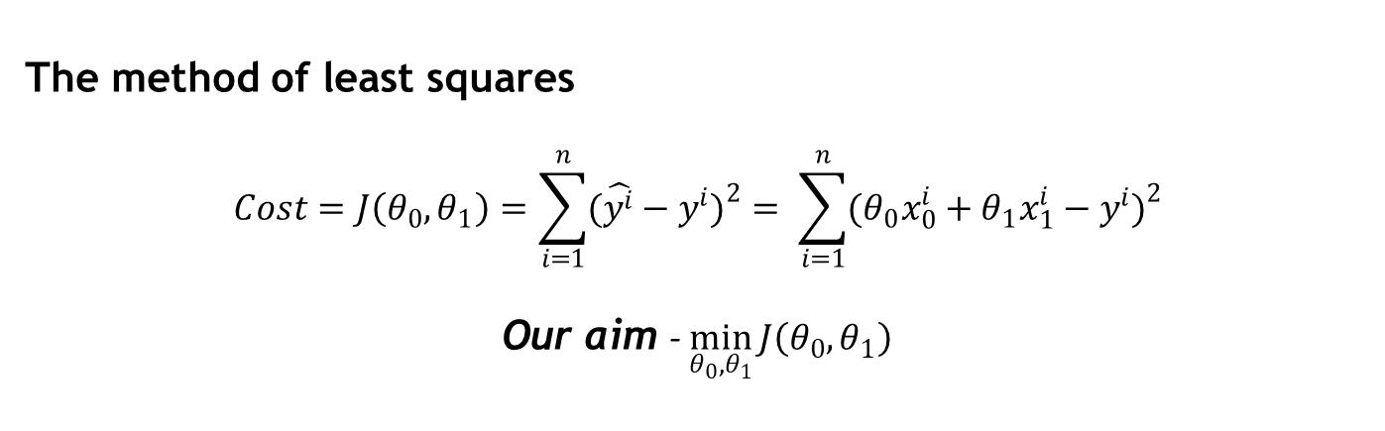
Linear Regression with one variable
(x_{i},y_{i}), i=1,n – number of observations (red points)
$$\hat{y}=ax+b$$
$\hat{y}=θ_{0}+θ_{1}x_{1}= θ_{0}x_{0}+θ_{1}x_{1}$, $x_{0}=1$
$θ_{0}$ - intercept, $θ_{1}$ - slope
The method of least squares
$$Cost=J\left(θ_{0},θ_{1}\right)=\sum_{i=1}^{n}{(\hat{y^{i}}−y^{i}})^{2}= \sum_{i=1}^{n}{(θ_{0}x_{0}^{i}+θ_{1}x_{1}^{i}−y^{i})^{2}}$$
Our aim - $\min_{θ_{0},θ_{1}}{J\left(θ_{0},θ_{1}\right)}$
ML-course. Regression

Slide 15
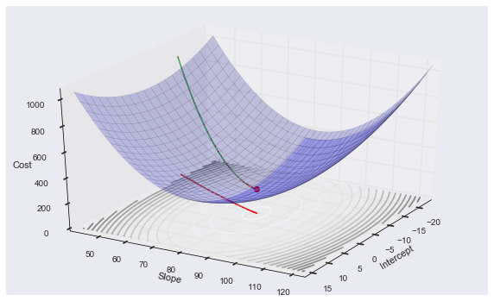
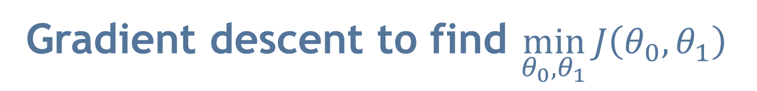
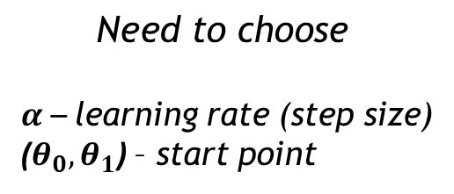
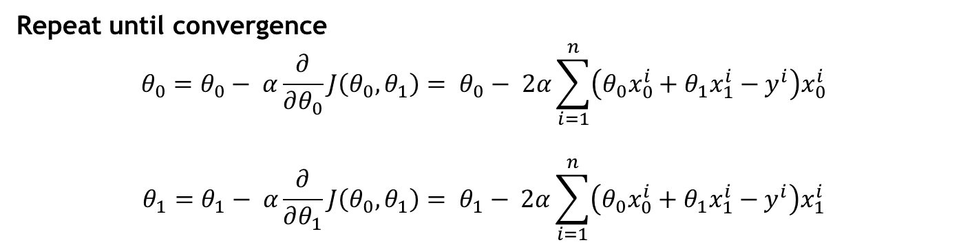
Gradient descent to find $\min_{θ_{0},θ_{1}}{J\left(θ_{0},θ_{1}\right)}$
$$\text{Need} \text{to} \text{choose}$$
$α$ – learning rate (step size)
($θ_{0},θ_{1}$) – start point
Repeat until convergence
$$θ_{0}=θ_{0}− α\frac{∂}{∂θ_{0}}J\left(θ_{0},θ_{1}\right)= θ_{0}− 2α\sum_{i=1}^{n}{\left(θ_{0}x_{0}^{i}+θ_{1}x_{1}^{i}−y^{i}\right)x_{0}^{i}}$$
$$θ_{1}=θ_{1}− α\frac{∂}{∂θ_{1}}J\left(θ_{0},θ_{1}\right)= θ_{1}− 2α\sum_{i=1}^{n}{\left(θ_{0}x_{0}^{i}+θ_{1}x_{1}^{i}−y^{i}\right)x_{1}^{i}}$$
ML-course. Regression

Slide 16
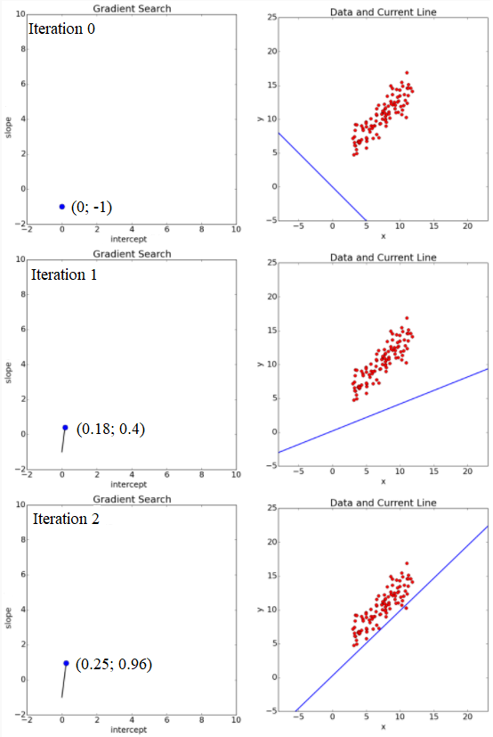
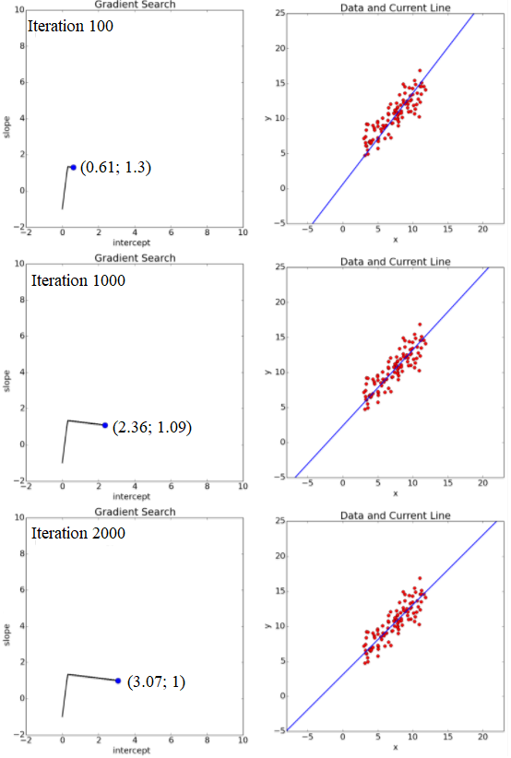
Gradient descent (example)
ML-course. Regression

Slide 17
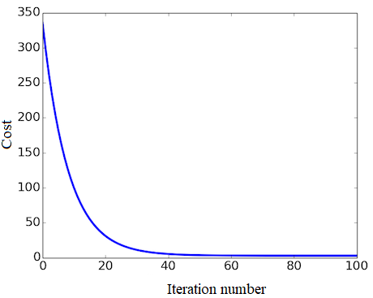
Gradient descent (example)
17
ML-course. Regression

Slide 18
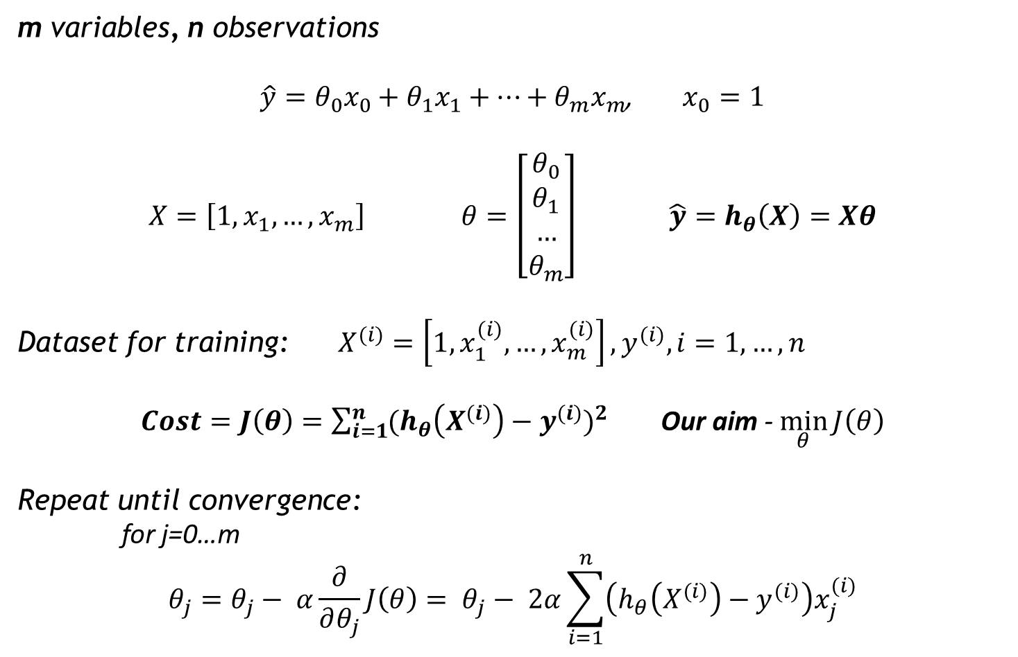
Linear Regression with multiple variables
m variables, n observations
$\hat{y}=θ_{0}x_{0}+θ_{1}x_{1}+…+θ_{m}x_{m}$, $x_{0}=1$
$X=\left[1, x_{1}, …, x_{m}\right]$ $θ=\left[\begin{aligned}θ_{0} \\ θ_{1} \\ … \\ θ_{m}\end{aligned}\right]$ $\hat{y}=h_{θ}\left(X\right)=Xθ$
Dataset for training: $X^{(i)}=\left[1, x_{1}^{(i)}, …, x_{m}^{(i)}\right], y^{(i)}, i=1,…,n$
$Cost=J\left(θ\right)=\sum_{i=1}^{n}{(h_{θ}\left(X^{(i)}\right)−y^{(i)}})^{2}$ Our aim - $\min_{θ}{J\left(θ\right)}$
Repeat until convergence:
for j=0…m
$$θ_{j}=θ_{j}− α\frac{∂}{∂θ_{j}}J\left(θ\right)= θ_{j}− 2α\sum_{i=1}^{n}{\left(h_{θ}\left(X^{(i)}\right)−y^{(i)}\right)x_{j}^{(i)}}$$
ML-course. Regression and Classification 2018

Slide 19
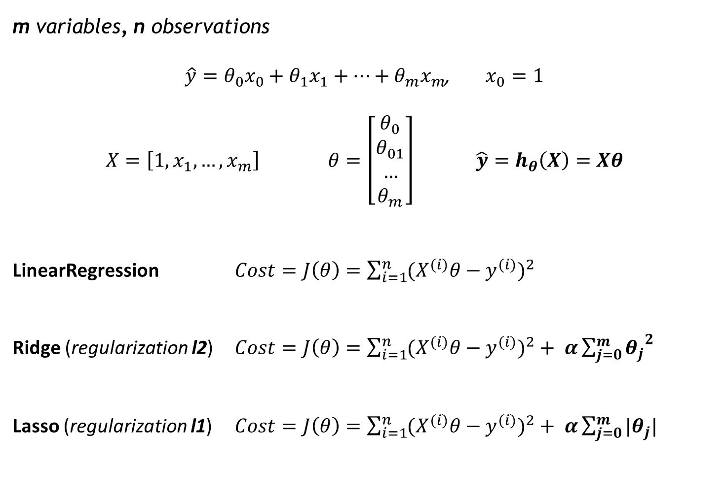
Cost functions for LinearRegression, Ridge and Lasso in scikit-learn
m variables, n observations
$\hat{y}=θ_{0}x_{0}+θ_{1}x_{1}+…+θ_{m}x_{m}$, $x_{0}=1$
$X=\left[1, x_{1}, …, x_{m}\right]$ $θ=\left[\begin{aligned}θ_{0} \\ θ_{01} \\ … \\ θ_{m}\end{aligned}\right]$ $\hat{y}=h_{θ}\left(X\right)=Xθ$
LinearRegression $Cost=J\left(θ\right)=\sum_{i=1}^{n}{(X^{(i)}θ−y^{(i)}})^{2}$
Ridge (regularization l2) $Cost=J\left(θ\right)=\sum_{i=1}^{n}{(X^{(i)}θ−y^{(i)}})^{2}+ α\sum_{j=0}^{m}{{θ_{j}}^{2}}$
Lasso (regularization l1) $Cost=J\left(θ\right)=\sum_{i=1}^{n}{(X^{(i)}θ−y^{(i)}})^{2}+ α\sum_{j=0}^{m}{{|θ}_{j}|}$
ML-course. Regression

Slide 20
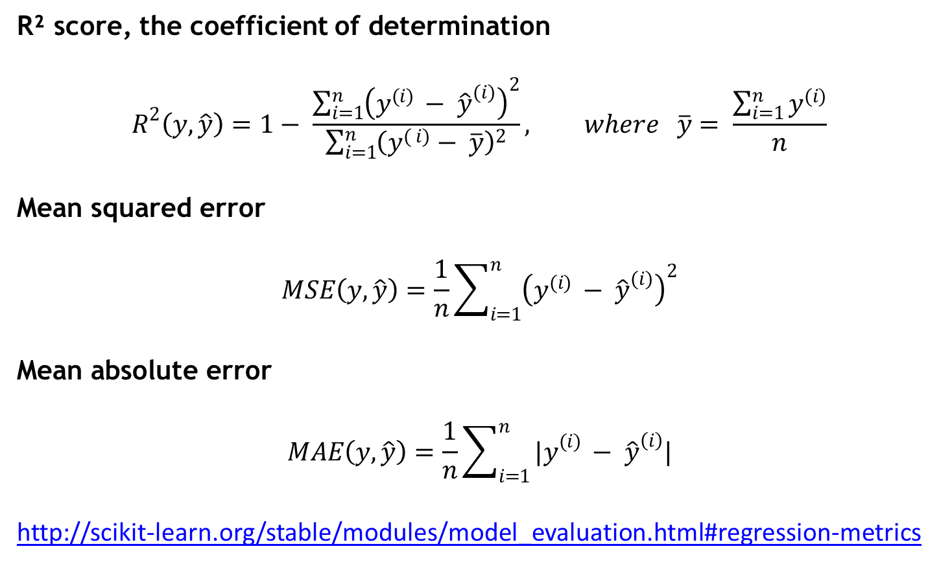
Regression metrics
R² score, the coefficient of determination
$$R^{2}\left(y, \hat{y}\right)=1− \frac{\sum_{i=1}^{n}{{\left(y^{(i) }− {\hat{y}}^{(i)}\right)}^{2}}}{\sum_{i=1}^{n}{{\left(y^{( i)}− \overline{y}\right)}^{2}}}, where \overline{y}= \frac{\sum_{i=1}^{n}{y^{(i)}}}{n}$$
Mean squared error
$$MSE\left(y, \hat{y}\right)=\frac{1}{n}\sum_{i=1}^{n}{{\left(y^{(i) }− {\hat{y}}^{(i)}\right)}^{2}}$$
Mean absolute error
$$MAE\left(y, \hat{y}\right)=\frac{1}{n}\sum_{i=1}^{n}{{|y}^{(i) }− {\hat{y}}^{\left(i\right)}|}$$
http://scikit-learn.org/stable/modules/model_evaluation.html#regression-metrics
ML-course. Regression

Slide 21
Choose the best model
Models | R^2
 | train | test
LinearRegression() | 0.73 | 0.75
LinearRegression(normalize = True)
LinearRegression with PolynomialFeatures
n=2
n=3
Ridge with PolynomialFeatures
a=0.1, n=2
a=0.1, n=3
a=100 000 000, n=3
Lasso with PolynomialFeatures
n=2
a=0.001
a=1
n=3
a=0.001
a=1
a=100
ML-course. Regression

Slide 22
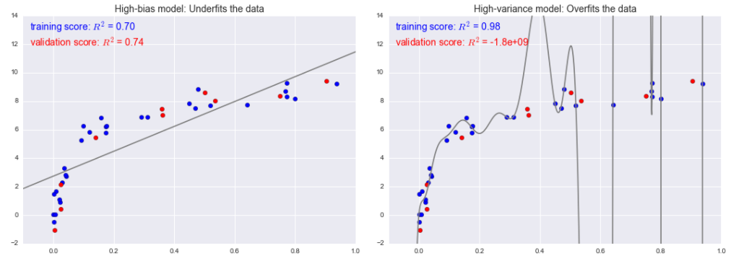
Bias-Variance Trade-Off
For high-bias models, the performance of the model on the validation set is similar to the performance on the training set (but the performance is worse than for appropriate fitting).
For high-variance models, the performance of the model on the validation set is far worse than the performance on the training set.
ML-course. Regression

Slide 23
Bias-Variance Trade-Off
What to do in case of high-bias or high variance?
Change
Model complexity (e.g. via regularization)
Quantity of training samples
Set of features
Reading
Jake VanderPlas Python Data Science Handbook (05.03-Hyperparameters-and-Model-Validation)
Andrew Ng ML: Advice for Applying Machine Learning
ML-course. Regression

Slide 24
Ways to fix high bias/variance in linear models
High bias (underfitting) | High variance (overfitting)
Add more features Add polynomial features | More training examples Smaller set of features Use regularization Increase regularization strength (coefficient)
ML-course. Regression

Slide 25
Q & A Thank you!

