Slide 1
TENSOR.BY ML-course 2. Regression in Python Scikit-learn
Kate Miniukovich (Data Scientist),
miniukovich@rocketscience.ai

Slide 2
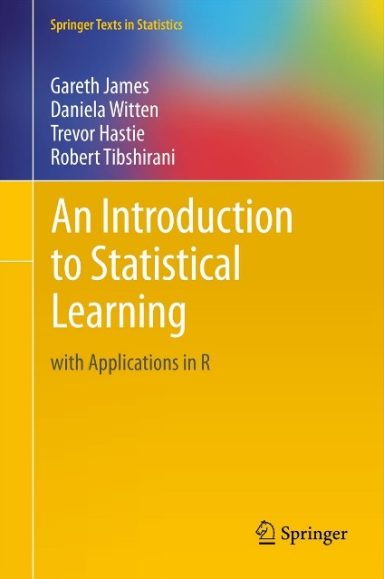
Reference
An Introduction to Statistical Learning by Gareth James, Daniela Witten, Trevor Hastie, and Robert Tibshirani, http://www-bcf.usc.edu/~gareth/ISL/ (available online for free)

Slide 3
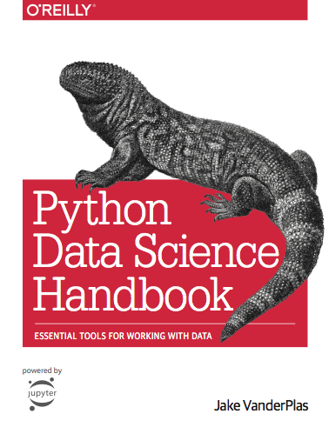
Reference
Jake VanderPlas
Python Data Science Handbook
https://jakevdp.github.io/PythonDataScienceHandbook/
Video
https://www.youtube.com/watch?v=L7R4HUQ-eQ0&t=6033s

Slide 4
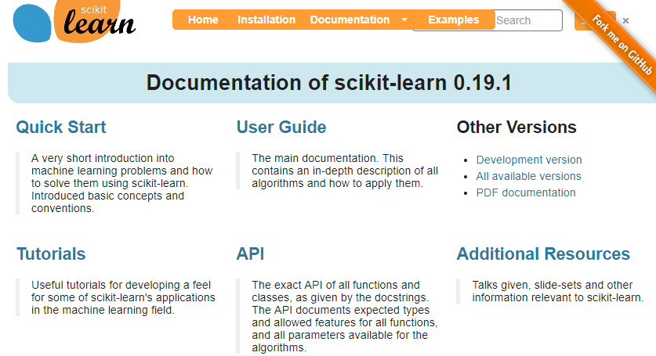
Reference
http://scikit-learn.org

Slide 5
Supervised vs. Unsupervised Learning
Supervised Data: 1) n observations; 2) p variables X1, X2, . . .,Xp, measured on each observation; 3) response Y measured on same n observations Y Continuous Discrete Regression Classification | Unsupervised Data: 1) n observations; 2) p variables X1, X2, . . .,Xp, measured on each observation Clustering…

Slide 6
Regression / Classification Problem
Steps to solve
Working with data
Modeling
ML-course. Regression

Slide 7
Representation of data in Scikit-learn
X
two-dimensional numpy arrays
shape – (n_samples, n_features)
Y
one-dimensional numpy arrays
shape – (n_samples, )
ML-course. Regression

Slide 8
Modeling
Choose a class of model
Fit the model to data
Validate the model and optimize hyperparameters
Predict for unknown data
ML-course. Regression

Slide 9


Mathematical model
f is some fixed but unknown function of X1, . . . , Xp, and e is a random error term, which is independent of X and has mean zero. In this formulation, f represents the systematic information that X provides about Y .
We can predict Y using our estimate for f
ML-course. Regression

Slide 10
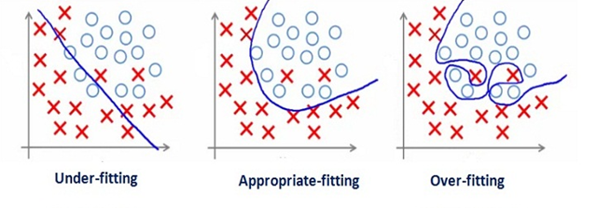
Bias-Variance Trade-Off
Underfitting (high bias) - algorithm is missing the relevant relations between features and target outputs
Overfitting (high variance) - modeling the random noise in the training data, rather than the intended outputs.
ML-course. Regression

Slide 11
Model validation
Data
train + test (e.g. 75% + 25%)
cross-validation
Metrics
Regression: R^2, MSE, MAE,…
http://scikit-learn.org/stable/modules/classes.html#sklearn-metrics-metricsmodel.score()
ML-course. Regression

Slide 12
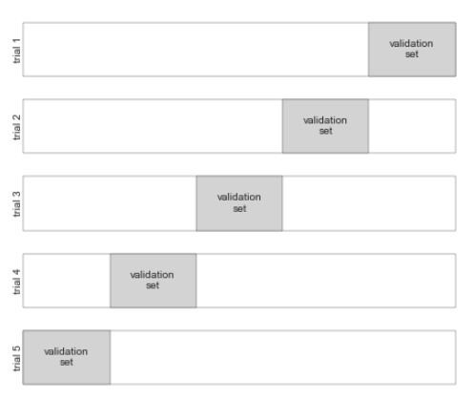
Model validation via cross-validation
ML-course. Regression

Slide 13
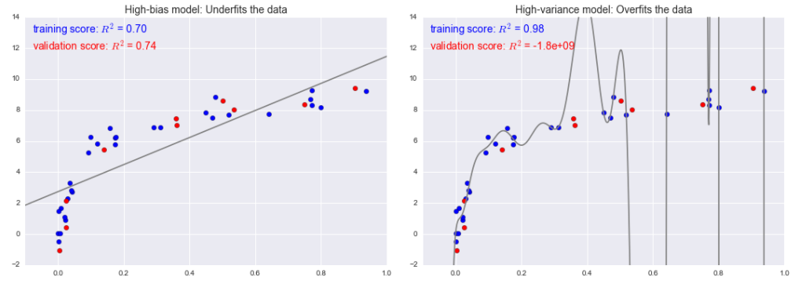
Bias-Variance Trade-Off
For high-bias models, the performance of the model on the validation set is similar to the performance on the training set.
For high-variance models, the performance of the model on the validation set is far worse than the performance on the training set.
ML-course. Regression

Slide 14
Bias-Variance Trade-Off
What to do in case of high-bias or high variance?
Change
Model complexity (e.g. via regularization)
Quantity of training samples
Set of features
Reading
Jake VanderPlas Python Data Science Handbook (05.03-Hyperparameters-and-Model-Validation)
Andrew Ng ML: Advice for Applying Machine Learning
ML-course. Regression

Slide 15
Some models for Regression in Python scikit-learn
Generalized Linear Models
Linear Regression
Ridge regression
Lasso regression
example of Linear, Ridge and Lasso Regressions in regression.ipynb
Ensemble methods
Random Forests
Gradient Tree Boosting
ML-course. Regression

Slide 16
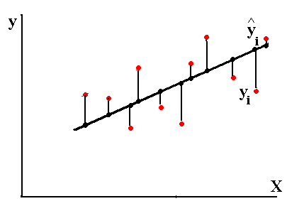
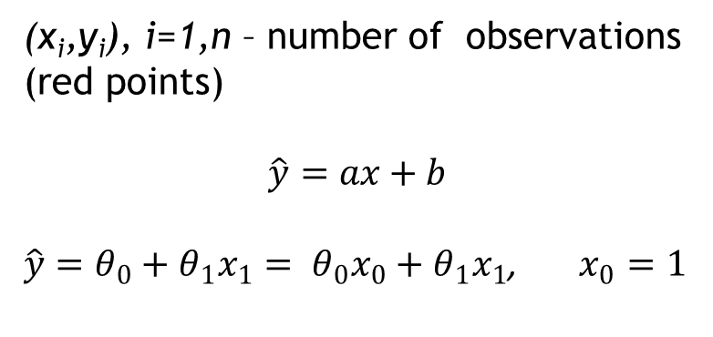
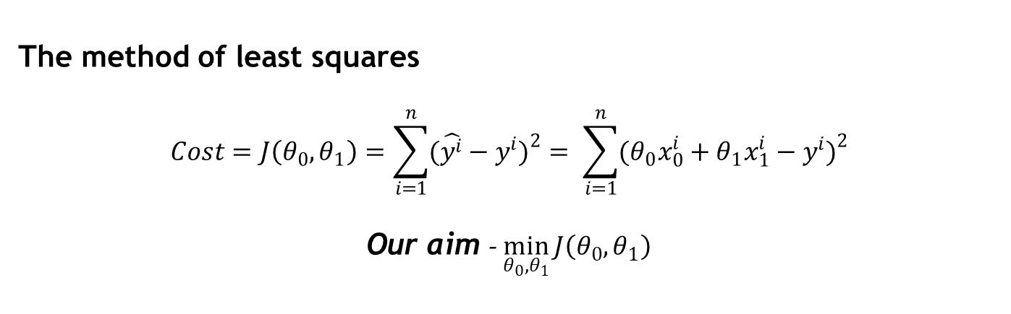
Linear Regression with one variable
(x_{i},y_{i}), i=1,n – number of observations (red points)
$$\hat{y}=ax+b$$
$\hat{y}=θ_{0}+θ_{1}x_{1}= θ_{0}x_{0}+θ_{1}x_{1}$, $x_{0}=1$
The method of least squares
$$Cost=J\left(θ_{0},θ_{1}\right)=\sum_{i=1}^{n}{(\hat{y^{i}}−y^{i}})^{2}= \sum_{i=1}^{n}{(θ_{0}x_{0}^{i}+θ_{1}x_{1}^{i}−y^{i})^{2}}$$
Our aim - $\min_{θ_{0},θ_{1}}{J\left(θ_{0},θ_{1}\right)}$
ML-course. Regression

Slide 17
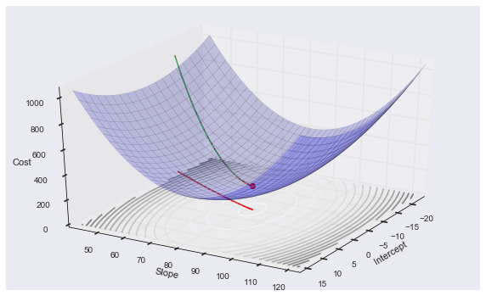
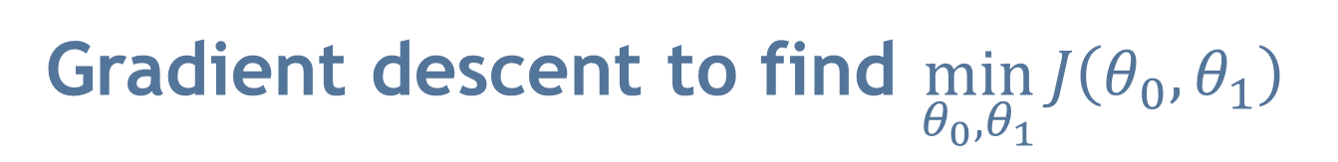
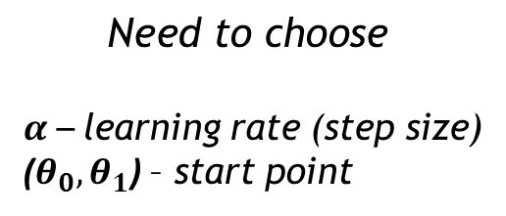
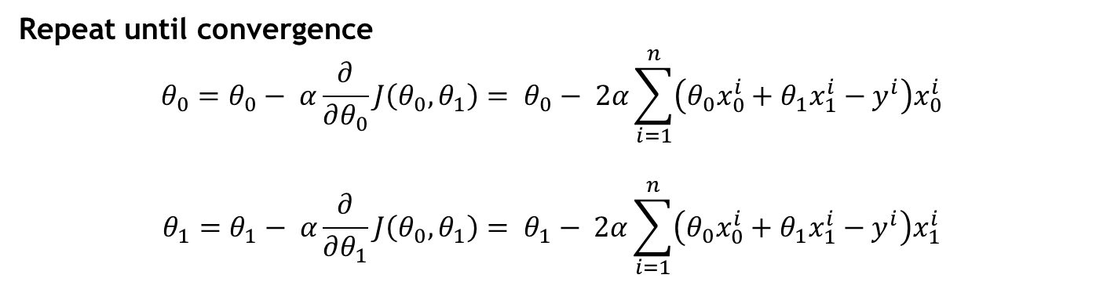
Gradient descent to find $\min_{θ_{0},θ_{1}}{J\left(θ_{0},θ_{1}\right)}$
$$\text{Need} \text{to} \text{choose}$$
$α$ – learning rate (step size)
($θ_{0},θ_{1}$) – start point
Repeat until convergence
$$θ_{0}=θ_{0}− α\frac{∂}{∂θ_{0}}J\left(θ_{0},θ_{1}\right)= θ_{0}− 2α\sum_{i=1}^{n}{\left(θ_{0}x_{0}^{i}+θ_{1}x_{1}^{i}−y^{i}\right)x_{0}^{i}}$$
$$θ_{1}=θ_{1}− α\frac{∂}{∂θ_{1}}J\left(θ_{0},θ_{1}\right)= θ_{1}− 2α\sum_{i=1}^{n}{\left(θ_{0}x_{0}^{i}+θ_{1}x_{1}^{i}−y^{i}\right)x_{1}^{i}}$$
ML-course. Regression

Slide 18
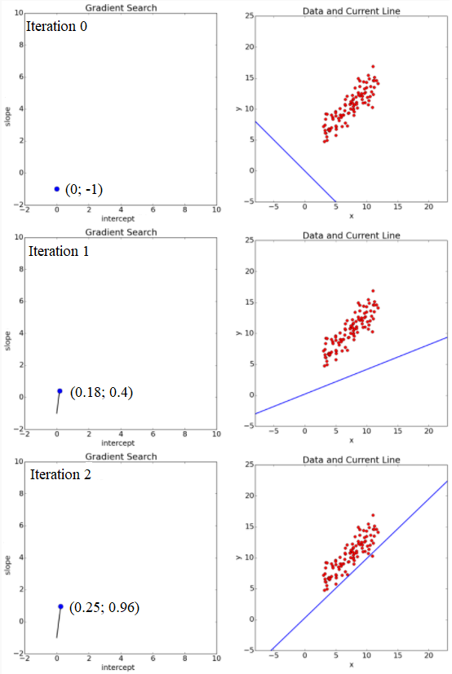
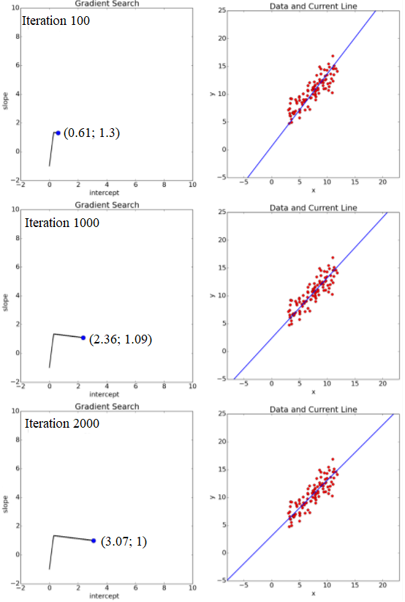
Gradient descent (example)
ML-course. Regression

Slide 19
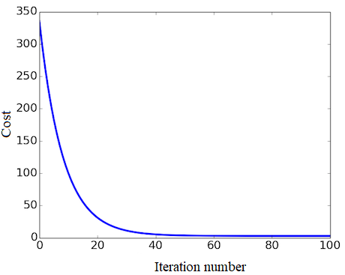
Gradient descent (example)
26
ML-course. Regression

Slide 20
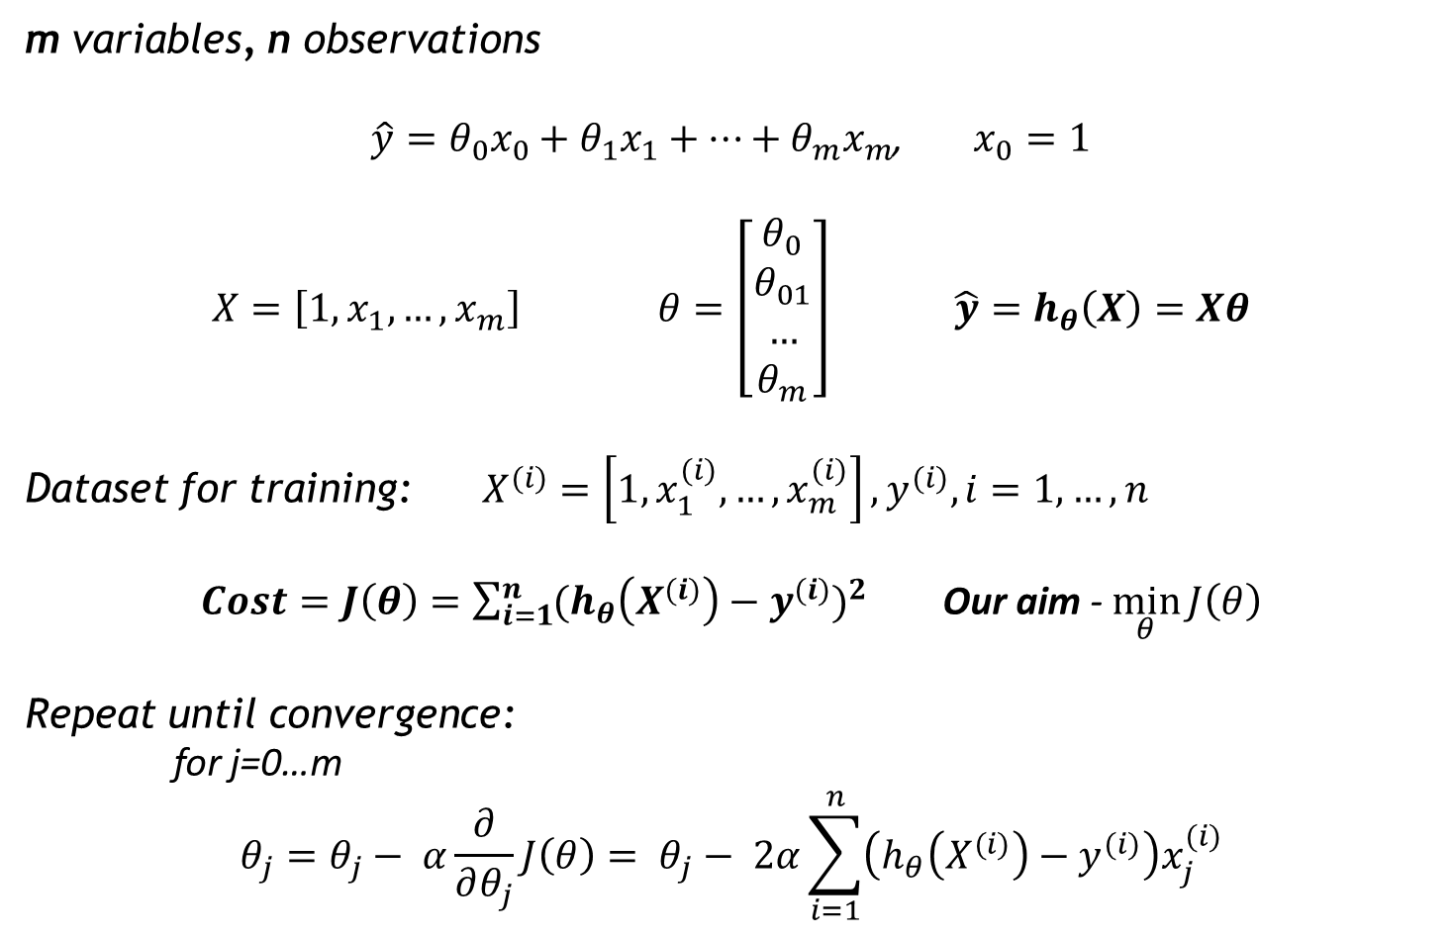
Linear Regression with multiple variables
m variables, n observations
$\hat{y}=θ_{0}x_{0}+θ_{1}x_{1}+…+θ_{m}x_{m}$, $x_{0}=1$
$X=\left[1, x_{1}, …, x_{m}\right]$ $θ=\left[\begin{aligned}θ_{0} \\ θ_{01} \\ … \\ θ_{m}\end{aligned}\right]$ $\hat{y}=h_{θ}\left(X\right)=Xθ$
Dataset for training: $X^{(i)}=\left[1, x_{1}^{(i)}, …, x_{m}^{(i)}\right], y^{(i)}, i=1,…,n$
$Cost=J\left(θ\right)=\sum_{i=1}^{n}{(h_{θ}\left(X^{(i)}\right)−y^{(i)}})^{2}$ Our aim - $\min_{θ}{J\left(θ\right)}$
Repeat until convergence:
for j=0…m
$$θ_{j}=θ_{j}− α\frac{∂}{∂θ_{j}}J\left(θ\right)= θ_{j}− 2α\sum_{i=1}^{n}{\left(h_{θ}\left(X^{(i)}\right)−y^{(i)}\right)x_{j}^{(i)}}$$
ML-course. Regression and Classification 2018

Slide 21
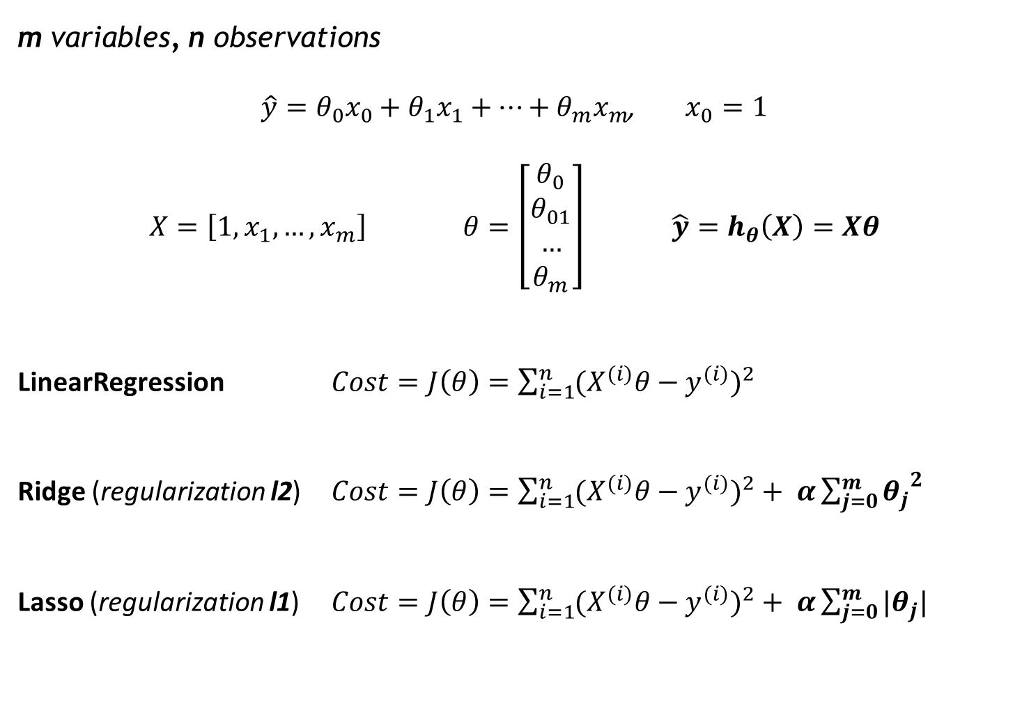
Cost functions for LinearRegression, Ridge and Lasso in scikit-learn
m variables, n observations
$\hat{y}=θ_{0}x_{0}+θ_{1}x_{1}+…+θ_{m}x_{m}$, $x_{0}=1$
$X=\left[1, x_{1}, …, x_{m}\right]$ $θ=\left[\begin{aligned}θ_{0} \\ θ_{01} \\ … \\ θ_{m}\end{aligned}\right]$ $\hat{y}=h_{θ}\left(X\right)=Xθ$
LinearRegression $Cost=J\left(θ\right)=\sum_{i=1}^{n}{(X^{(i)}θ−y^{(i)}})^{2}$
Ridge (regularization l2) $Cost=J\left(θ\right)=\sum_{i=1}^{n}{(X^{(i)}θ−y^{(i)}})^{2}+ α\sum_{j=0}^{m}{{θ_{j}}^{2}}$
Lasso (regularization l1) $Cost=J\left(θ\right)=\sum_{i=1}^{n}{(X^{(i)}θ−y^{(i)}})^{2}+ α\sum_{j=0}^{m}{{|θ}_{j}|}$
ML-course. Regression

Slide 22
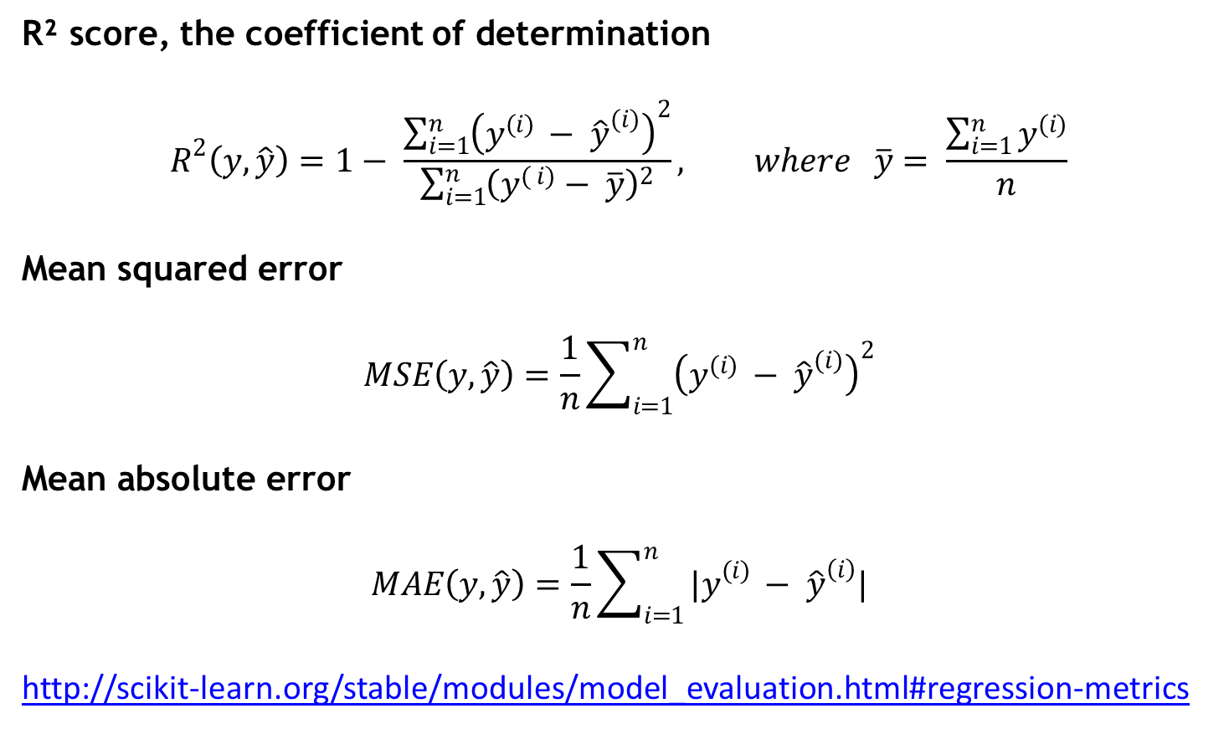
Regression metrics
R² score, the coefficient of determination
$$R^{2}\left(y, \hat{y}\right)=1− \frac{\sum_{i=1}^{n}{{\left(y^{(i) }− {\hat{y}}^{(i)}\right)}^{2}}}{\sum_{i=1}^{n}{{\left(y^{( i)}− \overline{y}\right)}^{2}}}, where \overline{y}= \frac{\sum_{i=1}^{n}{y^{(i)}}}{n}$$
Mean squared error
$$MSE\left(y, \hat{y}\right)=\frac{1}{n}\sum_{i=1}^{n}{{\left(y^{(i) }− {\hat{y}}^{(i)}\right)}^{2}}$$
Mean absolute error
$$MAE\left(y, \hat{y}\right)=\frac{1}{n}\sum_{i=1}^{n}{{|y}^{(i) }− {\hat{y}}^{\left(i\right)}|}$$
http://scikit-learn.org/stable/modules/model_evaluation.html#regression-metrics
ML-course. Regression

Slide 23
Choose the best model
Models | R^2
 | train | test
LinearRegression() | 0.73 | 0.75
LinearRegression(normalize = True) | 0.73 | 0.75
LinearRegression with PolynomialFeatures
n=2 | 0.95 | 0.81
n=3 | 1 | -2395
Ridge with PolynomialFeatures
a=0.1, n=2 | 0.94 | 0.84
a=0.1, n=3 | -1898 | -285964
a=100 000 000, n=3 | 0.93 | 0.82
Lasso with PolynomialFeatures
n=2
a=0.001 | 0.93 | 0.83
a=1 | 0.89 | 0.86
n=3
a=0.001 | 0.97 | 0.81
a=1 | 0.96 | 0.84
a=100 | 0.92 | 0.87
ML-course. Regression

Slide 24
Ways to fix high bias/variance in linear models
High bias (underfitting) | High variance (overfitting)
Add more features Add polynomial features | More training examples Smaller set of features Use regularization Increase regularization strength (coefficient)
ML-course. Regression

Slide 25
Q & A Thank you!

