Slide 1
TENSOR.BY ML-course 2. Regression and Classification in Python Scikit-learn
Kate Miniukovich (Data Scientist),
miniukovich@rocketscience.ai

Slide 2
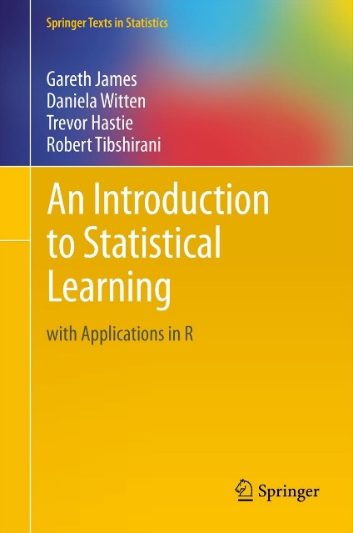
Reference
An Introduction to Statistical Learning by Gareth James, Daniela Witten, Trevor Hastie, and Robert Tibshirani, http://www-bcf.usc.edu/~gareth/ISL/ (available online for free)

Slide 3
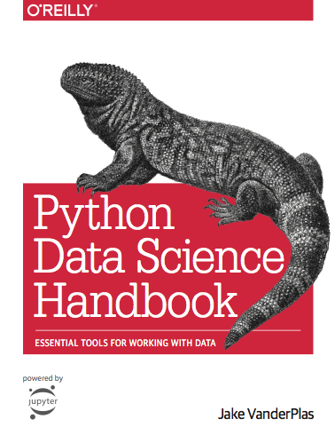
Reference
Jake VanderPlas
Python Data Science Handbook
https://jakevdp.github.io/PythonDataScienceHandbook/
Video
https://www.youtube.com/watch?v=L7R4HUQ-eQ0&t=6033s

Slide 4
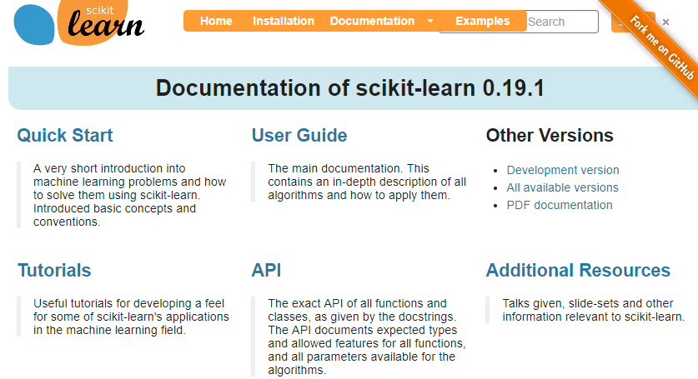
Reference
http://scikit-learn.org

Slide 5
Outline
Supervised vs. unsupervised learning
Working with data
Modeling
Regression
Classification

Slide 6
Supervised vs. Unsupervised Learning
Supervised Data: 1) n observations; 2) p variables X1, X2, . . .,Xp, measured on each observation; 3) response Y measured on same n observations Y Continuous Discrete Regression Classification | Unsupervised Data: 1) n observations; 2) p variables X1, X2, . . .,Xp, measured on each observation Clustering…

Slide 7
Regression / Classification Problem
Steps to solve
Working with data
Modeling
ML-course. Regression and Classification 2018

Slide 8
Working with data
Tidy data
Types of variables and actions
Missing data and imputation
Feature engineering
Data preprocessing for scikit-learn
ML-course. Regression and Classification 2018

Slide 9
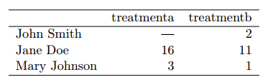
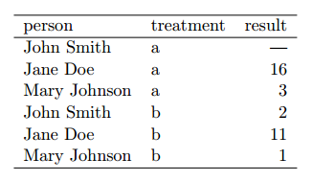
Working with data
Tidy Data
Tidy data is a standard way of mapping the meaning of a dataset to its structure. This is Codd’s 3rd normal form and the focus put on a single dataset rather than the many connected datasets common in relational databases.
In tidy data:
1. Each variable forms a column.
2. Each observation forms a row.
3. Each type of observational unit forms a table.
Which table below is tidy?
More about tidy data:
ftp://cran.r-project.org/pub/R/web/packages/tidyr/vignettes/tidy-data.html
ML-course. Regression and Classification 2018

Slide 10
Working with data
Types of variables and actions
Types of variables Categorical Text Numerical | Actions Convert to n binary vars (n – number of labels) Options: Scrap a pattern and convert it to n binary vars Convert text to numbers (Word2Vec) Drop text variable Scaling ? standardization = = mean removal +variance scaling Logarithm
ML-course. Regression and Classification 2018

Slide 11
Working with data
Missing data and imputation
Missing data: NaN
Imputation
Mean, median or mode
Prediction
Examples:
https://www.kaggle.com/kernels search on “Missing data imputation”
ML-course. Regression and Classification 2018

Slide 12
Working with data
Feature Engineering
Based on variables meaning
Technical approaches
Examples:
https://www.kaggle.com/kernels search on “Feature engineering”
ML-course. Regression and Classification 2018

Slide 13
Working with data
Representation of in Scikit-learn
X
two-dimensional numpy arrays
shape – (n_samples, n_features)
Y
one-dimensional numpy arrays
shape – (n_samples, )
ML-course. Regression and Classification 2018

Slide 14
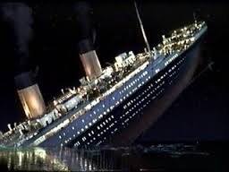
Working with data
Example
dataset: Titanic https://www.kaggle.com/c/titanic
classification_titanic.ipynb
ML-course. Regression and Classification 2018

Slide 15
Modeling
Choose a class of model
Fit the model to data
Validate the model and optimize hyperparameters
Predict for unknown data
ML-course. Regression and Classification 2018

Slide 16


Mathematical model
f is some fixed but unknown function of X1, . . . , Xp, and e is a random error term, which is independent of X and has mean zero. In this formulation, f represents the systematic information that X provides about Y .
We can predict Y using our estimate for f
ML-course. Regression and Classification 2018

Slide 17
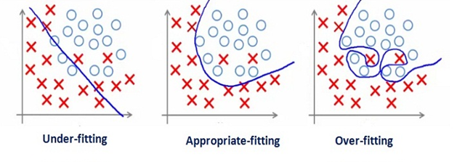
Bias-Variance Trade-Off
Underfitting (high bias) - algorithm is missing the relevant relations between features and target outputs
Overfitting (high variance) - modeling the random noise in the training data, rather than the intended outputs.
ML-course. Regression and Classification 2018

Slide 18
Model validation
Data
train + test (e.g. 75% + 25%)
cross-validation
Metrics
Regression: R^2, MSE, MAE,…
Classification: Accuracy, Confusion matrix, AUC,…
http://scikit-learn.org/stable/modules/classes.html#sklearn-metrics-metricsmodel.score()
ML-course. Regression and Classification 2018

Slide 19
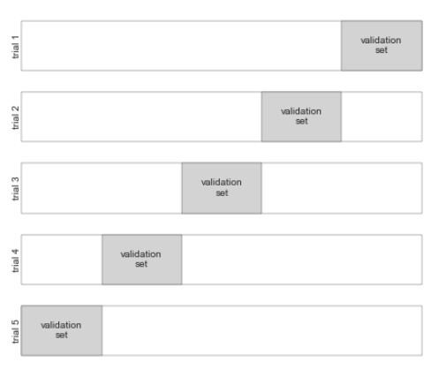
Model validation via cross-validation
ML-course. Regression and Classification 2018

Slide 20
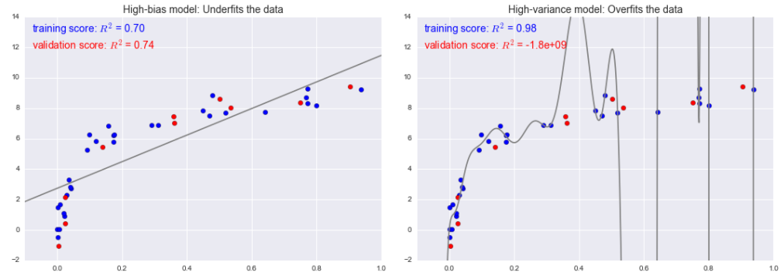
Bias-Variance Trade-Off
For high-bias models, the performance of the model on the validation set is similar to the performance on the training set.
For high-variance models, the performance of the model on the validation set is far worse than the performance on the training set.

Slide 21
Bias-Variance Trade-Off
What to do in case of high-bias or high variance?
Model complexity (e.g. regularization)
Quantity of training samples
Set of features
Reading
Jake VanderPlas Python Data Science Handbook (05.03-Hyperparameters-and-Model-Validation)
Andrew Ng ML: Advice for Applying Machine Learning

Slide 22
Some models for Regression in Python scikit-learn
Generalized Linear Models
Linear Regression
Ridge regression
Lasso regression
example of Linear, Ridge and Lasso Regressions in regression.ipynb
Ensemble methods
Random Forests
Gradient Tree Boosting
ML-course. Regression and Classification 2018

Slide 23
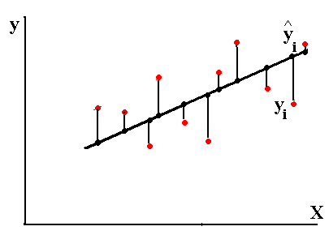
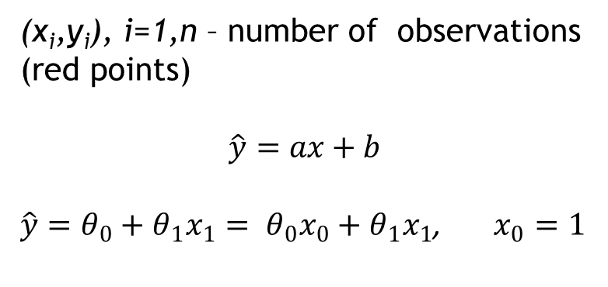
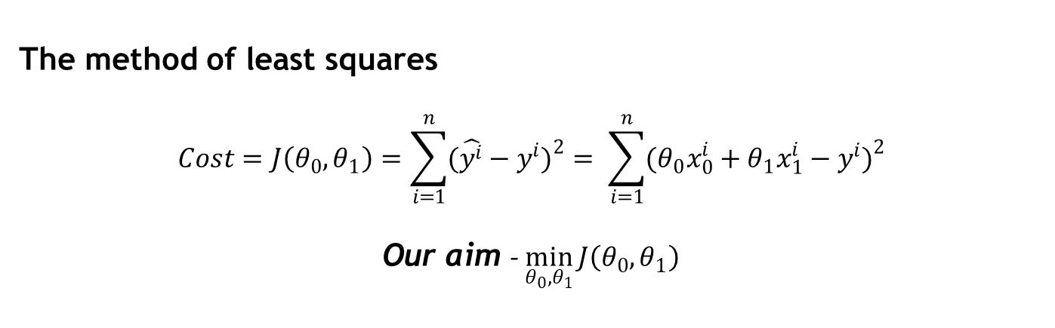
Linear Regression with one variable
(x_{i},y_{i}), i=1,n – number of observations (red points)
$$\hat{y}=ax+b$$
$\hat{y}=θ_{0}+θ_{1}x_{1}= θ_{0}x_{0}+θ_{1}x_{1}$, $x_{0}=1$
The method of least squares
$$Cost=J\left(θ_{0},θ_{1}\right)=\sum_{i=1}^{n}{(\hat{y^{i}}−y^{i}})^{2}= \sum_{i=1}^{n}{(θ_{0}x_{0}^{i}+θ_{1}x_{1}^{i}−y^{i})^{2}}$$
Our aim - $\min_{θ_{0},θ_{1}}{J\left(θ_{0},θ_{1}\right)}$
ML-course. Regression and Classification 2018

Slide 24
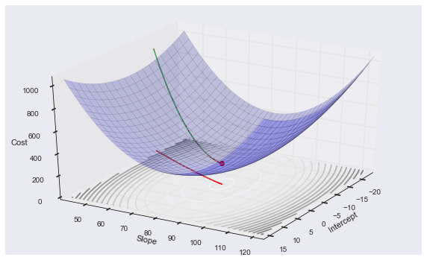
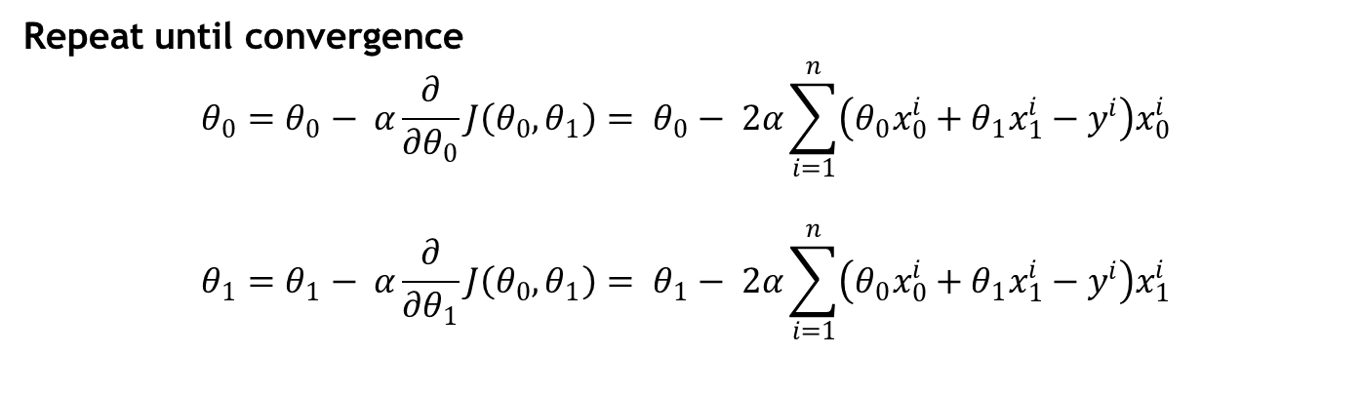
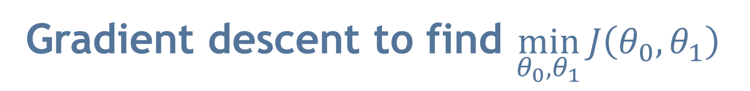
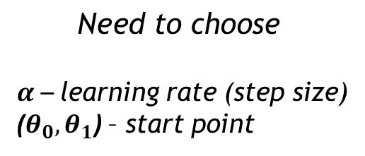
Gradient descent to find $\min_{θ_{0},θ_{1}}{J\left(θ_{0},θ_{1}\right)}$
$$\text{Need} \text{to} \text{choose}$$
$α$ – learning rate (step size)
($θ_{0},θ_{1}$) – start point
Repeat until convergence
$$θ_{0}=θ_{0}− α\frac{∂}{∂θ_{0}}J\left(θ_{0},θ_{1}\right)= θ_{0}− 2α\sum_{i=1}^{n}{\left(θ_{0}x_{0}^{i}+θ_{1}x_{1}^{i}−y^{i}\right)x_{0}^{i}}$$
$$θ_{1}=θ_{1}− α\frac{∂}{∂θ_{1}}J\left(θ_{0},θ_{1}\right)= θ_{1}− 2α\sum_{i=1}^{n}{\left(θ_{0}x_{0}^{i}+θ_{1}x_{1}^{i}−y^{i}\right)x_{1}^{i}}$$
ML-course. Regression and Classification 2018

Slide 25
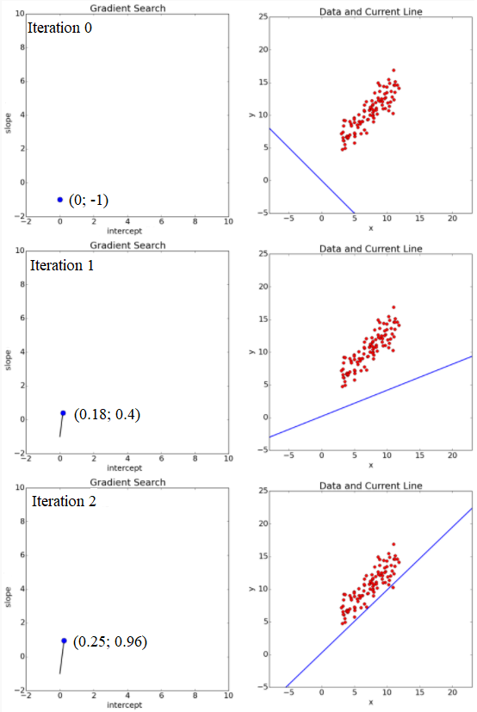
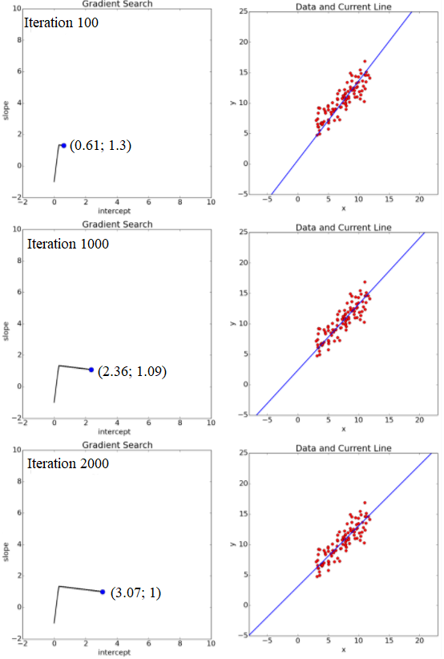
Gradient descent (example)
ML-course. Regression and Classification 2018

Slide 26
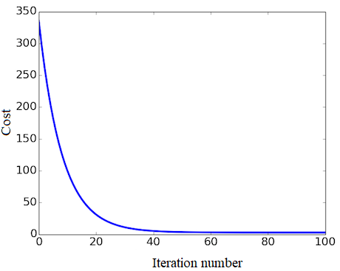
Gradient descent (example)
26
ML-course. Regression and Classification 2018

Slide 27
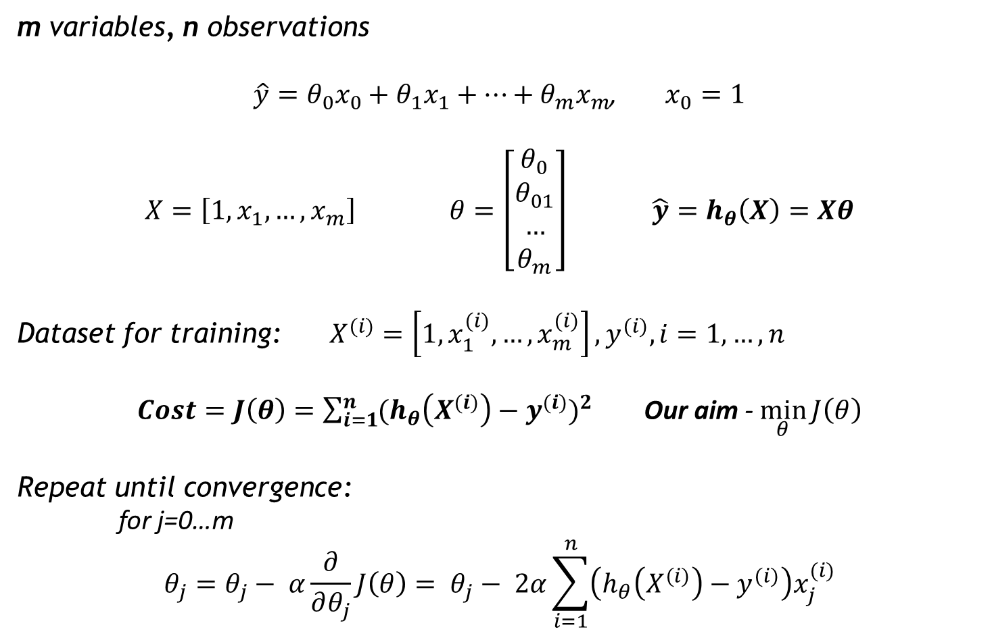
Linear Regression with multiple variables
m variables, n observations
$\hat{y}=θ_{0}x_{0}+θ_{1}x_{1}+…+θ_{m}x_{m}$, $x_{0}=1$
$X=\left[1, x_{1}, …, x_{m}\right]$ $θ=\left[\begin{aligned}θ_{0} \\ θ_{01} \\ … \\ θ_{m}\end{aligned}\right]$ $\hat{y}=h_{θ}\left(X\right)=Xθ$
Dataset for training: $X^{(i)}=\left[1, x_{1}^{(i)}, …, x_{m}^{(i)}\right], y^{(i)}, i=1,…,n$
$Cost=J\left(θ\right)=\sum_{i=1}^{n}{(h_{θ}\left(X^{(i)}\right)−y^{(i)}})^{2}$ Our aim - $\min_{θ}{J\left(θ\right)}$
Repeat until convergence:
for j=0…m
$$θ_{j}=θ_{j}− α\frac{∂}{∂θ_{j}}J\left(θ\right)= θ_{j}− 2α\sum_{i=1}^{n}{\left(h_{θ}\left(X^{(i)}\right)−y^{(i)}\right)x_{j}^{(i)}}$$
ML-course. Regression and Classification 2018

Slide 28
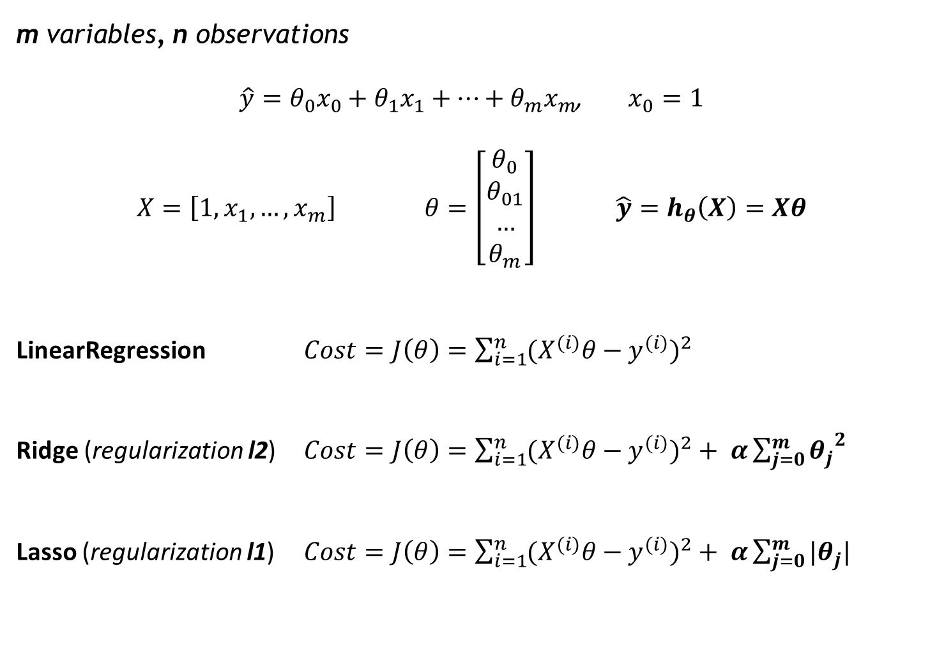
Cost functions for LinearRegression, Ridge and Lasso in scikit-learn
m variables, n observations
$\hat{y}=θ_{0}x_{0}+θ_{1}x_{1}+…+θ_{m}x_{m}$, $x_{0}=1$
$X=\left[1, x_{1}, …, x_{m}\right]$ $θ=\left[\begin{aligned}θ_{0} \\ θ_{01} \\ … \\ θ_{m}\end{aligned}\right]$ $\hat{y}=h_{θ}\left(X\right)=Xθ$
LinearRegression $Cost=J\left(θ\right)=\sum_{i=1}^{n}{(X^{(i)}θ−y^{(i)}})^{2}$
Ridge (regularization l2) $Cost=J\left(θ\right)=\sum_{i=1}^{n}{(X^{(i)}θ−y^{(i)}})^{2}+ α\sum_{j=0}^{m}{{θ_{j}}^{2}}$
Lasso (regularization l1) $Cost=J\left(θ\right)=\sum_{i=1}^{n}{(X^{(i)}θ−y^{(i)}})^{2}+ α\sum_{j=0}^{m}{{|θ}_{j}|}$
ML-course. Regression and Classification 2018

Slide 29
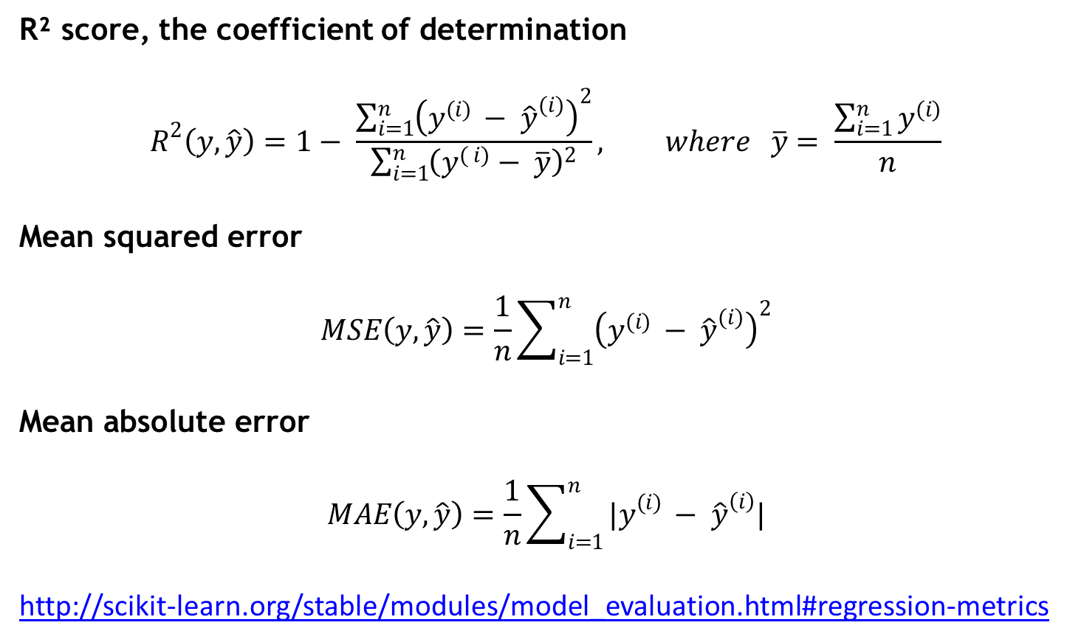
Regression metrics
R² score, the coefficient of determination
$$R^{2}\left(y, \hat{y}\right)=1− \frac{\sum_{i=1}^{n}{{\left(y^{(i) }− {\hat{y}}^{(i)}\right)}^{2}}}{\sum_{i=1}^{n}{{\left(y^{( i)}− \overline{y}\right)}^{2}}}, where \overline{y}= \frac{\sum_{i=1}^{n}{y^{(i)}}}{n}$$
Mean squared error
$$MSE\left(y, \hat{y}\right)=\frac{1}{n}\sum_{i=1}^{n}{{\left(y^{(i) }− {\hat{y}}^{(i)}\right)}^{2}}$$
Mean absolute error
$$MAE\left(y, \hat{y}\right)=\frac{1}{n}\sum_{i=1}^{n}{{|y}^{(i) }− {\hat{y}}^{\left(i\right)}|}$$
http://scikit-learn.org/stable/modules/model_evaluation.html#regression-metrics
ML-course. Regression and Classification 2018

Slide 30
Chose the best model
Models | R^2
 | train | test
LinearRegression() | 0.73 | 0.75
LinearRegression(normalize = True) | 0.73 | 0.75
LinearRegression with PolynomialFeatures
n=2 | 0.95 | 0.81
n=3 | 1 | -2395
Ridge with PolynomialFeatures
a=0.1, n=2 | 0.94 | 0.84
a=0.1, n=3 | -1898 | -285964
a=100 000 000, n=3 | 0.93 | 0.82
Lasso with PolynomialFeatures
n=2
a=0.001 | 0.93 | 0.83
a=1 | 0.89 | 0.86
n=3
a=0.001 | 0.97 | 0.81
a=1 | 0.96 | 0.84
a=100 | 0.92 | 0.87
ML-course. Regression and Classification 2018

Slide 31
Ways to fix high bias/variance in linear models
High bias (underfitting) | High variance (overfitting)
Add more features Add polynomial features | More training examples Smaller set of features Use regularization Increase regularization strength (coefficient)

Slide 32
Classification
Binary 2 classes | Multiclass more than 2 classes

Slide 33
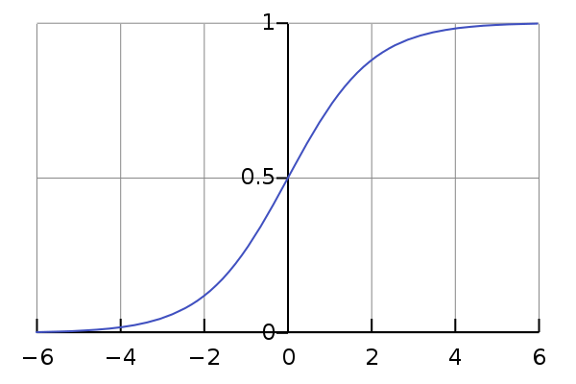
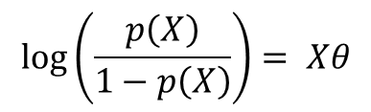
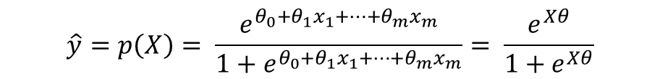
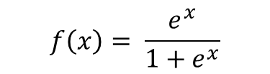
Binary Classification
Logistic Regression
To model p(X) = Pr(Y = 1|X) we need function that gives outputs between 0 and 1 for all values of X
Logistic function
$$\hat{y}=p\left(X\right)= \frac{e^{θ_{0}+θ_{1}x_{1}+…+θ_{m}x_{m}}}{1+e^{θ_{0}+θ_{1}x_{1}+…+θ_{m}x_{m}}}= \frac{e^{Xθ}}{1+e^{Xθ}}$$
$$\log\left(\frac{p\left(X\right)}{1−p\left(X\right)}\right)= Xθ$$
$$f\left(x\right)= \frac{e^{x}}{1+e^{x}}$$
ML-course. Regression and Classification 2018

Slide 34
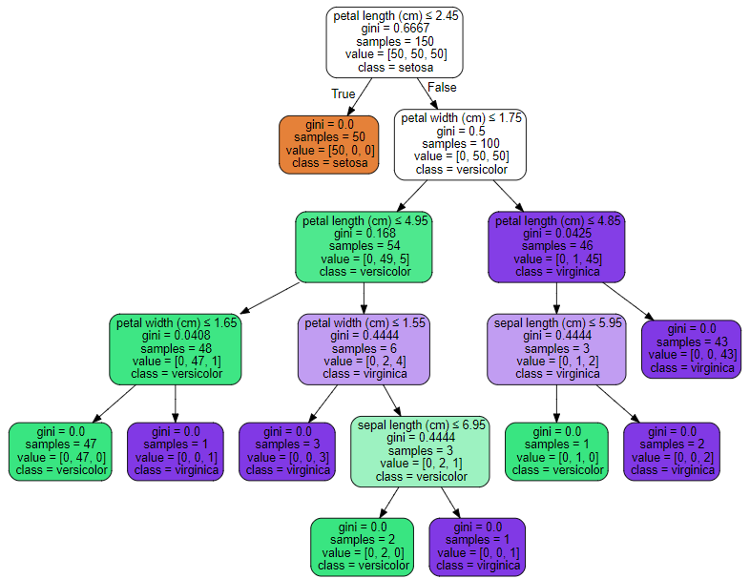
Binary Classification
Decision trees Bagging, Random Forests, Gradient Boosting
Good explanation of Boosted Trees http://xgboost.readthedocs.io/en/latest///model.html
ML-course. Regression and Classification 2018

Slide 35
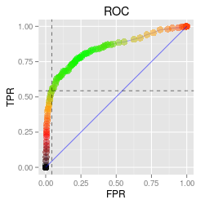
Classification metrics
Confusion matrix Survived (S) -1; Not Survived (NS) – 0
Actual/Predicted | 0 | 1 | Error
0 (N) | TN (NS as NS) | FP (NS as S) | FPR=FP/N (False Positive Rate)
1 (P) | FN (S as NS) | TP (S as S) | FNR=FN/P(False Negative Rate)
Accuracy = (TP+TN)/(P+N)
Precision = TP/(TP+FP) Recall = TPR = TP/P
F1 = 2*Precision*Recall/(Precision+Recall) - harmonic mean Precision and Recall
AUC - Area Under ROC Curve (the closer to 1, the better a model is)
Receiver operating characteristic curve
More: https://en.wikipedia.org/wiki/Precision_and_recall
ML-course. Regression and Classification 2018

Slide 36
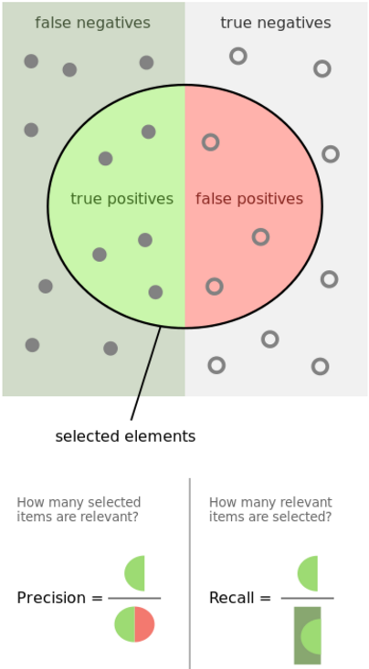
Classification metrics
Confusion matrix Survived (S) -1; Not Survived (NS) – 0
Actual/Predicted | 0 | 1 | Error
0 (N=438) | TN=365 | FP=? | FPR=FP/N = ?
1 (P=274) | FN=? | TP=212 | FNR=FN/P = ?
Total |  |  | (FN+FP)/(N+P) = ?
FN – ошибка первого рода; FP - ошибка второго рода
Accuracy = (TP+TN)/(P+N) - ?
Precision = TP/(TP+FP) -?
Recall = TPR = TP/P-?
http://scikit-learn.org/stable/modules/classes.html#classification-metrics
ML-course. Regression and Classification 2018

Slide 37
Some models for binary classification in Python scikit-learn
Generalized Linear Models
Logistic regression
example in classification_titanic_simple.ipynb
Ensemble methods
Random Forests
Gradient Tree Boosting
ML-course. Regression and Classification 2018

Slide 38
Binary Classification
Example: binary models for Titanic dataset
Models comparison based on AUC
Model | Train | CV | Test
LR | 0.82 | 0.8 | 0.77
RF | 0.88 | 0.84 | 0.8
GB | 0.87 | 0.84 | 0.79
ML-course. Regression and Classification 2018

Slide 39
Multiclass Classification
Some models
Logistic Regression
Random Forests, Gradient Boosting
example in mclass_classification.ipynb
One vs. All
One vs. One
Read more: https://en.wikipedia.org/wiki/Multiclass_classification
http://scikit-learn.org/stable/modules/multiclass.html
ML-course. Regression and Classification 2018

Slide 40
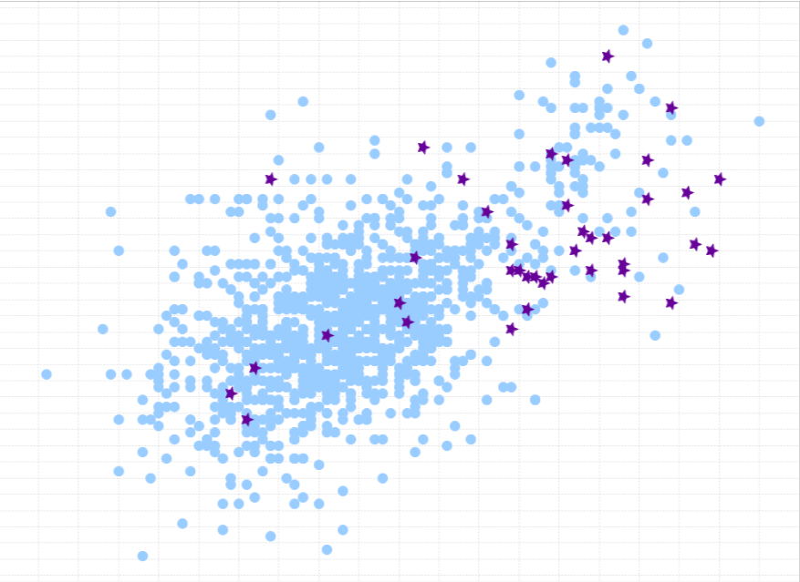
Classification: Unbalanced classes
Unbalanced classes - classes are not represented equally
Accuracy Paradox
Tactics to Combat Unbalanced Classes
1) Collect more data
2) Change Your Performance Metric
3) Resample Your Dataset
4) Generate Synthetic Samples
Read more: 8 Tactics to Combat Imbalanced Classes in Your Machine Learning Dataset http://machinelearningmastery.com/tactics-to-combat-imbalanced-classes-in-your-machine-learning-dataset/
ML-course. Regression and Classification 2018

Slide 41
Modeling
Hyperparameters optimization
Parameters to optimize
Good range of values
More about parameters to optimize and good range of values https://www.linkedin.com/pulse/approaching-almost-any-machine-learning-problem-abhishek-thakur?trk=hp-feed-article-title-like
ML-course. Regression and Classification 2018

Slide 42
Q & A Thank you!

