Slide 1
TENSOR.BY ML-course 3. Classification in Python Scikit-learn
Kate Miniukovich (Data Scientist),
miniukovich@rocketscience.ai

Slide 2
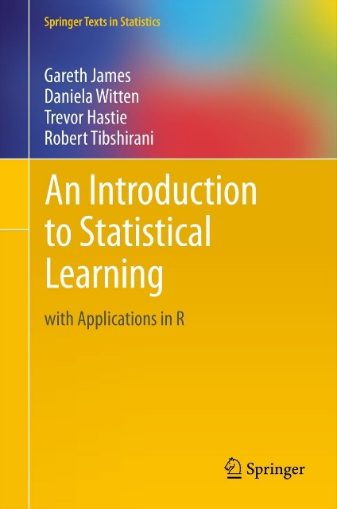
Reference
An Introduction to Statistical Learning by Gareth James, Daniela Witten, Trevor Hastie, and Robert Tibshirani, http://www-bcf.usc.edu/~gareth/ISL/ (available online for free)

Slide 3
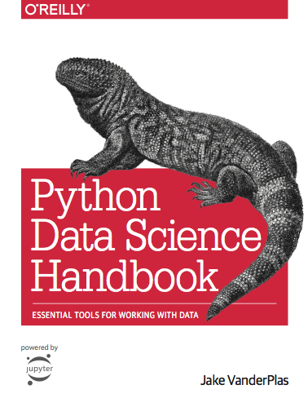
Reference
Jake VanderPlas
Python Data Science Handbook
https://jakevdp.github.io/PythonDataScienceHandbook/
Video
https://www.youtube.com/watch?v=L7R4HUQ-eQ0&t=6033s

Slide 4
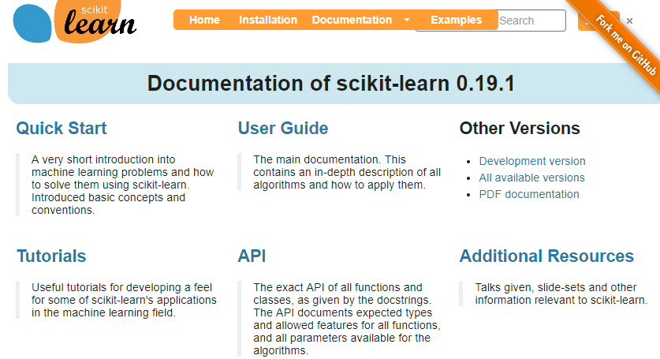
Reference
http://scikit-learn.org

Slide 5
Supervised vs. Unsupervised Learning
Supervised Data: 1) n observations; 2) p variables X1, X2, . . .,Xp, measured on each observation; 3) response Y measured on same n observations Y Continuous Discrete Regression Classification | Unsupervised Data: 1) n observations; 2) p variables X1, X2, . . .,Xp, measured on each observation Clustering…

Slide 6
Classification
Binary 2 classes | Multiclass more than 2 classes

Slide 7
Regression / Classification Problem
Steps to solve
Working with data
Modeling

Slide 8
Working with data
Tidy data
Types of variables and actions
Missing data and imputation
Feature engineering
Data preprocessing for scikit-learn

Slide 9
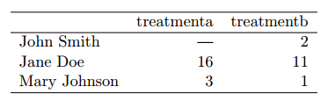
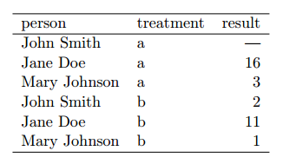
Working with data
Tidy Data
Tidy data is a standard way of mapping the meaning of a dataset to its structure. This is Codd’s 3rd normal form and the focus put on a single dataset rather than the many connected datasets common in relational databases.
In tidy data:
1. Each variable forms a column.
2. Each observation forms a row.
3. Each type of observational unit forms a table.
Which table below is tidy?
More about tidy data:
ftp://cran.r-project.org/pub/R/web/packages/tidyr/vignettes/tidy-data.html

Slide 10
Working with data
Types of variables and actions
Types of variables Categorical Text Numerical | Actions Convert to n binary vars (n – number of labels) Options: Scrap a pattern and convert it to n binary vars Convert text to numbers (Word2Vec) Drop text variable Standardization = = mean removal + variance scaling

Slide 11
Working with data
Missing data and imputation
Missing data: NaN
Imputation
Mean, median or mode
Prediction
Examples:
https://www.kaggle.com/kernels search on “Missing data imputation”

Slide 12
Working with data
Feature Engineering
Based on variables meaning
Technical approaches
Examples:
https://www.kaggle.com/kernels search on “Feature engineering”

Slide 13
Working with data
Representation of in Scikit-learn
X
two-dimensional numpy array
shape – (n_samples, m_features)
Y
one-dimensional numpy array
shape – (n_samples, )

Slide 14
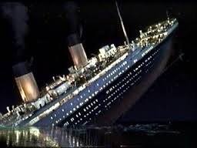
Working with data
Example
dataset: Titanic https://www.kaggle.com/c/titanic
classification_titanic_simple.ipynb
TENSOR.BY ML-course. Classification

Slide 15
Modeling
Choose a class of model
Fit the model to data
Validate the model and optimize hyperparameters
Predict for unknown data

Slide 16
Some models for binary classification in Python scikit-learn
Generalized Linear Models
Logistic regression
example in classification_titanic_simple.ipynb
Ensemble methods
Random Forests
Gradient Tree Boosting

Slide 17
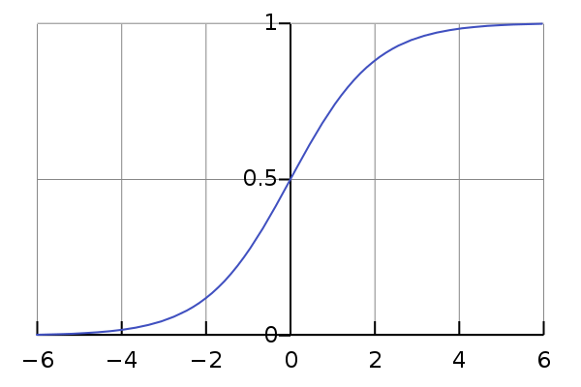
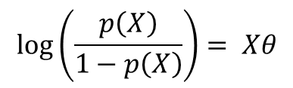
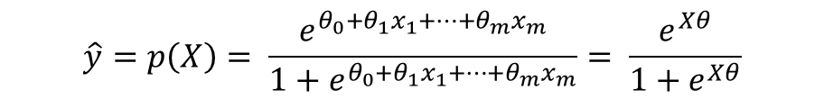
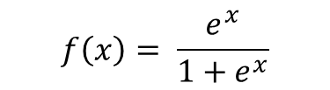
Binary Classification
Logistic Regression
To model p(X) = Pr(Y = 1|X) we need function that gives outputs between 0 and 1 for all values of X
Logistic function
$$\hat{y}=p\left(X\right)= \frac{e^{θ_{0}+θ_{1}x_{1}+…+θ_{m}x_{m}}}{1+e^{θ_{0}+θ_{1}x_{1}+…+θ_{m}x_{m}}}= \frac{e^{Xθ}}{1+e^{Xθ}}$$
$$\log\left(\frac{p\left(X\right)}{1−p\left(X\right)}\right)= Xθ$$
$$f\left(x\right)= \frac{e^{x}}{1+e^{x}}$$

Slide 18
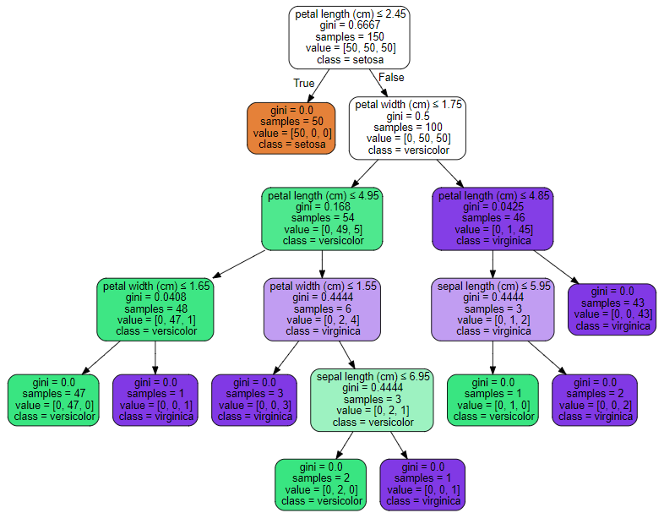
Binary Classification
Decision trees Bagging, Random Forests, Gradient Boosting
Good explanation of Boosted Trees http://xgboost.readthedocs.io/en/latest///model.html

Slide 19
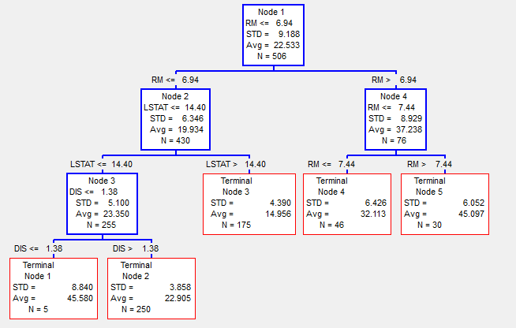
Regression
Decision trees Bagging, Random Forests,Gradient Boosting

Slide 20
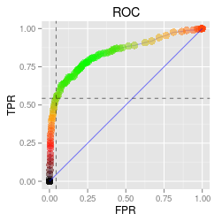
Classification metrics
Confusion matrix Survived (S) -1; Not Survived (NS) – 0
Actual/Predicted | 0 | 1 | Error
0 (N) | TN (NS as NS) | FP (NS as S) | FPR=FP/N (False Positive Rate)
1 (P) | FN (S as NS) | TP (S as S) | FNR=FN/P(False Negative Rate)
Accuracy = (TP+TN)/(P+N)
Precision = TP/(TP+FP) Recall = TPR = TP/P
F1 = 2*Precision*Recall/(Precision+Recall) - harmonic mean Precision and Recall
AUC - Area Under ROC Curve (the closer to 1, the better a model is)
Receiver operating characteristic curve
More: https://en.wikipedia.org/wiki/Precision_and_recall

Slide 21
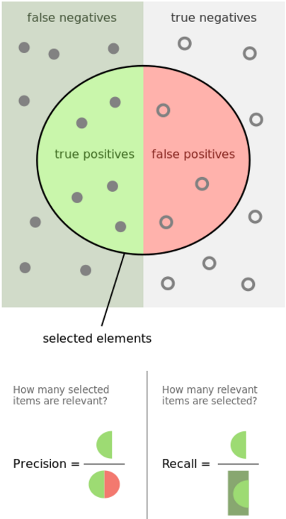
Classification metrics
Confusion matrix Survived (S) -1; Not Survived (NS) – 0
Actual/Predicted | 0 | 1 | Error
0 (N=438) | TN=365 | FP=? | FPR=FP/N = ?
1 (P=274) | FN=? | TP=212 | FNR=FN/P = ?
Total |  |  | (FN+FP)/(N+P) = ?
FN – ошибка первого рода; FP - ошибка второго рода
Accuracy = (TP+TN)/(P+N) - ?
Precision = TP/(TP+FP) -?
Recall = TPR = TP/P-?
http://scikit-learn.org/stable/modules/classes.html#classification-metrics

Slide 22
Binary Classification
Example: binary models for Titanic dataset
Models comparison based on Accuracy
Model | Train | CV | Test
LgR | 0.82 | 0.81 | 0.77
RF
GB

Slide 23
Multiclass Classification
Some classification algorithms naturally permit the use of more than two classes
Logistic Regression
Random Forests, Gradient Boosting
example in mclass_classification.ipynb
Techniques of transformation to binary
One vs. All
One vs. One
Read more: https://en.wikipedia.org/wiki/Multiclass_classification
http://scikit-learn.org/stable/modules/multiclass.html

Slide 24
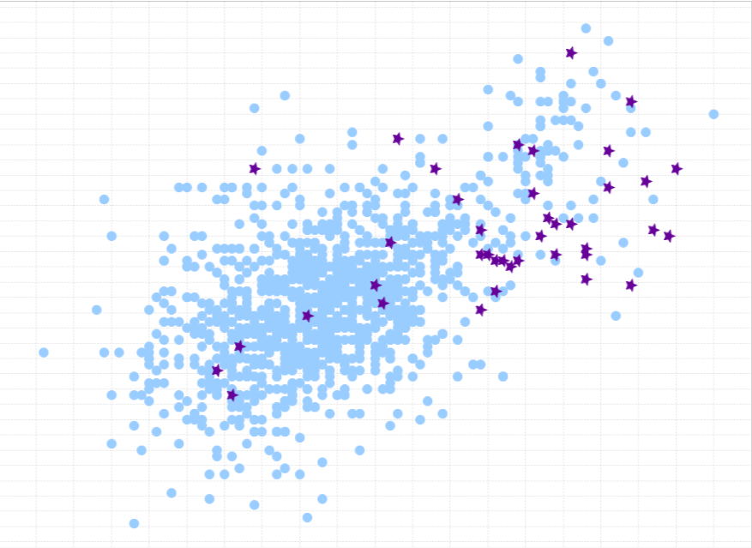
Classification: Unbalanced classes
Unbalanced classes - classes are not represented equally
Accuracy Paradox
Tactics to Combat Unbalanced Classes
1) Collect more data
2) Resample Your Dataset
3) Generate Synthetic Samples
4) Change Your Performance Metric
Read more: 8 Tactics to Combat Imbalanced Classes in Your Machine Learning Dataset http://machinelearningmastery.com/tactics-to-combat-imbalanced-classes-in-your-machine-learning-dataset/

Slide 25
Modeling
Hyperparameters optimization
Parameters to optimize
Good range of values
More about parameters to optimize and good range of values https://www.linkedin.com/pulse/approaching-almost-any-machine-learning-problem-abhishek-thakur?trk=hp-feed-article-title-like

Slide 26
Q & A Thank you!

