Slide 1
DB Programming
Connection
Data manipulation

Slide 2
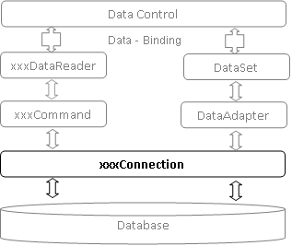
.NET Architecture

Slide 3
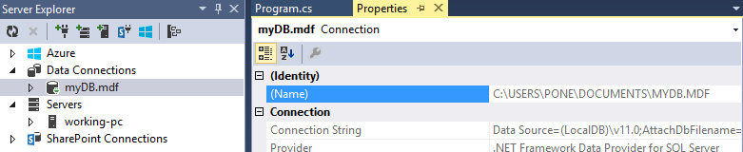
Connection: Data Provider
C#
Data Provider : SQL Server(Express Edition)

Slide 4
Connection String
C#
Data Provider : SQL Server(Express Edition)
private const String cnString = @"Data Source=(LocalDB)\v11.0;AttachDbFilename=|DataDirectory|myDB.mdf;Integrated Security=True;Connect Timeout=30";

Slide 5
Connection Object
C#
private const String cnString = @"Data Source=(LocalDB)\v11.0;AttachDbFilename=|DataDirectory|myDB.mdf;Integrated Security=True;Connect Timeout=30";
public static SqlConnection cn = new SqlConnection(cnString);
Library: System.Data.SqlClient

Slide 6
Test Database Version
C#
public static SqlConnection cn = new SqlConnection(cnString);
cn.Open();
Console.WritLine(cn.ServerVerion);
cn.Close();

Slide 7
Create MyConnection Class
class MyConnection {
private const String cnString ="";
private static SqlConnection cn;
private DbConnection() { }
public static SqlConnection GetCn()
{
cn = new SqlConnection(cnString);
return cn;
}
}

Slide 8
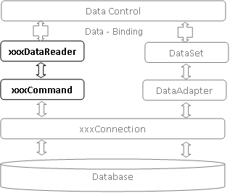
Connected Environment
SqlCommand
.ExecuteReader( sql, con) Select * From Student
.ExecuteScalar(sql, con)
Select count(*) from Student
.ExecuteNonQuery(sql, con)
Delete from student where id=@id”

Slide 9
Connected Environment
public List<Product> All()
{
String sql = "Select * from product";
SqlCommand cm = new SqlCommand(sql, con);
con.Open();
SqlDataReader dr = cm.ExecuteReader();
List<Product> products = new List<Product>();
while (dr.Read())
{
int id = (int)dr["id"];
String name = dr["name"].ToString();
float price = float.Parse(dr["price"].ToString()); products.Add(new Product(id, name, price);
}
dr.Close();
con.Close();
return products;
}
Connection
Command
Data Reader
new Product().All().ForEach(p => Console.WriteLine(p.Id + ":" + p.Name));

Slide 10
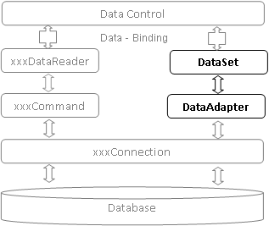
DisConnection Environment
SqlConnection con = DbConnection.GetCn();
String sql = "select * from Student";
SqlDataAdapter dp = new SqlDataAdapter(sql, con);
DataSet ds = new DataSet();
DataTable dt = new DataTable("Student");
ds.Tables.Add(dt);
dp.Fill(dt);
foreach (DataRow row in dt.Rows)
{
Console.WriteLine(row[0] + ":" + row[1]);
}

Slide 11
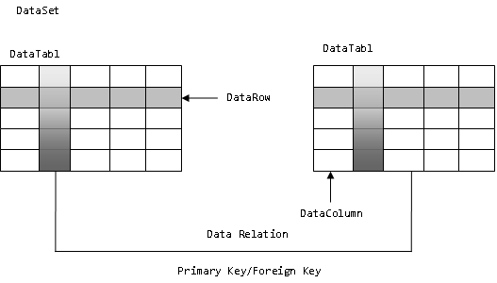
Data Set

Slide 12
Disconnection Environment
Connection
Data Adapter
Data Set
public DataTable SelectAll()
{
String sql = "select * from product";
SqlDataAdapter dp = new SqlDataAdapter(sql, con);
DataTable dt = new DataTable("product");
dp.Fill(dt);
return dt;
}
DataTable dt = new Product().SelectAll();
foreach (DataRow row in dt.Rows)
{
Console.WriteLine(row[0].ToString() + ":" + row[1].ToString());
}

Slide 13
SqlCommandBuilder
SqlDataAdapter da = new SqlDataAdapter(sql, con);
SqlCommandBuilder cb = new SqlCommandBuilder(da);
DataTable dt = new DataTable("Student");
da.Fill(dt);
dt.Rows[1]["fname"] = "lll";
dt.Rows.Add(new Object[] { null, "KK", "kk" });
dt.Rows[19].Delete();
da.Update(dt);

Slide 14
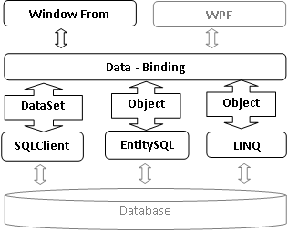
Window Form

Slide 15
Active Record Pattern
Product
+ Id:int
+ Name:String
+ Price:Float
Find(id) : Student
All(): List<Student>
Update()
Insert()
Delete(id)

Slide 16
Typical Method
Construct an instance of the Active Record from a SQL result set row
Construct a new instance for later insertion into the table
Static finder methods to wrap commonly used SQL queries and return Active Record objects
Update the database and insert into it the data in the Active Record
Get and set the fields
Implement some pieces of business logic

Slide 17
Repository Pattern
A repository should act as an in-memory collection of entities, and it should facilitate the query and retrieval processes for these entities without affecting database performance.
interface IRepository <T>{
IRepository Add (T t);
IRepository Remove (T t);
IRepository Update (T t);
IQueryable<T> Get ();
T Get (object primaryKey);
}

Slide 18
Example on dot Net
public void Add(Student entity)
{
DataRow dr = dt.NewRow();
dr.SetField("id", entity.Id);
dr.SetField("fname", entity.Fname);
dr.SetField("lname", entity.Lname);
dt.Rows.Add(dr);
}

Slide 19
การใช้งานใน Form (GUI)
private void Enroll_Click(object sender, EventArgs e) {
Student student = Register.get().getStudent();
CourseEnrollUoW courseEnrollUoW = new CourseEnrollUoW(student);
int course_id = Int32.Parse(this.txtCrId.Text);
int student_id = student.Id;
CourseEnroll courseEnroll = new CourseEnroll(student_id, course_id);
courseEnrollUoW.MarkNew(courseEnroll);
courseEnrollUoW.Commit();
RefreshDataGrid();
}

