Slide 1
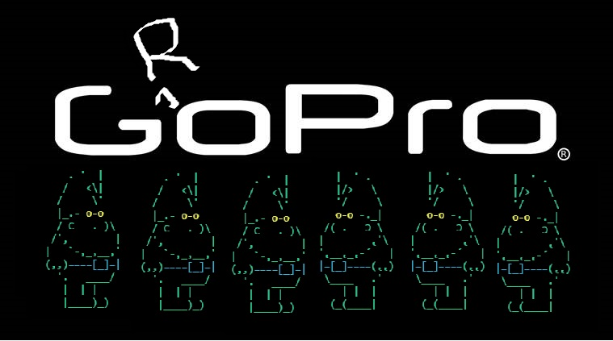
Alex, Clayton & Daniel

Slide 2
Introduction
Our Problem: We want to grow our own food. Do you?
Our solution: Our GroPro Hero App
Initial plans:
  Tracker of plants in garden
  Calendar of when to take certain actions on plants
  Variables such as climate, sunshine hours, difficulty & season
Next, a demonstration on our app.

Slide 3
Demonstration
Pre-existing users:
  farmerjoe@farm.com,

Slide 4
Review
We planned to have 3 Classes initially; User, Garden & Plants, we ended with 4.
Formatting and comparing dates proved a challenge.
Combining code had some minor issues.
YAML was difficult to implement with class variables in code.
UX was prioritized at expense of some functionality.
Progress bar GEM
Conclusion

Slide 5
Thankyou for Watching

