Slide 1
Tourist Guide
Lets Have a Better Tour Experience

Slide 2
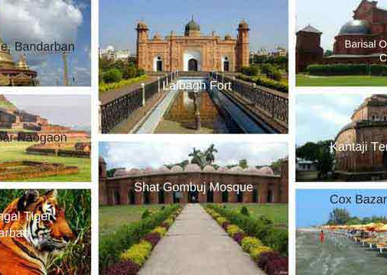
Submitted by:
Kazi Nuzhat Tasnem
2014-1-6-005
Tazin Ahmed
2014-1-60-105
Rajashree Roy
2014-3-60-070

Slide 3
Before starting anything else lets hear a story

Slide 4

This is tarina

Slide 5

She loves to go on a tour but often gets confused about where she should have her next tour.

Slide 6

So lets give her a smart solution for her problem.

Slide 7
Lets find a good way to help her

Slide 8

By using this project Tarina can select a place for her very easily. It also can suggest a place for her if she already had chosen any place for her earlier.

Slide 9
Pros and cons
pros
cons
U can log in/sign up to this project and find a solution.
There are so many limitations in this project. We assumed that the user is in Dhaka but it should take input from user that where s/he is.
The distance of the chosen place should shown from user’s place but it’s showing from Dhaka.

Slide 10
Improvement:
It has only covered a few places within Bangladesh. But we wanna cover the whole world and also include the cost, route and every single details about the chosen place.

Slide 11


Slide 12


