Slide 1
Test Cricket players’ performance analysis
Presented by
Tahiatul Jannath Bhuiyan
Fatema Khanam
Farzana Hannan Hera
Rajosree Roy

Slide 2
Overview
individual graphs
Scored runs
6 players individual performance graphs
Performance time
How many run they took with respect to ball faced
Existing time of 6 players in different match
6
4
Runs vs 4s
Strike rate
2
Runs
How many 4s they took with respect to runs
Strike rate analysis of 6playrs
6 players’ run rate at different innings
5
1
3

Slide 3
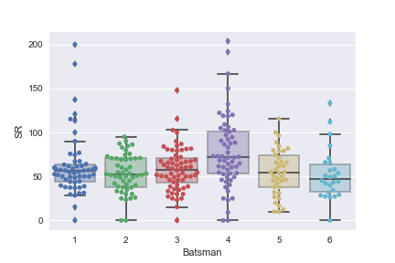
Strike rate

Slide 4

Analysis of strike rate graph
02
03
01
04
05
06
player1
player2
player3
player4
player5
player6
Average Strike rate is around 50, higher outliers
Average SR
in between 40 to 60, have no outliers
higher strike rate than other, around 170
Have some outliers
Almost same as
player 2
Avg SR in between 45 to 75
SR is higher
Than Player1

Slide 5
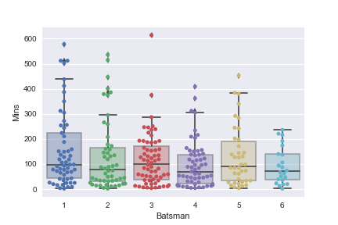
Performance Time

Slide 6
Analysis of Existing time of players
02
03
01
04
05
06
player2
player3
player4
player1
player5
player6
player1’s maximum time around 300
player3 maximum time around 298
player4 maximum time around 350
player1’s maximum time around 445
Better than others
Player5
maximum time around 390
player6 maximum time around 245

Slide 7
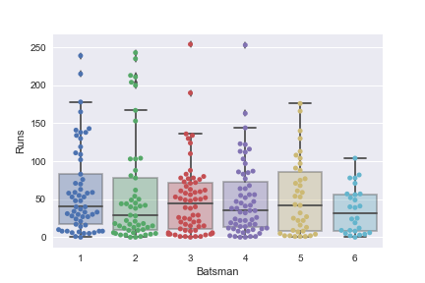
Runs

Slide 8
Analysis of RUNS scored by players
02
03
01
04
05
06
player2
player3
player4
player1
player5
player6
Player2 run rate 160
Player3 run rate 135
player4 run rate 140
Player1 run rate 175,performance is better
Player5
Run 175,which is better
player6 run 110,which is lower than others

Slide 9
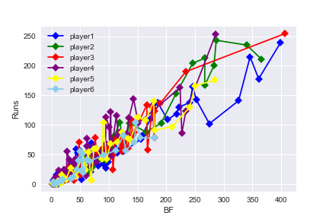
Run with respect to Ball Faced

Slide 10
Analysis of RUNS with respect to ball face
Blue points for player1, green points for player2, red points for player3, purple points are for player4, yellow points are for player5, sky blue points for player6.
player 3 has grater run with respect to ball face
Player 1 and player 2 have average consistency because they have also outliers from 200–250 runs
other player’s run score are below 200.
Player6 has lower run record with respect to ball face comparatively other players.

Slide 11
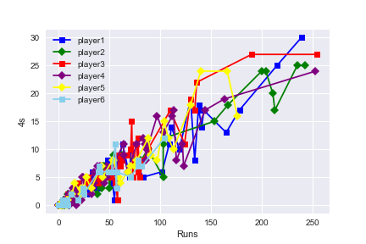
Runs vs 4s Graph analysis
all players have average consistency, the probability of number of 4s is more based on 250-400 ball faced for Player2 but player1, player3, player4 also have outliers.

Slide 12
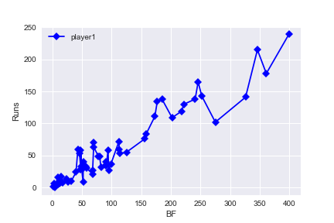
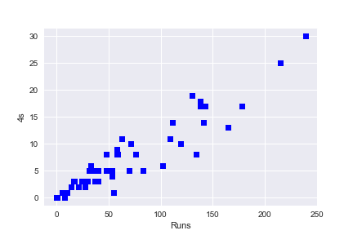
Individual Graphs for player1
Run with respect to ball face
Runs vs 4s Graph analysis

Slide 13
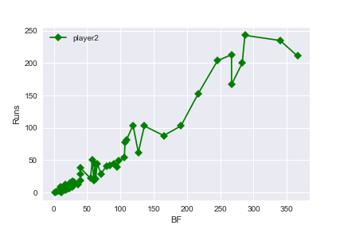
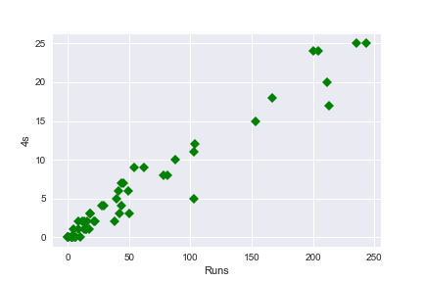
Individual Graphs for player2
Run with respect to ball face
Runs vs 4s Graph analysis

Slide 14
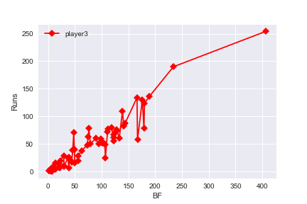
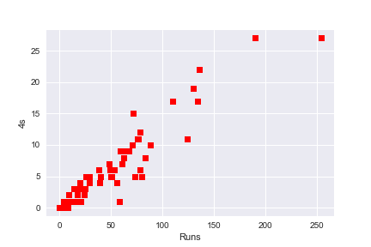
Individual Graphs for player3
Run with respect to ball face
Runs vs 4s Graph analysis

Slide 15
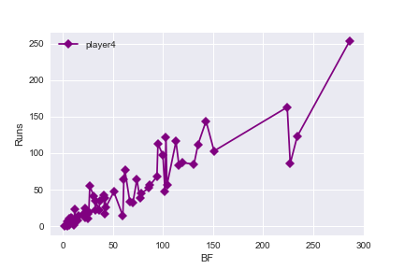
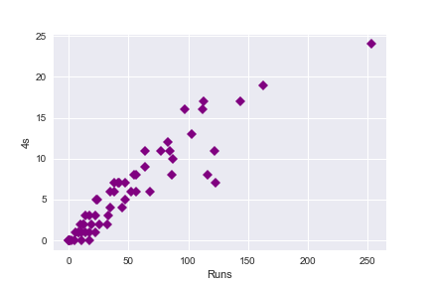
Individual Graphs for player4
Run with respect to ball face
Runs vs 4s Graph analysis

Slide 16
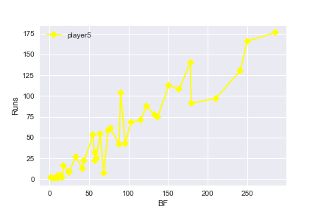
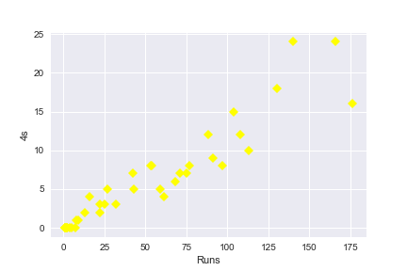
Individual Graphs for player5
Run with respect to ball face
Runs vs 4s Graph analysis

Slide 17
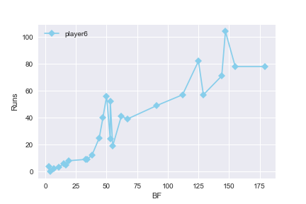
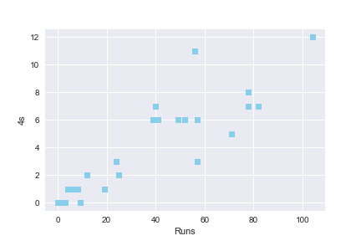
Individual Graphs for player6
Run with respect to ball face
Runs vs 4s Graph analysis

Slide 18
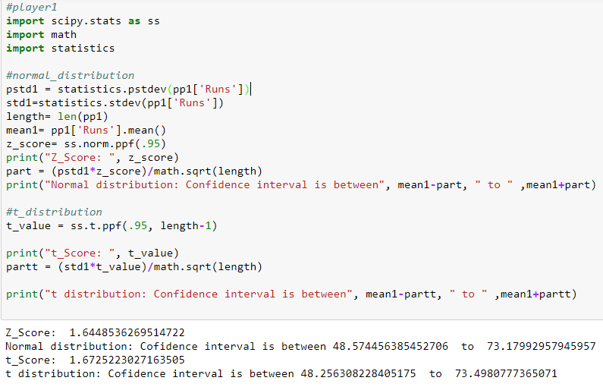
Career Prediction using Normal distribution and t-distribution

Slide 19
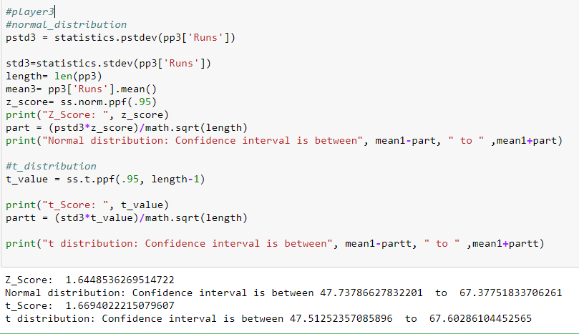
Continue……….

Slide 20
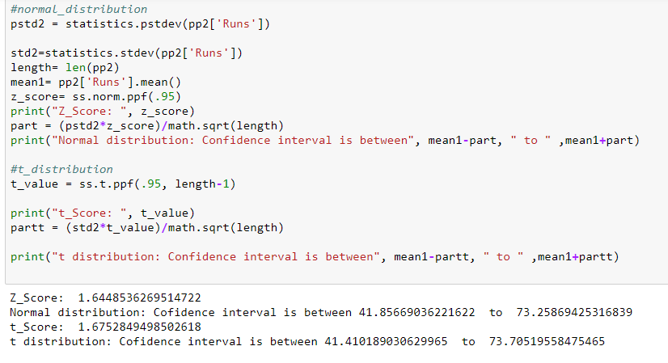
Continue………

Slide 21
Players’ Identification
Player | Calculated Avg SR | Calculated Avg Run | Actual Avg SR | Actual Avg Run | Name
P1 | 61.9495 | 60.8772 | 55.76 | 63.75 | Steven Smith
P2 | 53.2160 | 57.5577 | 58.26 | 53.26 | Virat Kohli
P3 | 58.4177 | 49.0781 | 54.06 | 49.92 | AB De Villiers
P4 | 77.6461 | 49.4068 | 74.73 | 48.77 | David Warner
P5 | 54.7658 | 53.0263 | 55.76 | 53.28 | Joe Root
P6 | 52.7150 | 35.7692 | 55.51 | 38.68 | Tamim Iqbal

Slide 22
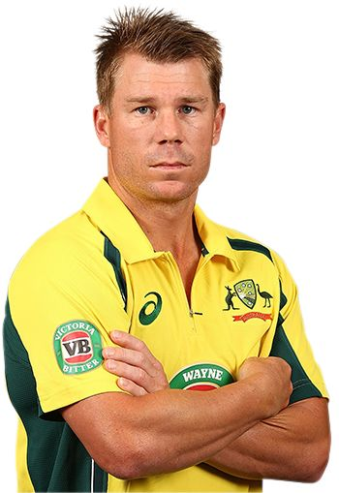
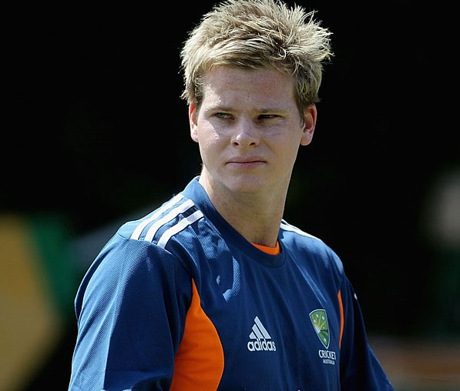
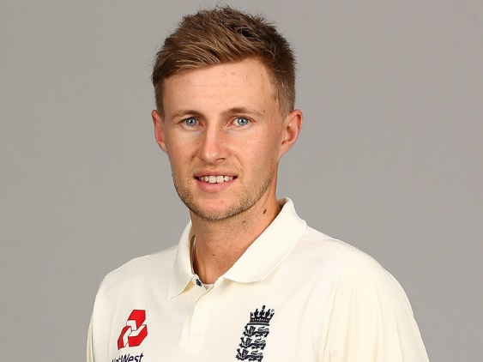
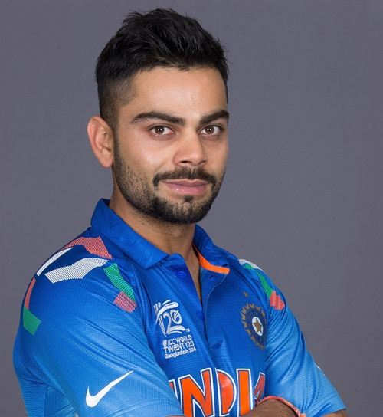
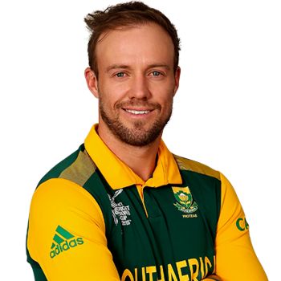
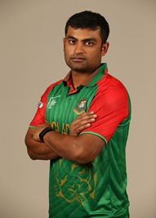
Players Identification
Player 4
Player 5
Player 1
Player 2
Player 3
Player 6

Slide 23


Slide 24


