Slide 1
Overview
Introduction
Genetic Algorithm
fitness function
Ant Colony Optimization Algorithm(min-max ant system)
How both of these algorithm work on parallel distributed database
Experimental Result

Slide 2
Introduction
The speed of query depend on the data transfer and order of join
The paper proposed a query optimized algorithm which is the combination of both Genetic AlgorithmAnt Colony Optimization Algorithm(min-max ant system)

Slide 3
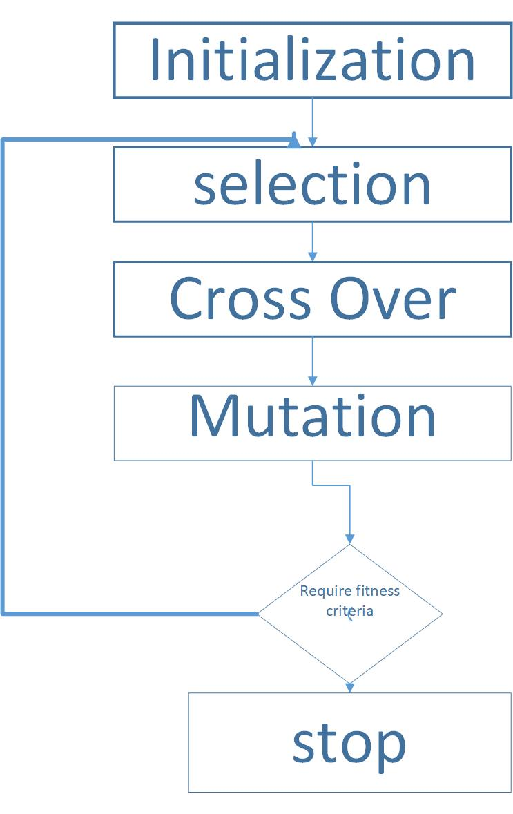
Genetic Algorithm

Slide 4
fitness function
The fitness function is defined over the genetic representation and measures the quality of the represented solution.
The fitness function is always problem dependent.
Fitness function value is inversely proportional to the cost of QEP, the higher the fitness function value is,
the more optimal corresponding QEP is
f (x) =1/ COST(x)

Slide 5
Selection
Relevant data
Irrelevant data

Slide 6
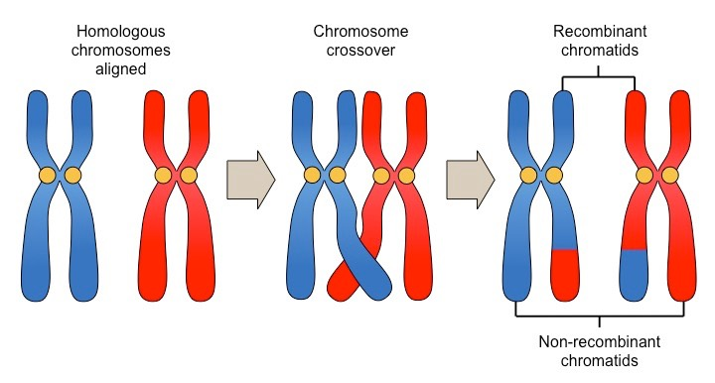
Genetic Algorithm
Cross Over

Slide 7
Genetic Algorithm(Contd…)
Cross Over(Contd…)
Choose the cross region from code of two maternal individuals.
24|6317|58
85|7136|42

Slide 8
Genetic Algorithm(Contd…)
Cross Over(Contd…)
Add cross region to each other
7136|24|6317|58
6317|85|7136|42

Slide 9
Genetic Algorithm (Contd…)
Cross Over(Contd…)
Remove the duplicate chromosomes, then get the new
individual.
71362458
63178542

Slide 10
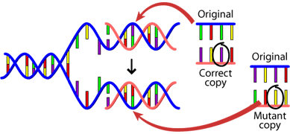
Genetic Algorithm (Contd…)
Mutation

Slide 11
Genetic Algorithm (Contd…)
Mutation (Contd…)
Select the best fitness value
71362458
63178542

Slide 12
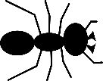
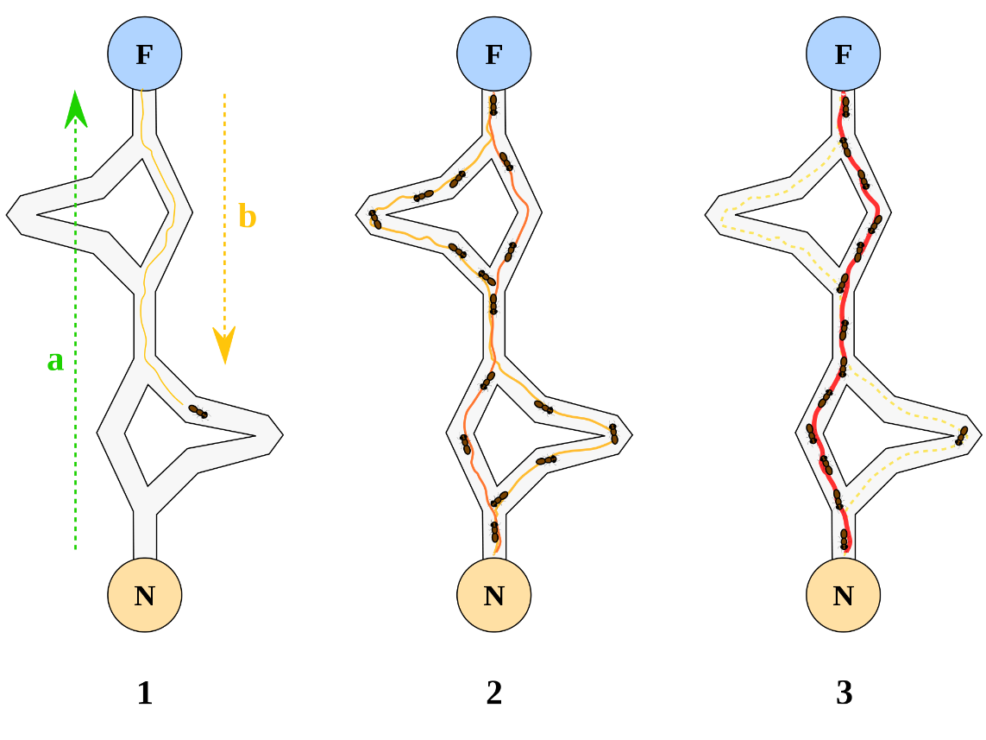

Ant Colony Optimization Algorithm(min-max ant system)
Optimal path

Slide 13
Ant Colony Optimization Algorithm(min-max ant system)
Set the minimum and maximum genetic iterations.
Calculate evolution rate of offspring population in genetic algorithm, set the minimum evolution rate.
Compare evolution rate,and find the optimal solution

Slide 14

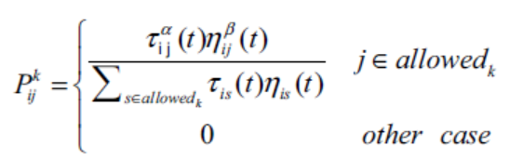

Ant Colony Optimization Algorithm(min-max ant system)
initial pheromone is set
Transition probability
Pheromone update

Slide 15
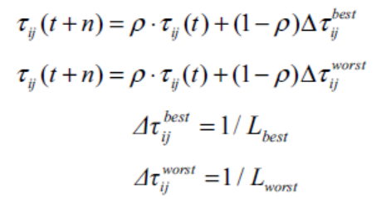
Ant Colony Optimization Algorithm(min-max ant system)
Global pheromone updating formula

Slide 16
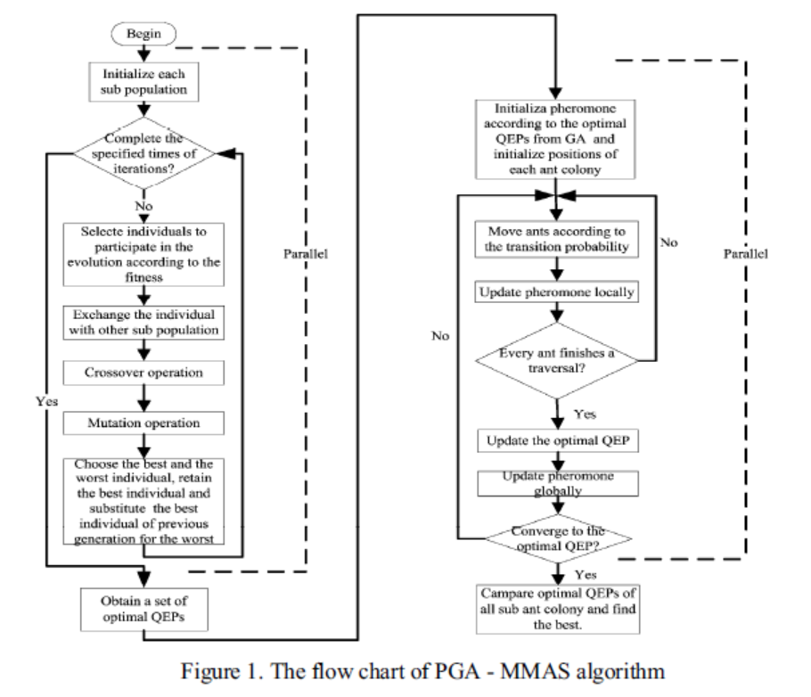
How both of these algorithm work on parallel distributed database

Slide 17
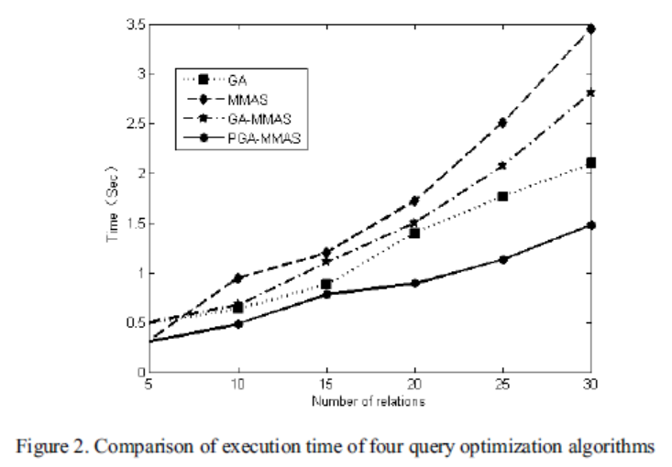
EXPERIMENTAL RESULTS

Slide 18
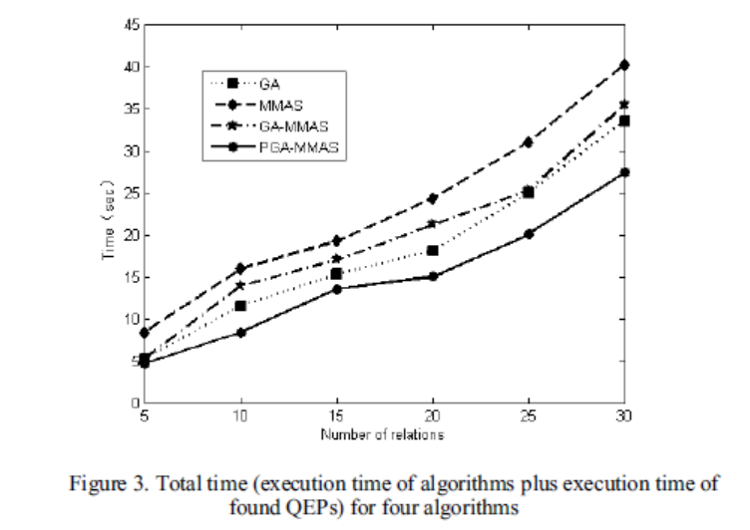
EXPERIMENTAL RESULTS

Slide 19


Slide 20


