Slide 2
OpenCelliD is BigData collection of Cell Towers and WiFi Aps. This database is built by the community and is free available for download. The row count is 39,374,666 The size is 3.12 GB, Last updated on : 2018-02-14

Slide 3
Remove Duplicates
SELECT [radio],[mcc],[net],[area],[cell],[unit],[lon],[lat],[range],[samples],[changeable],[created],[updated],[averageSignal]
,col3=count(*)
INTO holdkey
FROM [Opencellid].[dbo].[cell_towers_2018-01-31-T10-00-01]
GROUP BY [radio],[mcc],[net],[area],[cell],[unit],[lon],[lat],[range],[samples],[changeable],[created],[updated],[averageSignal]
HAVING count(*) > 1

Slide 4
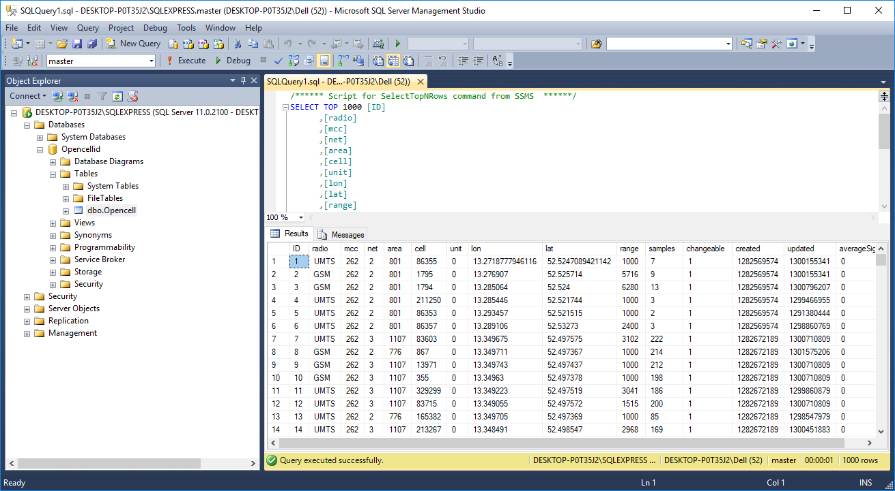
Database

Slide 5
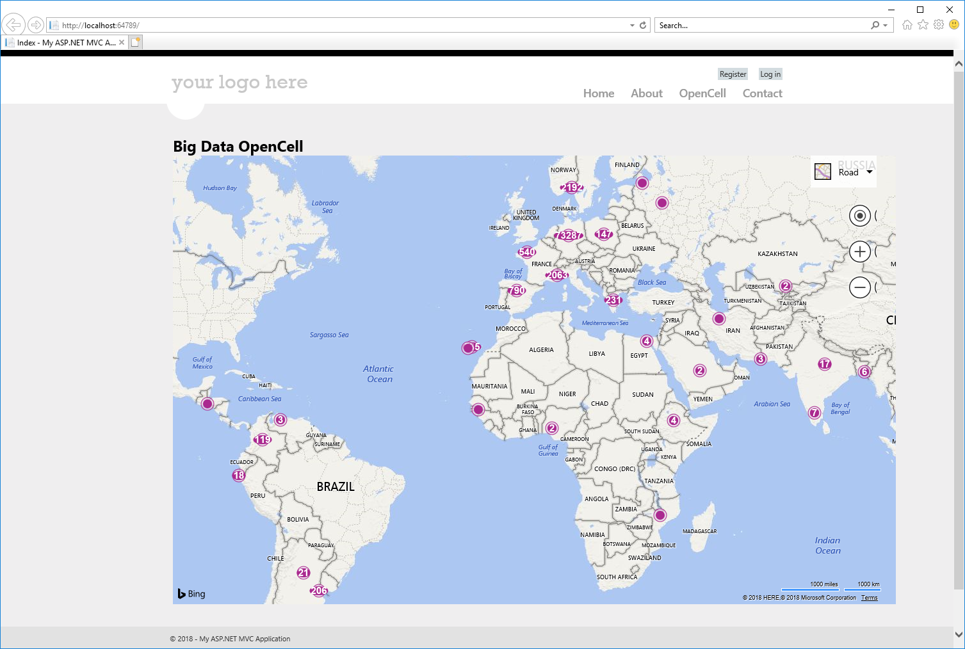

Slide 6
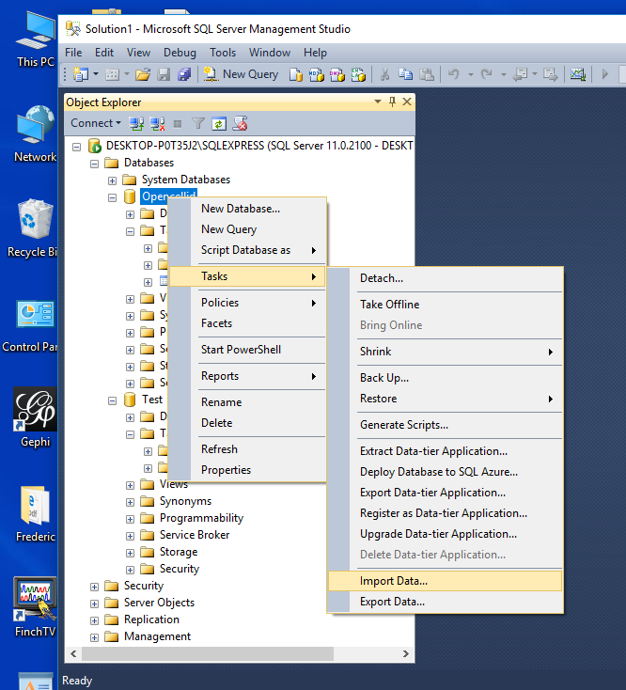
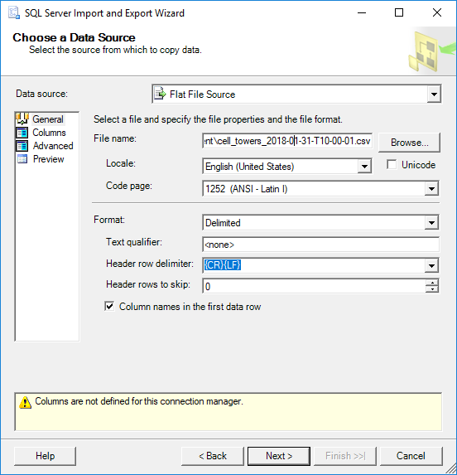
Create A new Database in SQL, name “Opencellid”.
Import Data using Task-> Import Data”
Choose “Flat File Source” and choose “Cell-tower.csv”

