Slide 1

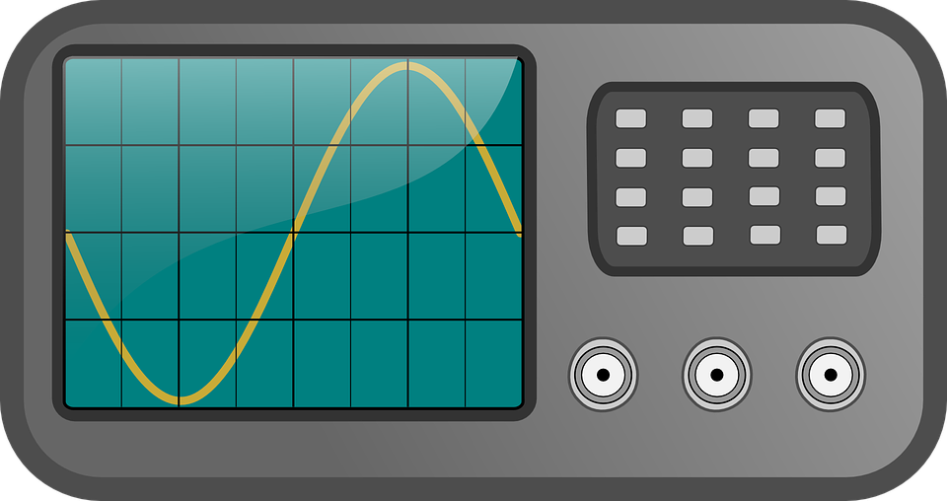
(He-Ne, λ=633 nm)
M
laser
Beam expander
L
L
SLM
M
PH
camera
M
PD
L
L
SMF
M
oscilloscope
BS
Notes:
Intensity profile setup. BS = beam splitter; M = mirror;

Slide 2

(He-Ne, λ=633 nm)
M
laser
Beam expander
L
L
SLM
M
PH
M
BS
BP
L
PD
L
oscilloscope
SMF
Notes:
Intensity profile setup. BP = beam profiler, in place of a camera.

