Slide 1
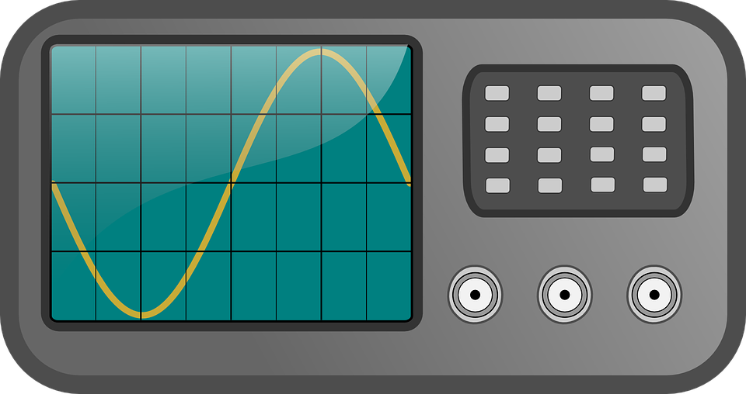

(He-Ne, λ=633 nm)
M
laser
Beam expander
L
L
SLM
M
PH
L
PD
L
oscilloscope
SMF
Notes:
SMF setup. L = spherical lens; PH = pinhole; SLM = spatial light modulator; SMF = single mode fiber; PD = photodetector

Slide 2
(He-Ne, λ=633 nm)
M
laser
Beam expander
L
L
SLM
M
PH
M
BS
camera
L
PD
L
oscilloscope
SMF
Notes:
Intensity profile setup. BS = beam splitter; M = mirror;

Slide 3
(He-Ne, λ=633 nm)
M
laser
Beam expander
L
L
SLM
M
PH
M
BS
BP
L
PD
L
oscilloscope
SMF
Notes:
Intensity profile setup. BP = beam profiler, in place of a camera.

