Slide 1
Predictor-Corrector Methods for IVPs
MATH 327 Numerical analysis
Minhwa (mina) Lee

Slide 2
Outline
Background of Predictor-Corrector Methods
Adams 4th-order Predictor-Corrector Method
Milne-Simpson Predictor-Corrector Method
Examples & Error Analysis & Stability

Slide 3
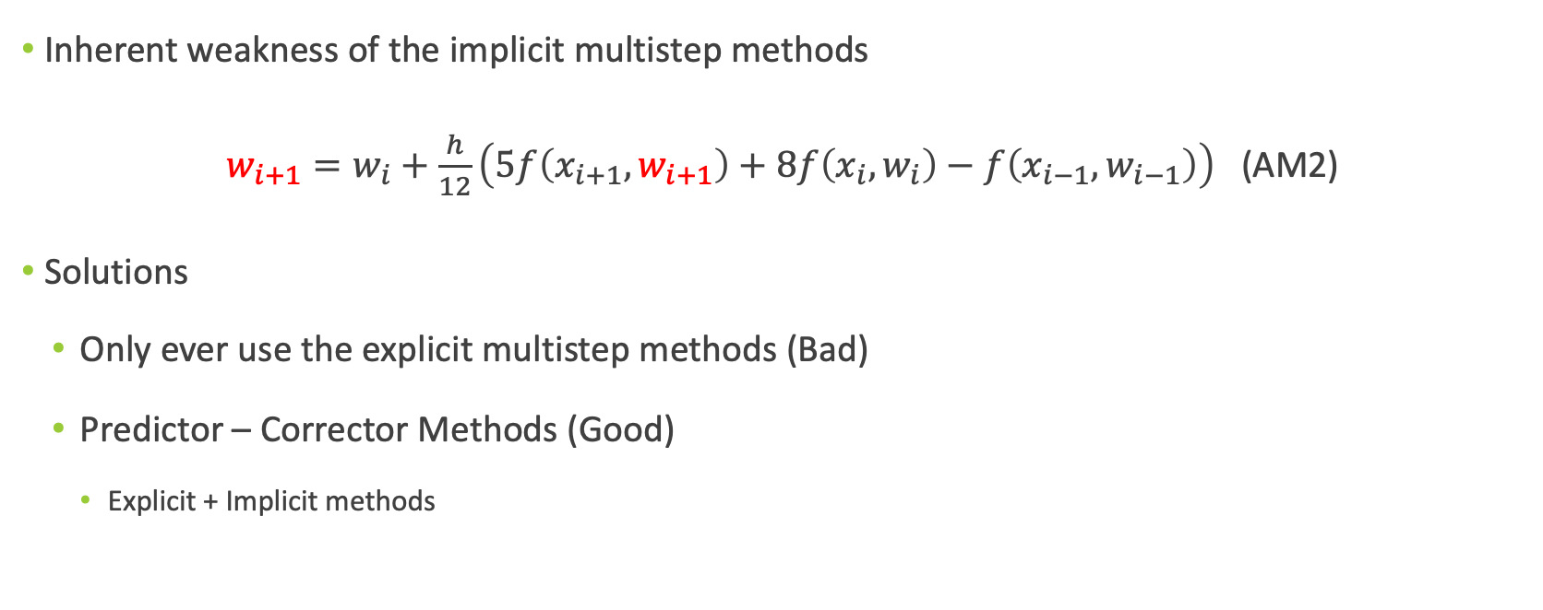
What is a Predictor-Corrector Method?
Inherent weakness of the implicit multistep methods
$w_{i+1}=w_{i}+\frac{h}{12}\left(5f\left(x_{i+1}, w_{i+1}\right)+8f\left(x_{i}, w_{i}\right)−f\left(x_{i−1}, w_{i−1}\right)\right)$ (AM2)
Solutions
Only ever use the explicit multistep methods (Bad)
Predictor – Corrector Methods (Good)
Explicit + Implicit methods

Slide 4
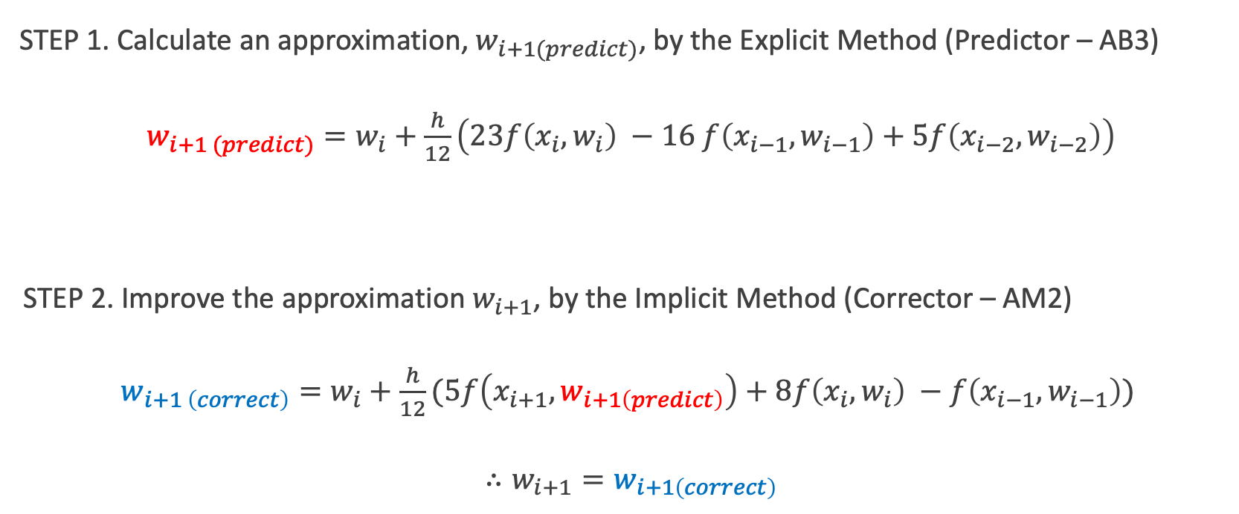
STEP 1. Calculate an approximation, $w_{i+1(predict)}$, by the Explicit Method (Predictor – AB3)
$w_{i+1 (predict)}=w_{i}+\frac{h}{12}\left(23f\left(x_{i}, w_{i}\right) −16 f\left(x_{i−1}, w_{i−1}\right)+5f\left(x_{i−2}, w_{i−2}\right)\right)$
STEP 2. Improve the approximation $w_{i+1}$, by the Implicit Method (Corrector – AM2)
$w_{i+1 \left(correct\right)}=w_{i}+\frac{h}{12}(5f\left(x_{i+1}, w_{i+1\left(predict\right)}\right)+8f\left(x_{i}, w_{i}\right) −f\left(x_{i−1}, w_{i−1}\right))$
$∴w_{i+1}=w_{i+1\left(correct\right)}$

Slide 5
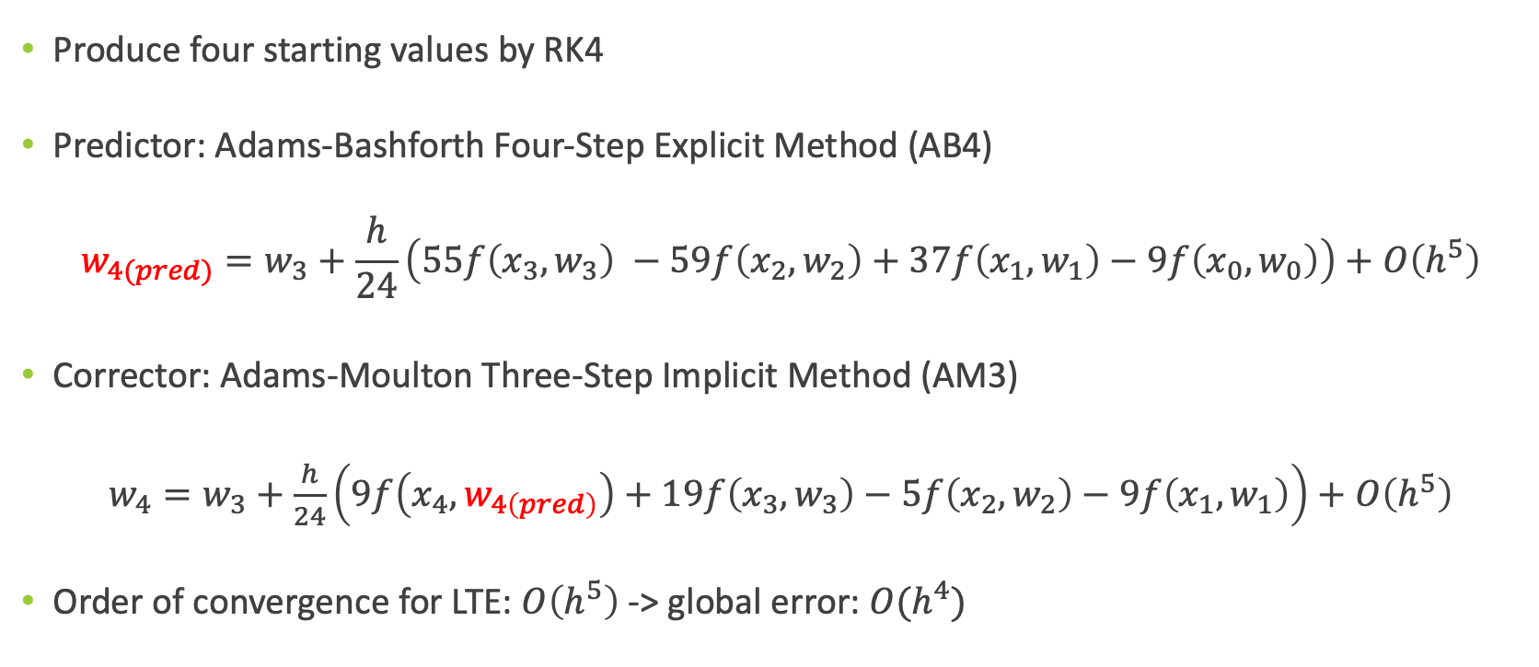
1. Adams 4th-order Predictor-Corrector (ABM4)
Produce four starting values by RK4
Predictor: Adams-Bashforth Four-Step Explicit Method (AB4)
$$w_{4(pred)}=w_{3}+\frac{h}{24}\left(55f\left(x_{3},w_{3}\right) −59f\left(x_{2},w_{2}\right)+37f\left(x_{1},w_{1}\right)−9f\left(x_{0},w_{0}\right)\right)+O\left(h^{5}\right)$$
Corrector: Adams-Moulton Three-Step Implicit Method (AM3)
$w_{4}=w_{3}+\frac{h}{24}\left(9f\left(x_{4},w_{4\left(pred\right)}\right)+19f\left(x_{3},w_{3}\right)−5f\left(x_{2},w_{2}\right)−9f\left(x_{1},w_{1}\right)\right)+O\left(h^{5}\right)$
Order of convergence for LTE: $O\left(h^{5}\right)$ -> global error: $O(h^{4})$

Slide 6
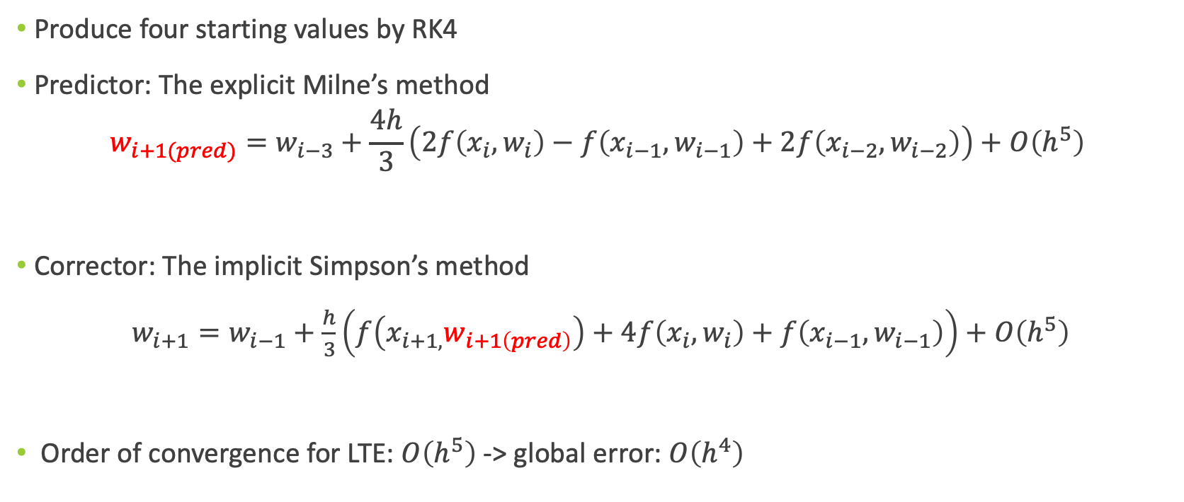
2. Milne-Simpson Predictor-Corrector (MS)
Produce four starting values by RK4
Predictor: The explicit Milne’s method
$$w_{i+1(pred)}=w_{i−3}+\frac{4h}{3}\left(2f\left(x_{i}, w_{i}\right)−f\left(x_{i−1}, w_{i−1}\right)+2f\left(x_{i−2}, w_{i−2}\right)\right)+O\left(h^{5}\right)$$
Corrector: The implicit Simpson’s method
$w_{i+1}=w_{i−1}+\frac{h}{3}\left(f\left(x_{i+1, }w_{i+1\left(pred\right)}\right)+4f\left(x_{i}, w_{i}\right)+f\left(x_{i−1}, w_{i−1}\right)\right)+O\left(h^{5}\right)$
Order of convergence for LTE: $O\left(h^{5}\right)$ -> global error: $O\left(h^{4}\right)$

Slide 7
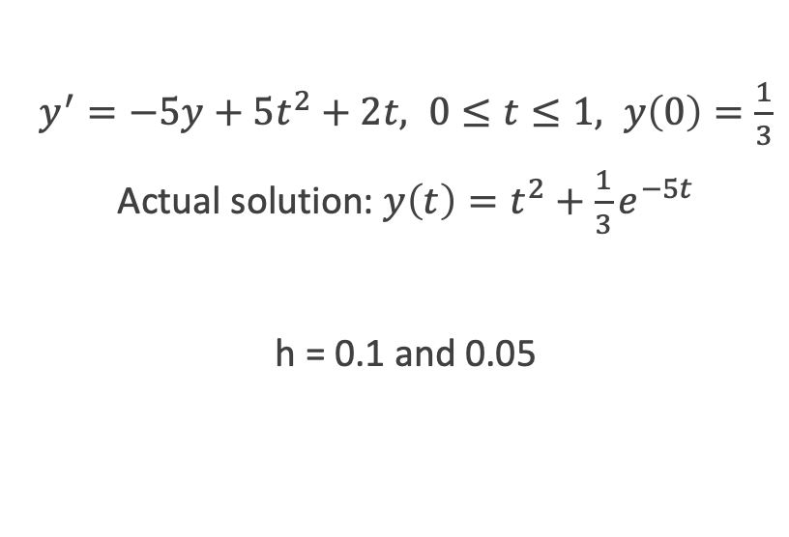

Examples
1. Exercise 4a in CH 5.6
2. Exercise 3d in CH 5.6
$y^{′}=\frac{2 −2ty}{t^{2}+1}, 0≤t≤1, y\left(0\right)=1$
Actual solution: $y\left(t\right)=\frac{2t+1}{t^{2}+1}$
h = 0.1 and 0.05
$y^{′}=−5y+5t^{2}+2t, 0≤t≤1, y\left(0\right)=\frac{1}{3}$
Actual solution: $y\left(t\right)=t^{2}+\frac{1}{3}e^{−5t}$
h = 0.1 and 0.05

Slide 8
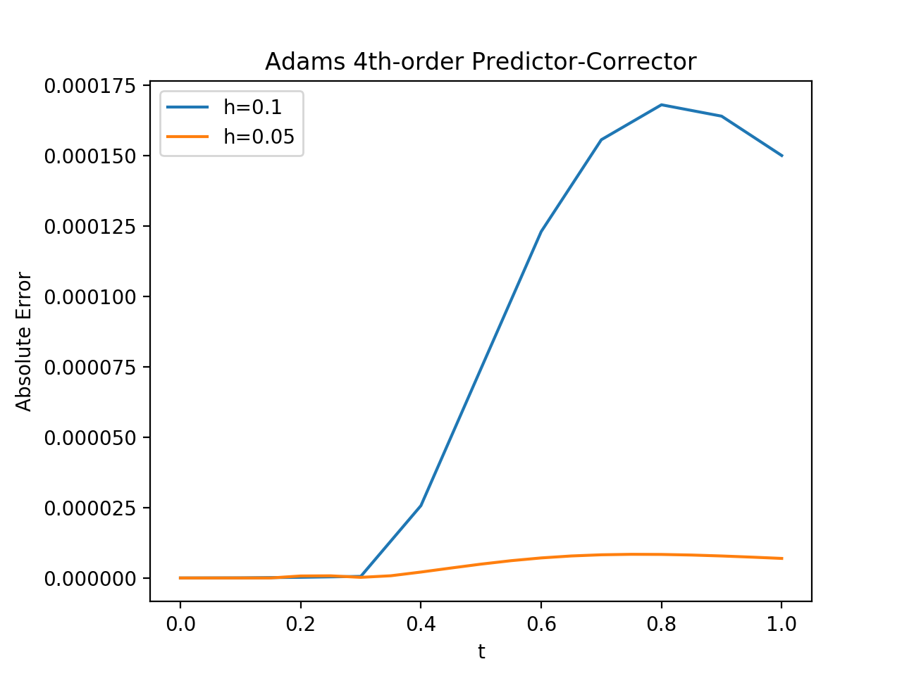
Error Analysis by ABM4
t | E (h = 0.1) | E (h = 0.05) | Ratio
0.1 | 4.72e-8 | 3.29e-9 | 14
0.5 | 7.44e-5 | 4.93e-6 | 15
0.9 | 1.64e-4 | 7.82e-6 | 20
Figure 1. ABM4 from Ex.1

Slide 9
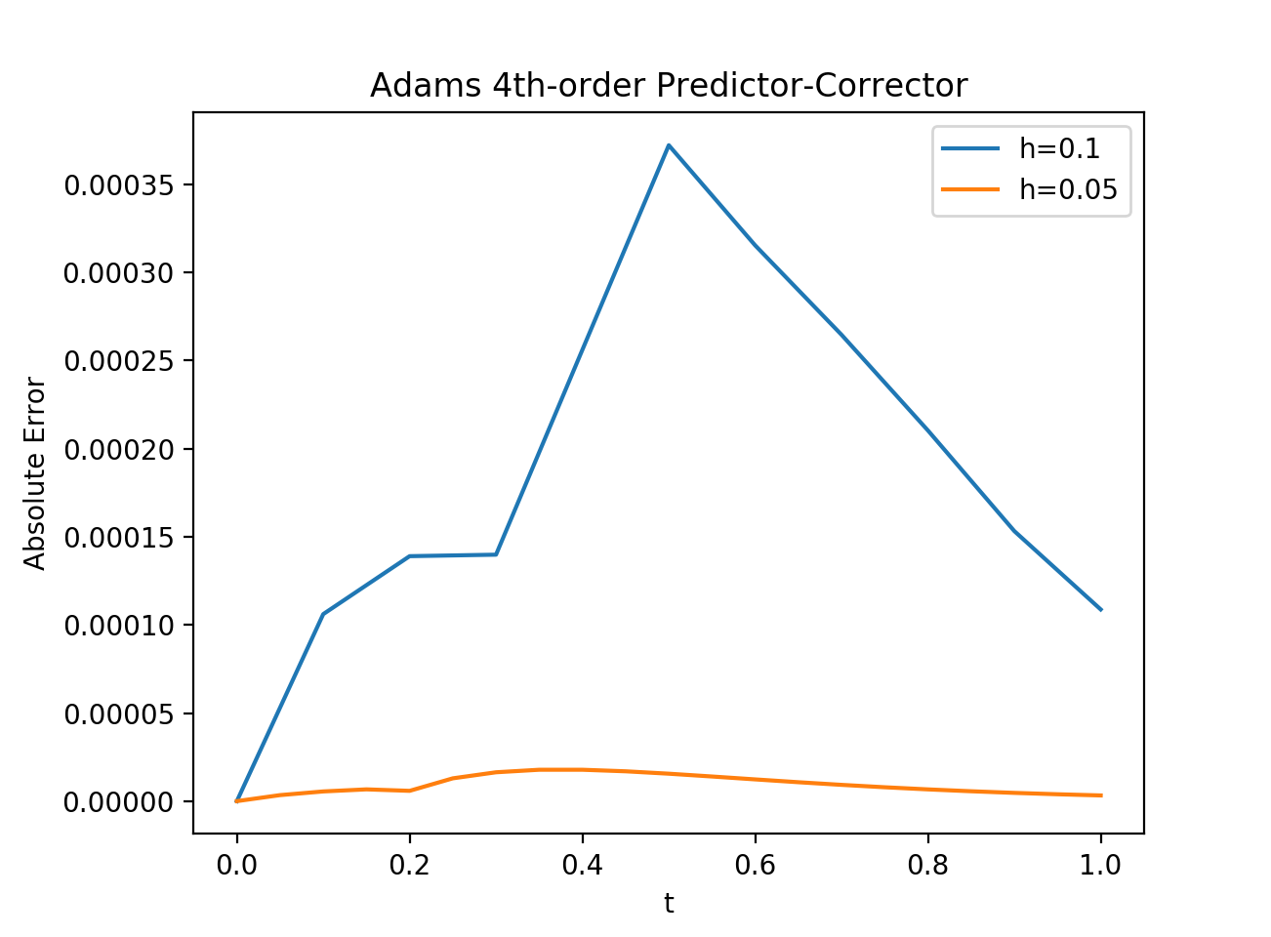
t | E (h = 0.1) | E (h = 0.05) | Ratio
0.1 | 0.00011 | 5.50e-6 | 17
0.4 | 0.00026 | 1.78e-5 | 14
0.5 | 0.00037 | 1.56e-5 | 18
Close to fourth-order global error
Figure 2. ABM4 from Ex. 2

Slide 10
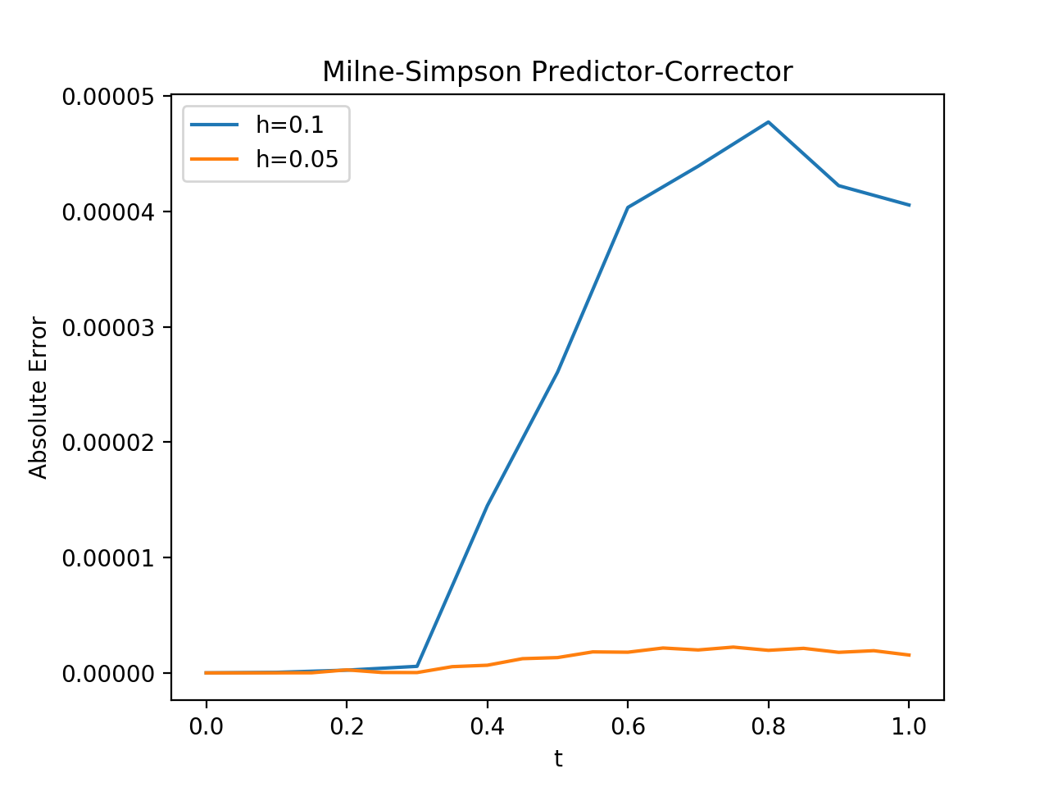
Error Analysis by MS
t | E (h = 0.1) | E (h = 0.05) | Ratio
0.1 | 4.72e-8 | 3.29e-9 | 14
0.5 | 2.61e-5 | 1.33e-6 | 19
0.9 | 4.22e-5 | 1.78e-6 | 23
Figure 3. MS from Ex. 1

Slide 11
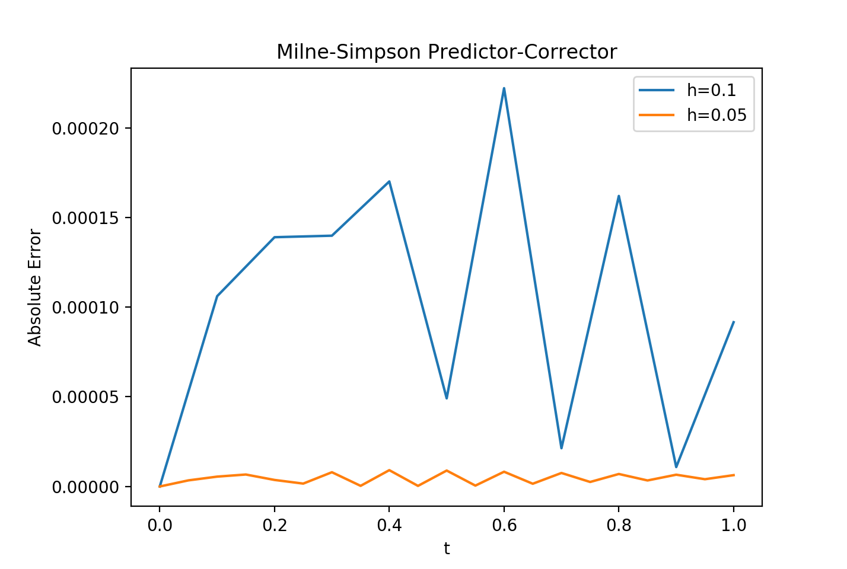
t | E (h = 0.1) | E (h = 0.05) | Ratio
0.1 | 1.06e-4 | 5.50e-6 | 19
0.3 | 1.40e-4 | 7.95e-6 | 17
0.4 | 1.70e-4 | 9.10e-6 | 18
Close to fourth-order global error

Slide 12
Error Analysis Comparison
Figure 2. ABM4 from Ex. 2
Figure 4. MS from Ex. 2

Slide 13
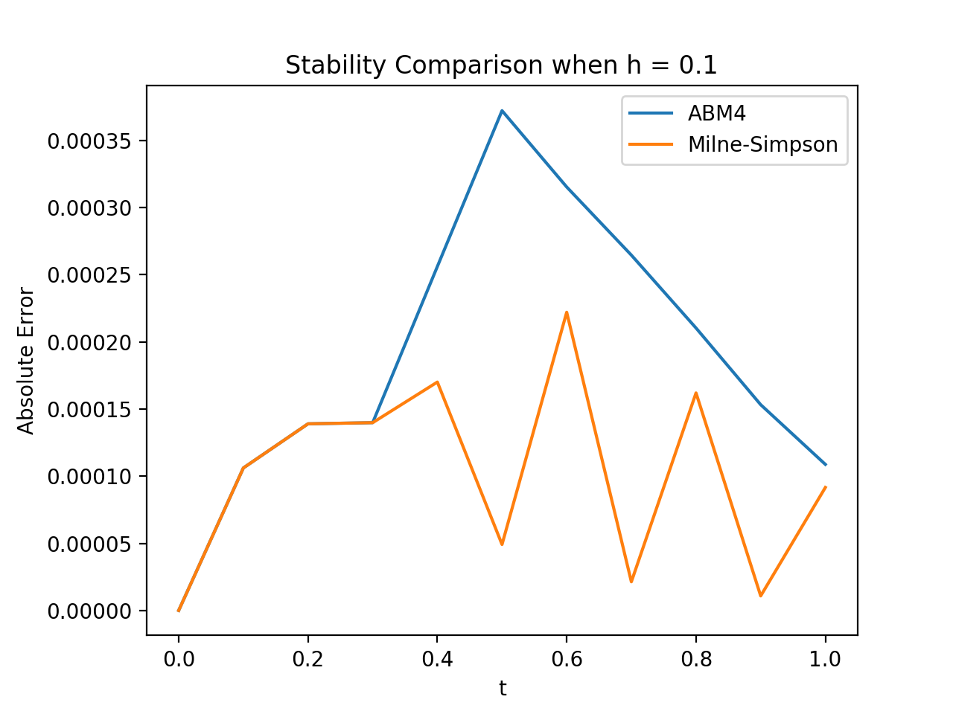
Stability
Strongly Stable: Adams-Bashforth-Moulton
Weakly Stable: Milne-Simpson
Round-off error > Local truncation error
Limited use
Figure 5. Stability Comparison from Ex. 2

Slide 14
Future Works
Explore another Predictor-Corrector methods
Ex. Adams Variable Step-size Predictor-Corrector
Examine Mathematical Interpretations of Stability in the Multistep methods

Slide 15
References
Richard L. Burden, J. Douglas Faires, and Annette M. Burden, Numerical Analysis, 10th edition, Cengage Learning, 2014.
Vladimir Dobrushkin, Mathematical Tutorial for the first course – Part IV: Milne’s Method, http://www.cfm.brown.edu/people/dobrush/am33/Mathematica/milne.html

