Slide 1
AWS AGENTIC AI HACKATHON · LEAP
GovEase
One conversation instead of four government visits
Team TEAM_NAME_TBD

Slide 2
FUTURE VISION
The Team
MEMBER_1_TBD
Wahed

Slide 3
FUTURE VISION
The Problem
Who it affects
Omar Haddad, a bakery owner in Deira who moved his shop to Al Quoz. His trade license expires in 20 days, and his last renewal was rejected because a supporting certificate had quietly expired.
The measurable claim
Turns four department visits and one rejection cycle into one confirmed conversation, and catches the rejection before submission.

Slide 4
FUTURE VISION
What the Agent Does
• Reads the uploaded Emirates ID, trade license, Ejari and tax certificate with Amazon Textract
• Flags the expired tax clearance and the Deira-to-Al Quoz address mismatch before anything is filed
• Sequences the linked services in dependency order from the policy Knowledge Base: tax clearance, address change, license renewal
• Asks for consent, then submits all three across departments and returns tracking ids and dates
• Tracks status, flags overdue applications and notifies Omar in Arabic

Slide 5
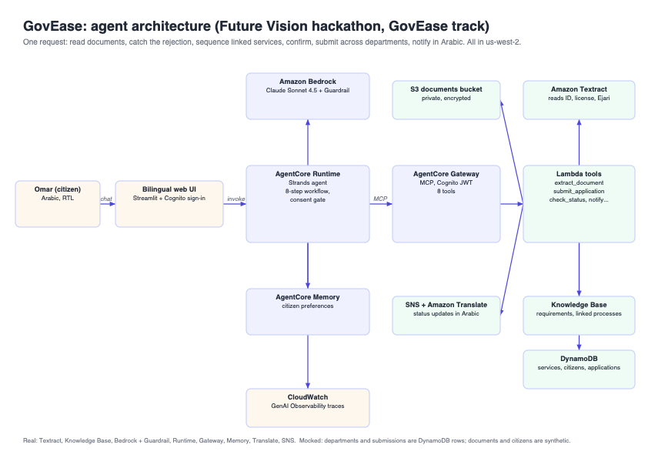
FUTURE VISION
Architecture
Kiro-built Strands agent on AgentCore Runtime with Claude Sonnet 4.5 on Bedrock and the baseline Guardrail. Eight tools run as a Lambda behind AgentCore Gateway (JWT via Cognito): Textract extraction with validity flags, Knowledge Base retrieval, DynamoDB services and applications, SNS plus Amazon Translate notifications. AgentCore Memory keeps citizen preferences. Traces in CloudWatch GenAI Observability.

Slide 6
FUTURE VISION
Live Demo: the aha moment
• Omar signs in to the Arabic right-to-left UI and asks to renew his license and update his address
• Agent reads four documents, finds the expired tax clearance and the address mismatch
• Agent proposes three services in order, 170 AED, 12 business days, and asks for consent
• Omar confirms; agent submits across three departments and returns three tracking ids
• Trace shows 12 autonomous tool calls; a request to backdate the certificate is refused

Slide 7
FUTURE VISION
Impact
• Customer impact: one named business owner, zero wasted trips, rejection prevented before filing
• Agentic depth: one request, 12 tool calls across Textract, Knowledge Base, DynamoDB, SNS, Translate
• Regional relevance: Ejari and trade-license flow, Arabic replies, right-to-left interface
• Honest limits: departments and submissions are mocked in DynamoDB; documents are synthetic

Slide 8
FUTURE VISION
What We Would Build Next
• UAE Pass sign-in and real DET, Ejari and FTA APIs behind the same Gateway tools
• Proactive follow-up: memory-driven status checks and reminders before expiry dates
• Cedar policies on the Gateway so submit_application is only allowed after a confirmation event
• Evaluations that score 'verified requirements before submitting' on every session

Slide 9
Thank you
Team TEAM_NAME_TBD · GovEase

