Slide 1
MiMPI:
Multithread Implementation of MPI
Félix García Carballeira
Jesus Carretero Pérez
Alejandro Calderón Mateos
http://arcos.inf.uc3m.es/~mimpi

Slide 2
Index
  Introduction.
  Objectives.
  MiMPI Design.
  Evaluation.
  Summary.

Slide 3
A MPI Introduction
MPI defines a Message Passing Interface.
MPI Objectives:
  Efficiency.
  Portability.
  Functionality.
Current version is MPI 2.0 (1997).
http://www.mpi-forum.org

Slide 4
Parallel programming: new models but no ideal tools.
communication network
Message passing
memory
Shared memory
thread
process
MPI multi-thread-safe implementations

Slide 5
Objectives
  To offer a thread-safe implementation of MPI.
  To use threads inside MPI implementation.
  To be easily portable to different platforms.

Slide 6
Why a multi-thread implementation of MPI?
  To improve performance in both, asynchronous and collective services.
  To enhance MPI design.
  Natural integration within clustering and parallel computing.

Slide 7
Design
MPI
PVM
...
XMP compressed
XMP
...
Shared Memory
TCP/IP
...
Win32
Unix
...

Slide 8
Collective service breakdown: MPI_Bcast
1
3
0
3
3
2
3
0
2
3
1
3
3
3
4
3
3
4
3
3
One level tree
Binary tree

Slide 9
Collective service breakdown: multi-operation execution
1
3
3
3
3
2
3
0
0
0
3
3
3
3
1
1
3
3
2
2
3
3
3
3
Consecutive sends
Overlapped sends.

Slide 10
Collective service breakdown:
Parallel send/receive services
Send request
Receive request
***
***
request queue
request queue
sends daemon
receives daemon

Slide 11
Improving MPI implementation...
  Use threads: best performance both asynchronous and collective services.
  Use compression: shorter message and less Ethernet collisions.

Slide 12
Evaluation
Benchmarks:
  Ping-Pong.
  Multi-threaded Ping-Pong.
  Ping-Pong with compression.
  Broadcast.
MPI Implementations:
  WMPI.
  MiMPI.
Platform:
  Windows 2000.

Slide 13
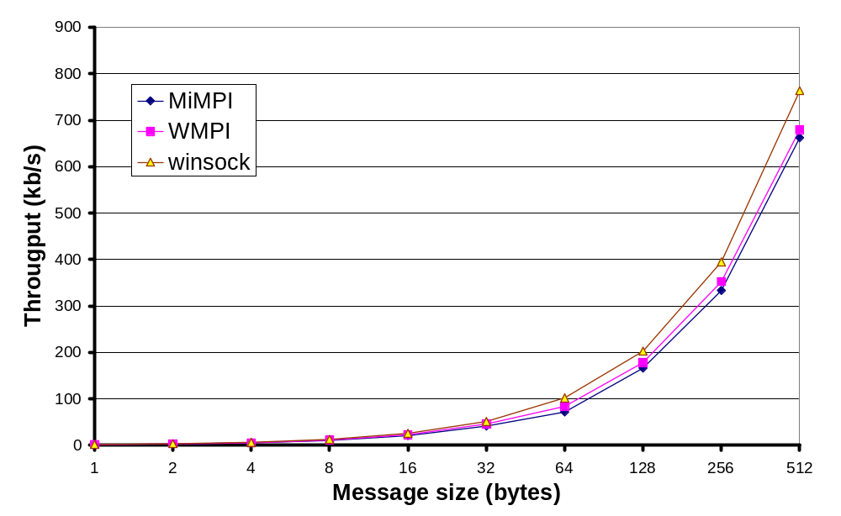
Ping-Pong. Short Messages

Slide 14
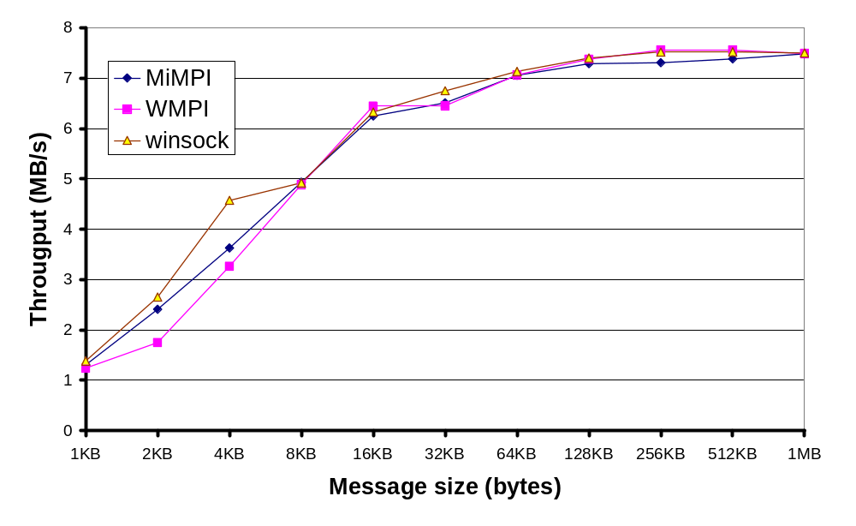
Ping-Pong. Large Messages

Slide 15
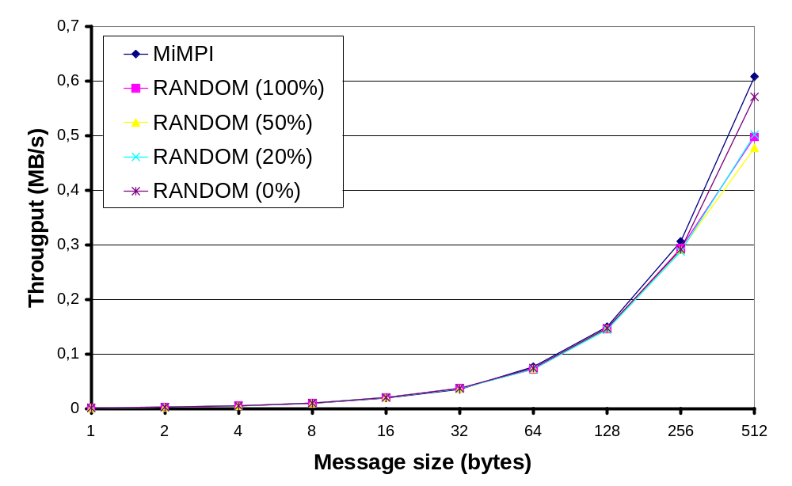
Ping-Pong.
MiMPI with compression (1/2)

Slide 16
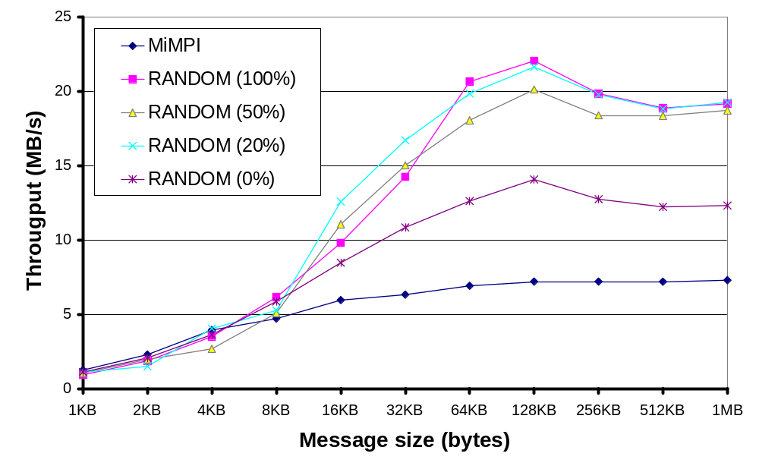
Ping-Pong.
MiMPI with compression (2/2)

Slide 17
Multi-threaded Ping-Pong
0
1

Slide 18
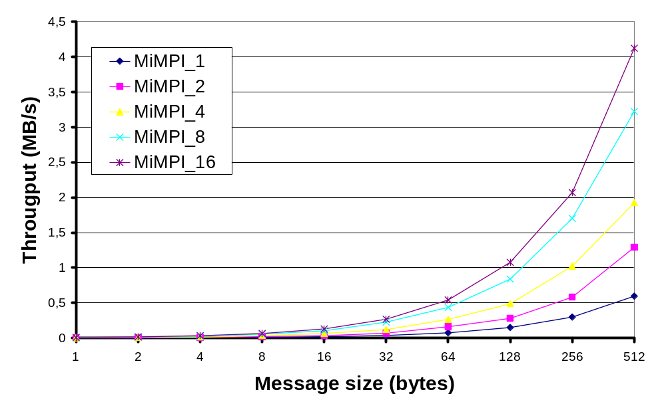
Multi-threaded Ping-Pong using MiMPI (1/2)

Slide 19
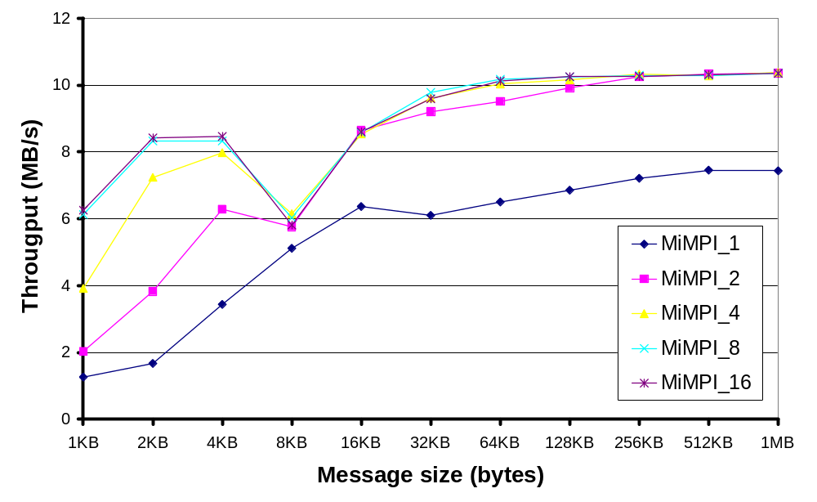
Multi-threaded Ping-Pong using MiMPI (2/2)

Slide 20
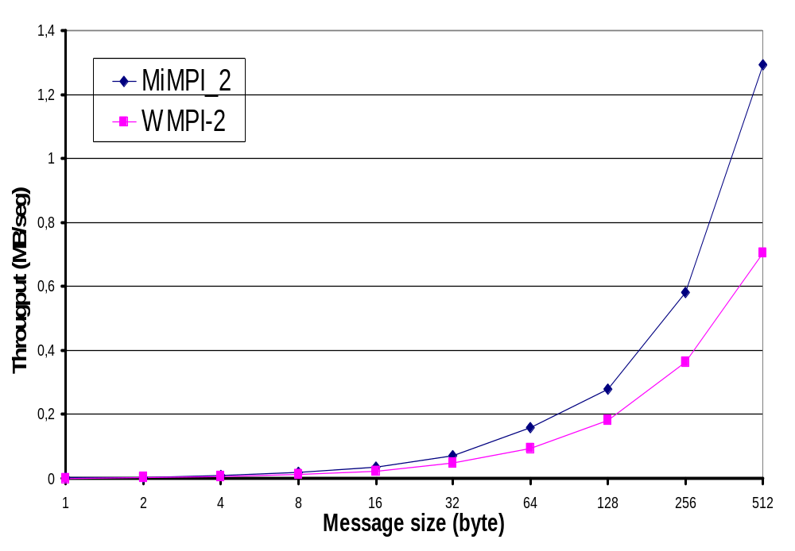
Multi-threaded Ping-Pong using 2 threads (1/2)

Slide 21
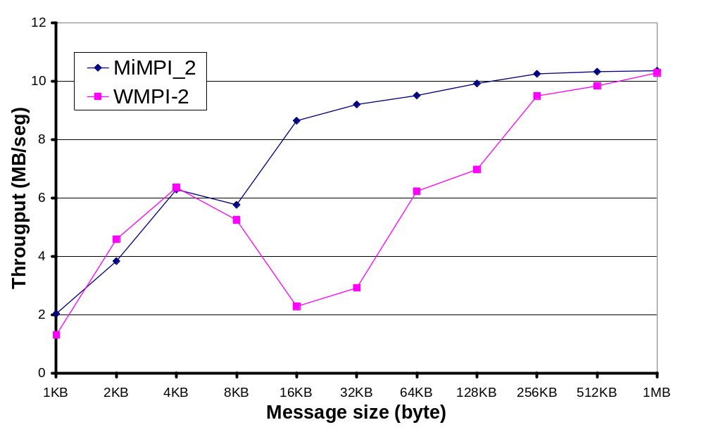
Multi-threaded Ping-Pong using 2 threads (2/2)

Slide 22
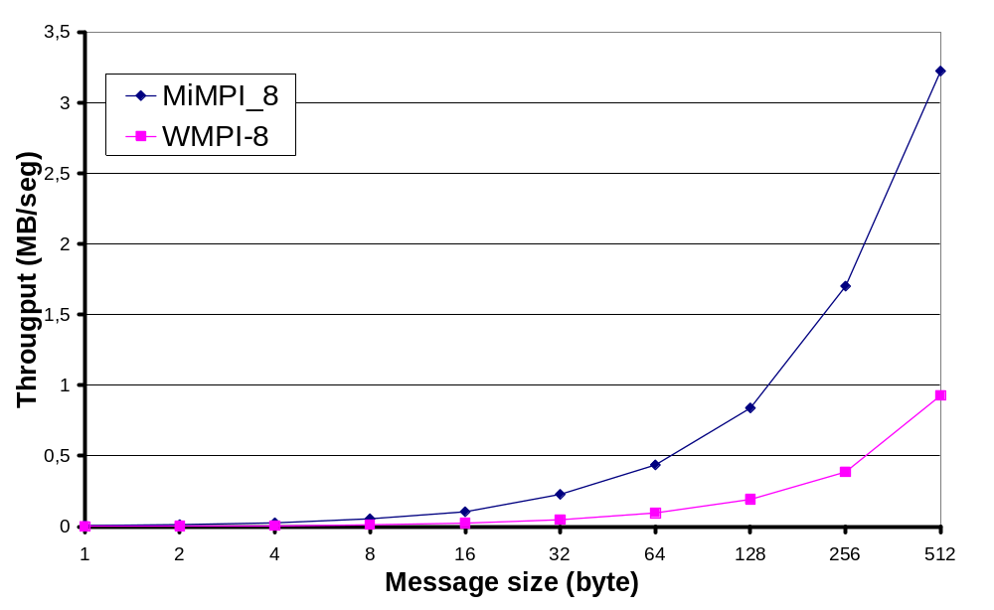
Multi-threaded Ping-Pong using 8 threads (1/2)

Slide 23
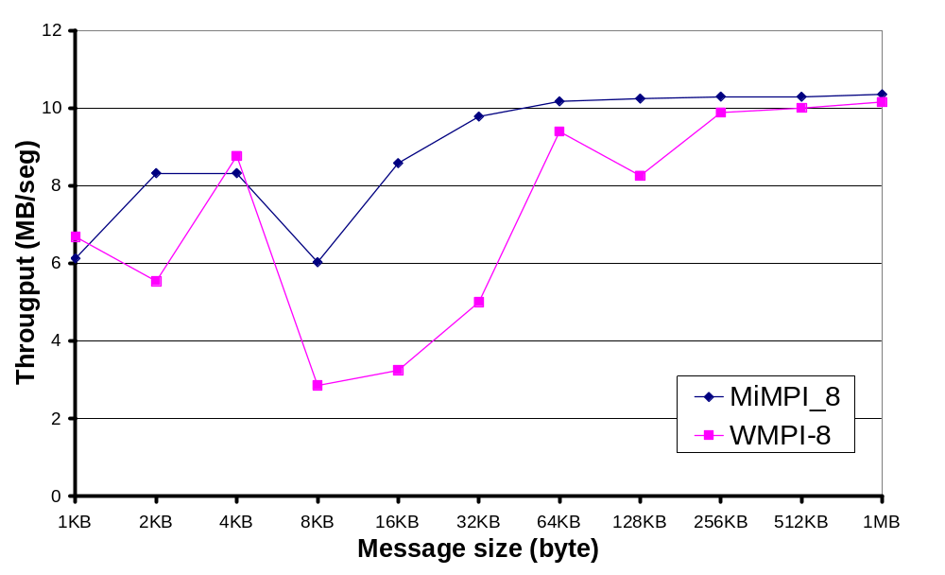
Multi-threaded Ping-Pong using 8 threads (2/2)

Slide 24
Broadcast
0
3
1
2

Slide 25
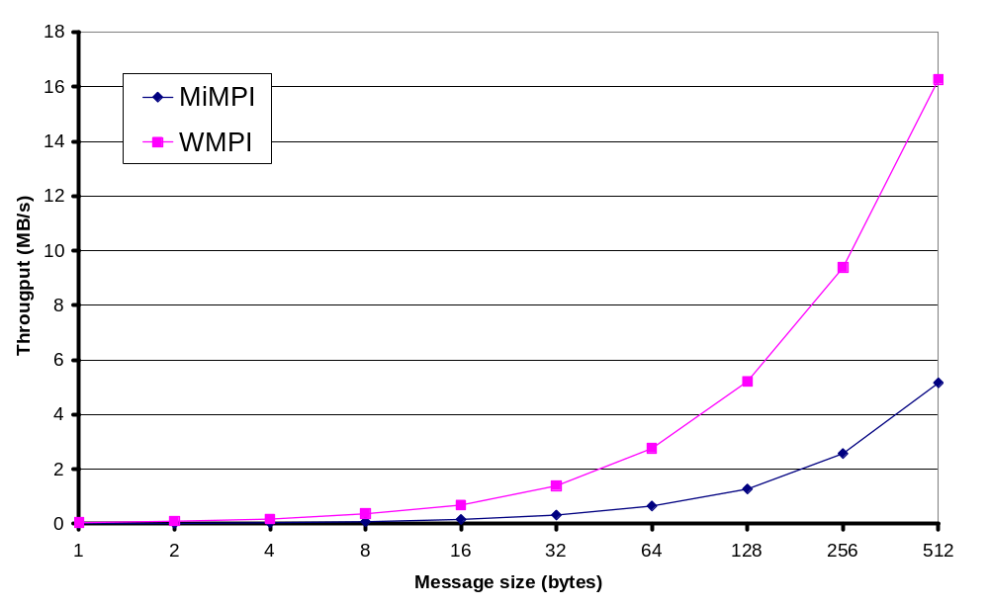
Broadcast

Slide 26
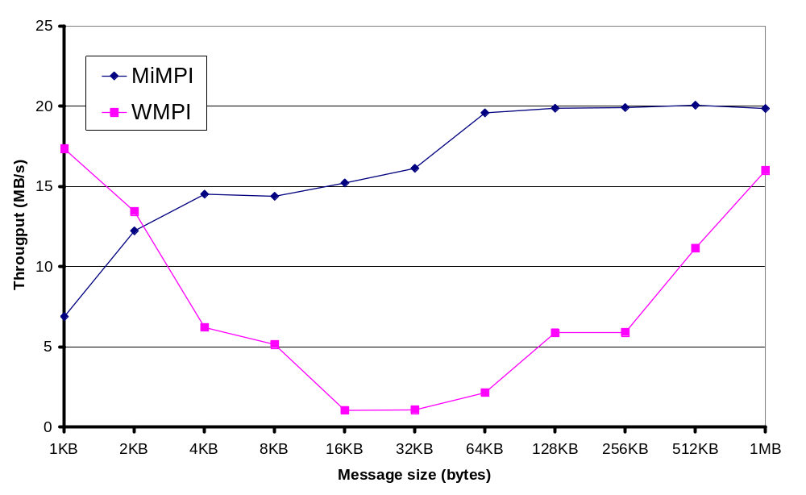
Broadcast (2/2)

Slide 27
Summary
  MiMPI implements a MPI thread-safe library
  MiMPI take advanced of a multi-threading implementation.
  MiMPI is modular and easy to extend.
  MiMPI has been ported to different platforms.
  MiMPI have several optimisations.

