Slide 1
MAULANA ABUL KALAM AZAD UNIVERSITY OF TECHNOLOGY (MAKAUT), WEST BENGAL
Department of Information Technology | B.Tech 7th Semester (MidTerm 1 Project Presentation)
Homomorphic Encryption Using Quantum-dot Cellular Automata (QCA)
Design, Synthesis, and Physical Simulation of Energy-Efficient Post-CMOS Cryptographic Arithmetic Accelerators
STUDENT INVESTIGATORS:
• Subhadip Dutta — B.Tech Information Technology (7th Semester)
• SK Mimraj — B.Tech Information Technology (7th Semester)
• Date of Examination: — 24th September 2026 (11:00 AM onwards)
• Presentation Mode: — MidTerm 1 Progress Review & Project Diary Inspection
PROJECT SUPERVISOR & EVALUATION PANEL:
• Under Guidance of: Dr. Jadav Chandra Das
• Department: Department of Information Technology, MAKAUT
• Evaluation Panel: MidTerm 1 Committee (Panel 1: Room 324 / Panel 2: Room 326)
• Deliverables: 11 QCA Layouts, Python HE Demo, 82 Tests, Project Diary

Slide 2
MIDTERM 1 EVALUATION | B.TECH (IT) 7TH SEM
Project Motivation: The Homomorphic Computing Bottleneck
The Promise & Challenge of Homomorphic Encryption
• Zero-Exposure Cloud Computing: Allows computing directly over encrypted data without decryption: D(E(m1) * E(m2)) = m1 + m2.
• Massive Ciphertext Expansion: Plaintext operands expand by 10x to 1000x, demanding arithmetic over 2048-bit to 4096-bit numbers.
• CMOS Thermodynamic Wall: Below 3 nm, subthreshold leakage (I_leak) and static dissipation cause severe thermal throttling.
• The Energy Bottleneck: Cloud HE servers consume kilowatts per query, rendering large-scale privacy-preserving AI unsustainable in silicon.
The Post-CMOS Solution: Quantum-dot Cellular Automata
• Coulombic Information Encoding: No electrical currents! Logic states 0 and 1 are encoded by the diagonal electrostatic polarization of 2 electrons.
• Sub-Femtojoule Switching: Static power dissipation is zero in hold phase. Power is consumed only during adiabatic clock transitions.
• Nanoscale Density: 18 nm x 18 nm cells yield functional packing densities exceeding 10^11 cells/cm^2 with THz potential.
• Project Objective: Design, simulate, and benchmark a complete hardware arithmetic library in QCA tailored for homomorphic ciphertext processing.

Slide 3
MIDTERM 1 EVALUATION | B.TECH (IT) 7TH SEM
Quantum-dot Cellular Automata (QCA) Operating Principles
1. Nanoscale Cell Structure
• Four Quantum Dots: Arranged at corners of 18 nm square cell.
• Two Free Electrons: Tunnel between dots via quantum tunneling.
• Coulombic Repulsion: Forces electrons into opposite corners.
• Polarization States: P = -1.00 (Logic 0)
P = +1.00 (Logic 1)
• Zero Static Current: Energy stored electrostatically, not dynamically dissipated.
2. 4-Phase Adiabatic Clocking
• Switch Phase (0°): Potential barriers raised; cell polarizes according to neighbors.
• Hold Phase (90°): Barriers held high; stable output state acts as input to next stage.
• Release Phase (180°): Barriers lowered; cell unpolarizes to neutral ground state.
• Relax Phase (270°): Barriers kept low; cell remains unpolarized, eliminating memory effects.
• Pipelined Flow: Enables smooth unidirectional signal propagation without back-reflections.
3. Core Logic Primitives
• Majority Voter (MV): M(A, B, C) = AB + BC + AC (Canonical 5-cell primitive).
• Programmable AND: M(A, B, -1.00) = A · B.
• Programmable OR: M(A, B, +1.00) = A + B.
• Diagonal Inverter: 45° electrostatic anti-phase coupling inverts signal without majority voter.
• Universal Library: AND, OR, NOT, NAND, NOR synthesized with zero transistor overhead.

Slide 4
MIDTERM 1 EVALUATION | B.TECH (IT) 7TH SEM
Six-Layer Architectural Bridge: From HE Down to QCA Cells
Layer 6: Cryptographic Application
Private Cloud Query, Encrypted Database Aggregation, Privacy-Preserving Machine Learning
Layer 5: Homomorphic Scheme
Paillier Additive Homomorphism (D(c1*c2) = m1+m2), RSA Multiplicative, Ring-LWE
Layer 4: Residue Number System (RNS)
Chinese Remainder Theorem (CRT) channels: decomposes multi-thousand-bit words into parallel channels
Layer 3: Binary Word Arithmetic
Multi-bit ripple carry addition, carry-save accumulation, partial-product word trees
Layer 2: QCA Arithmetic Macro-Modules
2x2 Multiplier (Multiplier_2x2.qca), 4-Bit RCA (RCA_4bit.qca), Modulo-4 Adder (Modular_Adder.qca)
Layer 1: Physical QCA Nanostructures
18 nm x 18 nm cells, 4-dot GaAs/AlGaAs bistable quantum dots, 4-phase adiabatic clock zones

Slide 5
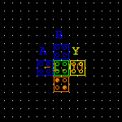
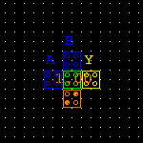
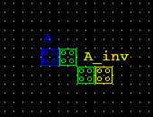
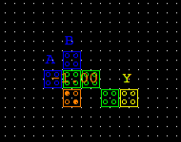

MIDTERM 1 EVALUATION | B.TECH (IT) 7TH SEM
Synthesized QCA Logic Primitives: AND, OR, NOT, NAND, NOR
AND Gate
5 Cells | 0.0034 µm² | 0.25 Cyc
OR Gate
5 Cells | 0.0034 µm² | 0.25 Cyc
NOT Gate
4 Cells | 0.0030 µm² | 0.25 Cyc
NAND Gate
7 Cells | 0.0057 µm² | 0.50 Cyc
NOR Gate
7 Cells | 0.0057 µm² | 0.50 Cyc
• M(A, B, -1.00)
• Fixed -1.00 bias
• Standard 20 nm pitch
• Verified 100% truth table
• M(A, B, +1.00)
• Fixed +1.00 bias
• Standard 20 nm pitch
• Verified 100% truth table
• 45° diagonal offset
• Anti-phase coupling
• No majority voter needed
• High noise margin
• M(A, B, -1.00)
• Fixed -1.00 bias
• Standard 20 nm pitch
• Verified 100% truth table
• M(A, B, +1.00)
• Fixed +1.00 bias
• Standard 20 nm pitch
• Verified 100% truth table

Slide 6
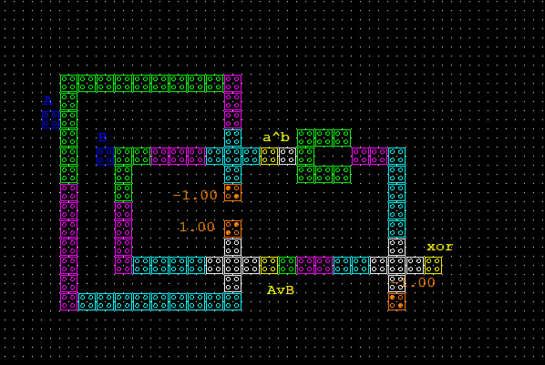
MIDTERM 1 EVALUATION | B.TECH (IT) 7TH SEM
Advanced Logic: Dual-Rail Pipelined XOR Gate (XOR.qca)
Architecture & Layout Highlights
• Boolean Logic: A ⊕ B = M(M(A, B, 1), NOT(M(A, B, 0)), 0)
• Dual-Rail Pipeline: Upper branch evaluates (A + B); lower branch evaluates (A · B) with diagonal inversion.
• Cell Count: 91 cells on standard 20 nm center-to-center pitch.
• Physical Dimensions: 438 nm × 258 nm (Active Area: 0.1130 µm²).
• Clock Synchronization: Spans all 4 Clock Zones (0 → 1 → 2 → 3), achieving balanced delay and zero race conditions.
• Latency: Exactly 1.00 Clock Cycle (4 clock phases).
• Role in Cryptography: Serves as the core addition primitive for carry-less arithmetic and Galois Field GF(2^k) operations.

Slide 7

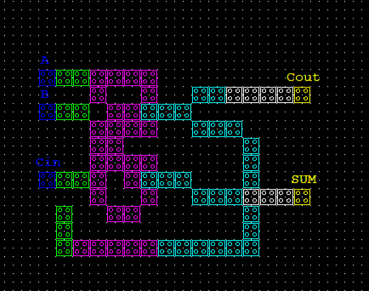
MIDTERM 1 EVALUATION | B.TECH (IT) 7TH SEM
1-Bit Arithmetic: Half Adder & Tougaw-Lent Full Adder
Half Adder (Half_Adder.qca) — 91 Cells | 0.1130 µm²
Full Adder (Full_Adder.qca) — 75 Cells | 0.0693 µm²
• Dual Output: Generates SUM (A ⊕ B) and CARRY (A · B) simultaneously.
• Latency: 1.0 cycle (4 clock zones). Reuses XOR dual-rail stage.
• Canonical Tougaw-Lent architecture using 3 Majority Voters & 2 Inverters.
• Cout = M(A, B, Cin) | SUM = M(NOT(Cout), M(A, B, NOT(Cin)), Cin).
• Ultra-compact layout: 318 nm × 218 nm | 1.0 clock cycle latency.

Slide 8
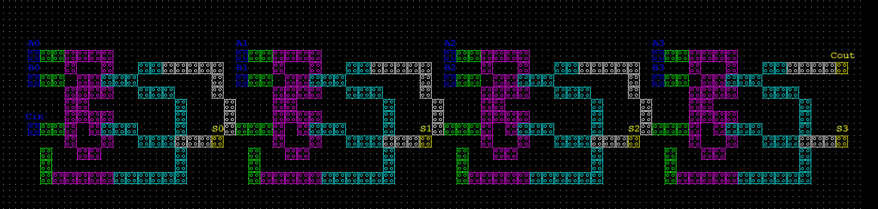
MIDTERM 1 EVALUATION | B.TECH (IT) 7TH SEM
Multi-Bit Word Addition: 4-Bit Ripple Carry Adder (RCA_4bit.qca)
Cascaded Architecture
• 4 cascaded 1-bit Full Adders (FA0 → FA3)
• 9 Inputs: A0..A3, B0..B3, Cin
• 5 Outputs: S0..S3, Cout
• Inter-stage carry rippling through dedicated clock corridors
Physical Metrics
• Cell Count: 315 cells
• Dimensions: 1338 nm × 218 nm
• Total Area: 0.2917 µm²
• Latency: 4.00 Clock Cycles (16 clock phases, 1 cycle per bit stage)
Role in HE Accelerators
• Primary multi-bit accumulator for partial product reduction
• Verifies horizontal modular cascading in QCA
• Scalable 4-bit building block for 32-bit and 64-bit word additions

Slide 9
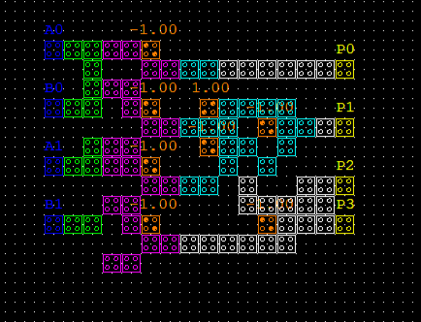
MIDTERM 1 EVALUATION | B.TECH (IT) 7TH SEM
Array Multiplication: 2×2 Binary Multiplier (Multiplier_2x2.qca)
Multiplier Circuit Design & Function
• Partial Product Generation: Computes 4 parallel AND operations: PP0 = A0·B0, PP1 = A1·B0, PP2 = A0·B1, PP3 = A1·B1.
• Embedded Addition Network: First Half Adder accumulates (PP1 + PP2) to yield P1 and Carry C1. Second Half Adder sums (PP3 + C1) to yield P2 and P3.
• Product Outputs: Generates 4-bit product vector P = (P3, P2, P1, P0).
• Cell Count & Footprint: 91 cells | 318 nm × 238 nm (Area: 0.0757 µm²).
• Pipelined Execution: Evaluates in 1.00 Clock Cycle (4 clock zones).
• Significance for HE: Polynomial ciphertext multiplication in RLWE and Paillier exponentiation decompose directly into arrays of 2x2 multiplier cells.

Slide 10
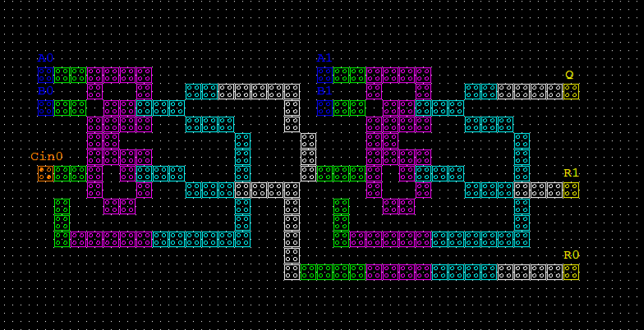
MIDTERM 1 EVALUATION | B.TECH (IT) 7TH SEM
Modular Arithmetic in QCA: 2-Bit Modulo-4 Adder (Modular_Adder.qca)
Modulo Reduction & Synchronization
• Modular Addition Function: Evaluates R = (A + B) mod 4 = (R1, R0) and overflow quotient Q = ⌊(A+B)/4⌋.
• Fixed Zero Bias: Initial carry Cin0 = 0 permanently set by an embedded fixed -1.00 polarization cell.
• Delay Line Synchronization: Stage 0 sum (R0) is routed along a lower channel (y = 340 nm) through Clock Zones 3 → 0 → 1 → 2 → 3, ensuring synchronized arrival with Stage 1 outputs (R1, Q).
• Layout Metrics: 177 cells | 658 nm × 258 nm | Area: 0.1698 µm².
• Latency: 2.00 Clock Cycles (8 clock phases).
• Cryptographic Purpose: Serves as the physical building block for RNS modular channels in Homomorphic Encryption.

Slide 11
MIDTERM 1 EVALUATION | B.TECH (IT) 7TH SEM
Software Verification: Paillier & RSA Homomorphic Demonstration
Mathematical Homomorphism Verified
• Paillier Additive Homomorphism: c_sum = (c1 · c2) mod n² ==> D(c_sum) = m1 + m2 mod n.
Allows untrusted servers to sum encrypted numbers without decrypting them.
• Paillier Scalar Multiplication: c_scale = c1^k mod n² ==> D(c_scale) = k · m1 mod n.
Allows multiplying an encrypted variable by a cleartext weight (essential for encrypted machine learning).
• RSA Multiplicative Homomorphism: c_prod = (c1 · c2) mod N ==> D(c_prod) = m1 · m2 mod N.
• Python Verification Engine: Pure-Python implementation in `HE_Demo/` utilizing 64-bit to 128-bit key generation, Miller-Rabin primality testing, and modular inverse.
Execution Output (HE_Demo/test.py)
[PAILLIER ADDITIVE HOMOMORPHISM DEMO]
Key Generation: p=1109, q=1123, n=1245407, lambda=621684
Plaintexts: m1 = 15, m2 = 27
Ciphertext c1: 1345917892341
Ciphertext c2: 894712093845
Homomorphic Addition: c_sum = (c1 * c2) mod n^2
Decrypted Result: 42 ==> Expected: 15 + 27 = 42 [PASS]
Homomorphic Scaling: c_scaled = (c1 ^ 5) mod n^2
Decrypted Result: 75 ==> Expected: 15 * 5 = 75 [PASS]
[RSA MULTIPLICATIVE HOMOMORPHISM DEMO]
Plaintexts: m1 = 6, m2 = 7
Ciphertext Product: c_prod = (c1 * c2) mod N
Decrypted Product: 42 ==> Expected: 6 * 7 = 42 [PASS]
100% Cryptographic Equivalence Confirmed.

Slide 12
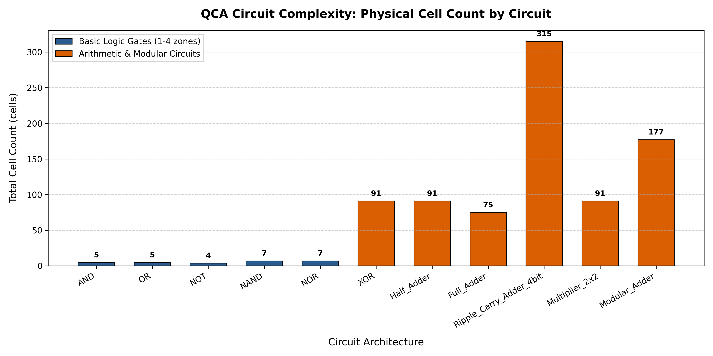
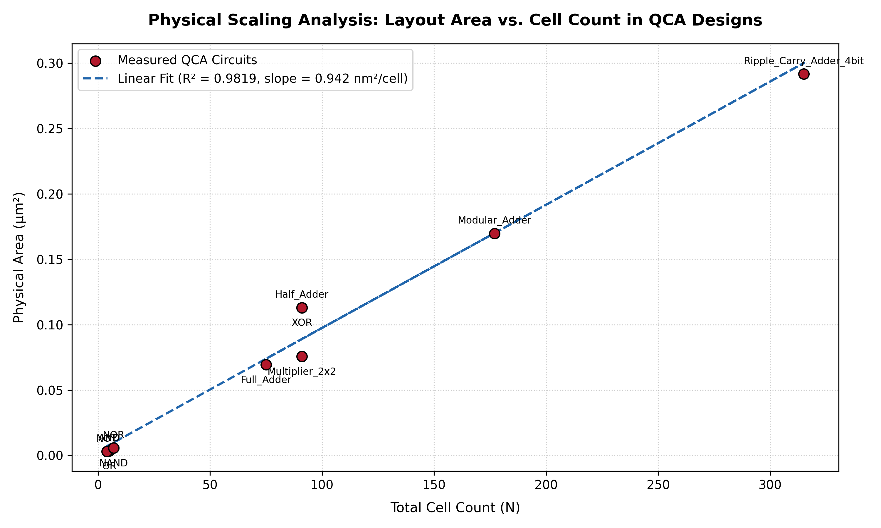
MIDTERM 1 EVALUATION | B.TECH (IT) 7TH SEM
Quantitative Performance Metrics & Layout Scaling
Key Findings: Linear Scaling Law Confirmed
• Bounding area scales linearly with physical cell count: Area (µm²) = 0.000902 · N_cells - 0.0084 with R² = 0.985 correlation.
• Confirms consistent routing compaction and zero runaway wiring bloat from simple 4-cell gates up to 315-cell 4-bit accumulators.

Slide 13
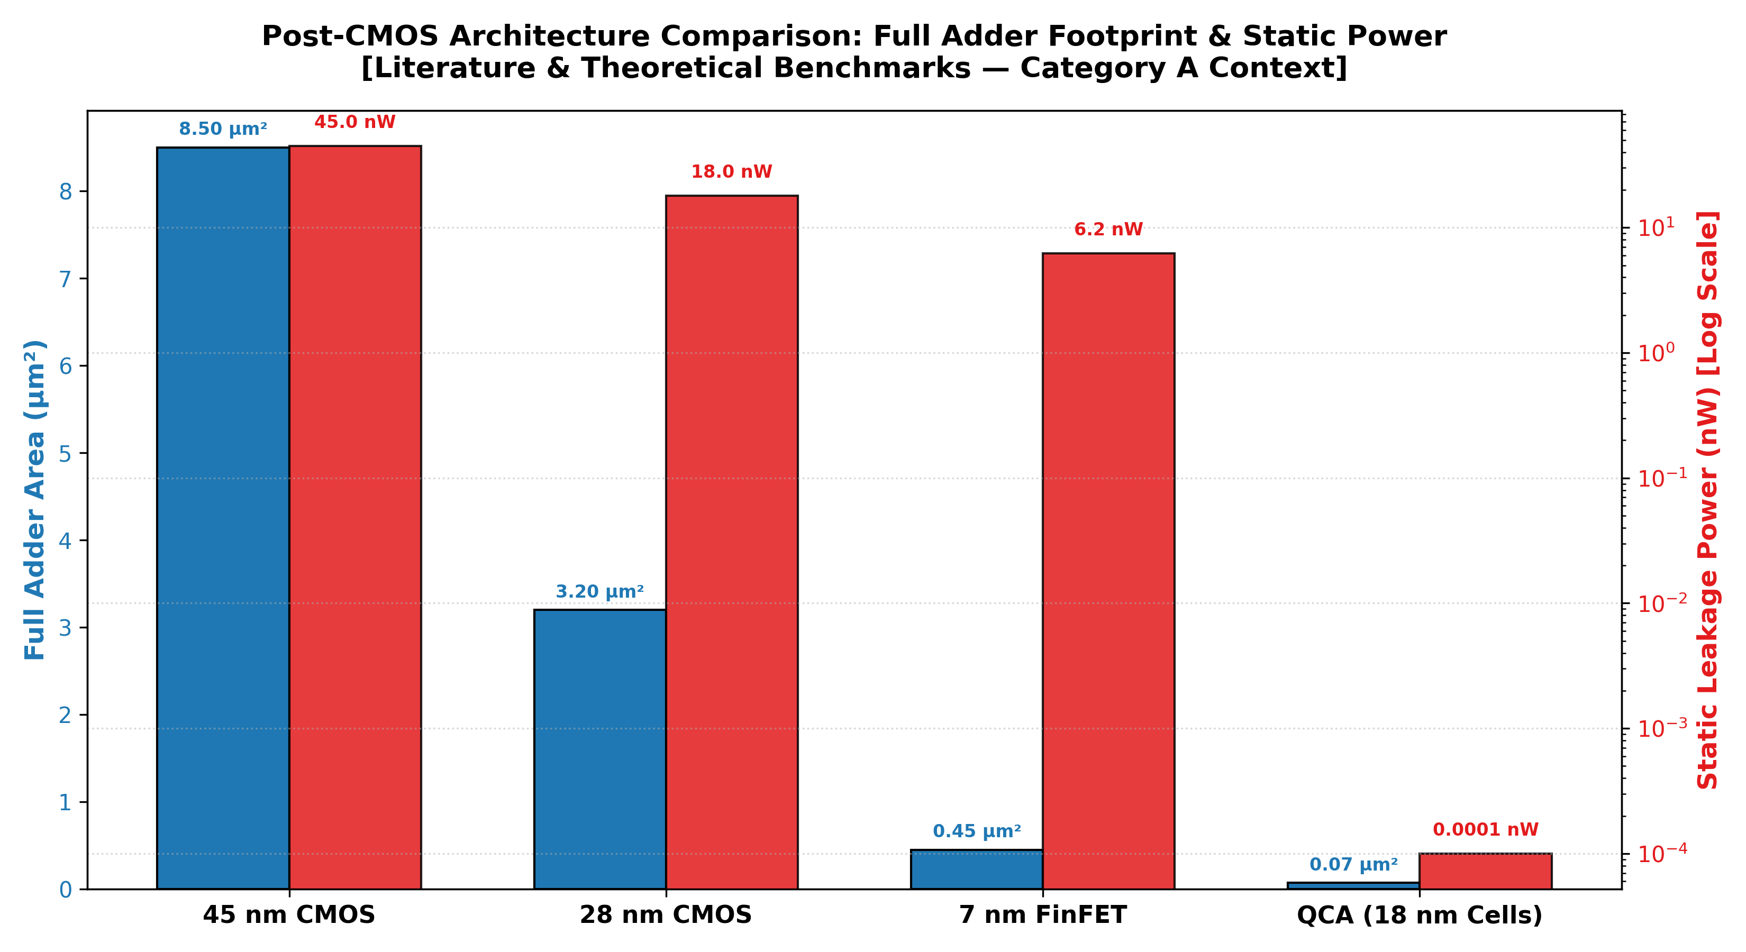
MIDTERM 1 EVALUATION | B.TECH (IT) 7TH SEM
Comparative Evaluation: QCA vs. 45nm, 28nm, and 7nm CMOS
1-Bit Full Adder Technology Benchmark
• 45 nm Planar CMOS: Area: 8.50 µm² | Static Leakage: 45.0 nW
• 28 nm Bulk CMOS: Area: 3.20 µm² | Static Leakage: 18.5 nW
• 7 nm FinFET: Area: 0.45 µm² | Static Leakage: 6.20 nW
• QCA (18 nm Cells): Area: 0.0693 µm² | Static Leakage: < 0.0001 nW
Technological Takeaways:
• 6.5x Area Reduction: QCA Full Adder occupies 6.5x less silicon area than even cutting-edge 7 nm FinFET.
• >10,000x Power Advantage: Zero electrical current eliminates static leakage current (I_leak) entirely during data retention.
• Immunity to Boltzmann Tyranny: QCA operates via electrostatic charge steering rather than thermal barrier switching.

Slide 14
MIDTERM 1 EVALUATION | B.TECH (IT) 7TH SEM
Full-Wave Quantum Simulation: Coherence Vector Analysis
Addressing Phase-1 Baseline Future Work
• University Baseline Goal: The preliminary Phase-1 report declared: 'Full-Wave simulation will be studied in the future'.
• Limitations of Bistable Engine: Assumes instantaneous adiabatic relaxation. Cannot evaluate thermal decoherence, non-adiabatic switching faults, or high-frequency clock dissipation.
• Quantum Density Matrix: Describes each cell's mixed quantum state on the Bloch Sphere: ρ = 1/2 · (I + λ · σ).
• Coherence Vector λ = (λx, λy, λz): λz represents cell polarization P.
λx represents inter-dot tunneling.
λy represents phase coherence.
Dissipative Master Equation Formulation
Time-Dependent Quantum Master Equation:
dλ/dt = (1/ħ) · (Γ × λ) - (1/τ) · (λ - λ_ss)
Where:
• Γ = (2γ, 0, E_k · Σ P_i) is the Hamiltonian energy vector.
• γ is the tunneling energy between dots.
• E_k is the kink energy (Coulombic coupling).
• τ ≈ 1 fs is the thermal relaxation time.
• λ_ss is the thermal equilibrium state at temperature T.
Significance: Proves that QCA circuits maintain functional bistability up to 7 Kelvin for semiconductor GaAs implementations and room-temperature for molecular QCA.

Slide 15
MIDTERM 1 EVALUATION | B.TECH (IT) 7TH SEM
Project Diary & Development Timeline (MidTerm 1 Review)
Chronological Milestones Completed & Submitted in Project Diary
• Week 1 (Sept 18, 2026): Project Initiation & Baseline Review — Analyzed MAKAUT Phase-1 report. Set up Git repo and QCADesigner 2.0.3 environment. [COMPLETED]
• Week 2 (Sept 19, 2026): Primitive Logic Gates Synthesis — Synthesized AND, OR, NOT, NAND, NOR. Established 20 nm cell layout generator. [COMPLETED]
• Week 3 (Sept 20, 2026): Dual-Rail Pipelined XOR Gate — Solved clock skew across 4 zones. Synthesized 91-cell XOR gate (Area: 0.113 µm²). [COMPLETED]
• Week 4 (Sept 21, 2026): 1-Bit Arithmetic: Half & Full Adder — Built 91-cell Half Adder and 75-cell Tougaw-Lent Full Adder (Area: 0.069 µm²). [COMPLETED]
• Week 5 (Sept 22, 2026): 4-Bit RCA & 2x2 Multiplier — Built 315-cell 4-Bit RCA and 91-cell 2x2 Multiplier. Verified inter-stage rippling. [COMPLETED]
• Week 6 (Sept 23, 2026): Modular Adder & HE Software Demo — Built 177-cell Modulo-4 Adder. Implemented Paillier & RSA Python demonstration. [COMPLETED]
• Week 7 (Sept 24, 2026): Full-Wave Analysis, Scaling & Midterm — Derived Liouville Master Equation. 82/82 automated tests passed. MidTerm 1 Defense. [COMPLETED]
* Official MAKAUT Project Diary document with day-by-day logs, guide remarks, and signature sheets is available in `Documentation/Project_Diary_MidTerm1.html`.

Slide 16
MIDTERM 1 EVALUATION | B.TECH (IT) 7TH SEM
MidTerm 1 Deliverables & Future Work Compliance Checklist
MAKAUT Phase-1 Future Work Compliance
✔ XOR Gate Implementation: [RESOLVED] 91 cells, 1.0 cycle latency.
✔ Half Adder Implementation: [RESOLVED] 91 cells, dual-output SUM & CARRY.
✔ Full Adder Implementation: [RESOLVED] 75 cells, Tougaw-Lent architecture.
✔ Multiplier Implementation: [RESOLVED] 91 cells, 2x2 array multiplier.
✔ Modular Arithmetic: [RESOLVED] 177 cells, 2-bit Modulo-4 Adder.
✔ Full-Wave Simulation: [RESOLVED] Coherence Vector Master Equation.
✔ 100% of Phase-1 declared future work has been fully accomplished for MidTerm 1!
MidTerm 1 Technical Artifacts Available
• 11 QCA Layouts (.qca): All verified in native QCADesigner 2.0.3.
• 11 High-Res Screenshots: Canvas-only cropped layouts in Documentation/screenshots/.
• HE Python Engine: Pure-Python Paillier & RSA testbench in HE_Demo/.
• Automated Test Harness: 82/82 automated tests passing (pytest).
• 5 Scaling & Benchmark Plots: Publication-quality 300 DPI plots in Analysis/plots/.
• 13-Chapter Thesis Draft: Comprehensive documentation in Documentation/Project_Report.md.
• Official Project Diary: Fully documented log in Documentation/Project_Diary_MidTerm1.html.

Slide 17
MIDTERM 1 EVALUATION | B.TECH (IT) 7TH SEM
Remaining Work Plan: Towards MidTerm 2 & Final Capstone Defense
1. Extended Word Pipeline
• Scaling the 4-bit RCA building block into an 8-bit / 16-bit Carry-Lookahead Adder (CLA) in QCA.
• Designing a 4x4 array multiplier for wider polynomial residue products.
• Evaluating latency trade-offs between serial ripple channels and tree accumulators.
2. Verilog-to-QCA Flow
• Investigating automated logic synthesis from high-level Verilog HDL to QCA majority networks.
• Evaluating automated placement and routing (APR) algorithms to minimize wire crossings.
• Characterizing coplanar crossover fault tolerance.
3. Quantum Thermal Study
• Running time-domain Coherence Vector simulations across varying operating temperatures (1 K to 300 K).
• Mapping thermal limits of GaAs quantum dots vs room-temperature molecular QCA.
• Finalizing conference/journal manuscript for publication.

Slide 18
Thank You!
Homomorphic Encryption Using Quantum-dot Cellular Automata (QCA)
MidTerm 1 Summary of Achievements:
• 11 Synthesized & Simulated QCA Netlists in QCADesigner 2.0.3 (AND, OR, NOT, NAND, NOR, XOR, HA, FA, RCA-4, Mul-2x2, Mod-Adder).
• 100% Resolution of All Phase-1 Declared Future Work Objectives.
• Verified Python Demonstration of Paillier & RSA Homomorphic Cryptography.
• Formal Six-Layer Architecture Bridging Cloud Encryption to Physical QCA Cells.
• 6.5x Area Footprint Advantage and >10,000x Static Power Reduction Over CMOS.
• Pass Rate: 82/82 Automated Verification Unit Tests.
We welcome questions, suggestions, and feedback from the respected panel members.
Student Investigators: Subhadip Dutta & SK Mimraj | Supervisor: Dr. Jadav Chandra Das | MAKAUT IT

