Slide 1
Date: 12-Mar-23
Presentation
Stock gain forecasting for day using ML and NLP
Sarvsav Sharma (2020SC04239) Supervisor: Vinaya Sathyanarayana DSECLZG628T DISSERTATION

Slide 2
Problem Statement
On the profit day, we earn less profit however on the loss day, we have huge loss in the stock market because of our sentiments as we prefer to take less risk and don’t feel confident and comfortable with our decisions.

Slide 3
Solution
This tool will solve the problem and trade your money wisely to achieve maximum gains or low risk.
The program will take inputs, including the investor trading money, risk level, and amount of money that can be accepted as a loss.
The model is trained based on the 5 year data and news headlines, which will predict the closing amount.
The code will utilise the model and based on risk level of user provide the maximum amount that a user can invest for trading either as a buy or sell of the stock.
If the loss value is very close to the user input, then it will suggest not to invest.
And, with continuous investment, the trader will be able to make the profit.

Slide 4
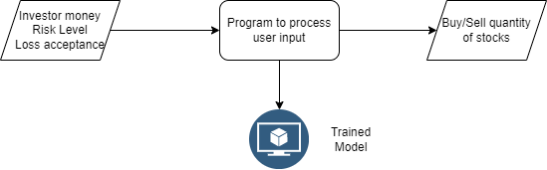
Architecture of program
Flow diagram

Slide 5
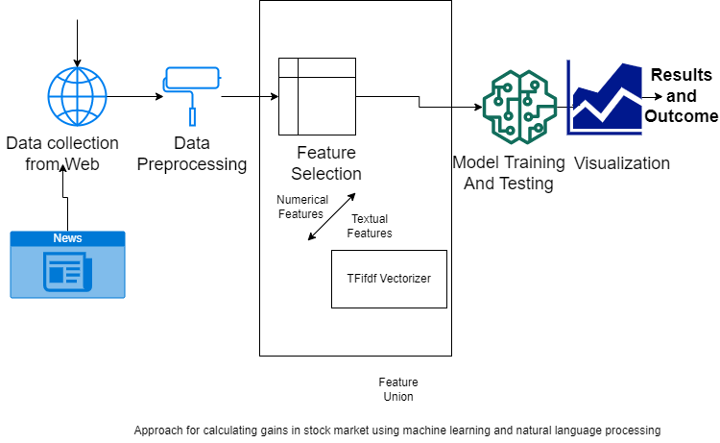
Architecture of Model
Stock market data

Slide 6
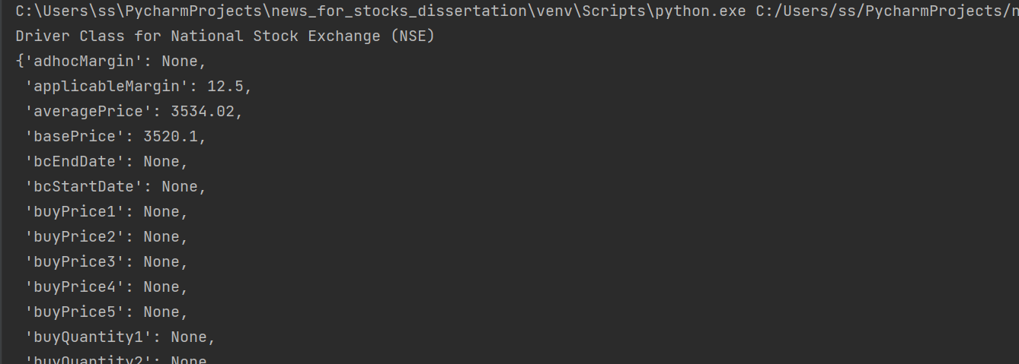
Data Collection - Numerical Data
The data collection can be performed using the below
python libraries (nsetools)
parsed real time from the API
https://pypi.org/project/googlefinance/
https://nsetools.readthedocs.io/en/latest/
https://tradingeconomics.com/nifty:ind
https://finance.yahoo.com/quotes/API,Documentation/view/v1/?guccounter=1&guce_referrer=aHR0cHM6Ly93d3cuZ29vZ2xlLmNvbS8

Slide 7
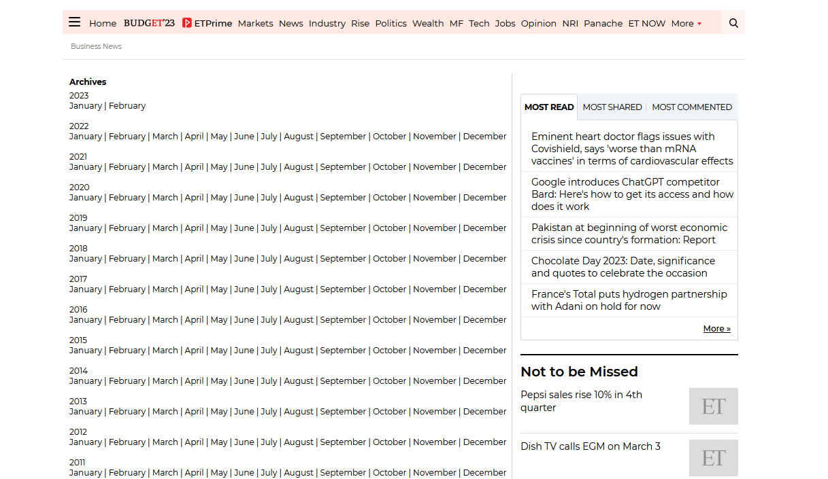
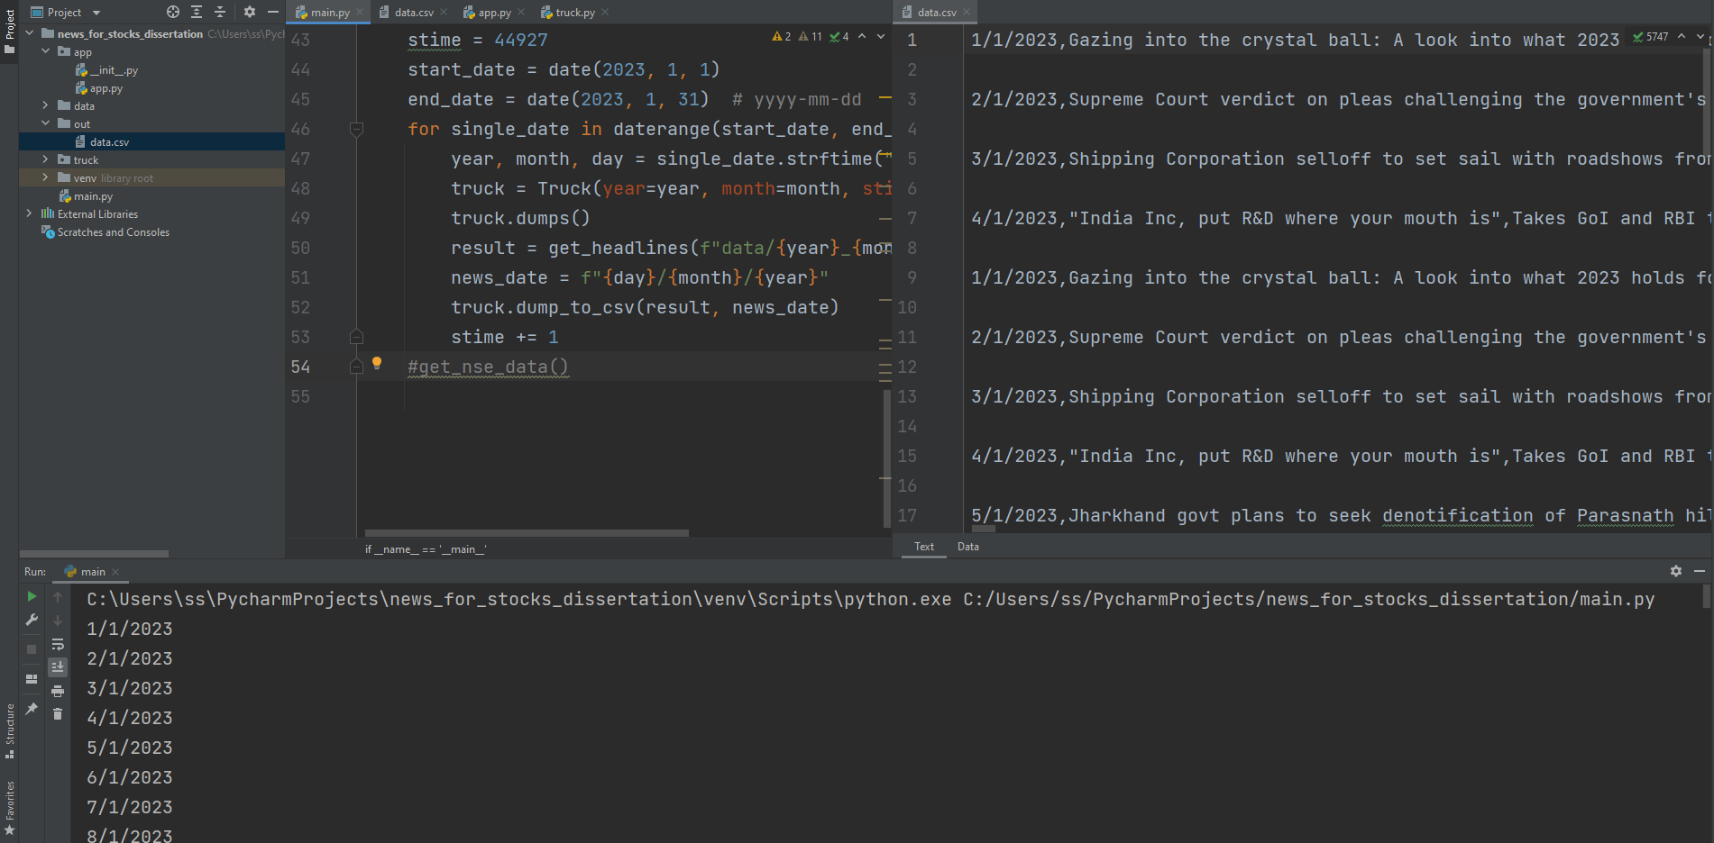
Data Collection - Textual Data
Data has been collected from economictimes.com using below URL:
https://economictimes.indiatimes.com/archive.cms

Slide 8
Data Preparation
Activities performed on numerical data:
Basic Understating of the data set, its datatypes, statistical description
Checking for Null Values
Feature Engineering
EDA
Activities performed on textual data:
Collection of raw data from the website
Removal of special characters including double quotes
Convert to numerical data using Vader

Slide 9
Data Preparation Continued
Activities performed on combined data (numerical + textual):
Combining textual and numerical data
Filter the data based on null values
Arranged the weekend data
Reordered and renamed columns
Conversion of datatypes

Slide 10
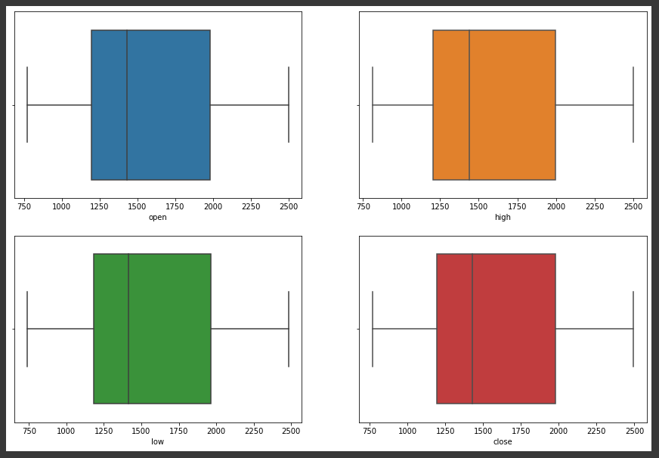
No outliers found in the data

Slide 11
ML model building
The following models have been implemented to obtain the highest accuracy for the data:
Linear regression
Xgboost regressor
Light GBM Regressor
SVR polynomial regression
SVR linear regression
Auto h2o model
The SVR Polynomial regression model seems to be promising

Slide 12
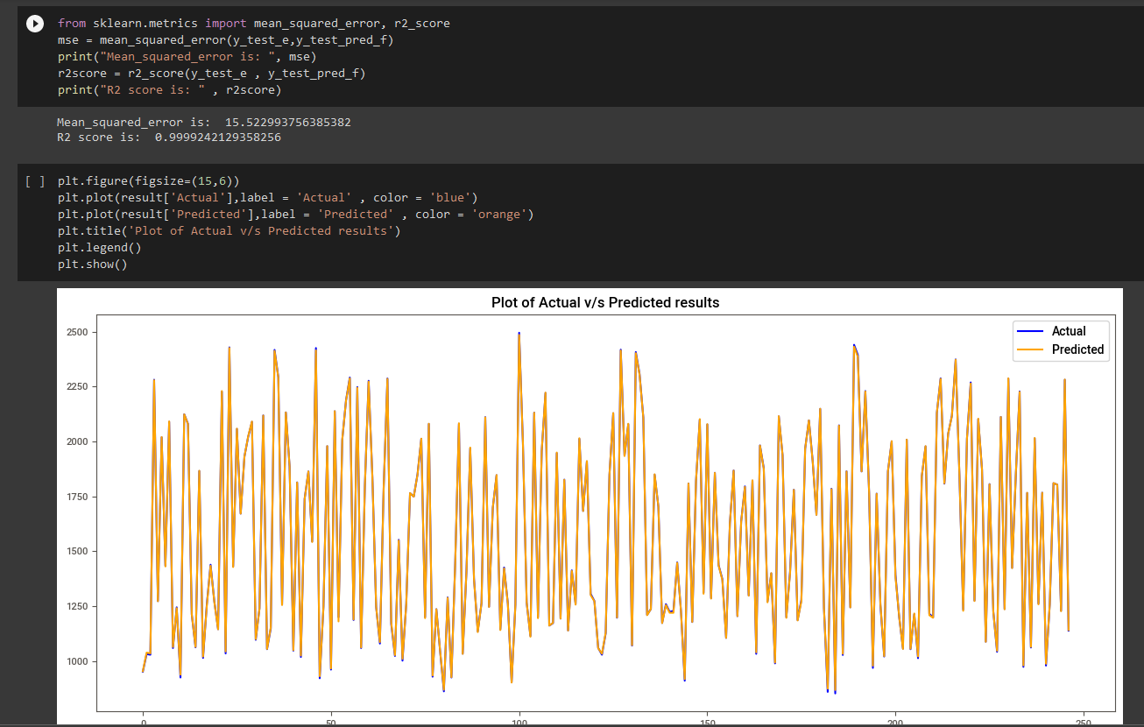
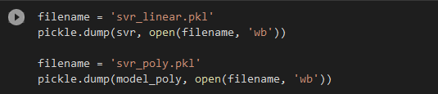
Checking accuracy and mse values
Results from svr poly model

Slide 13
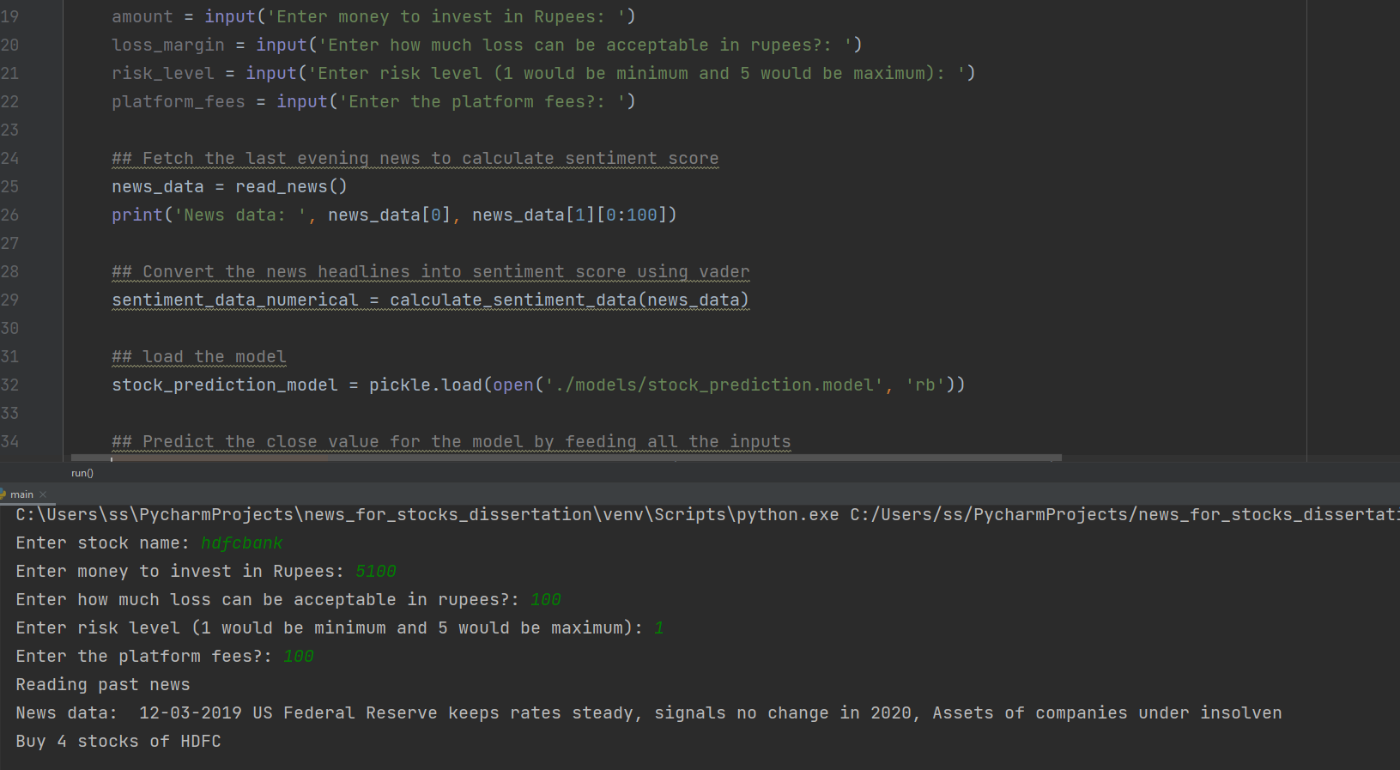
Calculating gains

Slide 14
Code
The GitHub code utilizes the trained model created using collab notebook
GitHub: https://github.com/sarvsav/dissertation
Collab: https://colab.research.google.com/drive/1DXR8oXGeJ7yX96o72R2uoPWJGffi-hDj?usp=sharing
Dataset: Uploaded in github repository inside data folder
Models: Uploaded in github repository inside models folder

Slide 15
Thank You

