Slide 1


Slide 2

CSS Properties

Slide 3
CSS Properties
There are a lot of properties! We will teach you the most essential
color
Changes the color of your text
Value is either a default color value (red, blue, etc.), RGB or HEX value (we will go over this next week)
background-color
Changes the background color of your HTML element
Value is either a default color value (red, blue, etc.), RGB or HEX value (we will go over this next week)

Slide 4
CSS Properties
text-align
Values: left, center, right, justify
text-decoration
Values: underline, overline, line-through
font-size
Value in px (ex: 16px or 24px)
Other ways to define font too (but we won’t go over them)
font-weight
Values: normal, bold, bolder, or lighter
Or use values from 100, 200, …, to 900
400 = normal, 700 = bold

Slide 5
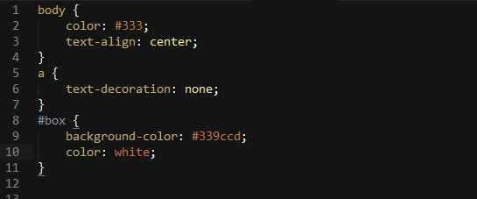
CSS Properties
Sample:

Slide 6
CSS pseudo-classes

Slide 7
CSS pseudo-classes
Adds effects to your selectors
Syntax:
.selector:pseudo-class { …css styles … }
Ex: a:visited { … }, #box1:hover { … }
Common pseudo-classes:
:visited = Links you’ve visited
:active = Links when you click on them (happens in milliseconds)
:hover = When mouse is over element
:focus = When typing in the current <input> tag (we go over <input> tags later on)
Remember :hover! Most likely you will use this the most ;)

Slide 8
CSS pseudo-classes
:hover

Slide 9
CSS pseudo-classes
:active (happens briefly)
Click this Link
Click this Link
:visited
Click this Link

Slide 10
CSS pseudo-classes
:focus
Name:
Name:
Age:
Age:
Year:
Year:
Major:
Major:

Slide 11
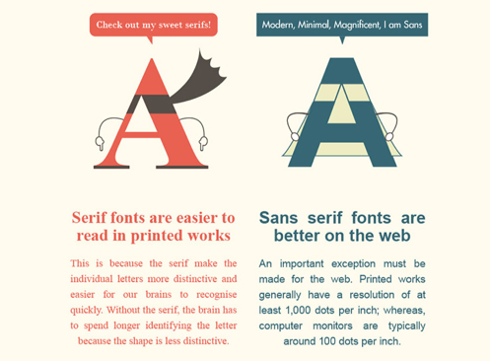
CSS Properties – Font Family
Before we talk about font-family, let’s go over some basics
There are 2 types of fonts: Serif and Sans-serif

Slide 12



CSS Properties – Font Family
On the web, we call commonly used fonts “web-safe”, meaning all browsers can render the fonts without trouble
Here is a list of web-safe “serif” fonts:

Slide 13




CSS Properties – Font Family
Here is a list of web-safe “sans-serif” fonts:

Slide 14
CSS Properties – Font Family
Let’s see the CSS property for using a font-family
font-family
Example: font-family: Arial;
Usually there are more than one font-family value
Example: font-family: Helvetica, Arial, Verdana, sans-serif;
This means the font-family Helvetica will be used
If Helvetica is not supported by the browser, the next font is used
These are called fallback fonts
The last fallback font in this example is sans-serif (what the browser chooses as the default sans-serif)
If no fallback fonts or no font defined, default serif font used

Slide 15
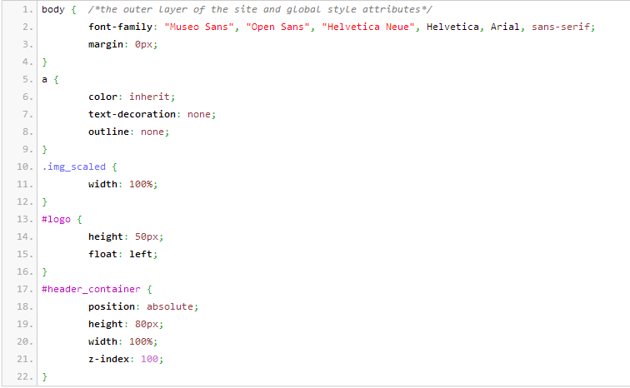
CSS Properties – Font Family

Slide 16
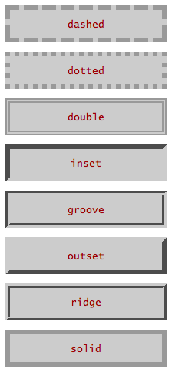
CSS Properties – Font Family
Lastly, there is border
border
Takes in 3 values, space-separated
1st value: border-width in px (pixels)
2nd value: border-style
3rd value: color
Example: border: 1px solid #999;
Thin solid gray border around your element

Slide 17
CSS Box Model

Slide 18
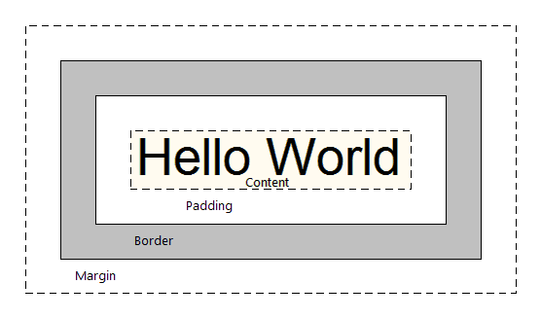
CSS Box Model
The CSS Box Model is the standard way of structuring your elements and web pages. It allows us to add space and borders to an element

Slide 19
CSS Box Model
Facebook makes use of the Box Model everywhere

Slide 20
CSS Box Model
4 Key components
Content
Padding
Border
Margin
Content is everything inside an element
Example: In <p>Hello World</p>, “Hello World” is the content
Border is the line that surrounds an element
Padding is the space between the content and border
Margin is the space from the border and nearby elements

Slide 21
CSS Box Model
We went over border last week
border
Takes 3 values: width, style, color
Example: border: 1px dashed blue;
Padding and Margin can take in 1, 2, 3 or 4 values
1 Value:
padding: 10px; = 10 pixels of space all around, from content to border
2 Values:
margin: 5px 10px; = 5 pixels of space above and below border, 10 pixels of space to the left and right of border
Corresponds to top & bottom, left & right

Slide 22
CSS Box Model
3 Values:
padding: 10px 5px 20px; = Corresponds to top, left & right, bottom
4 Values:
margin: 10px 5px 20px 15px; = Corresponds to top, right, bottom, left (clockwise)

Slide 23
CSS Box Model
Padding
Content
Border
Margin
Hello World!
In this example, a possible style for the element is:
padding: 15px;
border: 2px solid #ccc; /* light-gray */
margin: 5px 10px;

Slide 24
CSS Box Model
Padding
Content
Border
Margin
Hello World!
Also know that if you add a background-color to your image, it will color in the content and the padding portions of the element
Background-color will not affect the margin!!!

Slide 25
CSS Box Model
Currently we have divs that stack vertically. What does this mean?
Divs are, by default, blocks
They take up the entire row
By default, you cannot stack divs side by side
They look like this:

Slide 26
CSS Box Model
In order to stack horizontally, you must alter the CSS style for display
display
There are 3 important values for display: block, inline-block, inline
block
“block” displays respect all margins, paddings, height & width
Except, they have an auto-line break after it (next element goes directly below it)
inline-block
Exactly like a block but it has no line break after it
inline
Can have left & right margins/paddings, but no top & bottom ones. Also has no height/width. Allows elements next to them

Slide 27
CSS Box Model
Block Example
This has padding/margins.
Stacked vertically.

Slide 28
CSS Box Model
Inline-Block Example
Side by side
With margin/padding
And you can set the width/height

Slide 29
CSS Box Model
Inline Example (essentially a <span> tag)
No top/bottom
No height/width
But you can stack horizontally.
See?

Slide 30
CSS Box Model - Examples
Inline Example (essentially a <span> tag)
The quick brown fox jumps over the lazy dog.
<div>
The quick <span id=“bold”>brown fox</span> jumps over the lazy dog.
</div>

Slide 31
CSS Box Model - Examples
What happens if instead of <span>, you use <div>?
<div>
The quick <div id=“bold”>brown fox</div> jumps over the lazy dog.
</div>
The quick
brown fox
jumps over the lazy dog.

Slide 32
CSS Box Model - Examples
Now if add the CSS properties to id=“bold”:
display: inline-block & padding: 0 40px
<div>
The quick <div id=“bold”>brown fox</div> jumps over the lazy dog.
</div>
The quick brown fox jumps over the lazy dog.
You can add width, padding, and margins to your elements!
Amazing!

Slide 33
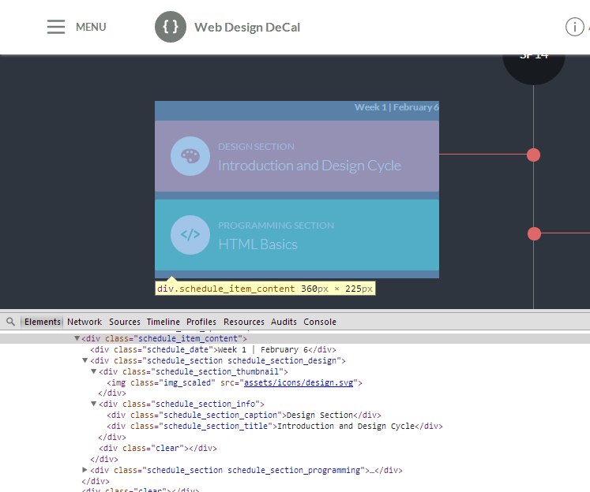
CSS Box Model

Slide 34
Centering a Div
Text or Div Element
Centering text is easy, use text-align: center
What if you want to center a <div> that has a certain width?
Center me! I want this box to be in the center! :)

Slide 35
Centering a Div
Text or Div Element
By default, if you give your <div> a width (say 200px), it will automatically be on the left
Center me! I want this box to be in the center! :)

Slide 36
Centering a Div
Text or Div Element
To center a <div>, add 2 CSS properties to the element:
margin-left: auto; margin-right: auto;
Margin-left and margin-right auto lets the browser place your element in the center of page, or center of the above element (if it is not <body>)

Slide 37
Centering an Image
Image
What about centering an image? (<img> tags)
Again, by default it is on the left

Slide 38
Centering an Image
Image
To center an image, like text, add margin-left/right to auto
Also, specifically add display: block

Slide 39
Centering an Image
Image
Remember that <div> elements by default are display: block
<img> tags by default are not display: block, so we must type in display: block manually, to tell the browser that the image takes up the entire row

Slide 40
CSS Color

Slide 41
CSS Color
Color is important for font colors, background colors, borders, etc.!
Color on the web can be represented in 3 ways:
A default color value
Hex Value
RGB Value
What do these mean?
Default Color
16 pre-defined CSS colors
Example: red, blue, black, white, maroon, etc.
Too limited may not be what you want!

Slide 42
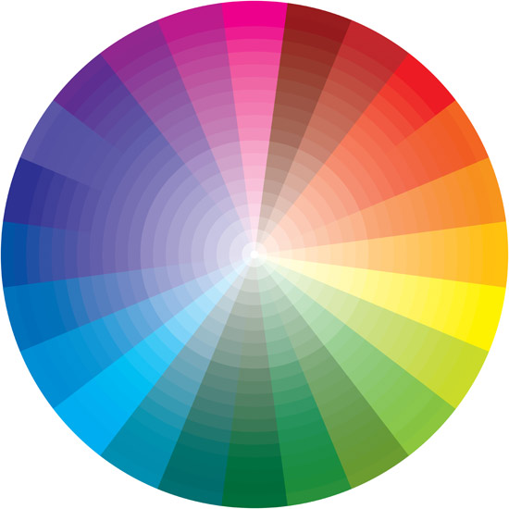
CSS Color
Hex Color (Hexadecimal)
Millions of ways to define a color!
Syntax: Pound sign # followed by 6 digits/characters from 0 to 9 and A to F
Example: #FF0000 (red), #339CCD (light blue), #888888 (gray)
0-9 & A-F = 16 possible values
16*16*16*16*16*16 = 16 Million Ways
To Define 1 Color!

Slide 43

CSS Color - Hex
Hex values are 6 digits, or 3 bytes
Each byte is 2 digits and represents a “color”
Red corresponds to the 1st byte, Green to the 2nd, Blue to the 3rd
A “0” indicates no color. Increasing the value to 1, 2, etc. increases the color. An “F” indicates full color (lightest)
Example: #0000FF
Equivalent to “no reds”, “no greens”, “full blues” = Pure Blue
What is “Purple”?
Answer: #FF00FF! It is a mix of pure red and pure blue. Other shades may include #AA00AA or #330033.

Slide 44
CSS Color - Hex
Screens and monitors are black by default
When you have #000000 (no color), this means you get black
When you have #FFFFFF (all colors), you get white
Thus, some red on a black surface = dark red: #330000
Another fun tip! If a color’s byte has 2 repeating digits (88, FF, 00), and all 3 bytes have repeating digits, you can do a shorthand by using the single digit
Example: #FF0000 → #F00
#CC88DD → #C8D
#000000 → #000

Slide 45
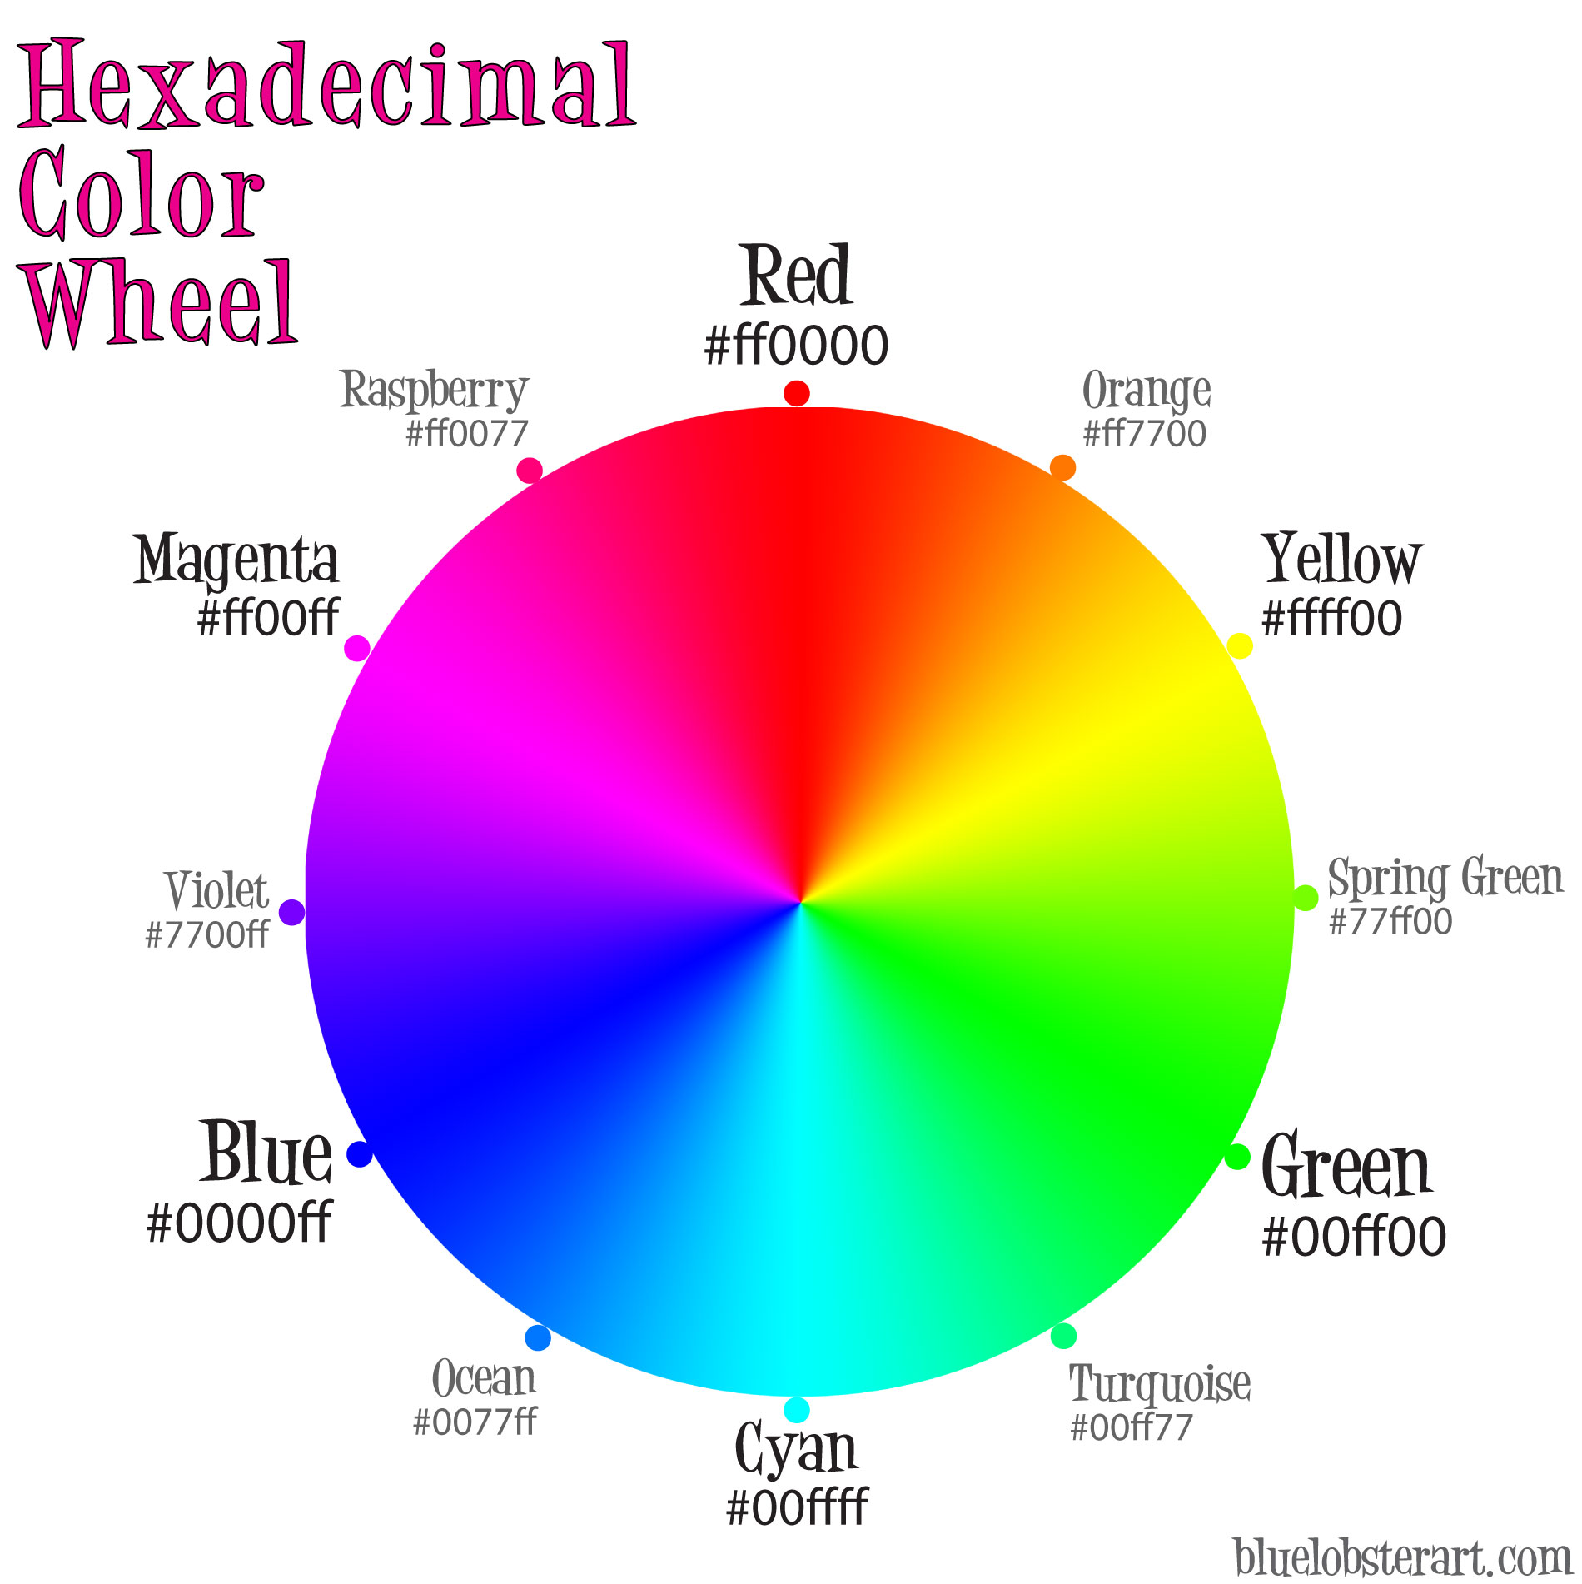
CSS Color - Hex

Slide 46
CSS Color - RGB
RGB colors
Syntax: rgb(255, 0, 0)
rgb(…) takes in 3 values: red, green, blue
Similar to Hex. 0 in rgb is 00 in hex, 255 in rgb is FF in hex
Examples:
rgb(255, 0, 0) vs. #FF0000
rgb(51, 156, 205) vs #339CCD
Which to use? RGB or Hex?
Hex is great, supported by all browsers
Hex is used excessively in Photoshop, Illustrator, etc.
Easy to memorize over digits

Slide 47
Hands-on Activity

