Slide 1
CSS BOX MODEL & SELECTORS
Adam Sebti, Programming section TA

Slide 2
This section
CSS Selectors
CSS Box Model

Slide 3
CSS Selectors
Use an id:
Single ID element per page
Use a class:
Multiple classes per page
Use when things are repeated

Slide 4
#id
Use # for ids in the CSS file!

Slide 5
<div id=“example”></div>
#example {
font-size: 25px;
color: white;
}

Slide 6
.class
Use . for classes in the CSS file!

Slide 7
<div class=“example”></div>
.example {
font-size: 25px;
color: white;
}

Slide 8
Different types of CSS selectors
In CSS, there’s way more than .class and #id, for instance:
element1 element2 {
/* Selects all element2 elements in all element 1’s */
}
div p {
/* Selects all <p> elements in all <div> elements*/
}

Slide 9
Different types of CSS selectors
A space makes the difference!
Choosing elements with both classes vs. something else
.class1 .class2 {
/* Selects elements of class2 whose parents are class1 */
}
.class1.class2 {
/* Selects elements of BOTH class1 and class2. */
}

Slide 10
Different types of CSS selectors
Pseudo-classes react to various page events.
For example, hovering over a certain element:
#test:hover {
/* Styles elements with id=“test” when user hovers over */
}
#popup:hover {
/* Styles elements with id=“popup” when user hovers over */
}

Slide 11
Different types of CSS selectors
Finally, nth-child, which is a little tricker.
element1:nth-child(n) {
/* Selects every element1 that is the nth child of its parent */
}
p:nth-child(3) {
/* Selects every <p> that is the 3rd one of its parent */
}

Slide 12
Different types of CSS selectors
Finally, nth-child, which is a little tricker.
element1:nth-child(n) {
/* Selects every element1 that is the nth child of its parent */
}
p:nth-child(3) {
/* Selects every <p> that is the 3rd one of its parent */
}

Slide 13
Different types of CSS selectors
p:nth-child(3) {
/* Selects every <p> that is the 3rd one of its parent */
}
<div class=“parent”>
<p></p>
<p></p>
<p></p>
<p></p>
</div>

Slide 14
Different types of CSS selectors
p:nth-child(3) {
/* Selects every <p> that is the 3rd one of its parent */
}
<div class=“parent”>
<p></p>
<p></p>
<p></p>
<p></p>
</div>

Slide 15
Goal: See all websites in terms of boxes.

Slide 16

How would I “stack” those profiles?

Slide 20
Which should be id’s and which should be classes?

Slide 21
<div class=“profile”></div>
<div id=“andy-img”></div>
<div id=“andy-bio”></div>

Slide 22
<div class=“profile”></div>
<div id=“andy-img”
class=“circular”></div>
<div id=“andy-bio”
class=“bio”></div>

Slide 23
ID’s & Classes: Profile Page
Use an id:
Unique elements in classes
The color of the profile
Use a class:
Reuse the code!
Essentially everything else:
Circularity of images
Formatting of the bios
The margin between image & bio

Slide 24
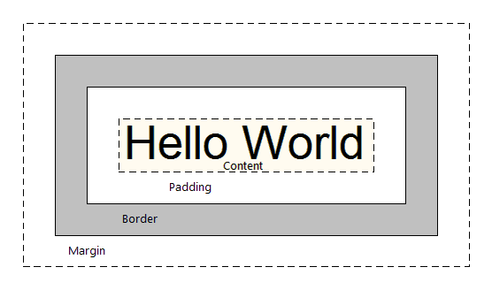
This way of structuring your elements is the CSS Box Model.

Slide 25
For example: Facebook’s News Feed

Slide 26
The CSS Box Model
4 Key Components
Content
Padding
Border
Margin

Slide 27
The CSS Box Model
4 Key Components
Content - inside the element
Padding - between the content and border
Border - surrounds the content
Margin - space between border and nearby elements

Slide 28



Slide 29
Margin
Content
Padding
Border

Slide 30
The CSS Box Model - Border
Border
Takes in 3 values: width, style, color
ex.) border: 1px dashed blue;
Note that style and color are optional

Slide 31
The CSS Box Model - Padding & Margin
Padding & Margin
If 1 value:
padding: 10px; then 10 pixels of space all around, from content to border
If 2 values:
padding: 10px 5px; then 10 pixels goes above and below, and 5 pixels goes left and right of content

Slide 32
The CSS Box Model - Padding & Margin
Padding & Margin
If 3 values:
padding: 10px 5px 15px; then they in the order: top, left & right, bottom.
If 4 values:
padding: 10px 5px 15px 20px; then they are assigned clockwise (top, right, left, bottom)

