Slide 1
Moar CSS
Philip Su, Programming section TA

Slide 2
Moar CSS
Fonts
Display
Background
Images
Centering (horizontally)

Slide 3
CSS Properties - Fonts
Properties - there are many. These are the most important:
color: Not to be confused with background-color!
font-size: 20px Takes in a pixel value and sets its size
font-weight: Takes in 100 - 900 aka (lightest to boldest)

Slide 4
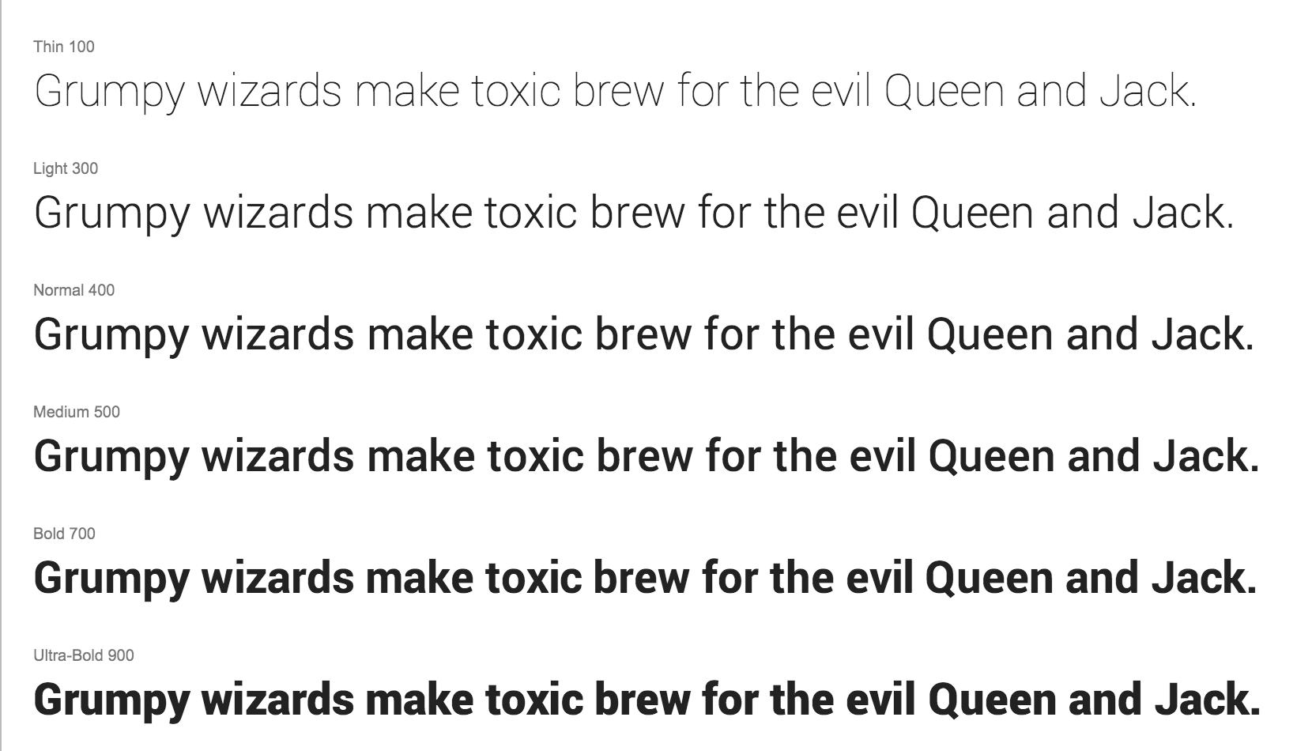
CSS Properties - Fonts

Slide 5
CSS Properties - Fonts
Properties - there are many. These are the most important:
font-style: Typically we only pass in ‘italic’ or ‘normal’
text-align: left | center | right
text-shadow: h-shadow v-shadow color;
ex.) text-shadow: 2px 2px #ff0000;

Slide 6



CSS Properties - Fonts (text shadow)

Slide 7
CSS Properties - Fonts
Properties - there are many. These are the most important:
font-style: Typically we only pass in ‘italic’ or ‘normal’
text-align: left | center | right
text-shadow: h-shadow v-shadow color;
ex.) text-shadow: 2px 2px #ff0000;

Slide 8
CSS Properties - Display
To stack ‘em side-by-side, alter display
Display has 3 important values: block, inline, inline-block
block: respects margins, paddings, but has auto-line break

Slide 9
CSS Properties - Display
To stack ‘em side-by-side, alter display
Display has 3 important values: block, inline, inline-block
block: respects margins, paddings, but has auto-line break
inline: block but with no spacing at all

Slide 10
CSS Properties - Display
To stack ‘em side-by-side, alter display
Display has 3 important values: block, inline, inline-block
block: respects margins, paddings, but has auto-line break
inline: block but with no spacing at all
inline-block: has left and right margins/paddings but not top and bottom! allows you to stack horizontally

Slide 11
CSS Properties - Display: Block
This has padding/margins.
Stacked vertically.

Slide 12
CSS Properties - Display: Inline
No top/bottom
No height/width
But you can stack horizontally.
See?
Essentially a <span>!

Slide 13
CSS Properties - Display: Inline-Block
Side by side
With margin/padding
And you can set the width/height

Slide 14
*Heavy panting* Any questions?

Slide 15
CSS Properties - Images
Properties - there are many. These are the most important:
width: 200px Typically best to only set this and not
height: 400px
min-width and max-width exist too!
opacity: Takes in a value from 0.0 to 1.0 aka (transparent to opaque)

Slide 16


CSS Properties - Images
opacity: 1.0;
opacity: 0.4;

Slide 17
CSS Properties - Images
Properties - there are many. These are the most important:
border-radius: 50% | 2px This rounds off your edges!
overflow: visible | hidden | scroll;

Slide 18
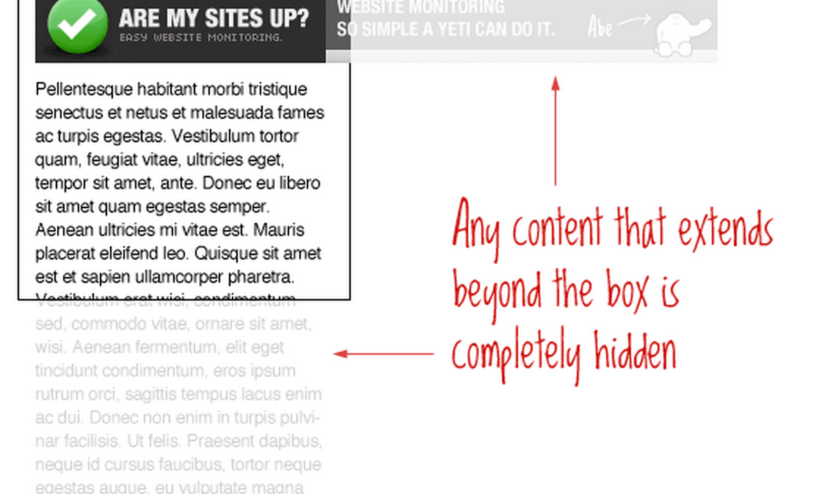
CSS Properties - Images (Overflow)

Slide 19
CSS Properties - Background
Properties - there are many. These are the most important:
background-color: #FF00AA | rgba(255, 144, 0, 0.6)
background-image: url(../assets/img/puppy.gif);
background-repeat: no-repeat;
background-position: left | center | right top | center | bottom;

Slide 20
CSS Properties - Background
Properties - there are many. These are the most important:
background: #FF00AA url(../assets/img/puppy.gif) no-repeat left | center | bottom;

Slide 21
CSS Properties - Centering an Element
To center a div horizontally:
display: block; (Note that this happens by default)
margin-left: auto;
margin-right: auto;

Slide 22
*Sigh of relief* Any questions?

