Slide 1
CSE 338
Artificial Intelligence Lab
Group 5
Project Presentation

Slide 2

Project Title:
Rain Fall Prediction of Bangladesh
Using
Artificial Intelligence
&
Machine Learning

Slide 3
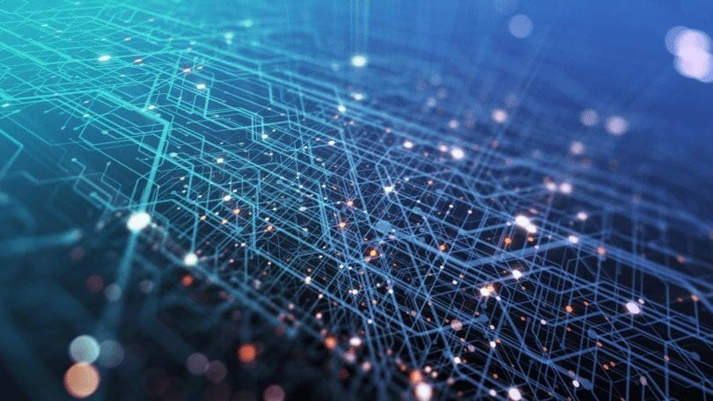
Group Members:
Name
Md. Azharul Karim Chowdhury Anik
Sabiha Jahan Mim
Oishik Biswas
Riddhiman Swanan Debnath
Kabir Ahmed
Registration No
2017331035
2018331059
2018331069
2018331073
2018331125

Slide 4
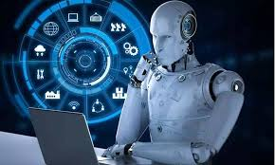
Introduction
Climate change has become a headache for mankind irrespective of country, nation and regions as each and every living beings on this planet have to face the direct and indirect impact of this issue. People are working on to detect the patterns of climate change, and rainfall is no exception. It’s a challenging task to make a accurate rainfall prediction model. Making prediction on rainfall can’t be done by the traditional way. This project is a small effort using the knowledge of machine learning and artificial intelligence to find out the pattern for rainfall prediction.

Slide 5
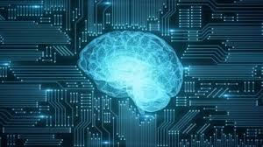
Objective
Rainfall prediction has it’s own purpose as our agricultural country needs enough rainfall to sustain agricultural products for food and raw materials of industrial sector.
Besides, rainfall has it’s direct connection with natural calamities like drought or floods, which brings the damage of crops, human lives and property and may cause famine or instability in social and economical infrastructure.

Slide 6
Having a better rainfall prediction model will give people and the authority the opportunity to make a better preparation to minimize the damage of lives and property. Farmers will be among one of the most beneficials from this model.
This model can ensure efficient utilization of water management too. Rainfall prediction is a challenging task and it’s necessary that the results should be accurate.

Slide 7
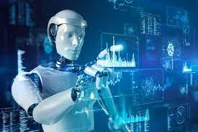
Problem Description
Climate is a important aspect of human life. As rainfall is an essential part of overall climate, the rainfall prediction should be accurate as much as possible.
In this project, we have tried to deal with the prediction of the rainfall in Bangladesh, analyzing the data of previous years and understanding the probable outcome of rainfall in future years, so that farmers can choose crops according to the probable availability of water as the necessity of water varies for different crops.

Slide 8
Besides, they can be aware of the probable natural calamities like drought or floods. Rainfall provides us with fresh water resource, which is necessary for not only drinking purposes, but also for agricultural or other purposes. This prediction has become very significant because of recent climate change facts as the normal pattern of rainfall has changed drastically.

Slide 9

Dataset Collection
This dataset contains about 50 years of daily weather observations from many locations across Bangladesh, containing the amount of daily rainfall.
The dataset we have taken for this project can be found clicking the following link.
RainFall Dataset

Slide 10
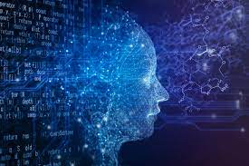
Methodology
Front End:
1) Streamlit
Back End:
1) Streamlit
Model Test & Training:
Google Colab

Slide 11
Here is the table with different models and their corresponding MSE values:
Model Name | MSE Value
Decision Tree | 312.858214423485
Linear Regression | 369.5528070107824
KNeighbors Classifier | 761.3355303307702
MLP Classifier | 410.4744293909435
Random Forest | 329.7653556009468
Gradient Boosting | 330.5131475085028
XGBoost Regression | 330.50708084977293

Slide 12
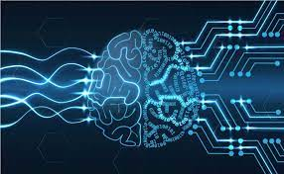
System Description

Slide 13

Result Analysis

Slide 14
Future Work
As of now the model has been trained for the mentioned state in the project. It can further be expanded to other countries or regions. The program will also be made general by making it pick the best model using cross validation and accuracy score to predict the rainfall. The accuracy of the model can also be boosted using methods like algorithm tuning, feature selection etc. Other machine learning algorithms can also be used to predict the results.

Slide 15

Conclusion
This project has been designed to predict the rainfall for Bangladesh in any desired day in future based on the information of previous years. Rainfall prediction is one of the most difficult and uncertain tasks that has a significant impact on human society. Accurate and timely rainfall prediction can proactively help reduce human and financial loss. This project can provide with the task of helping farmers and other people in the agricultural industry to choose their crops wisely for the harvest season so that they would not have to face any loss, along with predicting the possibility of calamities like drought and flood.

