Slide 1
CSE 338 Artificial Intelligence Lab Group 5 Project Presentation

Slide 2

Project Title: Rain Fall Prediction of Bangladesh Using Artificial Intelligence & Machine Learning

Slide 3
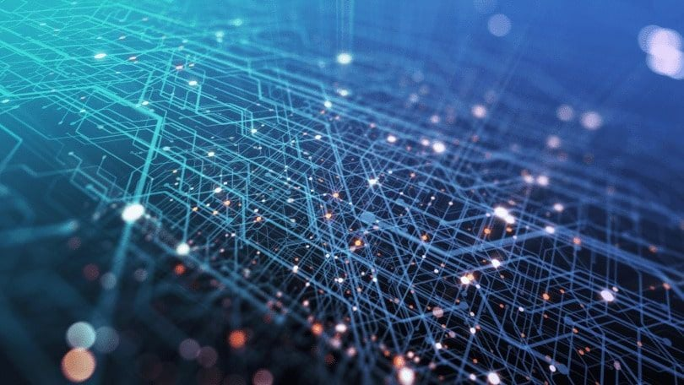
Group Members:
Name
Md. Azharul Karim Chowdhury Anik
Sabiha Jahan Mim
Oishik Biswas
Riddhiman Swanan Debnath
Kabir Ahmed
Registration No
2017331035
2018331059
2018331069
2018331073
2018331125

Slide 4

Motivation
Climate change has become a headache for mankind irrespective of country, nation and regions as each and every living beings on this planet have to face the direct and indirect impact of this issue. People are working on to detect the patterns of climate change, and rainfall is no exception. It’s a challenging task to make a accurate rainfall prediction model. Making prediction on rainfall can’t be done by the traditional way. This project is a small effort using the knowledge of machine learning and artificial intelligence to find out the pattern for rainfall prediction.

Slide 5

Objective
Rainfall prediction has it’s own purpose as our agricultural country needs enough rainfall to sustain agricultural products for food and raw materials of industrial sector.
Besides, rainfall has it’s direct connection with natural calamities like drought or floods, which brings the damage of crops, human lives and property and may cause famine or instability in social and economical infrastructure.

Slide 6
Having a better rainfall prediction model will give people and the authority the opportunity to make a better preparation to minimize the damage of lives and property. Farmers will be among one of the most beneficials from this model.
This model can ensure efficient utilization of water management too. Rainfall prediction is a challenging task and it’s necessary that the results should be accurate.

Slide 7
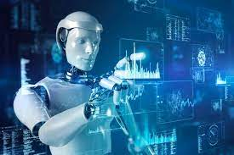
Problem Description
Climate is a important aspect of human life. As rainfall is an essential part of overall climate, the rainfall prediction should be accurate as much as possible.
In this project, we have tried to deal with the prediction of the rainfall in Bangladesh, analyzing the data of previous years and understanding the probable outcome of rainfall in future years, so that farmers can choose crops according to the probable availability of water as the necessity of water varies for different crops.

Slide 8

Dataset Collection
This dataset contains about 50 years of daily weather observations from many locations across Bangladesh, containing the amount of daily rainfall.
Dataset has been taken from Kaggle

Slide 9
Model Preprocessing
Model Name | MSE Value
Decision Tree | 312.858214423485
Linear Regression | 369.5528070107824
KNN Classifier | 761.3355303307702
MLP Classifier | 410.4744293909435
Random Forest | 329.7653556009468
Gradient Boosting | 330.5131475085028
XGBoost Regression | 330.50708084977293

Slide 10

Tech Stack
Front End:
1) Streamlit
Back End:
1) Streamlit
Model Test & Training:
Google Colaboratory

Slide 11
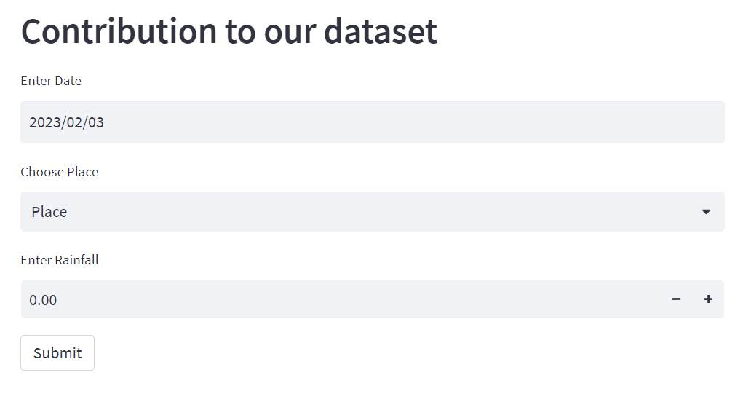
Application
User can contribute to the dataset

Slide 12
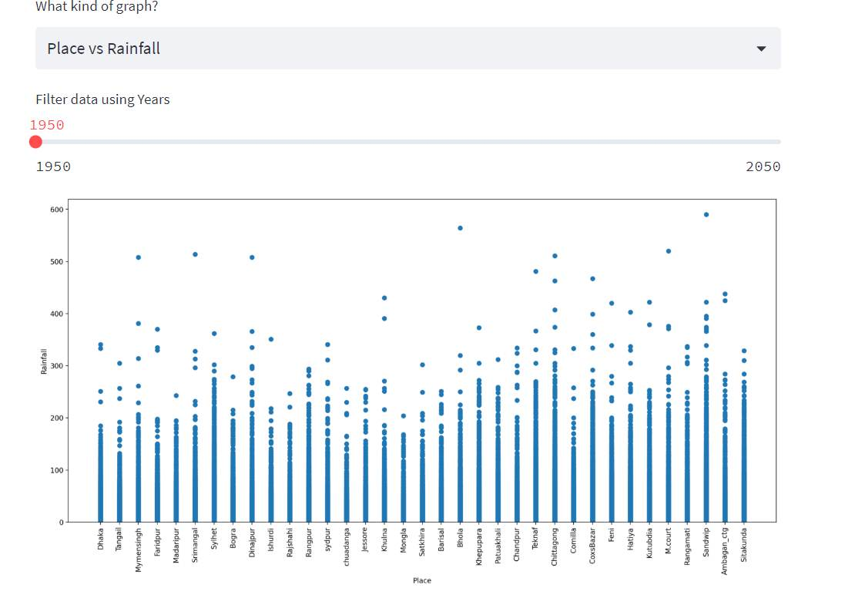
Application
Place vs Rainfall Graph
Places can be customized

Slide 13
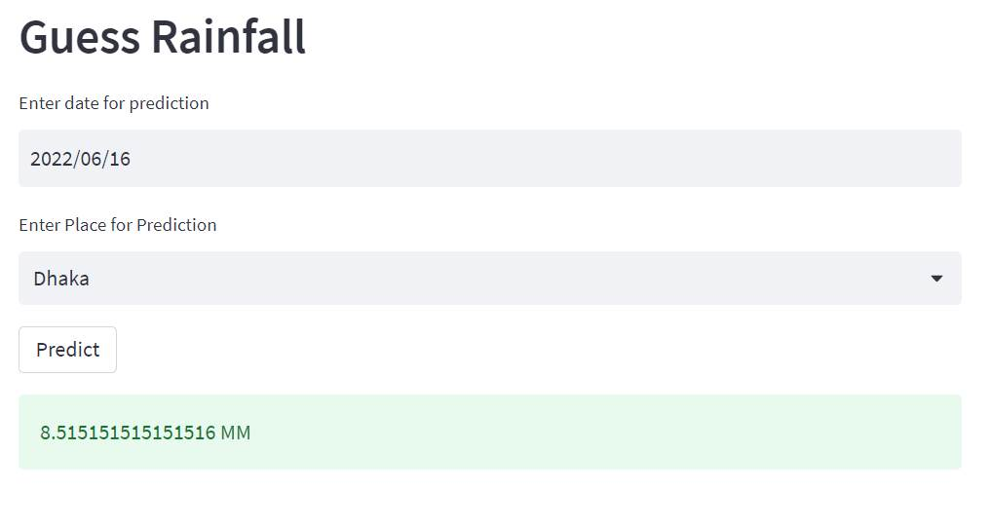
Application

Slide 14

Future Work
Considered only 35 areas of Bangladesh.
More features can be added to increase the efficiency of the model.
The web-app can be enhanced as a weather forecaster.

Slide 15

Conclusion
This project has been designed to predict the rainfall for Bangladesh in any desired day in future based on the information of previous years. Rainfall prediction is one of the most difficult and uncertain tasks that has a significant impact on human society. Accurate and timely rainfall prediction can proactively help reduce human and financial loss. This project can provide with the task of helping farmers and other people in the agricultural industry to choose their crops wisely for the harvest season so that they would not have to face any loss, along with predicting the possibility of calamities like drought and flood.

Slide 16
Thank You!

