Slide 1
Mimsy
A Modern Headless Content Management System
PDG - 2025
Alexandre Philibert
Calum Quinn
Valentin Ricard

Slide 2
Explanation - What is a CMS?
“A content management system (CMS) is a software application that lets users create, edit, collaborate on, publish and store digital content. “
https://www.techtarget.com
A headless CMS does not manage how the content is displayed in the final products frontend. It manages the data schema and content, not its layout.

Slide 3
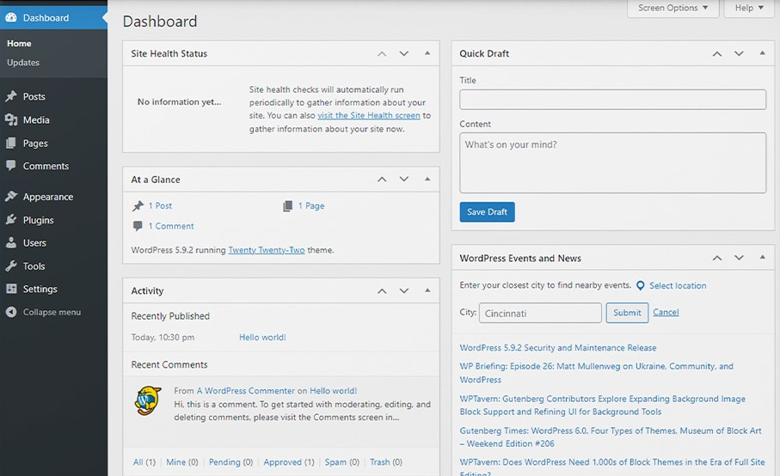
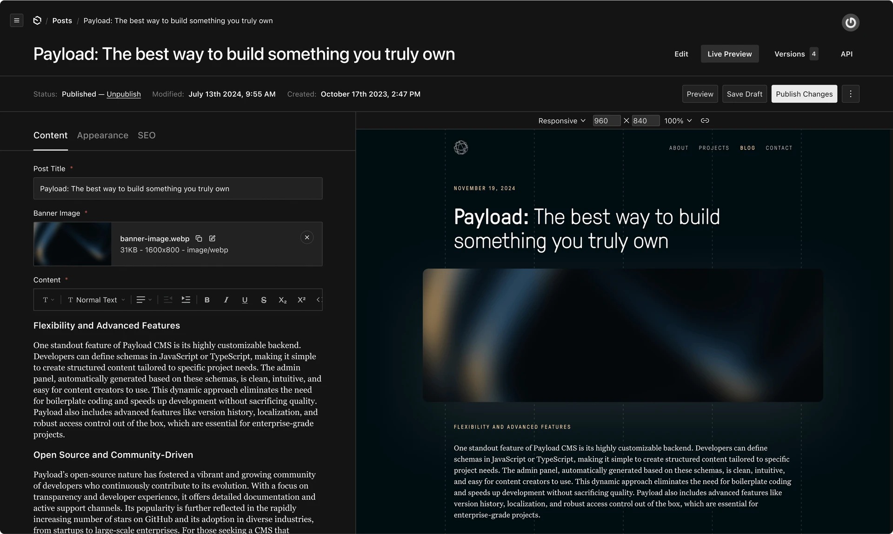
Other CMS

Slide 4
Project justification
Most existing CMS solutions are overly complex due to customizability.
We wanted to build something that:
Is quick and easy to set up
Is developer oriented
Doesn't burden developers with schema changes

Slide 5
Idea
A headless CMS with the following objectives:
Developer-first experience
Zero-downtime operations
Type safety
SvelteKit native
Agency-focus

Slide 6
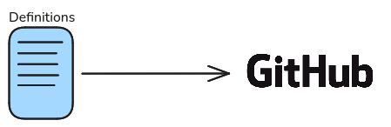
Workflow overview
Developer productivity being the primary goal when it comes to Mimsy's workflow.
Here's how developers can go from concept to production in minutes.
Define the desired collections in a JSON file according to the specified format
Push the changes to GitHub

Slide 7
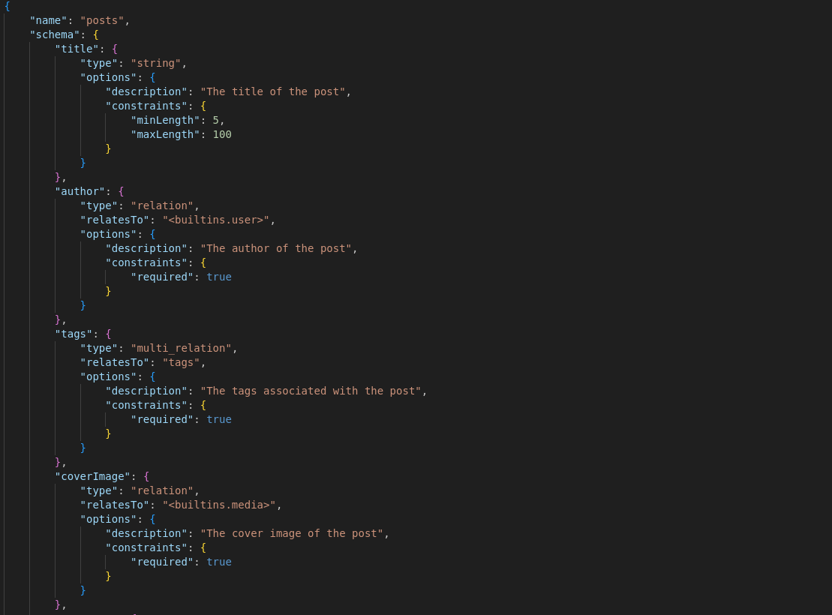

Slide 8
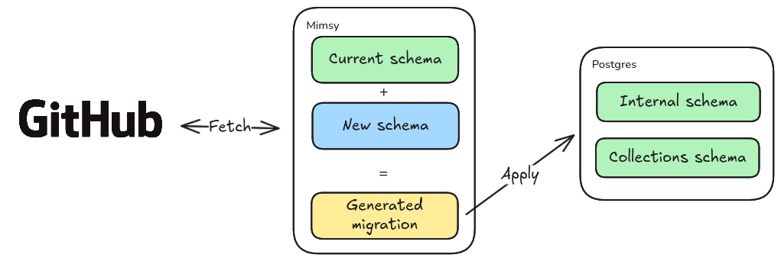
Wait
3. Mimsy fetches the schema update
4. Necessary migration is generated to reach the new schema
5. Seamless migration rollout of the new schema

Slide 9
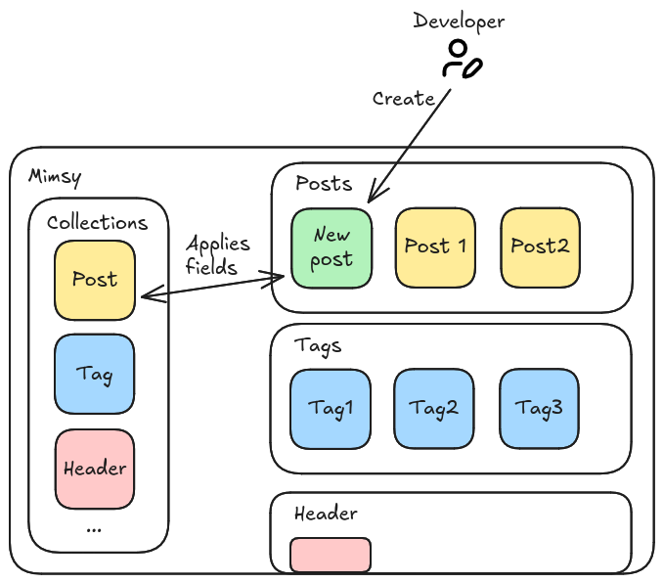
Resource creation
6. Once the collections are in production, the developer can create resources based on the collection definition

Slide 10
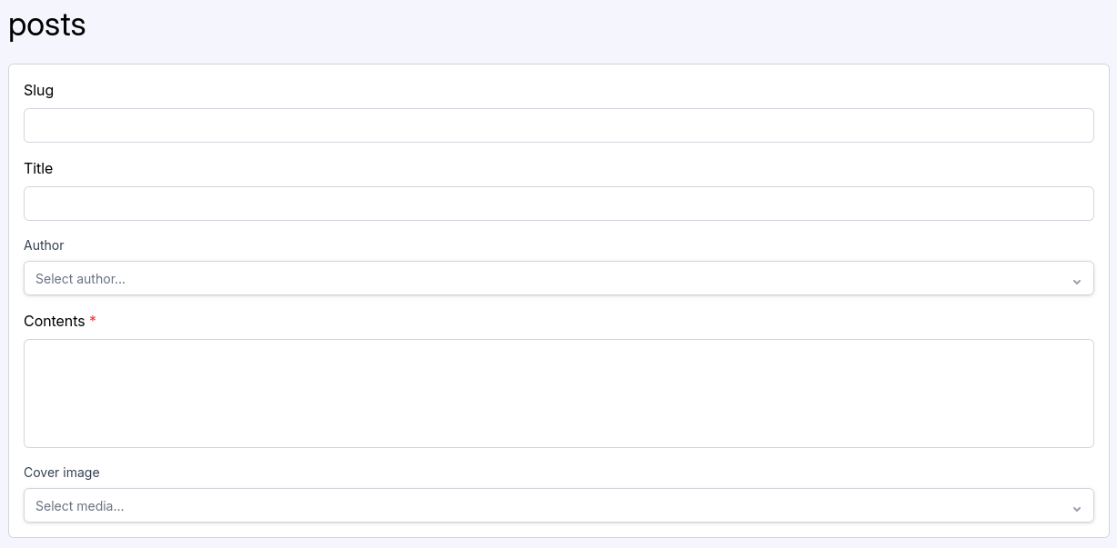
Resource content
7. Finally, the developer can now provide specific content for each resource

Slide 11









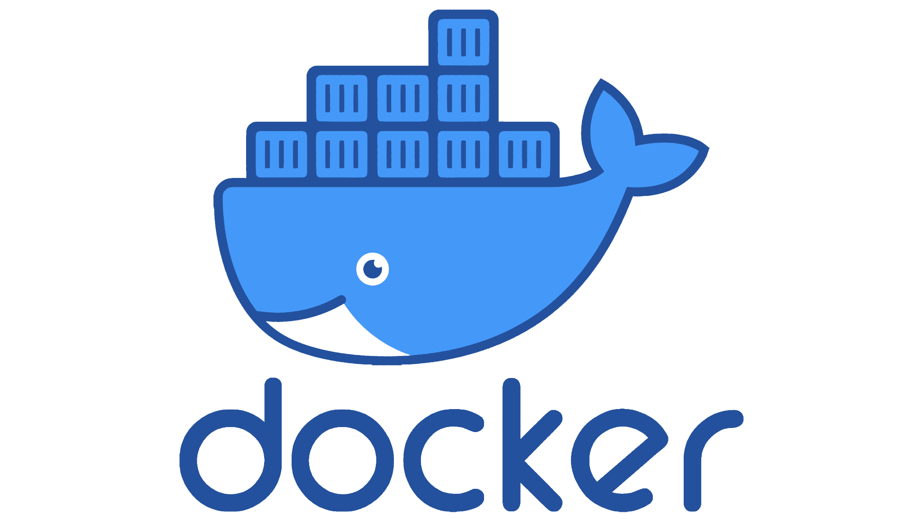




Technology stack

Slide 12
Development workflow and deployment strategy
Trunk-based development paired with GitOps automation to ensure rapid, reliable production deployments.
Key Benefits:
Fast Feature Delivery: Seamless flow from development to production
Reduced Friction: Automated pipelines eliminate manual steps
Quick Iteration Cycles: Immediate feedback on features and design changes
Deployment Confidence: GitOps ensures consistent, reproducible deployments

Slide 13
Conclusion
Mimsy addresses the fundamental disconnect between traditional CMS platforms and modern development workflows. Today, developers can effortlessly define content structures in TypeScript and deploy them across any frontend architecture with confidence.
We've transformed our vision of developer-centric content management into reality. Strategic decisions made under time constraints have yielded a lean, purposeful architecture that serves as an ideal foundation for building a complete, production-ready platform.
< REFORMULATE >

