Slide 1




















NIRVANA
INNOVATION
PROJECT HARMONIZE
2.8
Million Social Media posts
2.5
Million Website search queries
27.2
Thousand Review posts
New
iOS
ANDROID
App
100
Hours of Online videos
201
Million emails sent
EVERY MINUTE
ALL SOCIAL MEDIA
IN ONE PLACE
57
Thousand Pictures posts
50.7
Thousand Thoughts posts
Facebook, Twitter, LinkedIn, Instagram, Pinterest, Reddit, Snapchat, TikTok, MeetUp, Nexdoor, Whisper, Tumblr,Digg, YouTube, Yelp, Flickr, LiveJornal, Goodreads, Qzone, WhatsApp…
Project Manager:
MASHA M HARNESS
 (415) 802-3177
 masha.harness@gmail.com
12%
34%
56%
i

Slide 2
NIRVANA
INNOVATION
PROJECT HARMONIZE
Project Manager:
TABLE of CONTENTS
MASHA M HARNESS
 (415) 802-3177
 masha.harness@gmail.com
Title
Executive Summary
Waterfall Methodology
Agile-Scrum Methodology
Scrumban Methodology
XP Methodology
SDLC Usability Matrix
i
1
3
5
7
9
11
Table of Contents
SDLC
Agile Methodology
Agile-Kanban Methodology
Lean Methodology
DevOps Methodology
Summary
ii
2
4
6
8
10
12
ii

Slide 3
NIRVANA
INNOVATION
PROJECT HARMONIZE
Project Manager:
EXECUTIVE SUMMARY
MASHA M HARNESS
 (415) 802-3177
 masha.harness@gmail.com
Nirvana Innovations is a software app development startup with enormous growth potential; a pioneer in the “All-In-One Social Media” software app market.
Goal: perform analysis using the project information and knowledge of SDLC methodologies to determine which software development process approach would be most efficient / to recommend the most appropriate SDLC methodology for this project.
Project Essential Factors:
Familiar technology: Nirvana has only completed a handful of projects; most have been SW apps;
Complex software product: “All-In-One Social Media” app for use on iOS and Android. This complex app would essentially combine all major social media platforms in one place;
Speed to market: No one has released an app yet;
Not interested in project documentation;
Effective, constant face-to-face communication
Involvement in the development process;
Weekly demo, with each iteration building on and providing improvements to the last;
The requirements have been provided; however, some may change based on feedback from continuing focus groups.
1

Slide 4






NIRVANA
INNOVATION
PROJECT HARMONIZE
Project Manager:
SDLC
MASHA M HARNESS
 (415) 802-3177
 masha.harness@gmail.com
SDLC: The Software Development Life Cycle is a structured process that enables the production of high-quality, low-cost software solutions, in the shortest possible production time.
BENEFITS
Test
Deploy
IMPORTANCY
Provides a work structure to coordinate the complicated nature of a software development project.
Drives the necessity to think about the big picture when planning ahead.
Assists management in project control by laying out expected tasks, deliverables, and timelines.
Provides project transparency by providing a view to all of the project details to team members.
Enhances speed and accuracy by providing a clear, manageable path to a successful project completion.
It provides a standardized framework that defines activities and deliverables
It aids in project planning, estimating, and scheduling
It makes project tracking and control easier
It increases visibility on all aspects of the life cycle to all stakeholders involved in the development process
It increases the speed of development
It improves client relations
It decreases project risks
It decreases project management expenses and the overall cost of production
Implement
Maintain
Design
Plan
ROLES: Project Sponsor, Project Manager, Business Analyst, Developers, Systems Architect, Testers, End User.
2

Slide 5



NIRVANA
INNOVATION
PROJECT HARMONIZE
Project Manager:
WATERFALL METHODOLOGY
MASHA M HARNESS
 (415) 802-3177
 masha.harness@gmail.com
SUMMARY: Waterfall is a linear approach to development. It works best when requirements are thoroughly understood and will remain stable throughout the project. Each distinct stage of development generally finishes before the next one can begin.
PROS
CONS
It is a mature methodology and has processes that are well documented.
Each phase is executed one at a time.
Developers and customers agree
on deliverables early in the development lifecycle, which makes planning and design straightforward.
It’s best when used for smaller projects where the time frame is short, and the requirements are well defined
Software can be designed upfront based on an understanding of all requirements.
Waterfall works best when requirements remain stable throughout the project.
Project costs can be accurately estimated.
Waterfall should be avoided if you anticipate changes during the large project; it does not accommodate new requirements.
You must wait until the end of the process to see the outcome.
Testing comes in late in the process and can cause delays and unexpected costs.
The process can take longer since you cannot move to the next phase until the current phase is completed.
Minimal client communication.
There is a high-risk factor.
PLAN
DESIGN
IMPLEMENT
TEST
DEPLOY
MAINTAIN
ROLES: Project Manager, Business Analyst, Developers, Testers
3

Slide 6
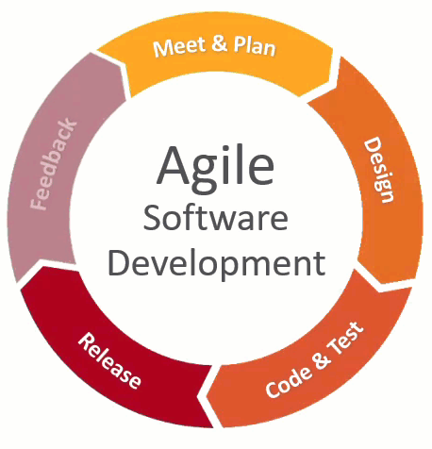
NIRVANA
INNOVATION
PROJECT HARMONIZE
Project Manager:
AGILE METHODOLOGY
MASHA M HARNESS
 (415) 802-3177
 masha.harness@gmail.com
SUMMARY: Agile is an iterative approach to development. It emphasizes the rapid delivery of an application in complete functional components. Agile is not an absolute set of steps to follow. It has several frameworks, all of which include a process for continuous improvement.
PROS
CONS
Relies on a very high level of customer involvement; development is often more user-focused. Customer sees value sooners with frequent deployments
Receive and provide immediate feedback; adapt to change and respond faster.
Detect and fix issues and defects faster.
Sprint planning creates a predictable delivery of an incremental product update; predictable costs and predictable development schedules for each Sprint.
Light documentation
It is likely that some items set for delivery will not be completed within the allotted timeframe.
Product delivery can be fragmented rather than a whole unit.
Budgets and timelines cannot be established with accuracy.
Projects can become ever-lasting without a defined end date.
Requires extra discipline when members are geographically distributed.
More time and commitment is required.
ROLES: Product Owner • Scrum Master • Development Team
4

Slide 7
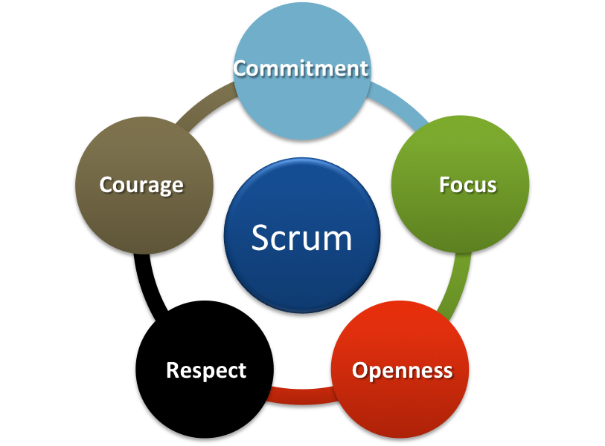
NIRVANA
INNOVATION
PROJECT HARMONIZE
Project Manager:
AGILE-SCRUM METHODOLOGY
MASHA M HARNESS
 (415) 802-3177
 masha.harness@gmail.com
SUMMARY: Scrum focuses on planning, committing, and delivering work using time-boxed development phases called Sprints. Optimized for software delivery. Pushes software teams hard. Requires significant Project Management overhead.
PROS
CONS
Scrum is the more structured framework of agile.
Designed to organize and coordinate development teams to delivery quality, market-ready solutions, both quickly and efficiently.
Sprints enable predictability by ensuring inspection and adaptation of progress toward a Sprint Goal in at least four weeks.
No clear image of the end product.
The end result might be a whole lot different from what was planned initially.
Must be a very high team commitment. Due to the changing environment, a team must be able to react swiftly and adopt new technologies if needed.
Don’t have a specific time and cost estimates.
ROLES: Scrum Master (Champion of the Method) • Product Owner (Voice of the Product) • Scrum Team (Getting the Work Done)
5

Slide 8
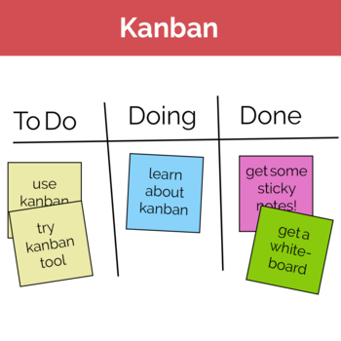
NIRVANA
INNOVATION
PROJECT HARMONIZE
Project Manager:
AGILE-KANBAN METHODOLOGY
MASHA M HARNESS
 (415) 802-3177
 masha.harness@gmail.com
SUMMARY: Kanban focuses on visualizing your workflow, limiting work in progress, and maximizing efficiency. Optimized for task management, where tasks can be software, hardware, or others. Balance of productivity vs. overhead.
PROS
CONS
Kanban is optimized for continuous delivery. The focus is always on adapting o the customer, even mid-Sprint.
The team is highly responsive to change.
The goal is continuous delivery. The team will be able to deliver a release at any time, often via the cloud.
The team needs a good balance of managing customer demand for features, functionality, and fixes with the team's development capacity.
The project needs a customer-centric focus. Kanban guarantees these features will always be worked on first.
Sufficient for tracking bug reports and fixes.
Allows for maximum flexibility and responsiveness, customer inputs to be made at any time, and continuous delivery of the software.
Less effective in shared-resource situations.
May cause poor productivity.
Easier to misuse process.
Harder to plan out and project large release initiatives
Can be difficult to manage different priorities.
ROLES: Kanban shifts roles as needed. Service Delivery Manager, Service Request Manager, Technical Lead, and the team.
6

Slide 9

NIRVANA
INNOVATION
PROJECT HARMONIZE
Project Manager:
SCRUMBAN METHODOLOGY
MASHA M HARNESS
 (415) 802-3177
 masha.harness@gmail.com
SUMMARY: Scrumban combines the best features of both Scrum and Kanban during project development. Uses Kanban type capacity planning (WiP), but Scrum type release planning (Sprints) to deliver enhancement and patch releases on a regular schedule.
PROS
CONS
It is less formal, time-boxed, yet largely task-driven process that can produce a release on a predictable schedule.
Work iterations are kept short. The length of the iteration is measured in weeks. This ensures that a team can easily adapt and change their course of action to a quickly changing environment.
Continuously integrating software from multiple developers and testing is key to keeping the codebase quality high.
Would typically be used for a project that is in sustaining mode and doesn’t require continuous delivery of the SW.
Specially designed for project that requires frequent maintenance, having unexpected user stories and programming errors. Using these approaches, the team’s workflow is guided in a way that allows minimum completion time for each user story or programming error.
Scrumban doesn't keep the team on a tight enough schedule in a short delivery timespan.
The end of Sprint review and retrospective are not applicable when using Scrumban.
Effective for very small teams (1-3 engineers), working on application projects.
Scrumban removes some of the more rigid aspects of Scrum and left each team to create a custom approach to development.
ROLES: There are no required roles. Project Manager, Technical Lead, and the team.
7

Slide 10
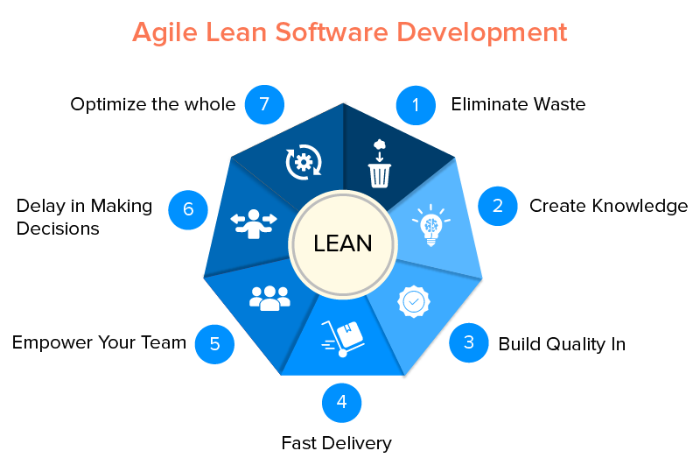
NIRVANA
INNOVATION
PROJECT HARMONIZE
Project Manager:
LEAN METHODOLOGY
MASHA M HARNESS
 (415) 802-3177
 masha.harness@gmail.com
SUMMARY: reducing waste and improving efficiency with a goal of shortening the product development cycles and rapidly identifying when a concept, or process, is no longer viable.
PROS
CONS
Quick Delivery
Low Development Costs
Employee Empowerment
Team Skill Level
Team Discipline
Heavy/High Degree of Documentation
ROLES: Project Sponsor, Lean Champions, Lean Project Leaders
8

Slide 11
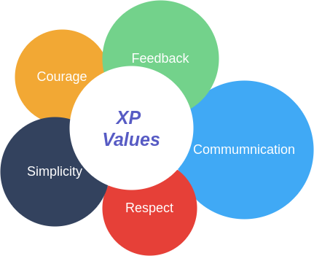
NIRVANA
INNOVATION
PROJECT HARMONIZE
Project Manager:
EXTREME PROGRAMMING (XP) METHODOLOGY
MASHA M HARNESS
 (415) 802-3177
 masha.harness@gmail.com
SUMMARY: Extreme Programming provides iterative and frequent small releases throughout a project, allowing team members and customers to examine and review the project’s progress throughout the SDLC.
PROS
CONS
Creates software quickly
Practices simplicity
Encourages accountability
Allows continuous feedback
Delivering working software constantly.
Customer is involved throughout the whole development journey.
Focuses on code instead of design
Lacks defect documentation
Is ineffective for geographically separated teams.
Requires the team to be highly experienced and committed to making the project successful.
No picture of the end product. You might end up with something completely different than what was planned initially.
Team needs to attend frequent daily meetings in order to bring everybody on the same page as there is a lack of documentation.
ROLES: Customer, Manager, Coach, Developer
9

Slide 12
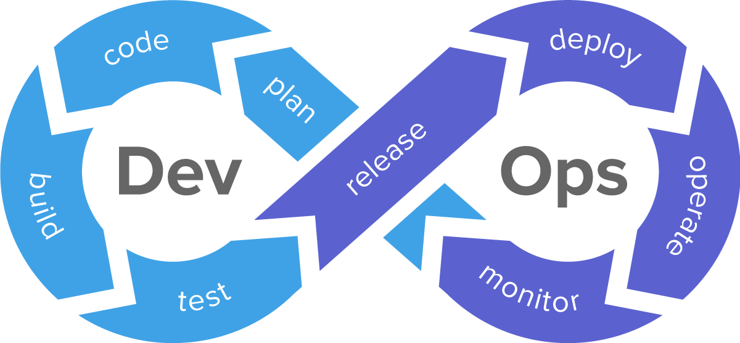
NIRVANA
INNOVATION
PROJECT HARMONIZE
Project Manager:
DevOps METHODOLOGY
MASHA M HARNESS
 (415) 802-3177
 masha.harness@gmail.com
SUMMARY: DevOps is a set of practices that involves close collaboration between the software development (Dev) with information technology operations (Ops) departments during the software development life cycle.
PROS
CONS
Continuous delivery with maximum speed, functionality, and innovation.
Testing Automation integral to process.
Ops and Dev teams collaborate to accelerate the delivery process.
A single team composed of cross-functional members all working in collaboration.
Heavy Documentation
Large cross-functional team
DevOps requires culture change
ROLES: Project Manager, Software Development team (Dev), IT Operations team (OpS)
10

Slide 13
NIRVANA
INNOVATION
PROJECT HARMONIZE
Project Manager:
SDLC USABILITY MATRIX
MASHA M HARNESS
 (415) 802-3177
 masha.harness@gmail.com
FACTORS | WATERFALL | AGILE | AGILE-SCRUM | AGILE-KANBAN | SCRUMBAN | LEAN | XP
Familiar technology | Excellent | Excellent | Excellent | Excellent | Excellent | Excellent | Excellent
Changing Requirements | Poor | Excellent | Excellent | Good | Good | Good | Excellent
Complex software | Poor | Good | Good | Good | Good | Good | Excellent
Speed to market | Poor | Poor | Excellent | Poor | Good | Excellent | Excellent
Weekly demo | Poor | Excellent | Excellent | Good | Good | Good | Excellent
Effective face-to-face communication | Poor | Excellent | Excellent | Excellent | Excellent | Good | Excellent
Customer Involvement in Developing | Poor | Excellent | Excellent | Excellent | Excellent | Good | Excellent
Customer’s request: No documentations | Poor | Good | Excellent | Good | Good | Poor | Excellent
11
Notes:
Use the matrix to compare and contrast the different SDLC methodologies and to recommend the best option

Slide 14
NIRVANA
INNOVATION
PROJECT HARMONIZE
Project Manager:
SUMMARY
MASHA M HARNESS
 (415) 802-3177
 masha.harness@gmail.com
The XP Methodology model is highly preferred in Nirvana Innovation new “All-In-One Social Media” app for iOS and Android where the user interface is one of the main components to keep customers happy.
Nirvana Innovation is delivering working software constantly. Thus, the customer can see the return of his investment almost immediately. In addition, the Nirvana Innovation team is involved throughout the whole development process. A feedback and suggestions could be collected almost immediately, which lead to a better product.
Change is embraced for this highly complex product. You can adjust things along the way if something goes wrong. It focuses on reducing the cost of the entire project as opposed to Waterfall, where the cost of making changes is enormously high.
Team communication is one of the major principles the XP model consists of. Extreme Programming strives for great team communication through face-to-face interactions and daily meetings.
Similarly, to any Agile method, it requires the team to be highly experienced and committed to making the project successful. The team needs to attend frequent daily meetings in order to bring everybody on the same page as there is a lack of documentation.
However, here is a “warning flag”. A precise picture of the end-product could be not so obvious. It is a possibility that you might end up with something completely different than what was planned initially. Therefore, the team needs to attend frequent daily meetings in order to bring everybody on the same page as there is a lack of documentation.
12

Slide 15

NIRVANA
INNOVATION
PROJECT HARMONIZE
Project Manager:
THANK YOU
MASHA M HARNESS
 (415) 802-3177
 masha.harness@gmail.com

