Slide 1
Optimizing Container Transportation: Analysis and Modeling
By Mina Iravani

Slide 2
Agenda
Simulation
Key Learnings from Log File
How the Optimizer Works
Sequence of Jobs
Analysis of Executed Plan
AI Application-unsupervised learning
AI + Optimization Approach
Waiting Time of Jobs
Analysis of Executed Plan
AI + Optimization Approach
AI Approach
One-to-Many RNN Model
Encoder-Decoder Model
Training of Models

Slide 3
Simulation Key Learnings from Log File:
Input sources
The simulation initializes using an input Excel file and onsite data sources.
Dynamic updates
Executed jobs information are reported to reflect the latest conditions.
Triggering a new run
The location's current status and the number of order elements are updated in DEBUG lines to prompt a rescheduled plan.
Order assignment
Each Order ID is assigned to at most one vehicle plan per run to ensure efficient scheduling.
Job scheduling
The simulation plans the next 3–4 jobs per run, not further.

Slide 4
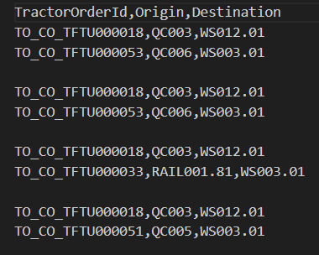
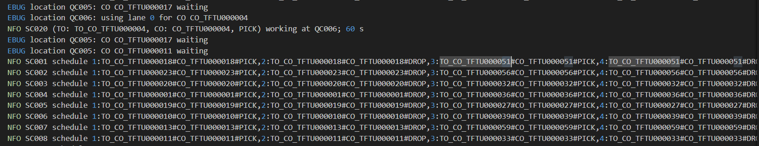
Simulation Example: Schedule of One SC
SC001, 3rd schedule:
TO_CO_53 QC006
TO_CO_33 RAIL
TO_CO_51 QC005
Destination: WS003.01

Slide 5
Simulation How the Optimizer Works:
The optimizer focuses on individual schedules rather than considering the waiting lists of other SCs. It ensures that similar orders are not placed consecutively or in parallel but does not account for the relations of SC plans.
It does not analyze historical timeframes related to waiting and operational periods at locations, which could significantly impact future scheduling decisions.
The optimizer struggles with long-term sequencing and cannot anticipate which jobs should follow after 3–4 tasks. As a result, it lacks a holistic view of job sequences across all vehicles, preventing the achievement of globally optimized execution times.

Slide 6
Agenda
Simulation
Key Learnings from Log File
How the Optimizer Works
Sequence of Jobs
Analysis of Executed Plan
AI Application-unsupervised learning
AI + Optimization Approach
Waiting Time of Jobs
Analysis of Executed Plan
AI + Optimization Approach
AI Approach
One-to-Many RNN Model
Encoder-Decoder Model
Training of Models

Slide 7
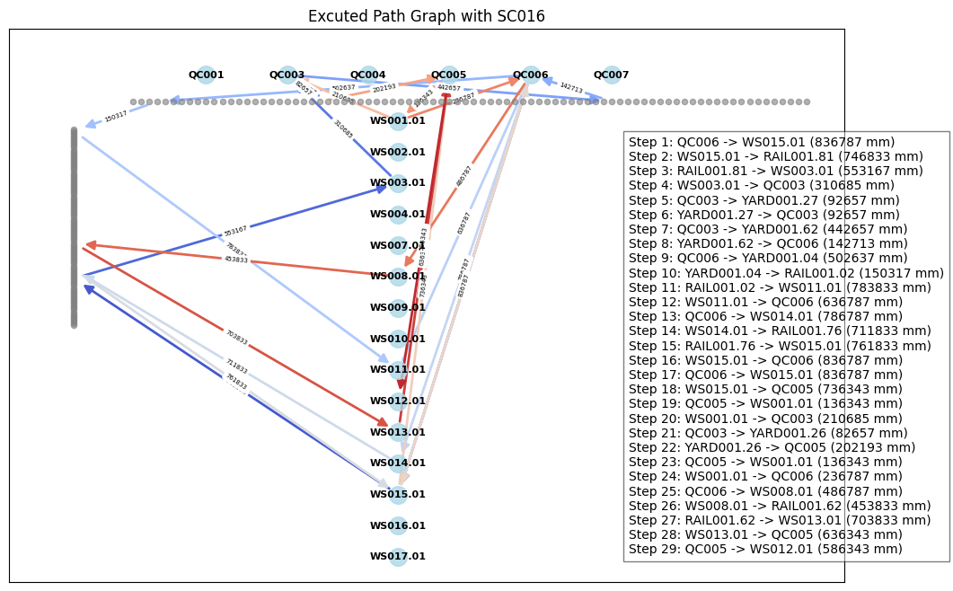
Analysis of Executed Plan sequence of Orders:

Slide 8
Analysis of Executed Plan sequence of Orders:16
WS15
836.8
QC6
836.8
WS15
736.3
QC5
136.3
WS01
210.7
QC3
82.7
YARD
202.2
QC5
136.3
WS01
236.8
QC6
486.8
WS08
453.8
RAIL1
2566.4
WS15
736.3
QC5
136.3
WS01
136.3
QC5
136.3
WS01
210.7
QC3
82.7
YARD
302.6
QC6
486.8
WS08
486.8
QC6
836.8
WS15
803.8
RAIL1
2566.3
QC3
QC5
QC6
YARD
WS01
YARD
WS08
WS15

Slide 9
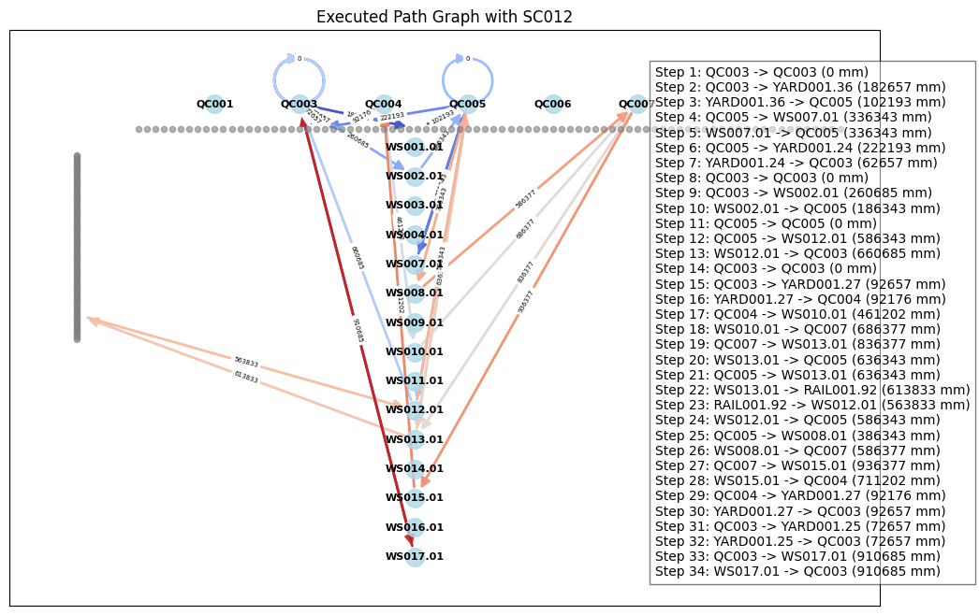
Sequence of Jobs Analysis of Executed Plan: SC12

Slide 10
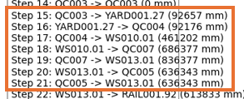
Sequence of Jobs Analysis of Executed Plan:
If there is no limitation on the number of carriers that can access the location simultaneously, the next job can be selected randomly among the closest next origin location!
QC3
QC4
QC5
QC7
By optimizer
YARD
WS01
WS10
686.4
QC7
836.4
WS13
636.4
QC5
636.4
WS13
2795.6
WS10
486.3
QC5
636.4
WS13
836.4
QC7
836.4
WS13
2795.5
RAIL
WS10
WS13

Slide 11
Sequence of Jobs Analysis of Executed Plan:
If there is no limitation on the number of carriers that can access the location simultaneously, the destination of next order is also important!
QC3
QC4
QC5
QC7
By optimizer
YARD
WS01
WS8
586.4
QC7
936.4
WS15
711.2
QC4
92.2
YARD
2326.2
WS8
361.2
QC4
92.2
YARD
392.22
QC7
936.4
WS15
1782.02
RAIL
WS08
WS15
1782.02+718=2500

Slide 12
Sequence of Jobs AI Application-unsupervised learning
The available container orders can be efficiently clustered using advanced clustering algorithms, based on the following criteria:
Origin location of orders
Destination location
Job duration or processing time
The number of clusters can be determined based on the desired complexity of the problem, allowing flexibility in optimizing for specific goals.
C3
C4
C5
C6
C3
C4
C4
C5
C6
C3
C4
C4
C5
C6
C3
C6
C4
C5
C5

Slide 13
Sequence of Jobs AI + Optimization Approach
How can the sequences of jobs be optimized individually for each straddle carrier?
Clusters can be arranged into short sequences, which can be validated as optimal based on their individual characteristics and interconnections. The optimizer can incorporate established patterns as additional constraints.
Rather than adjusting the total number of orders, the optimizer focuses on updating the cluster population. This model provides valuable insights into cluster distribution, enhancing the scheduling efficiency of upcoming jobs.
Pattern
C13
C42
C61
C53
Time penalty of C42 after C13
Time penalty of C61 after C42
Time penalty of C53 after C61

Slide 14
Agenda
Simulation
Key Learnings from Log File
How the Optimizer Works
Sequence of Jobs
Analysis of Executed Plan
AI Application-unsupervised learning
AI + Optimization Approach
Waiting Time of Jobs
Analysis of Waiting Times
AI + Optimization Approach
AI Approach
One-to-Many RNN Model
Encoder-Decoder Model
Training of Models

Slide 15
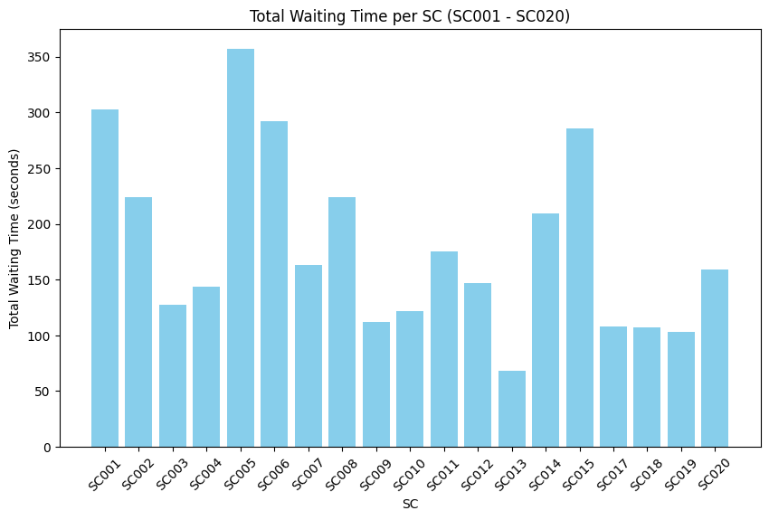
Waiting Time of Jobs Analysis of Total Waiting Time:
In total: 3430s~5%

Slide 16
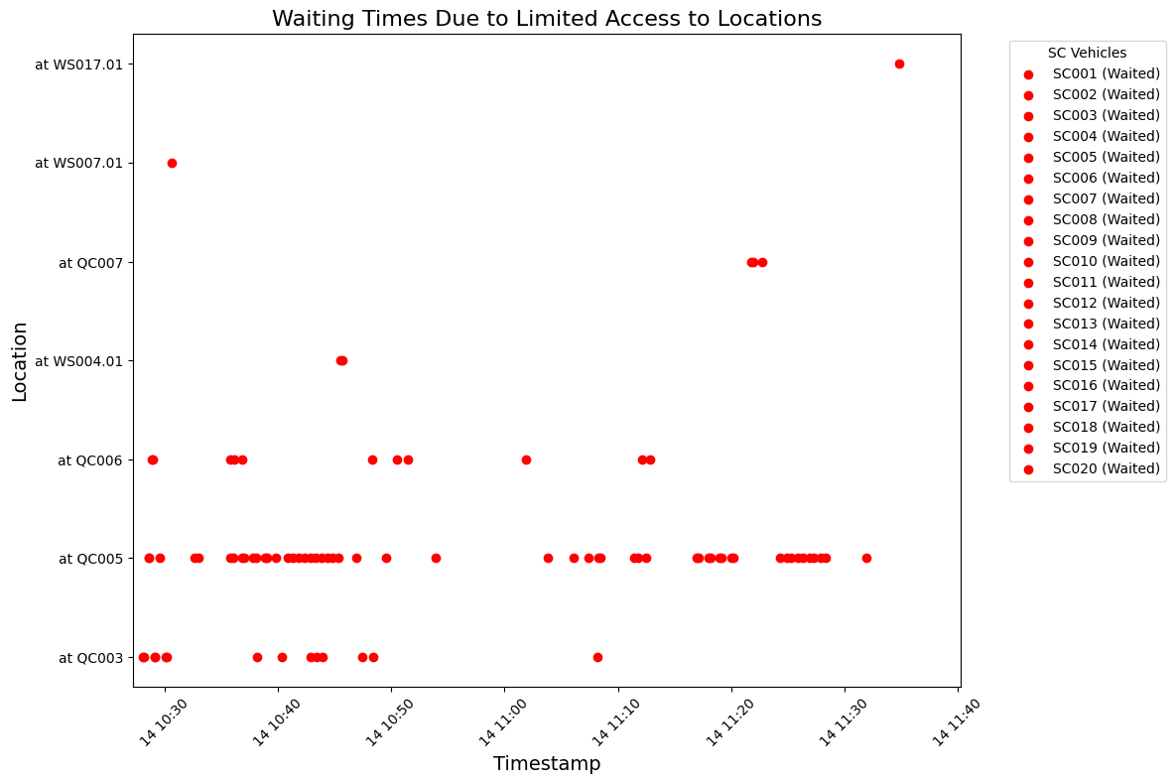
Waiting Time of Jobs Analysis of Waiting Time Distribution:

Slide 17
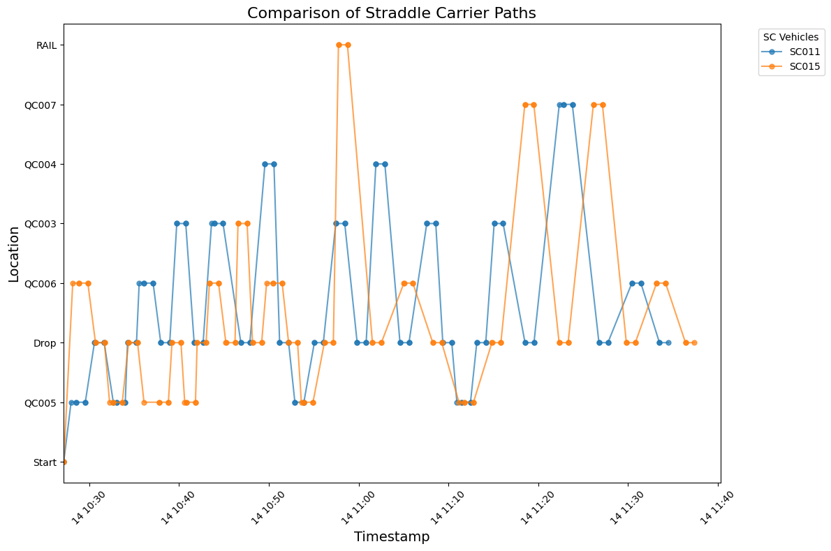
Waiting Time of Jobs Comparison of SC Paths:

Slide 18
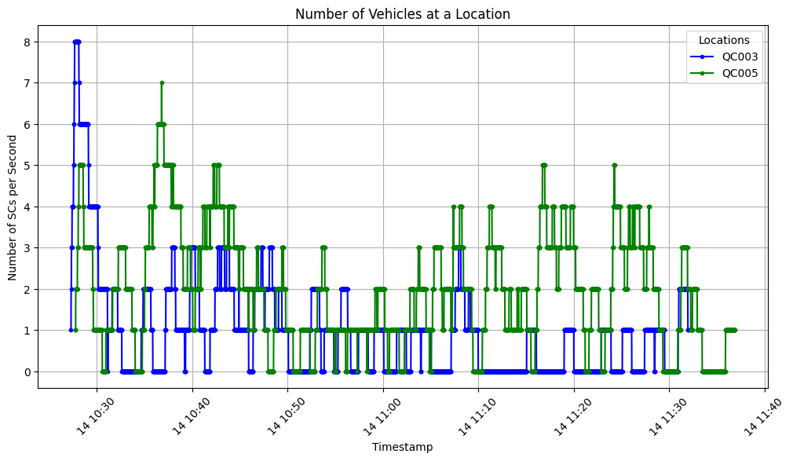
Waiting Time of Jobs Analysis of Number of SCs in one location:

Slide 19
Waiting Time of Jobs AI + Optimization Approach
This model enables proactive management of SC paths and potential waiting times caused by limited access to specific locations.
This approach helps minimize inefficiencies by balancing parallel work execution and transition times between clusters, improving overall job sequencing and resource allocation.
Time penalty between clusters
Working in the locations
Pattern1
Pattern2
SC1
C51
C42
C51
C63
SC2
Pattern1
Pattern2
C54
C62
C11
C51

Slide 20
Agenda
Simulation
Key Learnings from Log File
How the Optimizer Works
Sequence of Jobs
Analysis of Executed Plan
AI Application-unsupervised learning
AI + Optimization Approach
Waiting Time of Jobs
Analysis of Executed Plan
AI + Optimization Approach
AI Approach
One-to-Many RNN Model
Encoder-Decoder Model
Training of Models

Slide 21
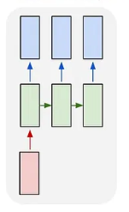
AI Approach One-to-Many RNN Model
An RNN takes a single input and generates multiple parallel sequences of outputs over time.
Given a fixed-length input X = (X₁, X₂, …, Xₙ)—which includes all features from the optimizer input file—the first RNN cell processes an item or token X as input, producing an output and a hidden state h₁ that carries information forward.
Each subsequent RNN cell generates an output based on the previous hidden state hₜ₋₁ and passes the updated hidden state hₜ to the next time step, ensuring continuity and context propagation across the sequence.
Output
20 SCs
…..
Hidden Layers
Input

Slide 22
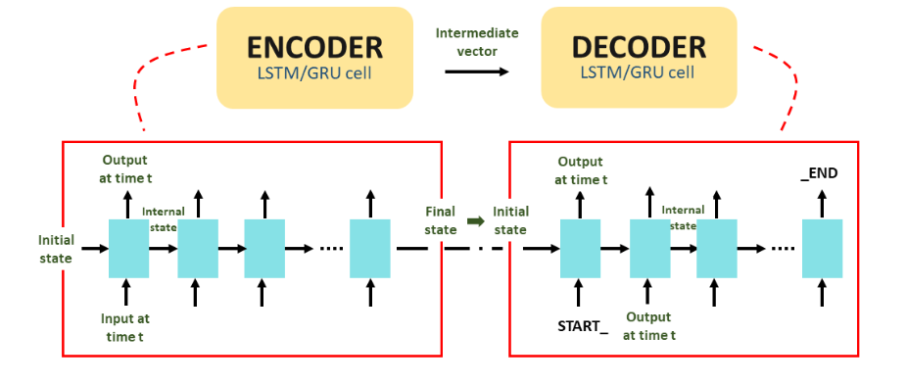
AI Approach Encoder-Decoder Model
Used in large language models for sequence-to-sequence tasks with variable-length vectors.
Indirectly maps input tokens to corresponding output tokens.
How can the Encoder-Decoder model be applied to this concept?
Similar to text summarization.
Each container order is treated as a word, and SC jobs form a sentence.
A random plan of all orders serves as the input sequence.
The optimum schedule for all SCs becomes the output sequence.
The number of SCs corresponds to the number of summary sentences.
Reference: Recurrent Neural Network Algorithms Overview

Slide 23
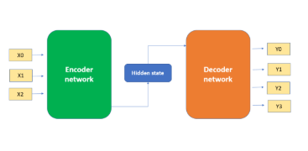
AI Approach Encoder-Decoder Model
Encoder
Utilizes an attention mechanism that accounts for the distance between tokens in the input sequence when generating embeddings.
Passes the token embeddings through a feed-forward layer, incorporating positional encoding to retain sequence information.
The hidden state consists of both token embeddings and positional encodings to capture contextual meaning.
Decoder
Composed of a self-attention layer to focus on relevant input tokens.
Includes a feed-forward network to process and generate the output sequence.

Slide 24
AI Approach Training of Models
Learning
Black Box
C51
C42
C51
C63
List of job orders in pattern1
List of job orders in pattern2
C54
C62
C11
C51
Prediction
Black Box
All orders

Slide 25
Thank You!
Looking forward to your thoughts and questions!

