Slide 1
Cryptocurrency Volatility Modeling
Min Seo Kim | Yigang Hou | Abdullah Naser
Math 548 Spring 2025

Slide 2
Table of Contents
01
02
03
04
05
06
Introduction
Preliminary EDA
Leverage Effect
Heavy Tails
Hybrid Models
Future Work

Slide 3
01
Introduction

Slide 4
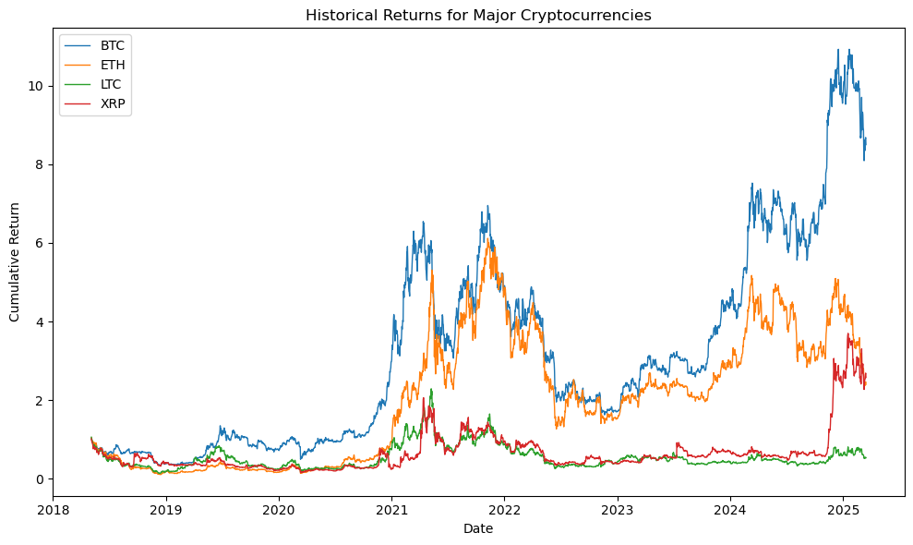
Why Cryptocurrency?
Cryptocurrencies have attracted widespread attention from both retail and institutional investors
However, their highly volatile and non-stationary nature pose significant difficulties for risk forecasting

Slide 5
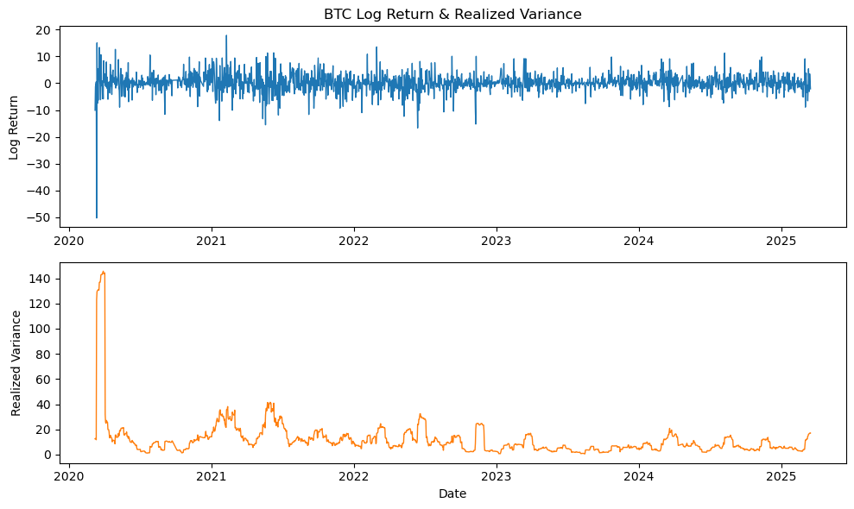
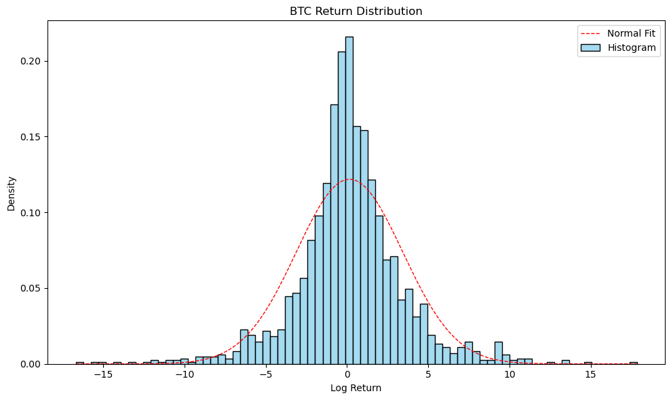
Current Challenges
While standard GARCH model can handle volatility clustering, they often struggle to accommodate asymmetric volatility responses and fat tails frequently observed in crypto markets

Slide 6
Research Objectives
Leverage Effect
Heavy Tails
Hybrid Models
Explore how negative returns increase future volatility, a stylized fact often seen in financial time series
Model extreme return events using distributions like Student’s t and GED to better capture fat-tailed behavior
Develop hybrid volatility models that integrate traditional econometrics with modern enhancements

Slide 7
02
Preliminary EDA

Slide 8
Data Collection & Pre-Processing
Download daily Binance BTC/USD data from 3/8/2020 to 3/16/2025
Compute daily log returns and their summary statistics
Left-skewed distribution (extremely negative returns are more frequent/severe)
Extreme kurtosis (>> 3) indicates fat tails and peakedness
ADF Stationarity Test
Test statistics = -14.31 (p-value < 0.01)
Return series is stationary

Slide 9
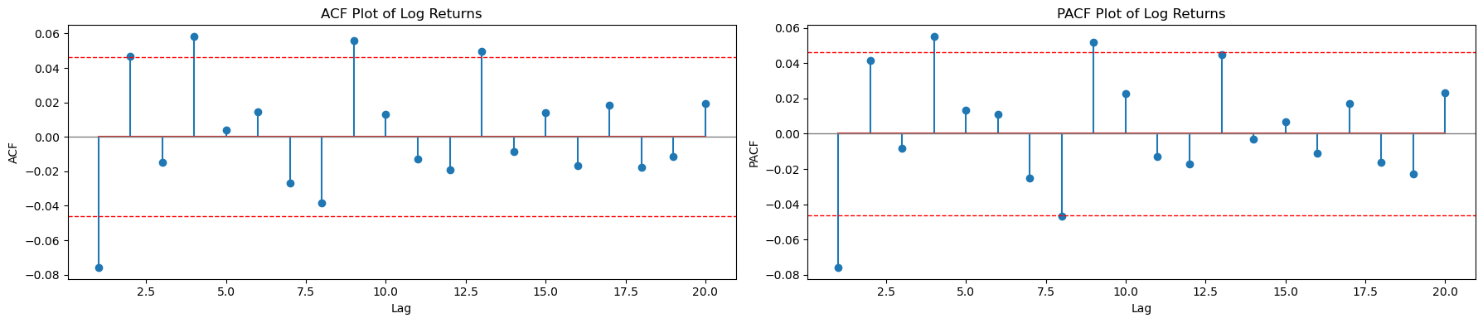
ARMA Demeaning
Remove serial correlation in the return series to isolate volatility dynamics
Ensure that volatility models focus on conditional variance (not predictability of returns)
Fit an ARMA(p, q) model to the return series
Grid search for optimal p, q values using AIC criteria (final specification: ARMA(0, 4))
Use residuals from ARMA model as the input to GARCH-type volatility models

Slide 10
03
Leverage Effect

Slide 11
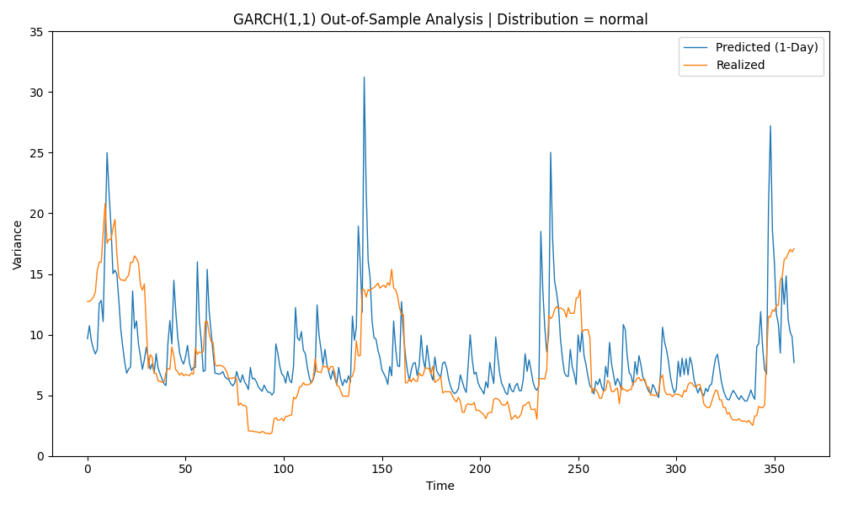

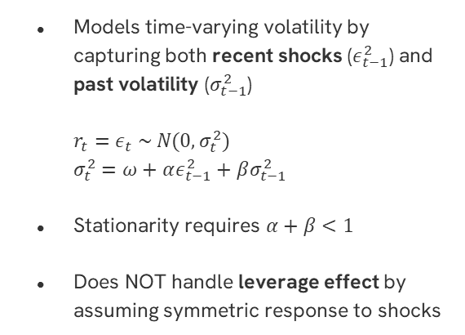
GARCH(1, 1)
Models time-varying volatility by capturing both recent shocks ($ε_{t−1}^{2}$) and past volatility ($σ_{t−1}^{2}$)
$r_{t}=ε_{t} \sim N(0, σ_{t}^{2})$
$σ_{t}^{2}=ω+αε_{t−1}^{2}+βσ_{t−1}^{2}$
Stationarity requires $α+β<1$
Does NOT handle leverage effect by assuming symmetric response to shocks
Notes:
First assume normally distributed residuals
Parameters estimated via maximum likelihood
Rolling out of sample evaluation

Slide 12
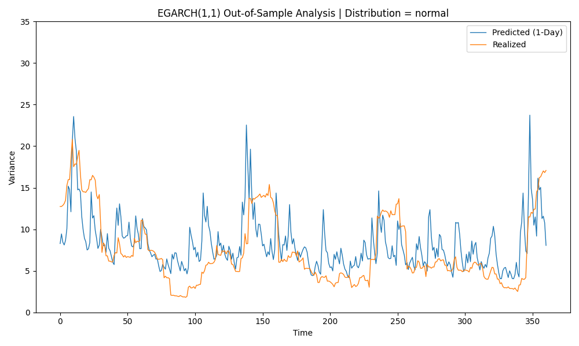

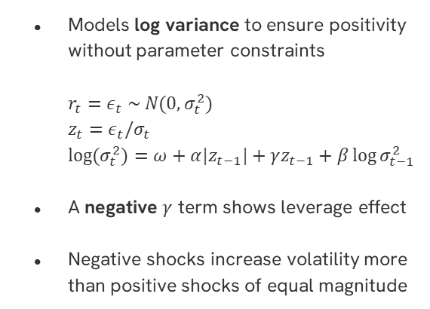
EGARCH(1, 1)
Models log variance to ensure positivity without parameter constraints
$r_{t}=ε_{t} \sim N(0, σ_{t}^{2})$
$z_{t}=ε_{t}/σ_{t}$
$\log{(σ_{t}^{2})}=ω+α|z_{t−1}|+γz_{t−1}+β\log{σ_{t−1}^{2}}$
A negative $γ$ term shows leverage effect
Negative shocks increase volatility more than positive shocks of equal magnitude

Slide 13
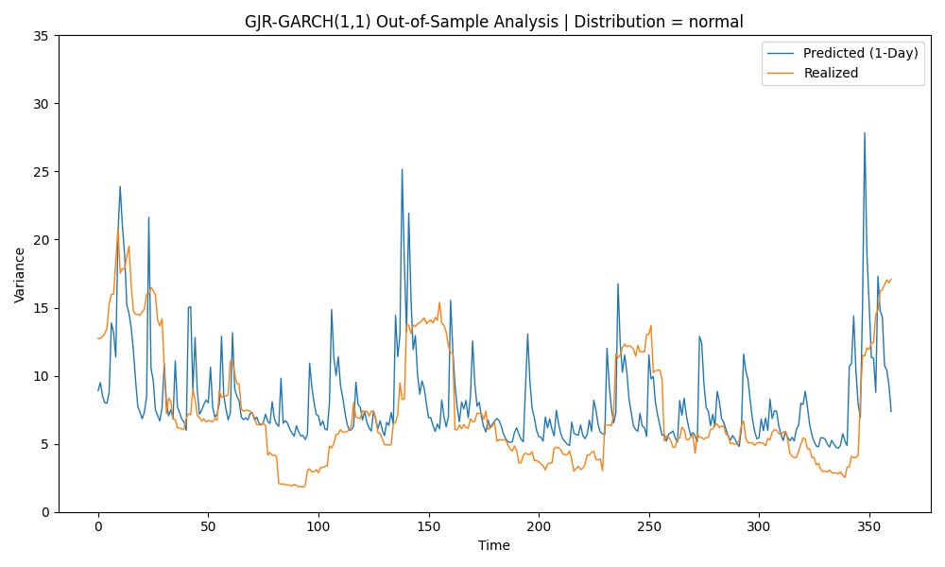

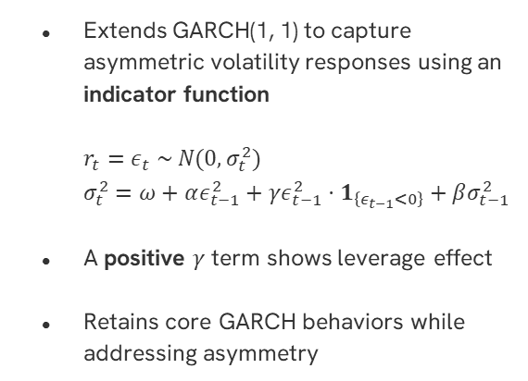
GJR-GARCH(1, 1)
Extends GARCH(1, 1) to capture asymmetric volatility responses using an indicator function
$r_{t}=ε_{t} \sim N(0, σ_{t}^{2})$
$σ_{t}^{2}=ω+αε_{t−1}^{2}+γε_{t−1}^{2}⋅1_{\left\{ε_{t−1}<0\right\}}+βσ_{t−1}^{2}$
A positive $γ$ term shows leverage effect
Retains core GARCH behaviors while addressing asymmetry

Slide 14
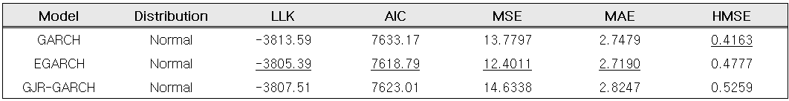
Model Comparison 1
Use MSE, MAE, and HMSE to evaluate out-of-sample variance forecast accuracy
Models that incorporate leverage effect (EGARCH, GJR-GARCH) show better in-sample fit than the symmetric GARCH model
EGARCH offers the best trade-off between model fit (highest LLK and lowest AIC) and predictive accuracy (lowest MSE and MAE) under the normal distribution

Slide 15
04
Heavy Tails

Slide 16
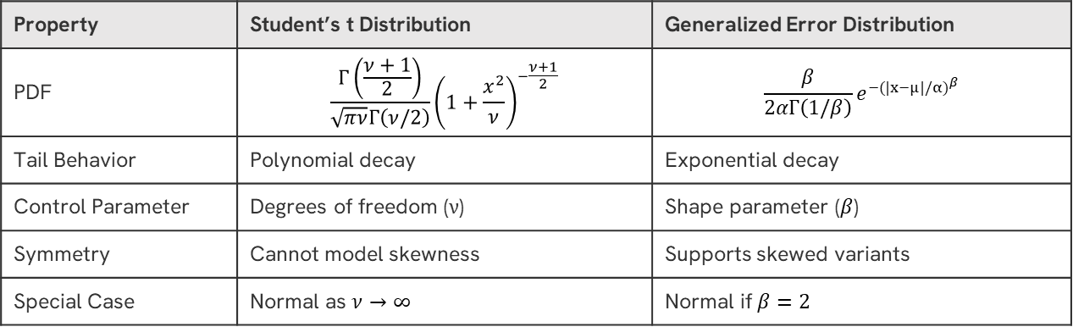
Alternative Distributions
Financial return distributions, especially in crypto markets, exhibit fat tails and extreme values more frequently than predicted by the normal distribution
Property | Student’s t Distribution | Generalized Error Distribution
PDF | $$\frac{Γ\left(\frac{ν+1}{2}\right)}{\sqrt{πν}Γ\left(ν/2\right)}{\left(1+\frac{x^{2}}{ν}\right)}^{−\frac{ν+1}{2}}$$ | $$\frac{β}{2αΓ\left(1/β\right)}e^{{−(|x−μ|/α)}^{β}}$$
Tail Behavior | Polynomial decay | Exponential decay
Control Parameter | Degrees of freedom (ν) | Shape parameter ($β$)
Symmetry | Cannot model skewness | Supports skewed variants
Special Case | Normal as $ν→∞$ | Normal if $β=2$

Slide 17
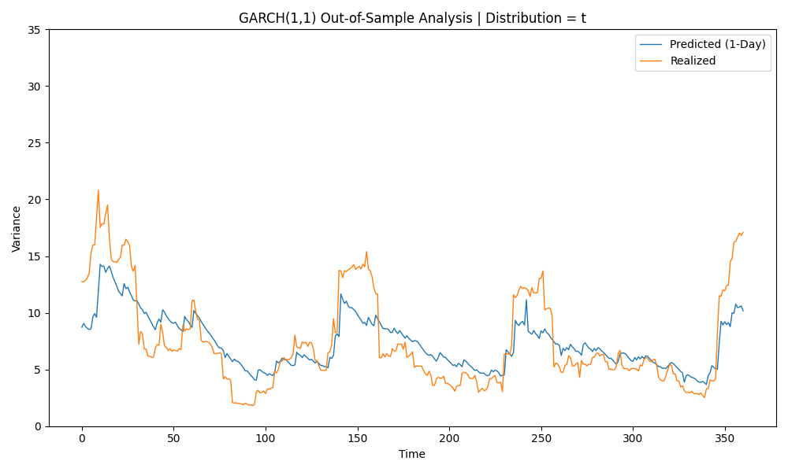
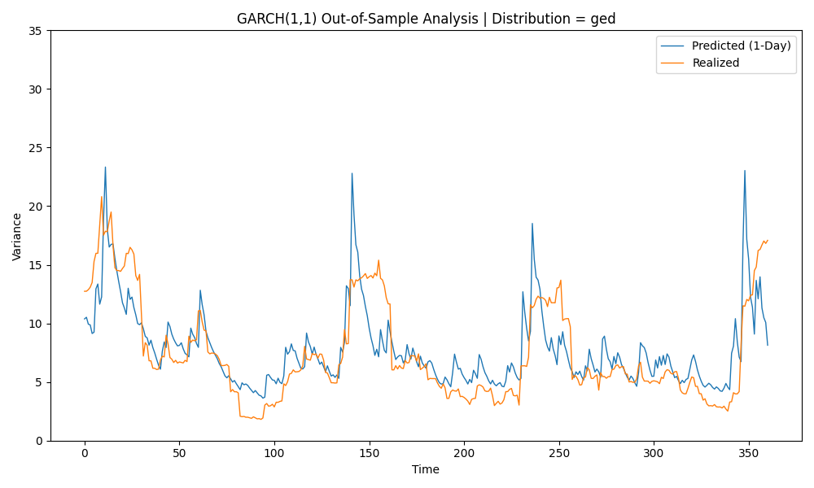
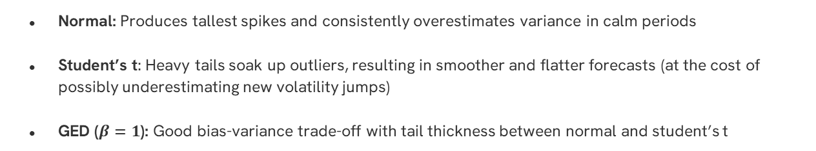
Impact of Distributional Assumptions
Normal: Produces tallest spikes and consistently overestimates variance in calm periods
Student’s t: Heavy tails soak up outliers, resulting in smoother and flatter forecasts (at the cost of possibly underestimating new volatility jumps)
GED ($β=1$): Good bias-variance trade-off with tail thickness between normal and student’s t
Notes:
Normal
Because the normal likelihood penalizes fat‑tailed shocks, the optimizer compensates by inflating conditional variance
The model thinks every large return must come from higher σ² rather than heavy tails
Student’s t
Heavy tails soak up extreme residuals, so the recursion needs less variance
Degrees‑of‑freedom absorb part of the shock → slower reaction
GED
GED’s tails are fatter than Gaussian but thinner than low‑ν t, so the variance recursion still reacts, but not as violently

Slide 18
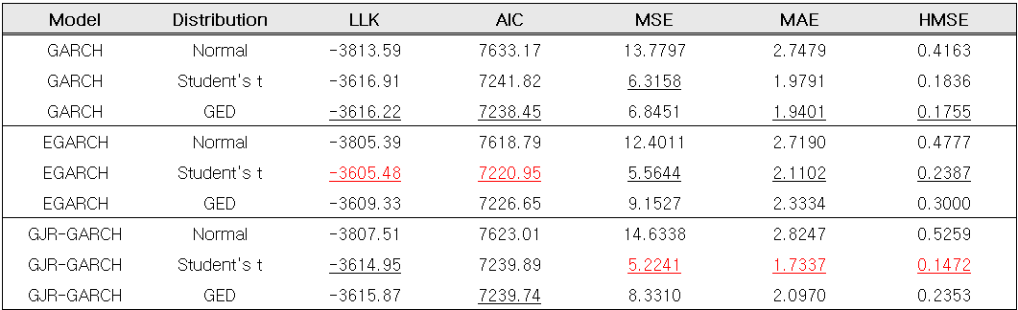
Model Comparison 2
Student’s t consistently achieves the best out-of-sample performance across most models with the lowest MSE, MAE, and HMSE

Slide 19
05
Hybrid Models

Slide 20
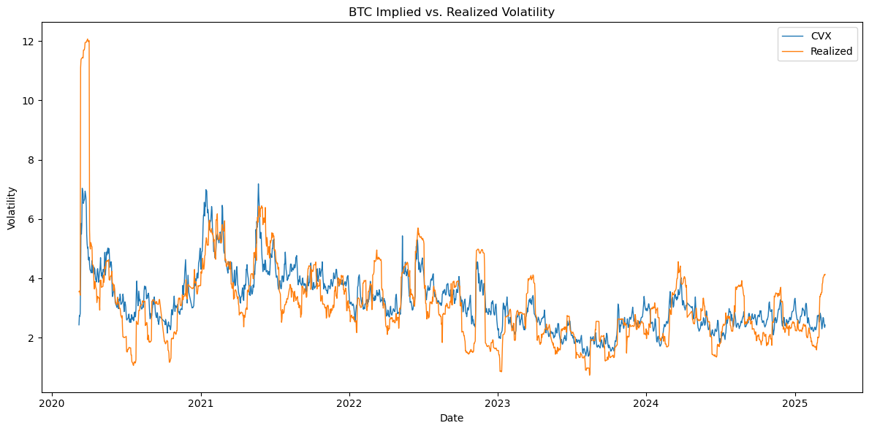
Cryptocurrency Volatility Index (CVX)
Similar in construction to VIX for S&P 500 but derived from option prices on Bitcoin
Acts as a forward-looking measure of uncertainty
Chosen as an additional feature due to its high correlation with realized volatility (r = 0.77)
Notes:
We hypothesize that CVX contains useful predictive signals for modeling future BTC volatility
CVX uses IDW method to compute the idea at the money 30 day option implied volatility
Each maturity date options can be calculated using the same Riemann sum approximation formula detailed in CBOE 2019 White paper on VIX

Slide 21
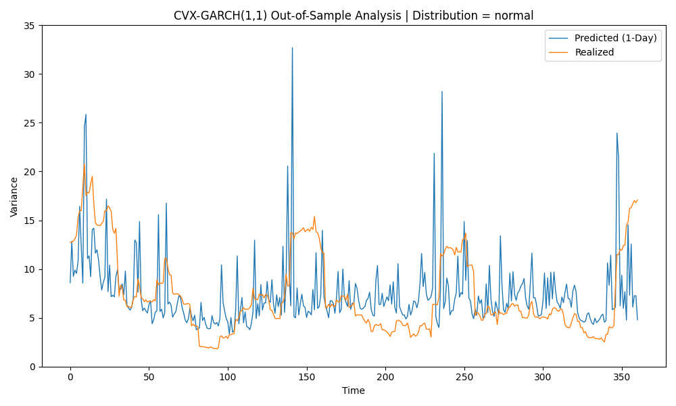

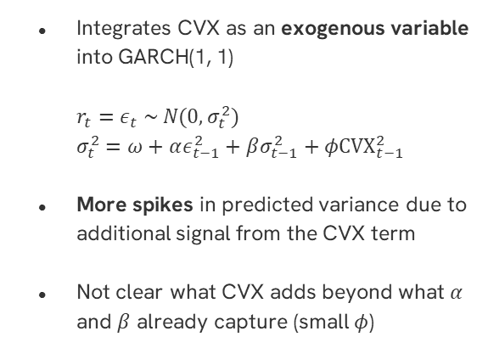
CVX-GARCH(1, 1)
Integrates CVX as an exogenous variable into GARCH(1, 1)
$r_{t}=ε_{t} \sim N(0, σ_{t}^{2})$
$σ_{t}^{2}=ω+αε_{t−1}^{2}+βσ_{t−1}^{2}+φCVX_{t−1}^{2}$
More spikes in predicted variance due to additional signal from the CVX term
Not clear what CVX adds beyond what $α$ and $β$ already capture (small $φ$)

Slide 22
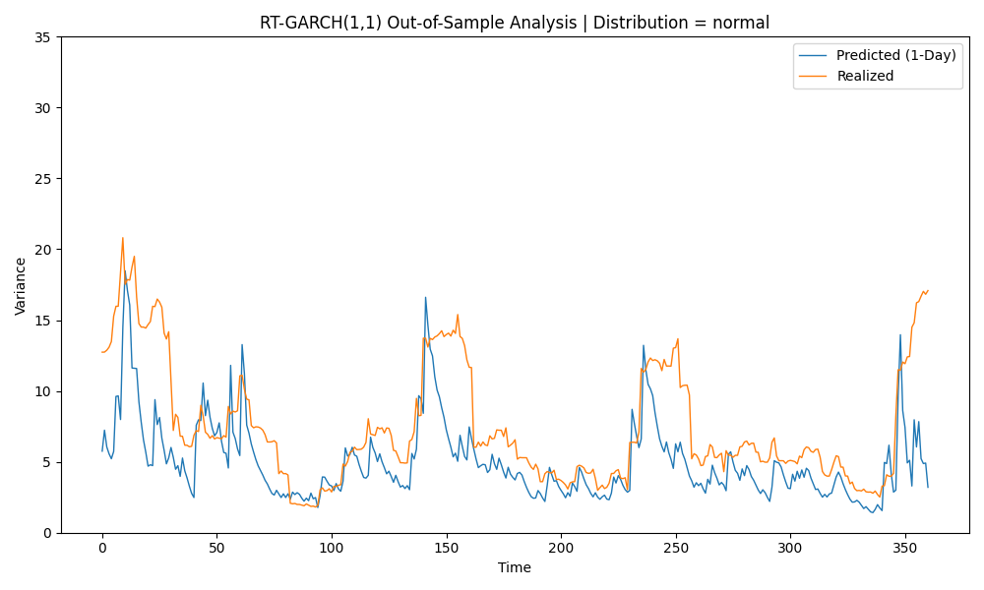

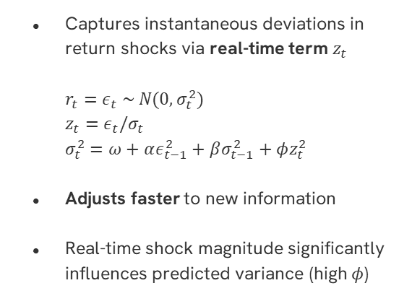
RT-GARCH(1, 1)
Captures instantaneous deviations in return shocks via real-time term $z_{t}$
$r_{t}=ε_{t} \sim N(0, σ_{t}^{2})$
$z_{t}=ε_{t}/σ_{t}$
$σ_{t}^{2}=ω+αε_{t−1}^{2}+βσ_{t−1}^{2}+φz_{t}^{2}$
Adjusts faster to new information
Real-time shock magnitude significantly influences predicted variance (high $φ$)
Notes:
Reduced overestimation of volatility despite using normal distribution

Slide 23
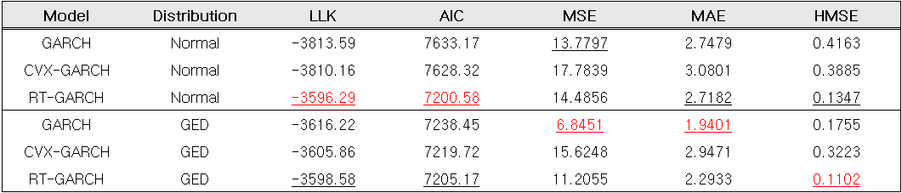
Model Comparison 3
CVX-GARCH has a marginally better in-sample fit than GARCH but worse out-of-sample performance due to CVX’s weak contribution and potential redundancy with lagged variance terms
RT-GARCH produces the best in-sample fit (highest LLK and lowest AIC) and the highest relative accuracy (lowest HMSE) across ALL models

Slide 24
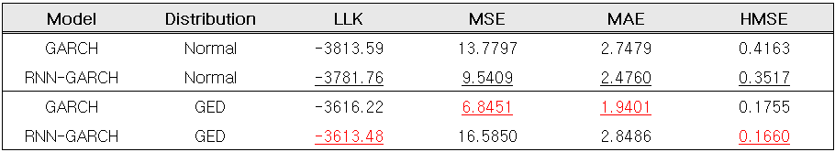
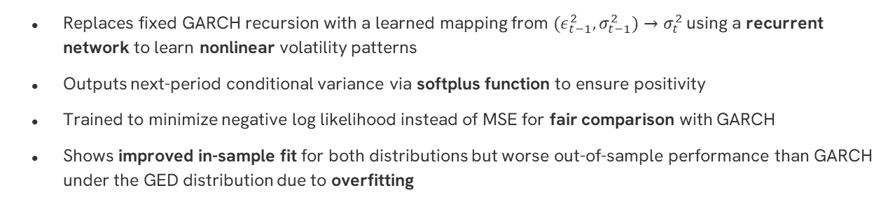
RNN-GARCH(1, 1)
Replaces fixed GARCH recursion with a learned mapping from ${(ε_{t−1}^{2},σ}_{t−1}^{2})→σ_{t}^{2}$ using a recurrent network to learn nonlinear volatility patterns
Outputs next-period conditional variance via softplus function to ensure positivity
Trained to minimize negative log likelihood instead of MSE for fair comparison with GARCH
Shows improved in-sample fit for both distributions but worse out-of-sample performance than GARCH under the GED distribution due to overfitting

Slide 25
06
Future Work

Slide 26
Next Steps
Leverage Effect
Incorporate leverage effect into CVX-GARCH, RT-GARCH, and RNN-GARCH using asymmetric volatility response terms
Heavy Tails
Fit skewed, fat-tailed distributions like skewed Student’s t or skewed GED to better capture return asymmetry and tail risk
Hybrid Models
Extend RNN architecture to other GARCH variants (e.g., RNN-EGARCH, RNN-GJR-GARCH) and look for other exogenous signals for improved forecasting

Slide 27
References
Bollerslev, Tim. “Generalized Autoregressive Conditional Heteroskedasticity.” Journal of Econometrics, vol. 31, no. 3, Apr. 1986, pp. 307–327, https://doi.org/10.1016/0304-4076(86)90063-1.
Nelson, Daniel B. “Conditional Heteroskedasticity in Asset Returns: A New Approach.” Econometrica, vol. 59, no. 2, Mar. 1991, pp. 347–370, www.jstor.org/stable/2938260, https://doi.org/10.2307/2938260.
Glosten, Lawrence R., et al. “On the Relation between the Expected Value and the Volatility of the Nominal Excess Return on Stocks.” The Journal of Finance, vol. 48, no. 5, Dec. 1993, pp. 1779–1801, https://doi.org/10.1111/j.1540-6261.1993.tb05128.x.
Smetanina, Ekaterina. “Real-Time GARCH*.” Journal of Financial Econometrics, vol. 15, no. 4, 2017, pp. 561–601, https://doi.org/10.1093/jjfinec/nbx008. Accessed 2 May 2022.
Woebbeking, Fabian. “Cryptocurrency Volatility Markets.” SSRN Electronic Journal, 2020, https://doi.org/10.2139/ssrn.3639098.

Slide 28
Any Questions?

