Slide 1
GitHub GameProgramming
소프트웨어학과
2021763013 김민영
2023.12.13(수)
게임프로그래밍
GitHub : https://github.com/min-young417/GameP

Slide 2
01 Repository

Slide 3
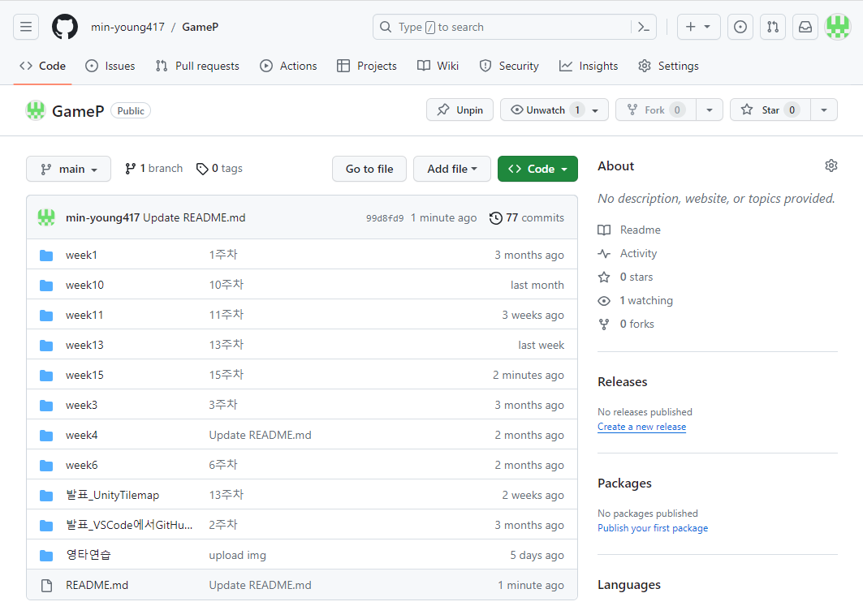
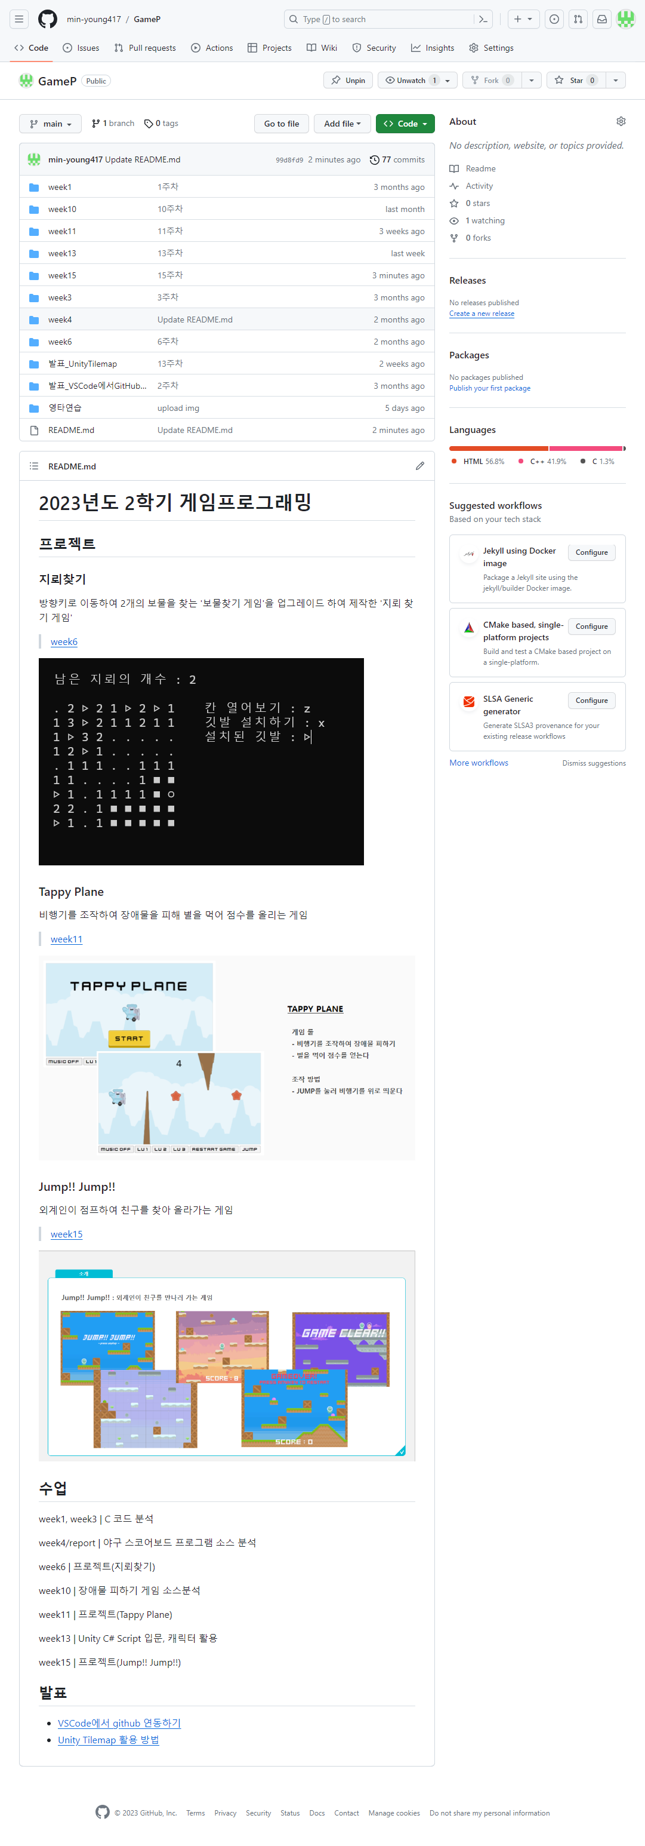
GitHub GameProgramming
Repository

Slide 4
02 Project

Slide 5
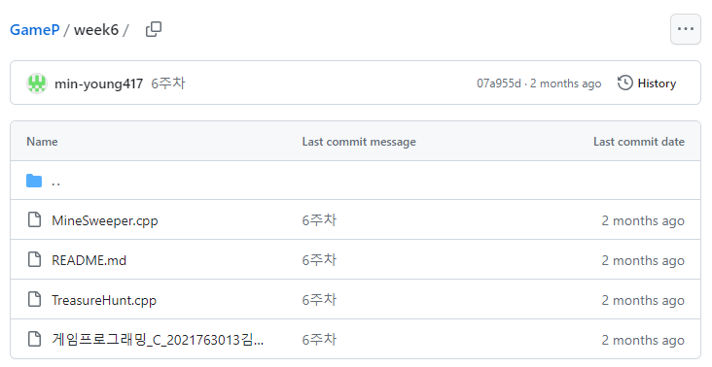
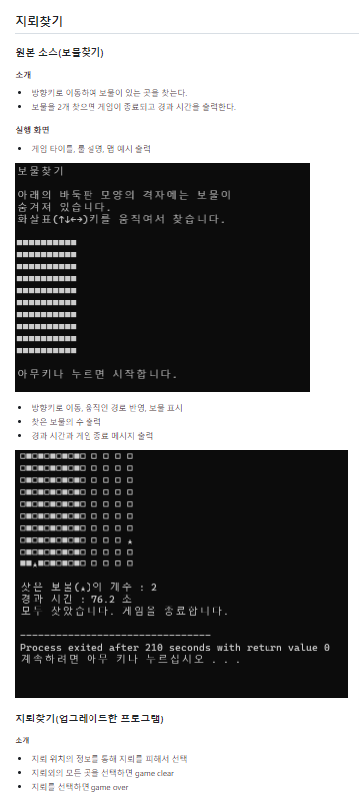
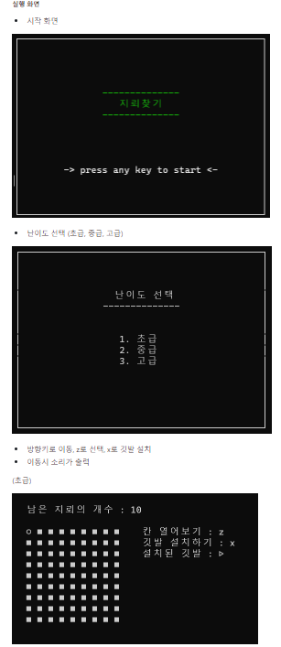
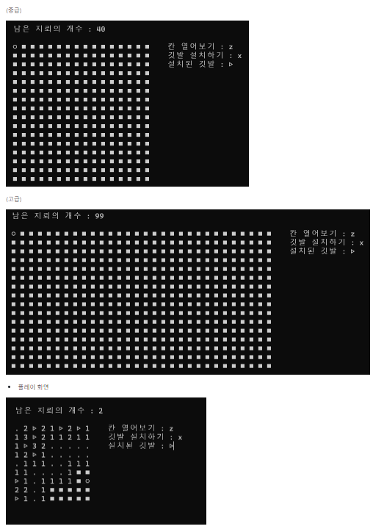
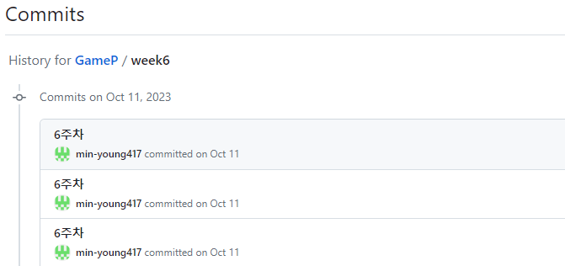
GitHub GameProgramming
week6 : 10/11 ~ 11/17 *Project - 지뢰찾기

Slide 6
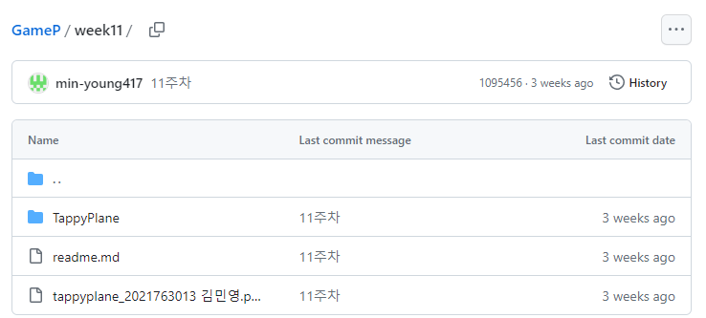
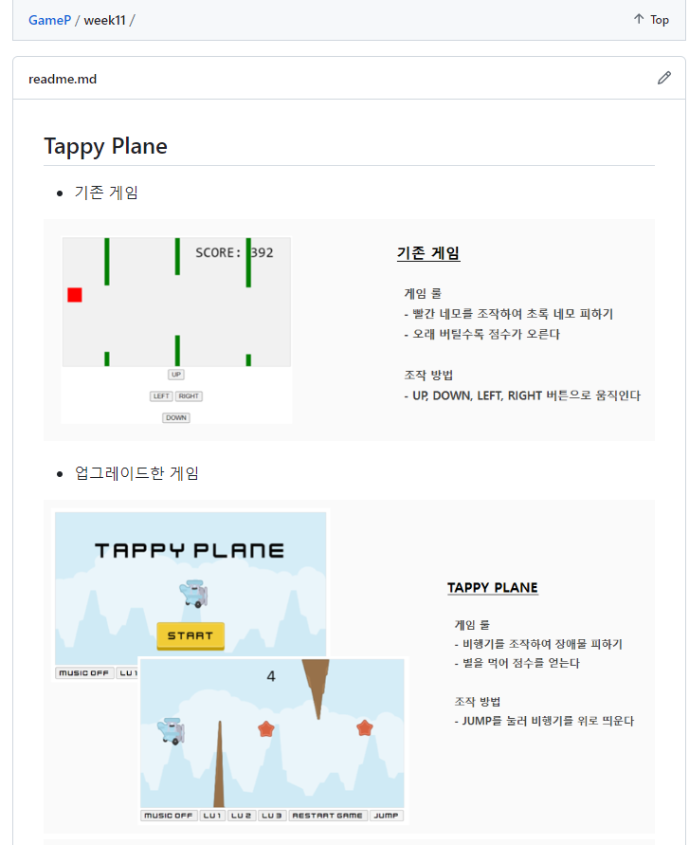
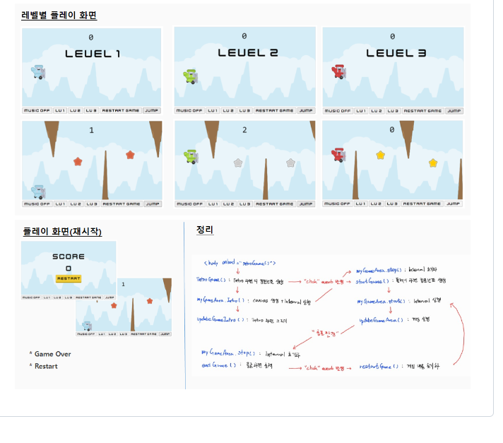
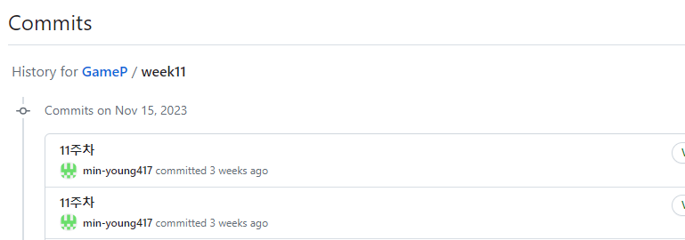
GitHub GameProgramming
week11 : 11/15~11/21 *Project - Tappy Plane

Slide 7
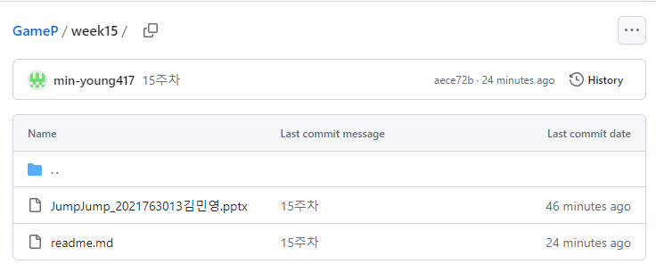
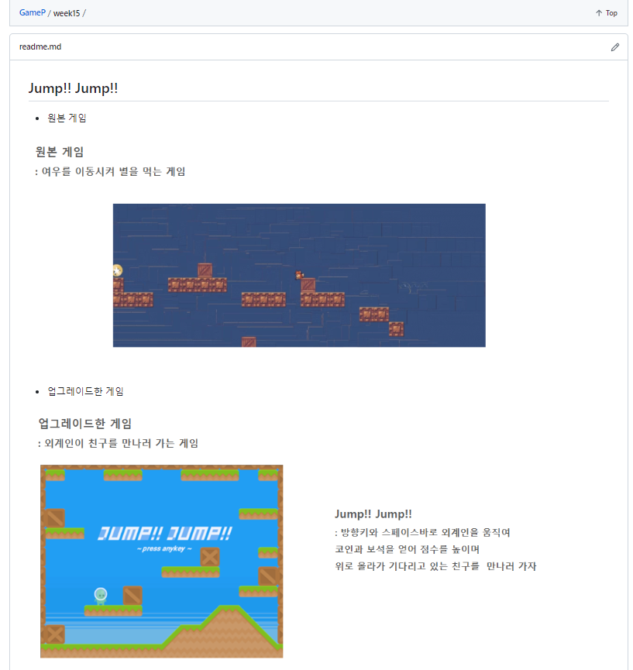
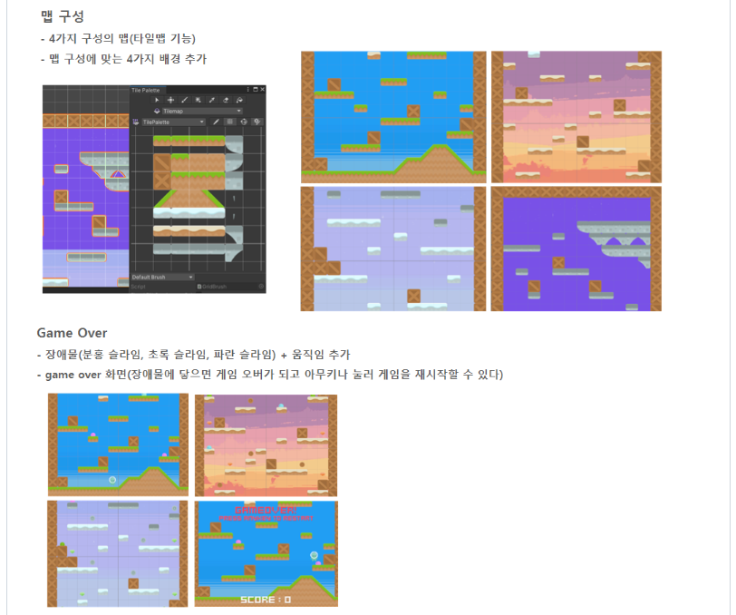
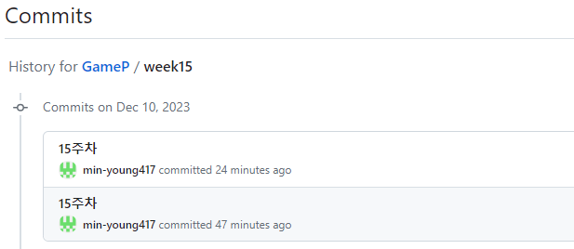
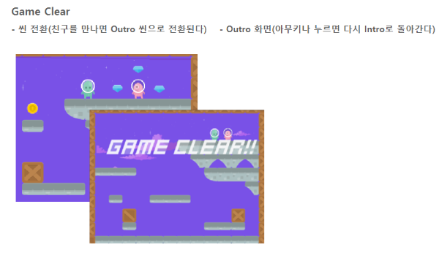
GitHub GameProgramming
week15 : 12/13 ~ 12/19 *Project - Jump!! Jump!!
*15주차 발표이기 때문에 15주차 디렉토리에 포함됨
*실제 기간 : 12/6 ~ 12/12

Slide 8
03 Other Directory

Slide 9
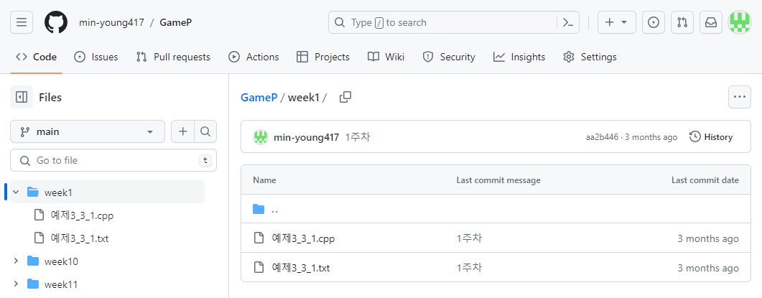
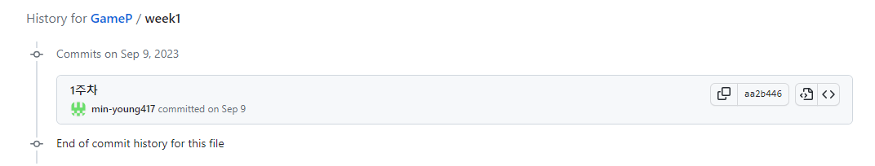
GitHub GameProgramming
week1 : 9/6 ~ 9/12

Slide 10
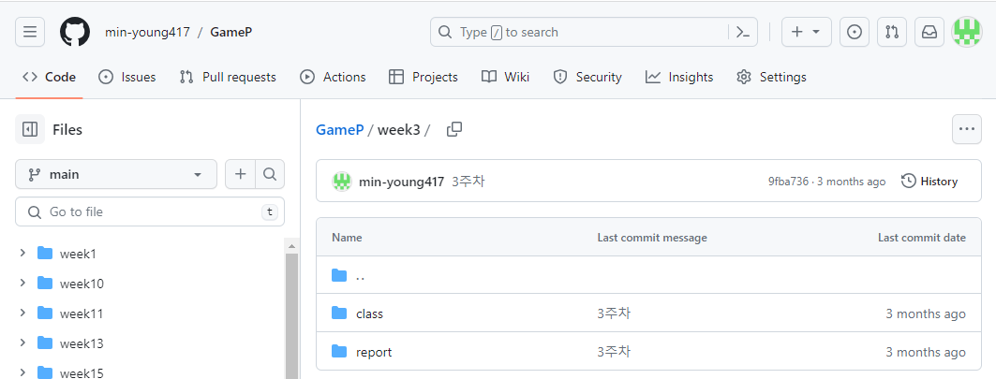
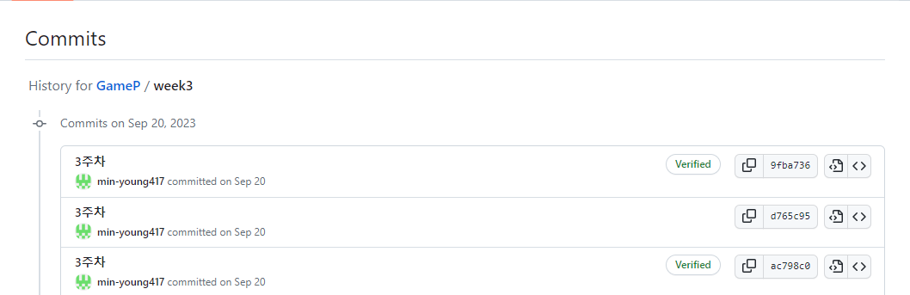
GitHub GameProgramming
week3/class : 9/20 ~ 9/26

Slide 11
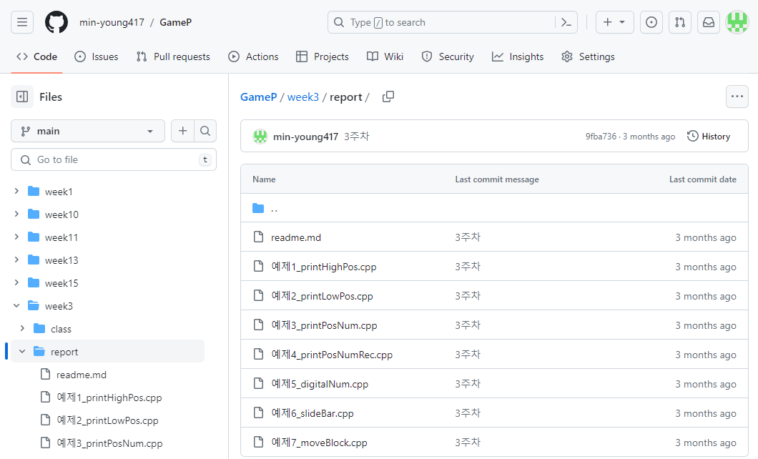
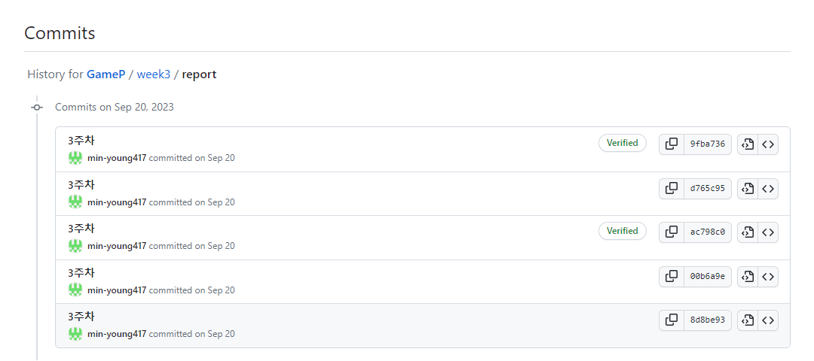
GitHub GameProgramming
week3/report : 9/20 ~ 9/26

Slide 12
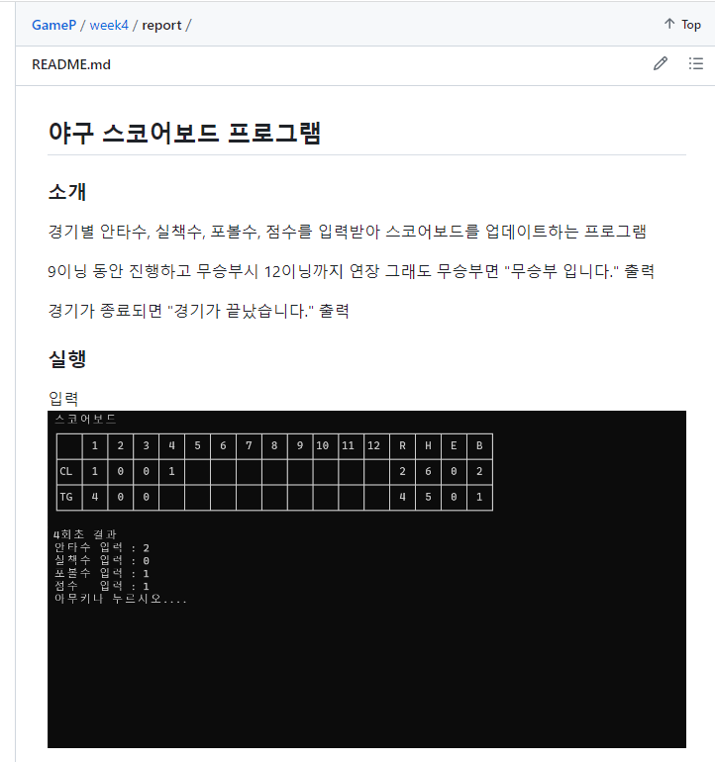
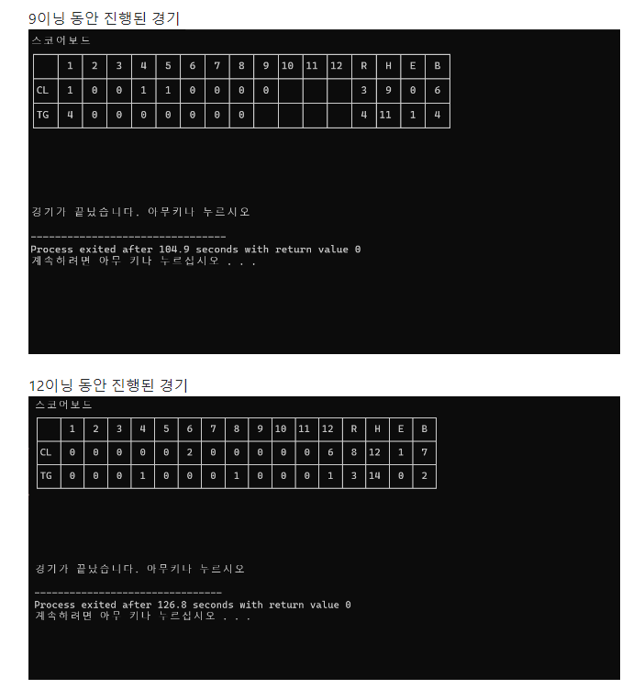
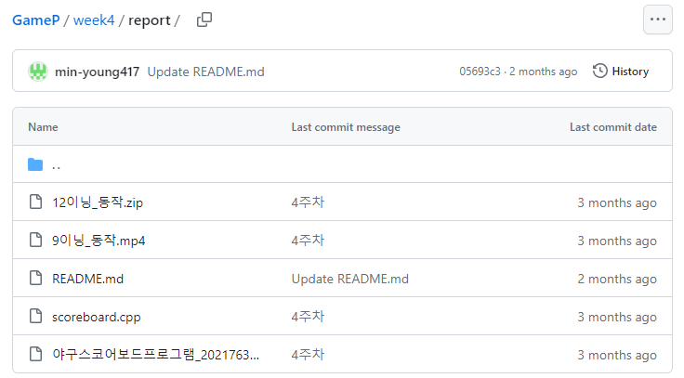
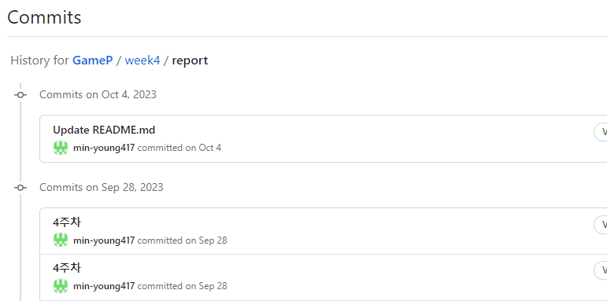
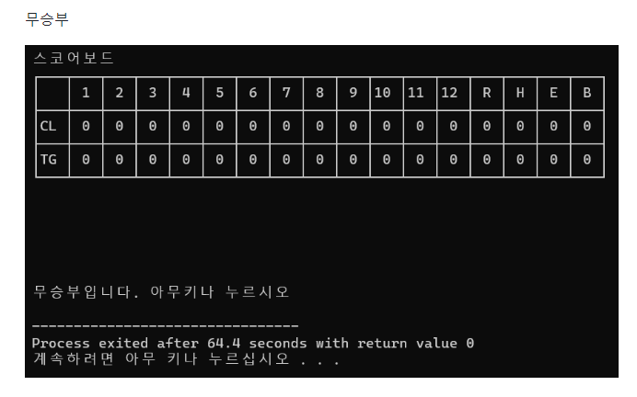
GitHub GameProgramming
week4/report : 9/27 ~ 10/3

Slide 13
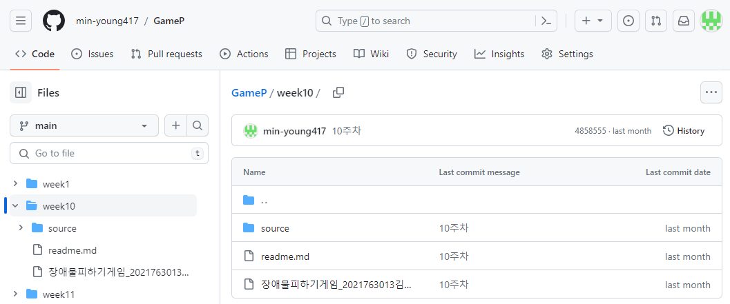
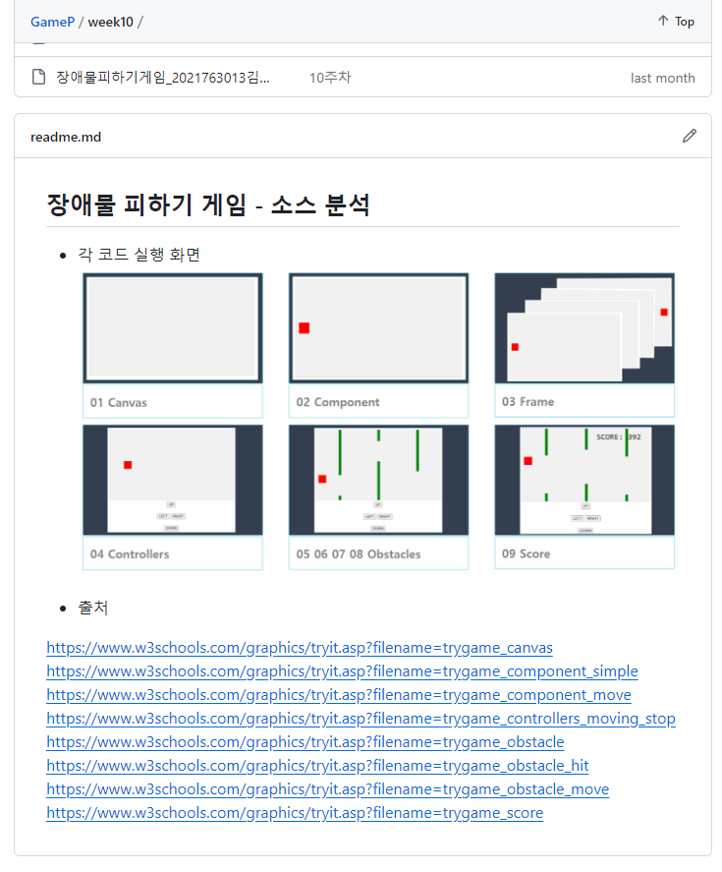
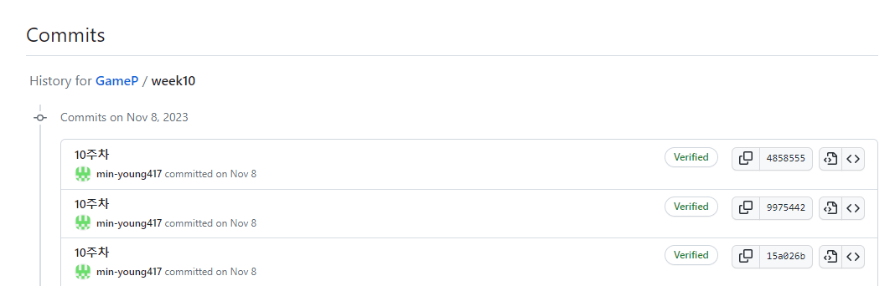
GitHub GameProgramming
week10: 11/8 ~ 11/14

Slide 14
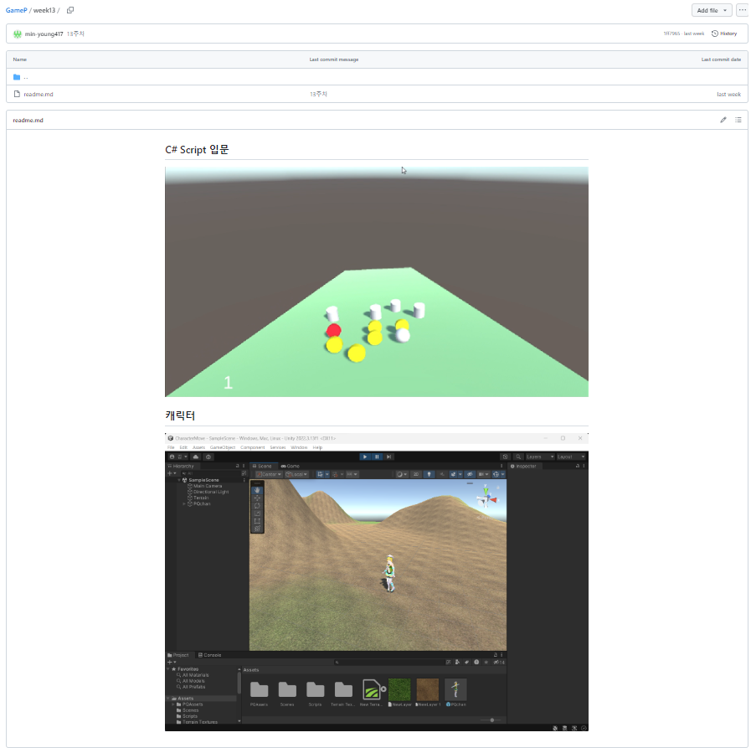
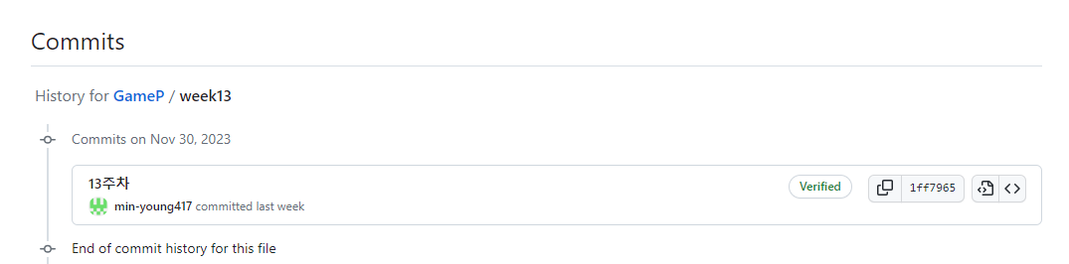
GitHub GameProgramming
week13: 11/29 ~ 11/14

Slide 15
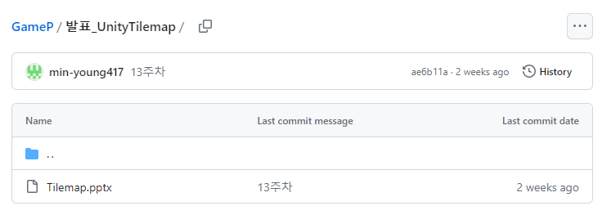
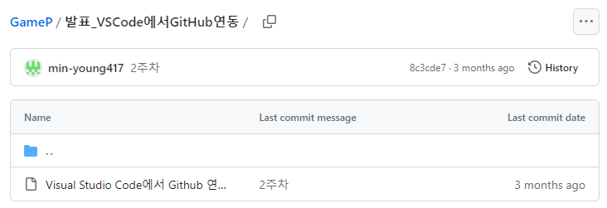
GitHub GameProgramming
추가 : 발표 ppt
점수(20/20)

