Slide 1
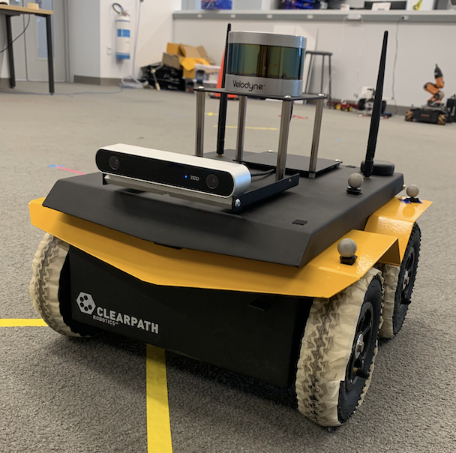
Real Time 3D Mapping
LIDAR, ZED & JACKAL
#SLAM
#Computer_Vision
#ROS #Python #C++
#Self_Driving
#JACKAL #ZED
# LIDAR
MINYOUNG CHANG
ANDY CHOI

Slide 2
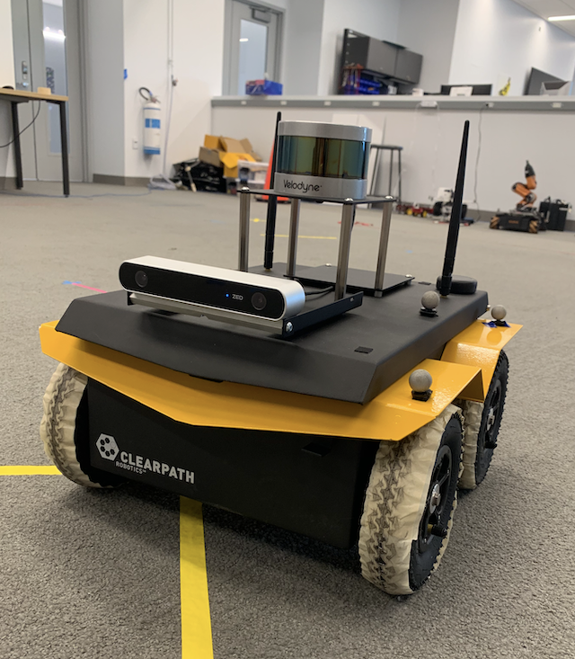
HARDWARE SETUP
PUCK VLP-16 LIDAR Sensor
< Velodyne >
ZED Stereo Camera
< STEREO LABS >
JACKAL
< CLEARPATH >

Slide 3
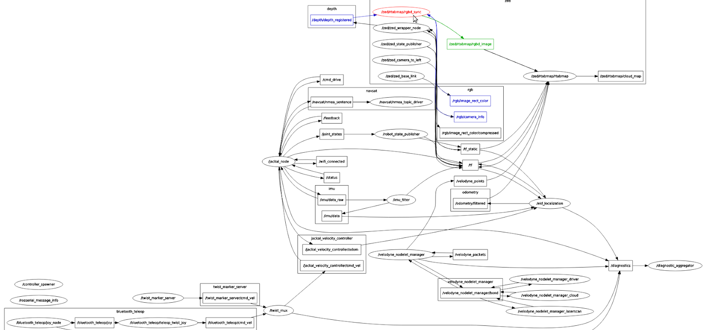
RQT GRAPH

Slide 4

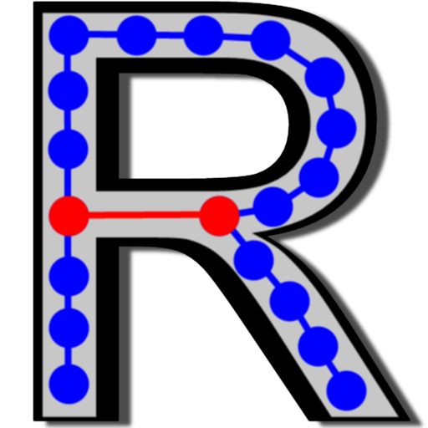
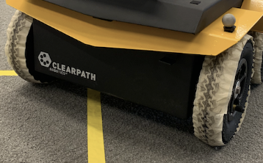

RQT GRAPH
ZED CAMERA
RTAB-Map
JACKAL
LIDAR

Slide 5
ZED Stereo Camera
/zed/rgbd_image
rtabmap/cloud_map
LIDAR
Velodyne
VLP-16
RTAB-Map
/velodyne_points
/tf
JACKAL
/imu_filter
/odometry/filtered
JACKAL velocity controller
/ekf_localization

Slide 6
ZED Stereo Camera
/zed/rgbd_image
rtabmap/cloud_map
LIDAR
Velodyne
VLP-16
RTAB-Map
/velodyne_points
/tf
JACKAL
/imu_filter
ODOMETRY / TF
/odometry/filtered
JACKAL velocity controller
/ekf_localization

Slide 7
ZED Stereo Camera
/zed/rgbd_image
rtabmap/cloud_map
LIDAR
Velodyne
VLP-16
RTAB-Map
/velodyne_points
POINT CLOUDS
/tf
JACKAL
/imu_filter
/odometry/filtered
JACKAL velocity controller
/ekf_localization

Slide 8
ZED Stereo Camera
/zed/rgbd_image
rtabmap/cloud_map
LOCALIZATION / LOOP CLOSURE DETECTION
LIDAR
Velodyne
VLP-16
RTAB-Map
/velodyne_points
/tf
JACKAL
/imu_filter
/odometry/filtered
JACKAL velocity controller
/ekf_localization

Slide 9
ZED Stereo Camera
/zed/rgbd_image
rtabmap/cloud_map
LOCALIZATION / LOOP CLOSURE DETECTION
LIDAR
Velodyne
VLP-16
RTAB-Map
/velodyne_points
POINT CLOUDS
MAPPING
/tf
JACKAL
/imu_filter
ODOMETRY / TF
/odometry/filtered
JACKAL velocity controller
/ekf_localization

Slide 10
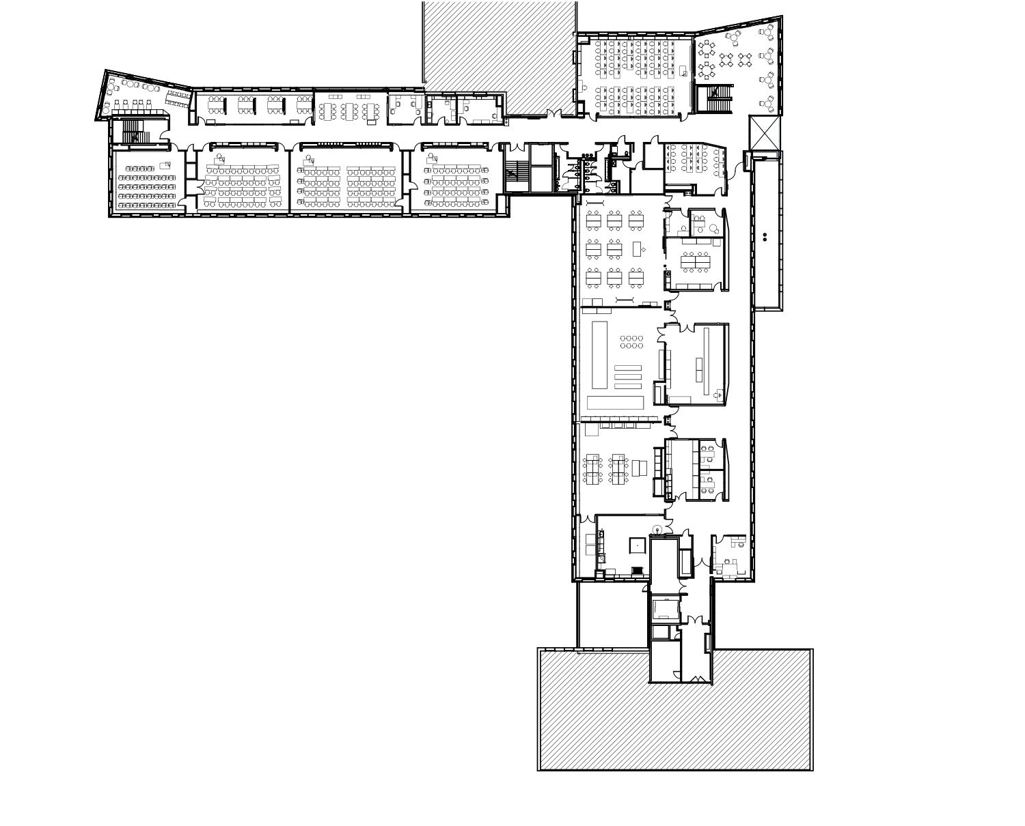
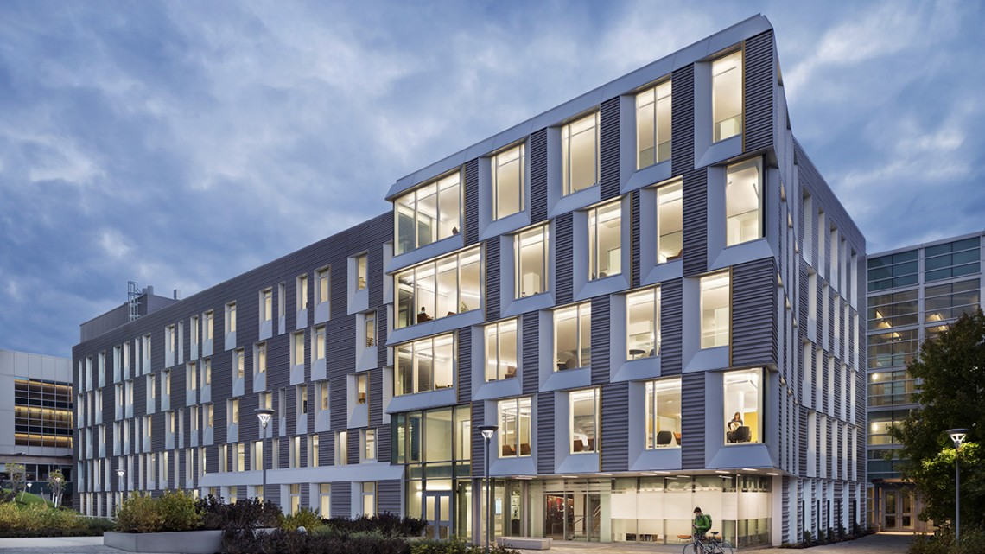
LOCATION
UPSON HALL,
CORNELL UNIVERSITY
LTL ARCHITECTURE AND PERKINS+WILL

Slide 11
LOCATION
UPSON HALL,
CORNELL UNIVERSITY
END
START
LTL ARCHITECTURE AND PERKINS+WILL

Slide 12
END
START

