Slide 1
UBI-MEDIA 2027 · PROJECT BRIEF
NewsAnalyzer
THE DECISION LOOP
證據優先
LLM 輔助
把社群媒體假新聞判斷
變成可追溯的證據分流
2,292
claims
SBERT
retrieval
safe
verdict
Evidence retrieval · multi-signal metadata · local auxiliary LLM
Tsangyu Lin · Hui Lin · Sheng-Chih Chen
Evidence before eloquence
Tamkang University · National Chengchi University
不是要讓模型變成真理裁判，
而是讓每次判斷都有出處。
研究重點：先證據、再融合、最後安全錨定
01
Notes:
開場先定義 NewsAnalyzer 的定位：它不是把更大的語言模型當成真理裁判，而是把可追溯的事實查核證據、metadata 訊號與本機語言模型組成一個可稽核的 credibility triage。

Slide 2
01 / PROBLEM
為什麼不能只讓 LLM 判真假？
純生成式判斷缺少四個關鍵條件：時效、語氣反制、出處與隱私邊界。
1
Temporal blindness
2
Stylistic deception
模型權重有知識截止日；新近爆發的在地謠言不一定在訓練資料中。
生成式假訊息可以寫得正式、順暢、像新聞；語氣漂亮不等於內容可信。
3
No auditable provenance
4
Privacy + latency
只輸出一個分數，使用者無法追溯：這個判斷依據了哪一個證據？
把瀏覽內容交給雲端 API，會增加延遲，也把使用者的閱讀脈絡帶離裝置。
核心問題不是「LLM 會不會寫字？」而是「它有沒有足夠證據在正確的時間做出保守判斷？」
NewsAnalyzer 的設計選擇：讓 empirical evidence 主導 verdict，讓 local LLM 負責 context 與 viewpoint extraction。
02
Notes:
這一頁不要把 LLM 描繪成沒有價值，而是說明 standalone LLM 作為唯一裁判時的四個結構性盲區。新聞場景需要的是 evidence-aware system。

Slide 3
02 / PRINCIPLE
NewsAnalyzer 的核心不是更大的模型，
而是更可靠的決策順序。
The system is deliberately asymmetric: empirical evidence can override a fluent generation.
01
02
03
先查證據
再融合訊號
最後安全錨定
SBERT semantic retrieval
在 2,292 筆查核語料中尋找證據
domain / sentiment / recency
與 evidence 共同形成分數
已知不實證據優先，
限制生成式模型翻案
LLM = auxiliary perspective extractor · retrieval + provenance = primary verdict
03
Notes:
這是整個簡報最重要的一頁。NewsAnalyzer 的 novelty 不是把 LLM 接到瀏覽器，而是把 LLM 降級成受約束的輔助元件，讓證據檢索與安全錨定成為主決策骨架。

Slide 4
03 / SYSTEM
從瀏覽器貼文到可追溯 verdict
Chrome MV3 client → local gateway → parallel evidence / metadata / local LLM → grounded verdict.
Client Tier · Chrome Extension (Manifest V3) — DOM MutationObserver · post extraction · floating rating badge
Gateway Tier · POST /judge
parallel branches: fact-check retrieval · metadata features · local auxiliary analysis
01 Fact-check census
02 Multi-signal metadata
03 Local auxiliary LLM
2,292 Cofacts records
SBERT MiniLM-L12 · θ = 0.72
domain · sentiment · recency · crowd
bounded risk indicators
Qwen3.8-27B · JSON / no-think
perspective + key points
Evidence + metadata + local analysis → final score + rating + source links
設計重點：parallel branches 可重疊；final score 的解釋欄位可回看每個訊號。
04
Notes:
用架構圖解釋資料流。前端只處理貼文擷取與 UI，gateway 才是多訊號融合核心。三個分支最後產生可解釋的 score、rating 與 source links。

Slide 5
04 / EVIDENCE
先建立一個可重現的「事實查核大盤普查」
The evaluation starts from a frozen Cofacts snapshot; retrieval and labels are fixed before comparing systems.
2,292
2,025
267
1,612
eligible claims
MISLEADING
CREDIBLE
rumor clusters
freeze date 2026-09-24
seed 42 · length(text) > 40
88.4% of the frozen corpus
inaccurate + partial
11.6% of the frozen corpus
accurate
cosine ≥ 0.80 · max cluster 102 · 1,400 singletons
Frozen corpus composition
Why the split matters
A
Record-level 5-fold
tests held-out records, but siblings may remain in the index.
MISLEADING 88.4%
CREDIBLE 11.6%
The class imbalance is real;
therefore accuracy alone is not the main signal.
B
Cluster-level 5-fold
keeps every near-duplicate rumor family in one fold.
Cluster-level = conservative retrieval lower bound
05
Notes:
這頁先解釋 corpus composition，因為 88.4% MISLEADING 會直接影響 accuracy 解讀。特別強調 cluster-level split：把相似謠言整簇放在同一 fold，避免近重複造成的樂觀偏差。

Slide 6
05 / RETRIEVAL
嚴格切分後，檢索仍保留可用訊號
θsim = 0.72 · verbatim query · Coverage 與 Selective Accuracy 必須一起讀。
Record-level 5-fold
Cluster-level 5-fold
95.3%
selective accuracy
90.8%
selective accuracy
Coverage 55.9%
Coverage 36.1%
CAA 53.2%
CAA 32.7%
Perturbation | Record Cov | Record Sel | Cluster Cov | Cluster Sel
Verbatim | 55.9% | 95.3% | 36.1% | 90.8%
Mild | 55.3% | 94.3% | 36.4% | 90.9%
Medium | 50.6% | 95.6% | 28.4% | 91.9%
Heavy | 40.0% | 93.9% | 22.6% | 90.6%
讀法
95.3% 不是全集 accuracy；
它是在已檢索到證據的 claims 上的 selective accuracy。
保守解讀：cluster split 的 selective accuracy 只下降約 4–5 個百分點，但 coverage 明顯下降；這是近重複移除後的 lower bound。
06
Notes:
這頁要主動避免誤導觀眾：95.3% selective accuracy 不是全部資料的 accuracy，因此旁邊一定要放 coverage。cluster-level 90.8% @ 36.1% coverage 是更保守的數字。

Slide 7
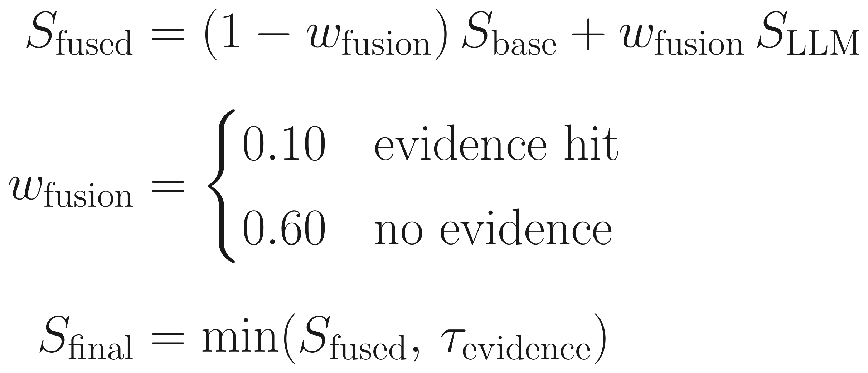
06 / MECHANISM
把「LLM 分數」放回可解釋的決策規則裡
Evidence hit → lower LLM weight; known counter-evidence → asymmetric upper bound.
Dynamic fusion
Asymmetric safety anchor
01
Evidence hit
wfusion = 0.10
retrieved evidence dominates
02
No evidence
wfusion = 0.60
local LLM can fill context
03
Known counter-evidence
Sfinal ≤ τevidence
do not let fluent text overturn evidence
同樣是 Qwen3.8-27B，差異來自 grounding、fusion 與 safety clamp。
Safety clamp 的價值：讓已知反證限制高分，而不是把所有不確定案例都判成假。
07
Notes:
這頁說明公式背後的設計意圖：evidence hit 時 LLM 權重降低，no evidence 時才提高；當有已知反證時，final score 受 evidence-specific upper bound 約束。這避免純生成式模型的語氣主導。

Slide 8
07 / COMPARISON
同模型比較：優勢來自架構，不是參數量
同一個 500-claim probe、同一個 cutoff 60、同一個 Qwen3.8-27B 引擎。
99.0%
88.1%
+10.85
498
NewsAnalyzer
Zero-shot Qwen3.8-27B
percentage points
paired valid claims
F1 0.994 · credible recall 98.1%
F1 0.932 · credible recall 60.0%
paired difference · 95% CI [8.03, 13.65] pp
2 invalid zero-shot outputs excluded · McNemar b=56, c=2
Paired accuracy · same model, same input
CREDIBLE-class recall
NewsAnalyzer
98.1%
hybrid
hybrid
99.0%
Zero-shot
60.0%
zero-shot
prompt only
88.1%
Grounding matters most on plausible claims.
Axis starts at 80% to make the paired gap visible; labels show exact values.
08
Notes:
這是 defense slide 的關鍵數字。必須說清楚 baseline 使用同一個 Qwen3.8-27B，避免把差異歸因給模型大小。再指出 credible-class recall 的差異：零樣本基線在像真的內容上容易放行。

Slide 9
08 / ABLATION
安全錨定是可量測的保護層
在 cutoff 60 的同一 500 筆 evaluation set 上，移除 safety clamp 的成本最大。
−2.8 pp
98.8%
98.2%
Interpretation
在已索引 claims 上，metadata 的邊際貢獻較小；clamp 仍能攔下高分 false negative。
remove safety clamp
evidence-only
metadata-only
98.6% → 95.8% accuracy
fact-check + feedback path
four metadata signals
Component ablation · accuracy (n = 500)
Why this matters
Full system
98.6%
The clamp is not a cosmetic post-processing step. It changes the error profile when evidence contradicts a fluent high-confidence generation.
Evidence-only
98.8%
Metadata-only
98.2%
w/o clamp
95.8%
Axis 94–100% exposes small but meaningful differences; exact labels are shown.
09
Notes:
這頁要誠實解讀 ablation：evidence-only 略高於 full system，不代表 metadata 沒用，而是在已索引、類別高度偏斜的 probe 上，metadata 的邊際訊號有限；真正明顯的是移除 safety clamp 後 accuracy 掉 2.8 個百分點。

Slide 10
09 / DEPLOYMENT
快取快、完整管線慢；隱私邊界也要說清楚
Two different latency numbers are not interchangeable: retrieval fast path vs full /judge round trip.
Latency profile · median by stage
Privacy boundary · bounded lookups
ON-DEVICE
sentiment
0.08 s
BOUNDED OUTBOUND
article body
title
similarity
0.10 s
fact-check
1.60 s
auxiliary LLM analysis
≤300-char claim prefix
web search
2.69 s
scoring + final verdict
public fact-check / search
deep analysis
4.34 s
Full /judge median 7.13s · P95 14.89s
No account identity · no full article text
Census vector fast path: 1.48 ms ·
stage medians are concurrent, so they are not additive.
這不是 zero egress；是 full text on-device + bounded lookup queries。
10
Notes:
這頁要主動分開兩個 latency：1.48 ms 是向量檢索 microbenchmark，7.13 秒是完整 client round trip。隱私也不能說 zero egress，因為查核與搜尋會收到 title 和最多 300 字元前綴。

Slide 11
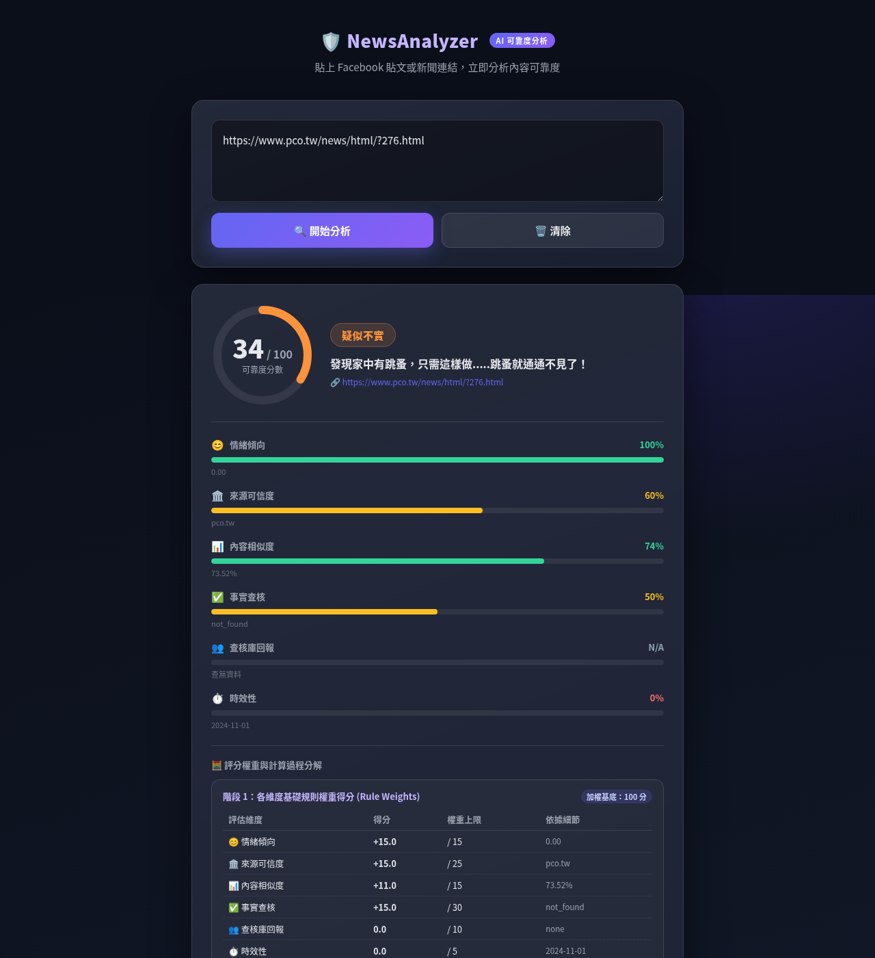
10 / CASE STUDY
沒有查核命中時，系統仍能保守分流
One live content-farm example demonstrates the fallback path; it is illustrative, not a quantitative claim.
UNINDEXED CLAIM
Live NewsAnalyzer interface
Live content-farm URL
01
Cofacts match?
sim < 0.72 → not_found
02
Metadata + local LLM
domain · HTTP · sentiment · context
03
Verdict
score 15.9 · Suspected Fake
Fallback is a feature, not a hole in the method.
Figure: web-based interface with live extraction, scoring, and local-LLM viewpoint output.
11
Notes:
這頁是展示 fallback：沒有高相似 Cofacts 證據時，系統不是假裝確定，而是用 metadata 與 local LLM 做保守 warning。要說清楚這是 single case，不把 15.9 當成整體 accuracy。

Slide 12
11 / BOUNDARY
這個系統還不知道什麼？
A credible triage system should make its deployment boundary as visible as its accuracy.
01
Class imbalance
02
Negation + entities
2,025 / 2,292 claims are MISLEADING; accuracy alone is not enough.
cosine similarity can miss contradiction and entity substitution.
03
Regional transfer
04
Human trust
Taiwan-centric index reaches only 55.3% retrieval accuracy on WSDM 2019 data.
No formal user study; usability, trust, and reliance remain open questions.
NewsAnalyzer is a triage aid, not an omniscient truth arbiter.
The research contribution is a more auditable decision boundary: evidence when available, transparent abstention when not.
12
Notes:
不要迴避限制。這一頁反而讓研究定位更可信：分類不平衡、否定與實體替換、跨區域轉移、使用者信任都還需要下一階段研究。

Slide 13
12 / TAKEAWAYS
三個帶走的事
NewsAnalyzer: evidence before eloquence, with uncertainty kept visible.
01
Evidence first
2,292 frozen claims + SBERT retrieval make the verdict auditable.
PROJECT SIGNAL
2,292
→ 90.8%
→ 99.0%
02
Conservative by design
Record-level 95.3% selective accuracy becomes 90.8% under cluster-level split.
evidence corpus
cluster-level lower bound
paired hybrid accuracy
03
Local, but honest
Full text and analysis stay on-device; only bounded lookups leave the device.
github.com/min20120907/NewsAnalyzer
Questions? · Evidence, uncertainty, and privacy can coexist.
13
Notes:
結尾重申三個 takeaway：evidence first、conservative by design、local but honest。不要再新增數字，讓 Q&A 聚焦研究定位與部署邊界。

