Slide 1
Implementation of Noble Gas Ingrowth

Slide 2
From Kerry
What specific noble gases should we consider? I was thinking He would be the logical one, but I guess that depends on which gases have, or will be, analysed by the U of Ottawa group.
The in situ production of some of these gases appears quite complicated. He production, however, seems relatively straight forward if the U and Th contents of the rocks are known. See also the attached paper (which I haven’t fully reviewed).
I don’t see mention of sorption of these gases on organic matter. Have you seen anything on this process?

Slide 3
From Uli
This is strictly for Helium. This may be a good way to get this started.
When implementing it, it should be done in a generic way, though. Not hard wired. i.e. it should be possible to add other noble gases in the future
My suggestion is as follows:
1. Enter all relevant mineral phases through input file. These will be defined in database, which can be a custom set-up (allows easy modification without additional coding)
2. In the code, whole-rock [U] and [Th], [Na], [Mg], [Al], [Si], [C] are calculated based on the minerals present on a cell by cell basis (I suggest to use consistent internal units, such as mol l-1 bulk, not the ones provided by Ballantyne et al)
3. Calculate the ingrowth of He based on that using the equations given below in units mol L-bulk s-1 for consistency with internal units
4. Tom suggests a release factor, but to my understanding this is diffusion driven. I suggest to use a simple mass transfer term that looks at a noble gas concentration in the solid phase and releases that to the aqueous phase (all done on a cell-by-cell basis) R = k ([NG]_solid x por x S_w - [NG]_aqueous), where k is a user specified mass transfer coefficient. [NG]_solid is the noble gas concentration in the solid phase, and [NG]_aqueous is the noble gas concentration in the aqueous phase, por is porosity, S_w is water saturation
5. This could be expanded to a mineral specific formulation. In this case, the NG ingrowth in each relevant phase would be tracked along with the release.
Re noble gas absprption into organic material. To my understanding nobles gases can be quite soluble in oil. My thinking was to treat the oil as a mineral phase (stagnant) and then let noble gases partition into this phase using a similar formulation as above using a simple mass transfer model. This part can be done later. We can refine this as we go.
It makes a lot of sense to start with He ingrowth, so that we can show some progress. Then go from there.

Slide 4
Tasks
Noble gases to be considered?
helium (He), neon (Ne), argon (Ar), krypton (Kr), xenon (Xe), radon (Rn), and oganesson (Og)
General formulation for noble gas ingrowth related to uranium (U) and thorium (Th) decay and noble gas absorption into organic matter.

Slide 5
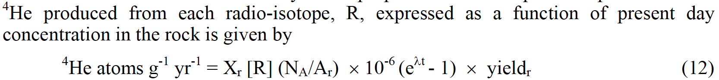
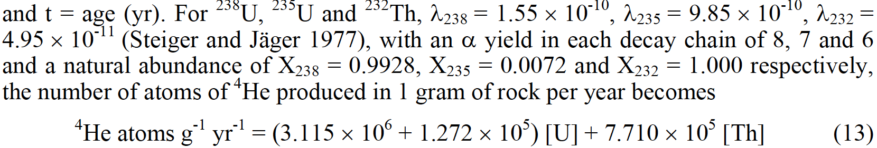
Formulation of He

Slide 6
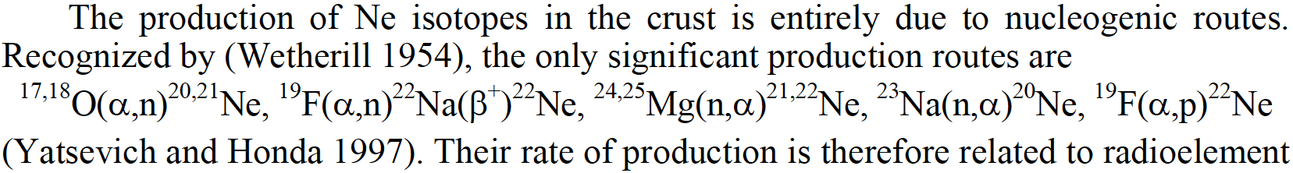
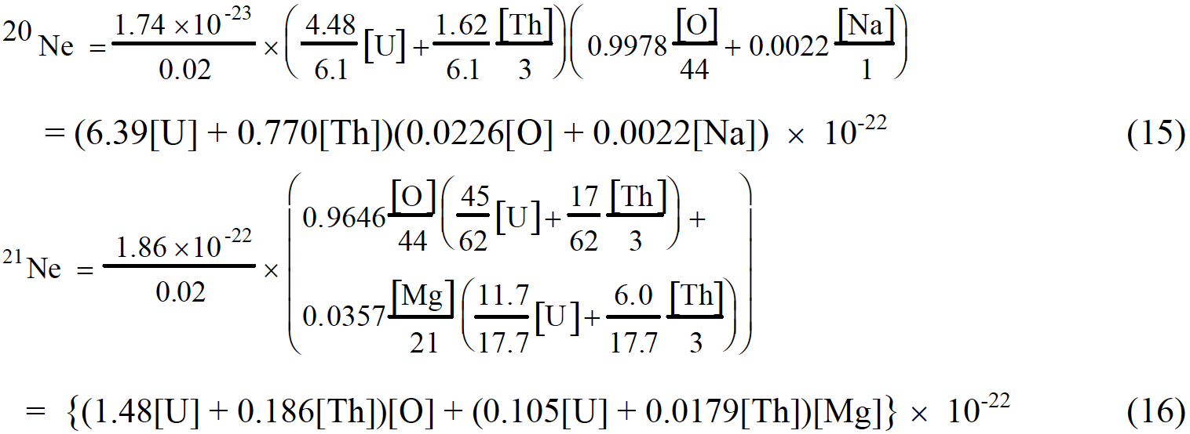
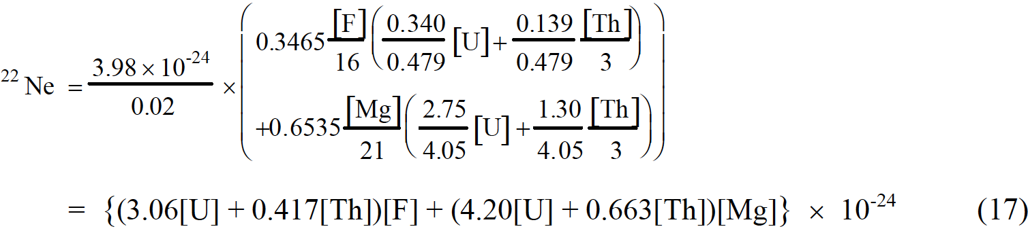
Formulation of Ne

Slide 7
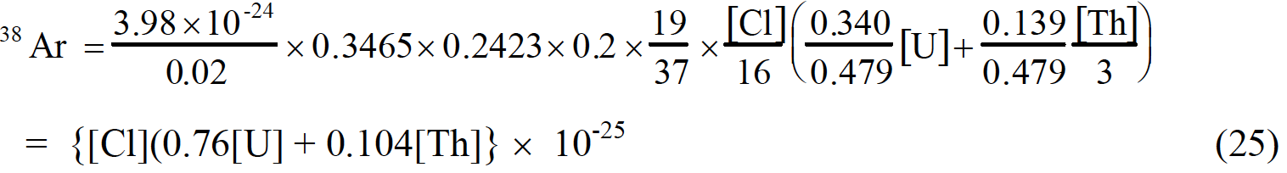
Formulation of Ar

Slide 8
Formulation of Kr and Xe

