Slide 1
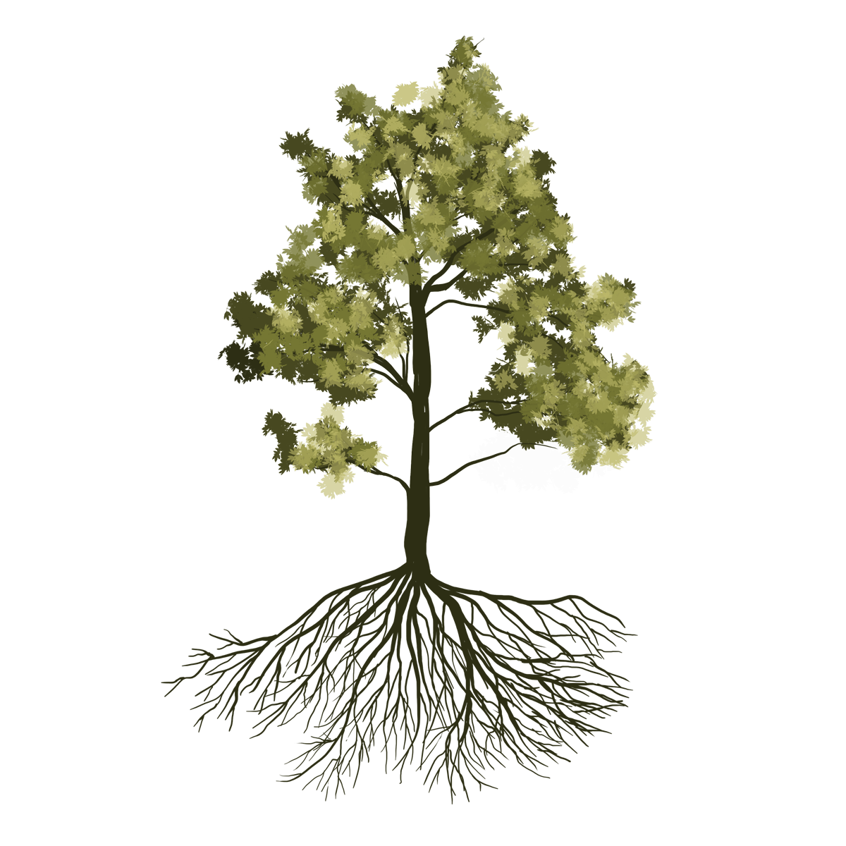
Zone dependent solute uptake and leaf recycle as minerals.

Slide 2
Zone dependent solute uptake and leaf recycle as minerals.

