Slide 1
 |  | 4 points Reproj. error | 8 points Reproj. error | 20 points Reproj. error
SIFT Image 1-0 & 1-1 | Homography | 917.11 | 1.97 | 0.45
 | DLT | 917.11 | 1.97 | 0.45
 | Normalized DLT | 917.11 | 1.62 | 0.44
SIFT Image 1-0 & 1-2 | Homography | 171.67 | 3.31 | 1.85
 | DLT | 171.67 | 3.31 | 1.85
 | Normalized DLT | 171.67 | 3.02 | 1.89
SuperPoint Image 1-0 & 1-1 | Homography | 2.05 | 1.49 | 0.62
 | DLT | 2.05 | 1.49 | 0.62
 | Normalized DLT | 2.05 | 1.46 | 0.62
SuperPoint Image 1-0 & 1-2 | Homography | 2.05 | 1.60 | 0.84
 | DLT | 4.87 | 1.60 | 0.84
 | Normalized DLT | 4.87 | 1.87 | 0.79

Slide 2
 |  | Matching pairs | After Outlier Rejection pairs
Image 1-0 & 1-1 | SIFT | 1485 | 1368
 | SuperPoint | 391 | 165
Image 1-0 & 1-2 | SIFT | 87 | 27
 | SuperPoint | 142 | 51

Slide 3
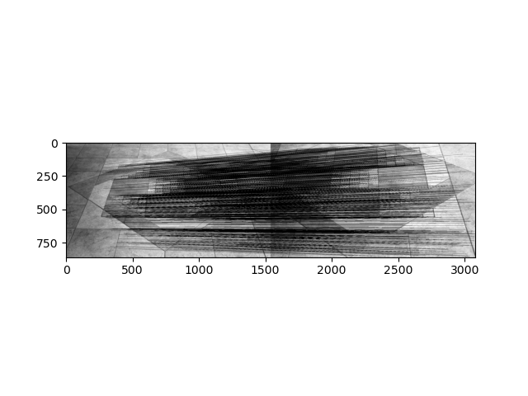
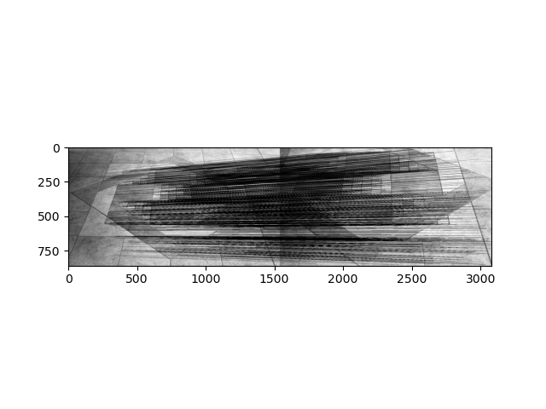
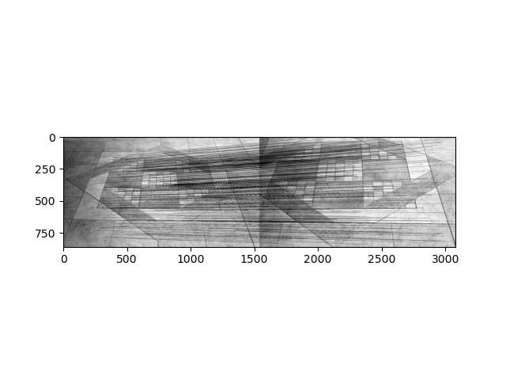
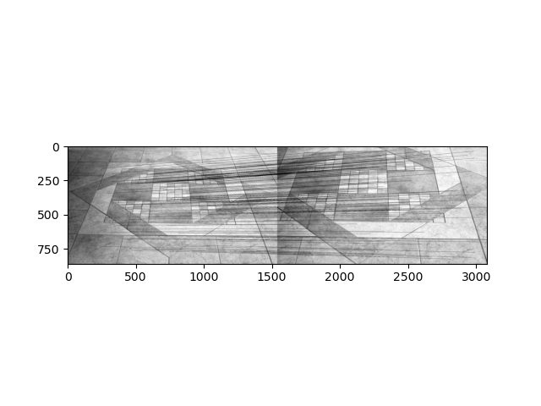
SIFT BFMatching
SIFT With RANSAC
SuperPoint BFMatching
SuperPoint With RANSAC

Slide 4
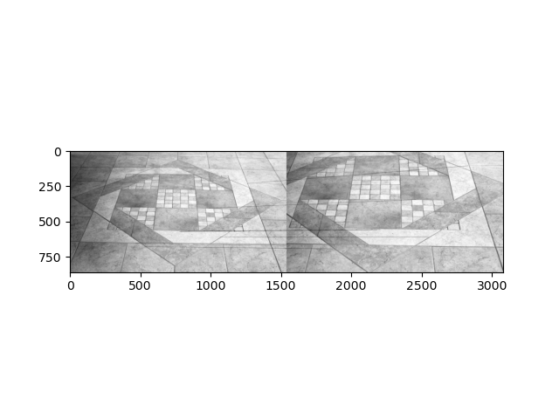

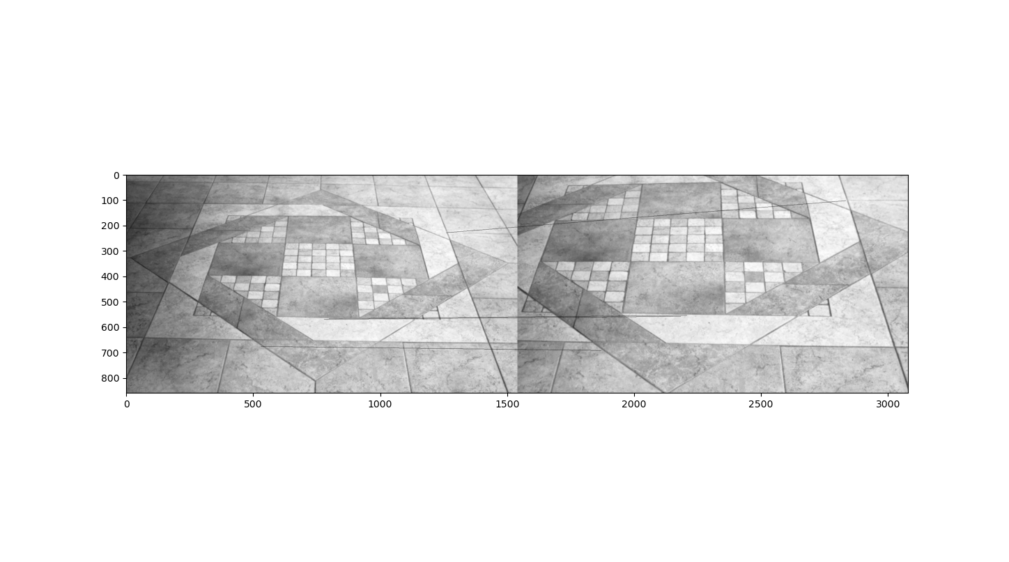
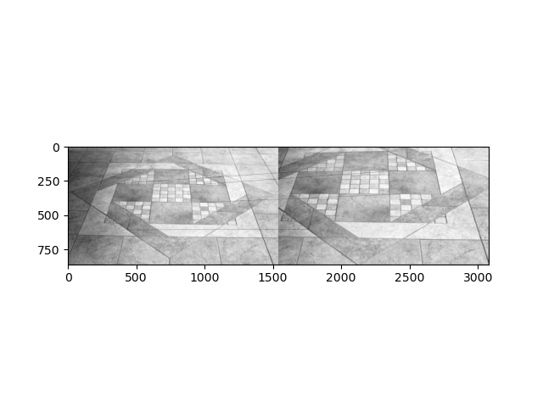
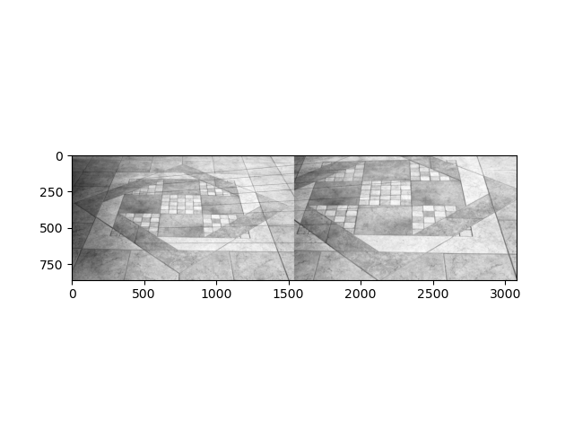

SIFT Select Top4
SIFT Select Top8
SIFT Select Top20
SuperPoint Select Top4
SuperPoint Select Top8
SuperPoint Select Top20

Slide 5
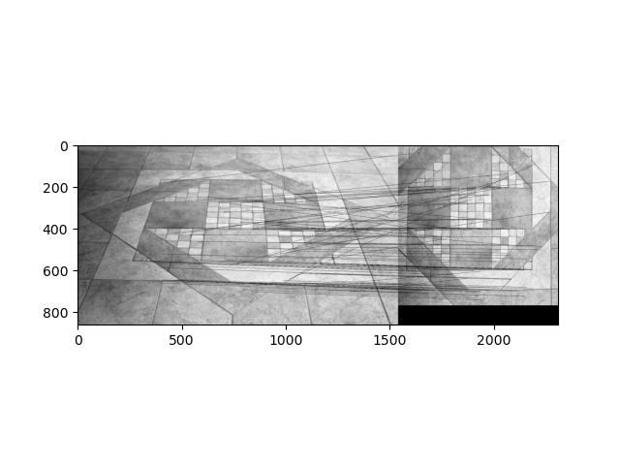
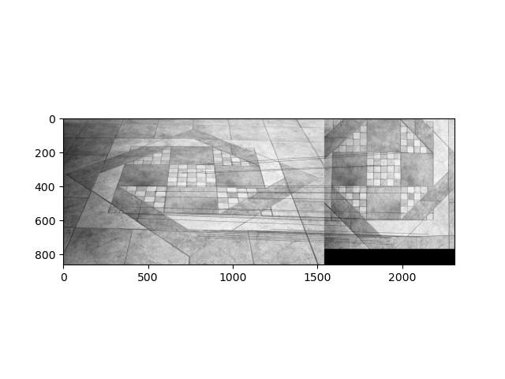
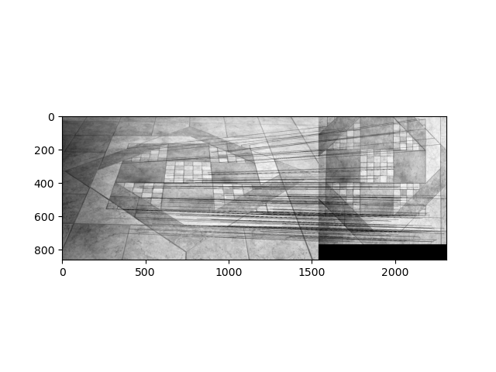
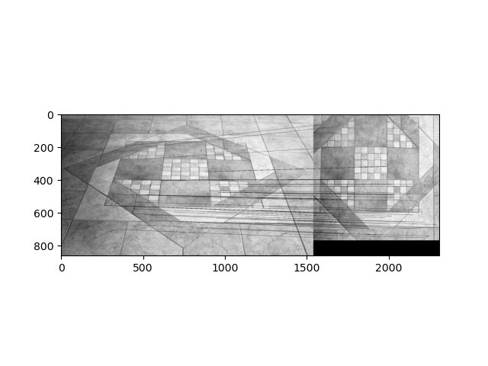
SIFT BFMatching
SIFT With RANSAC
SuperPoint BFMatching
SuperPoint With RANSAC

Slide 6






SIFT Select Top4
SIFT Select Top8
SIFT Select Top20
SuperPoint Select Top4
SuperPoint Select Top8
SuperPoint Select Top20

Slide 7
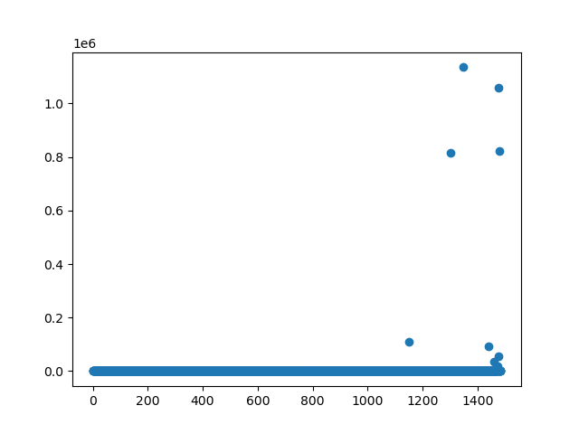
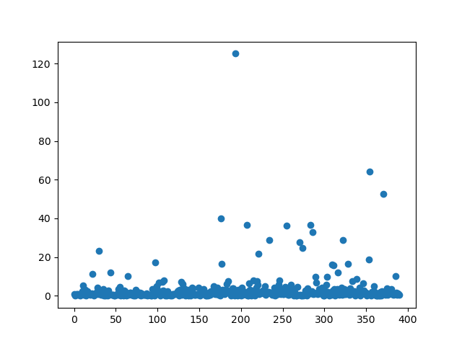
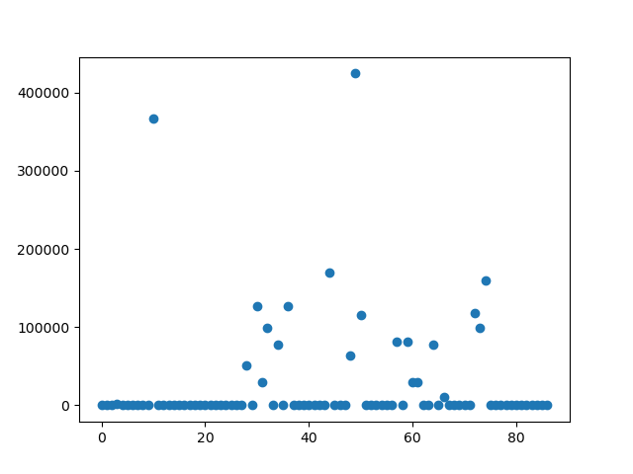
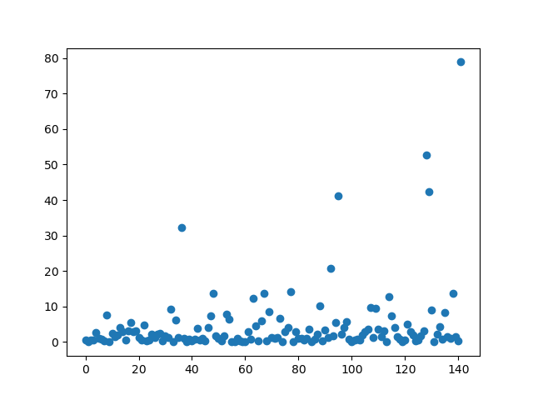
SIFT RANSAC
SuperPoint RANSAC
SIFT RANSAC
SuperPoint RANSAC

