Slide 1

Observer Pattern

Slide 2
Outline
Observer Pattern Explained
Coding Example

Slide 3
Observer Pattern
The Observer Pattern defines a one-to-many dependency between objects so that when one object changes state, all of its dependents are notified and updated automatically.
1
Notes:
We will go right on into the observer pattern definition: … We can see this design pattern used in many of today application like Youtube or Facebook. When a user upload a new Youtube video or one person change his/her status, all of their followers will get a notification about it.

Slide 4
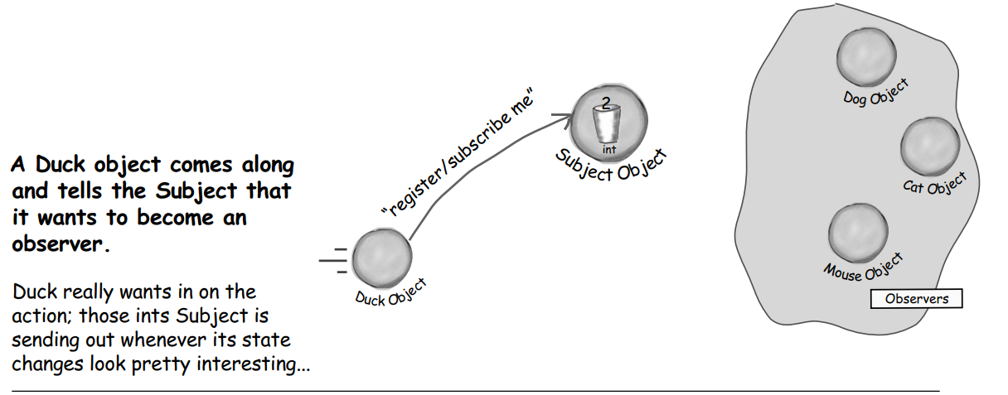
Process Illustration
Notes:
To demonstrate it further, let’s look at the following illustration

Slide 5
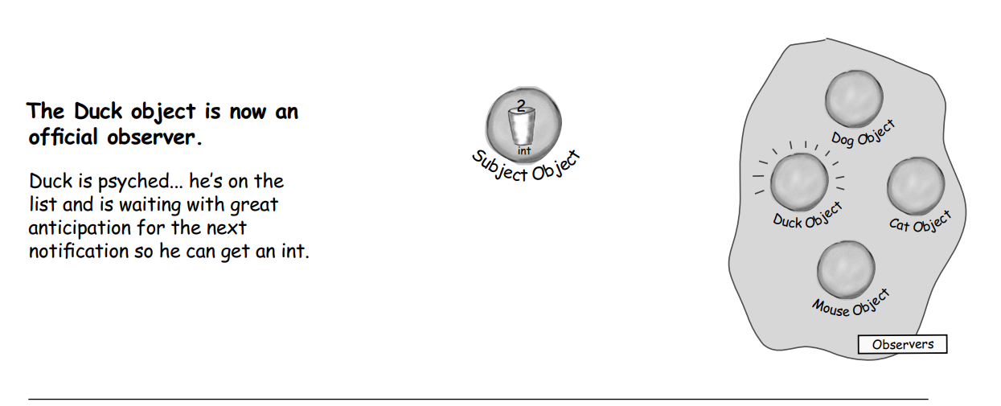
Process Illustration

Slide 6
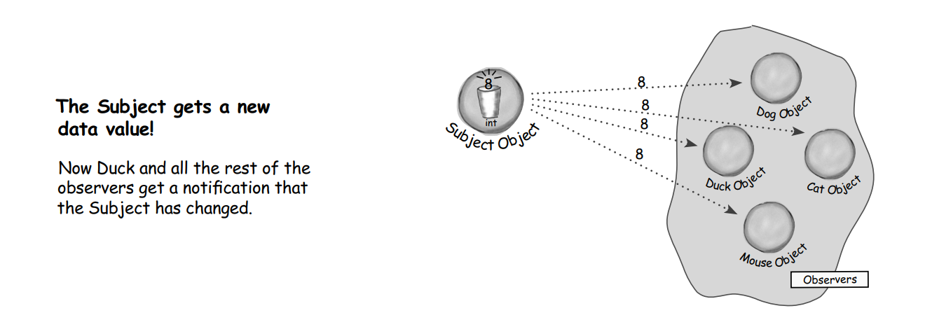
Process Illustration

Slide 7
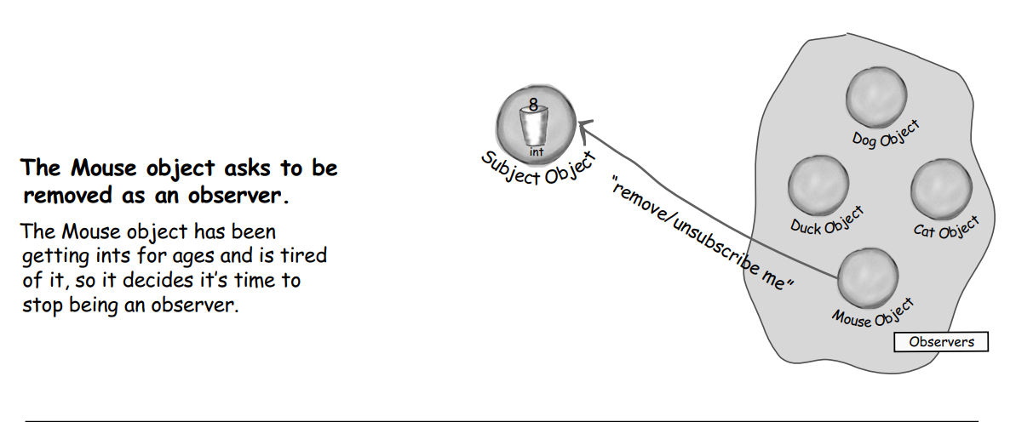
Process Illustration

Slide 8
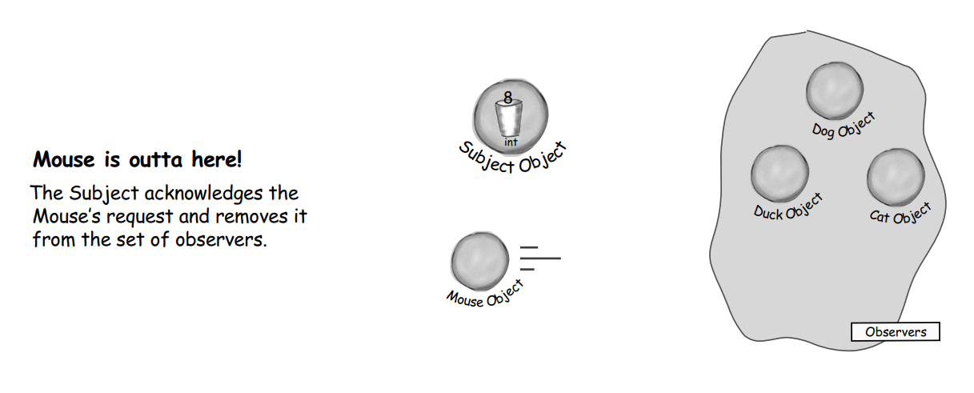
Process Illustration

Slide 9
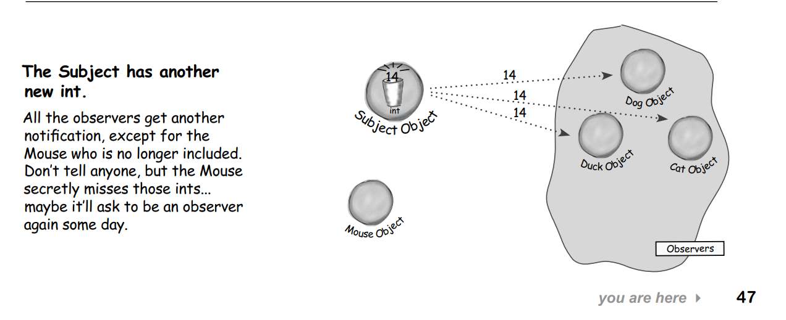
Process Illustration

Slide 10
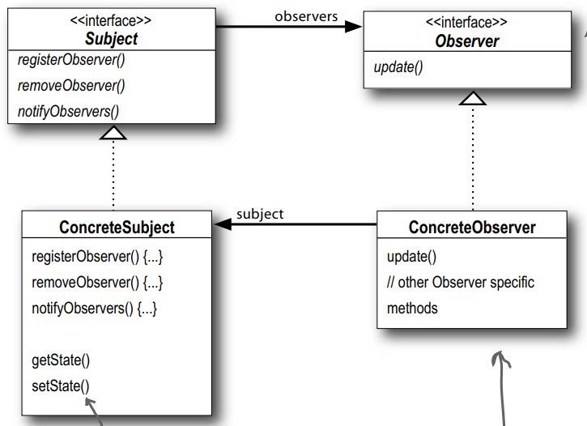
Class Diagram
Notes:
Here is the class diagram of the pattern.
To implement this into CPP, we have to use Interfaces. An interface describes the behavior or capabilities of a C++ class without committing to a particular implementation of that class.
So in this diagram, you can see that …

Slide 11
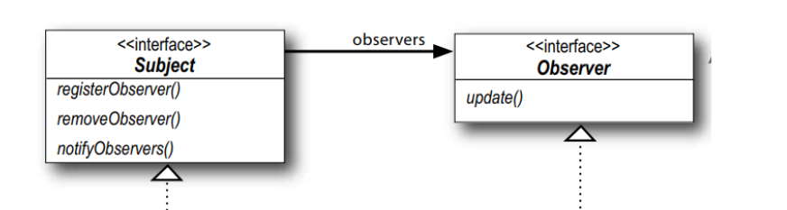
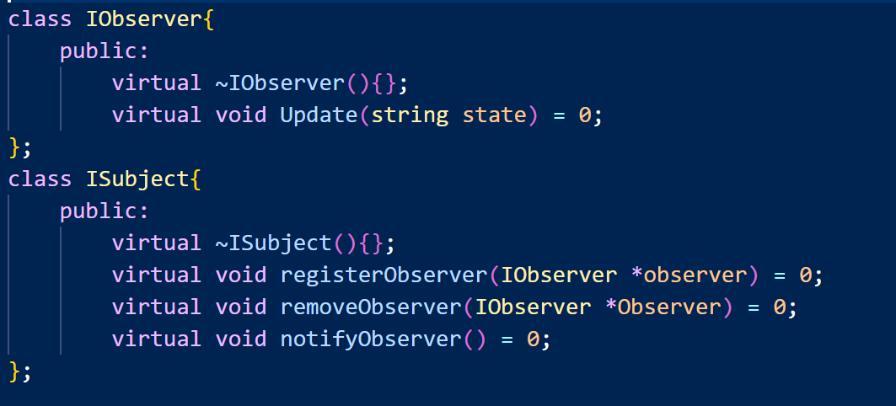
Coding Example

Slide 12
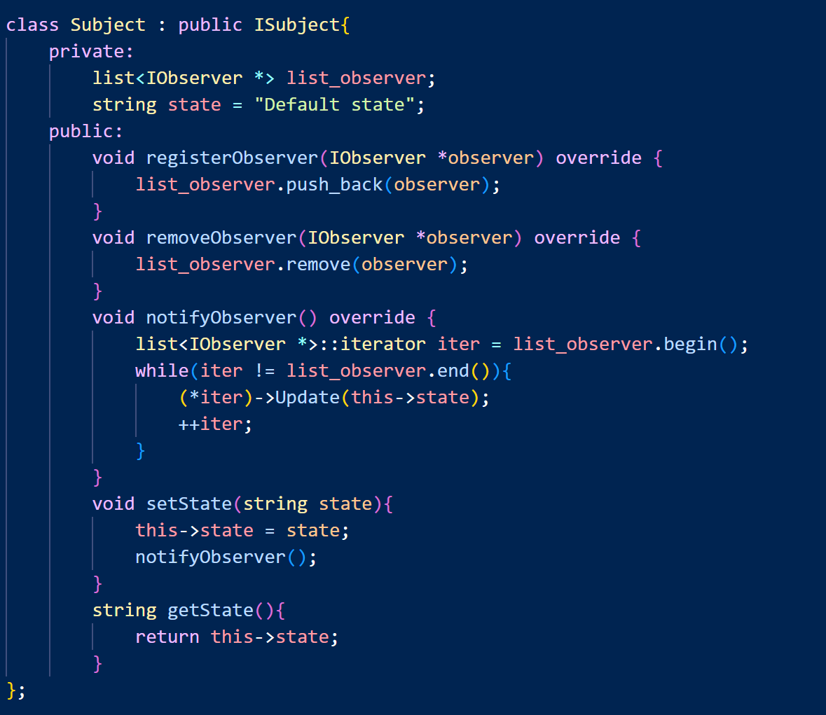
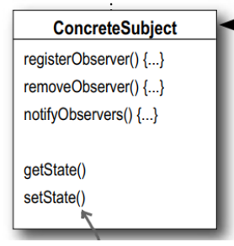
Coding Example

Slide 13
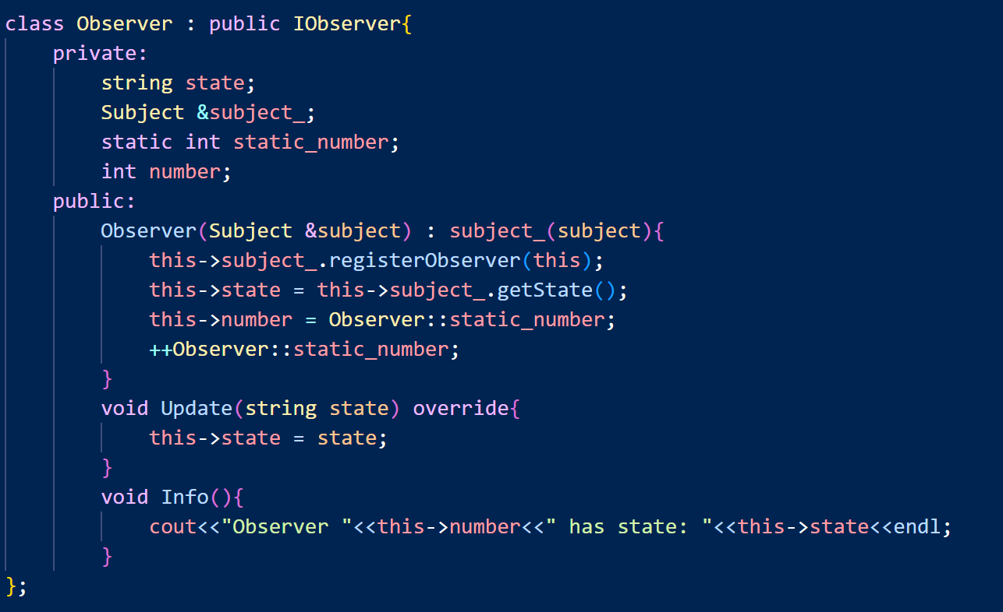
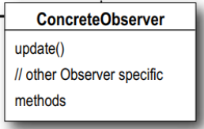
Coding Example

Slide 14
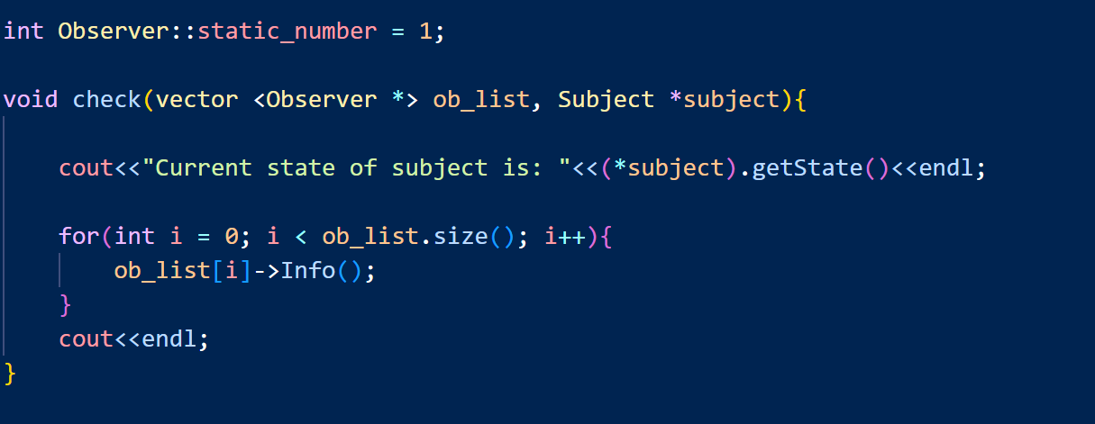
Coding Example

Slide 15
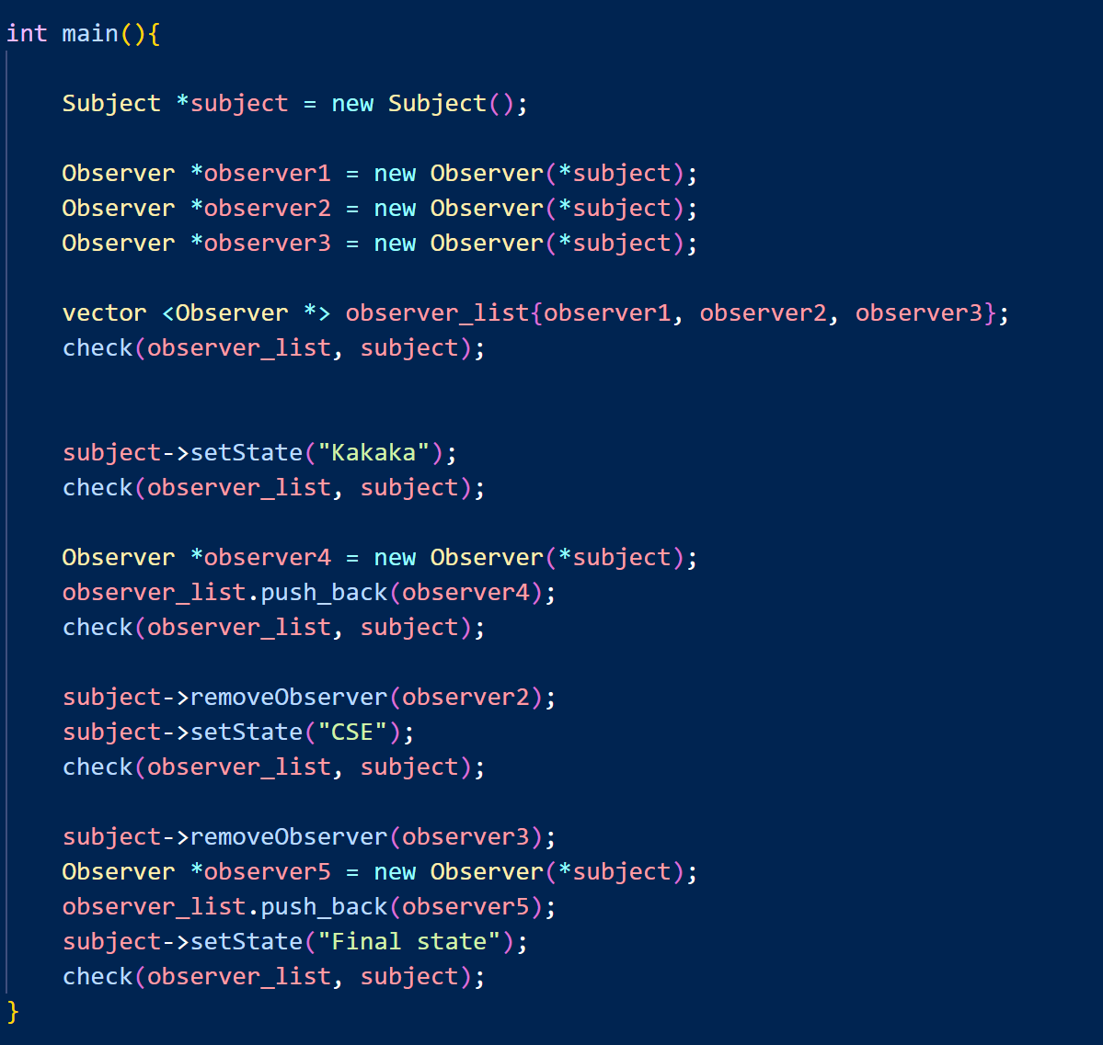
Coding Example

