Slide 1
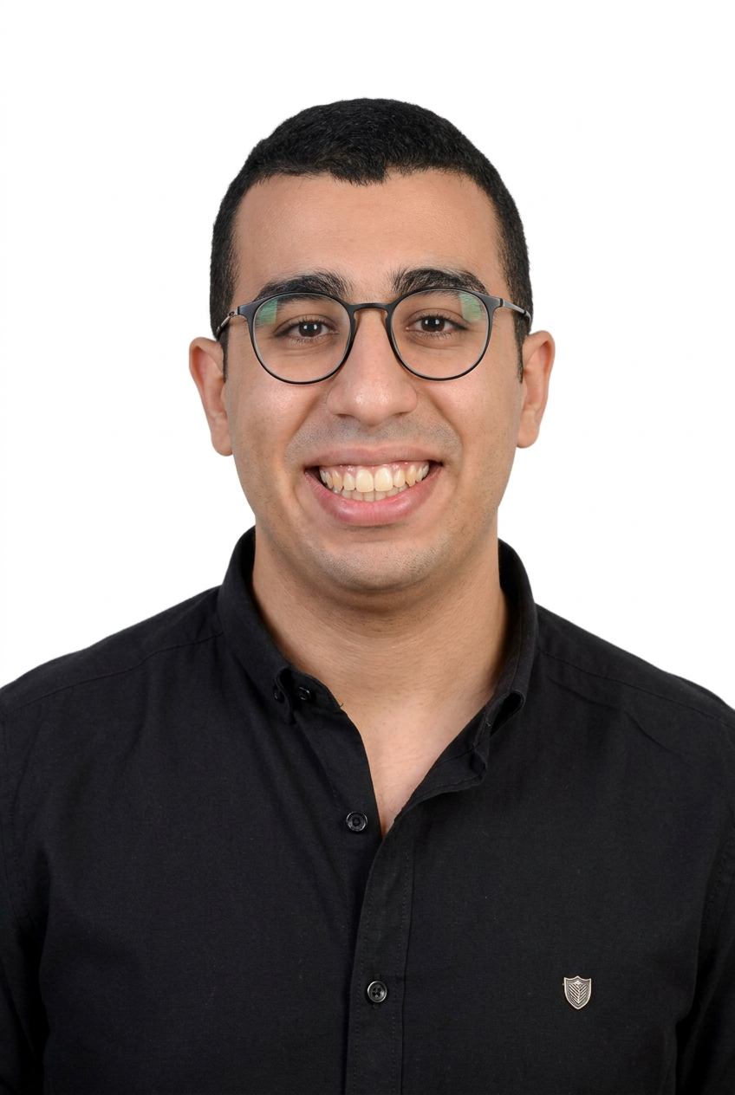
DEVOPS & MLOPS ENGINEER
Mina John Emil
Cloud-native infrastructure, CI/CD automation, and MLOps — built to hold up in production.
Cairo, Egypt • minajohn949@gmail.com • GitHub • LinkedIn
source
build
integrate
deliver
orchestrate
run
observe
Mina John Emil
1

Slide 2
ABOUT
A DevOps engineer bridging development, infrastructure, and AI
I'm Mina John Emil! I'm a DevOps & MLOps Engineer based in Cairo, Egypt. Over the past few years, I've architected and deployed cloud-native systems ranging from 3-tier microservices stacks on Kubernetes to a 14-pod .NET pipeline running across OpenShift and KinD, migrating full workloads to AWS along the way with EKS, RDS, and Route 53. Check out my GitHub to see for yourself.
The reason teams trust me with their infrastructure? I bridge the gap between development, operations, and AI building "Zero-Touch" GitOps pipelines with ArgoCD, standardizing deployments with Helm, and automating CI/CD end-to-end with Jenkins and Azure DevOps. I'm AWS Certified Solutions Architect and Oracle Cloud Architect Associate certified, and I bring that same rigor to machine learning operations — from LLM agent workflows to model deployment pipelines that cut operational overhead. Whether it's a startup's first cluster or an enterprise's AI deployment strategy, I work to make it scalable, secure, and self-healing. Get in touch today to learn more!
Mina John Emil
DevOps & MLOps Engineer
Cairo, Egypt
Mina John Emil
2

Slide 3
UNIQUE SELLING POINT
I help engineering teams ship machine learning and microservices reliably, through cloud-native CI/CD pipelines that turn a repository into a production system — with the monitoring and rollback paths already in place.
01
Every project ships with a short, professional walkthrough video showing you exactly how to monitor and maintain it yourself — no black boxes.
02
Ongoing support after delivery — if something breaks or needs adjusting, I'm still on the project with you.
03
Mina John Emil
3

Slide 4
EDUCATION & CERTIFICATIONS
2022 – 2027
B.Sc. Communication & Electronics Engineering
Helwan University — Grade: Excellent
CERTIFICATIONS
AWS Solutions Architect Associate
Amazon Web Services
Designs secure, cost-optimized, highly available AWS architectures — applied while migrating workloads to EKS, RDS, and Route 53.
AWS Cloud Practitioner
Amazon Web Services
Foundational AWS Cloud services, pricing models, and terminology — the entry point into the AWS certification track.
AWS AI Practitioner
Amazon Web Services
Validates AI, ML, and generative AI concepts on AWS — aligned with hands-on LLM agent and MLOps experience.
Mina John Emil
4

Slide 5
CERTIFICATIONS (CONT’D)
Oracle Cloud Architect Associate
Oracle
Architects OCI compute, network, storage, and IAM solutions for production-grade cloud workloads.
Oracle Cloud Foundations Associate
Oracle
Core Oracle Cloud Infrastructure services and cloud computing fundamentals.
CCST Networking
Cisco
Entry-level networking fundamentals and addressing — builds on CCNA (200-301) instructor experience at IEEE.
Microsoft Machine Learning Engineer
07/2026 – 01/2027
Digital Egypt Pioneers Initiative (DEPI)
Translated raw data into scalable data science models, optimizing data processing and pattern identification for systems.
Developed AI algorithms utilizing Python, MLflow, Hugging Face, mastering deep learning, NLP with attention models, computer vision.
Earned expertise in MLOps and cloud AI deployment, Azure AI Engineer Associate, culminating in a capstone project..
Mina John Emil
5

Slide 6
CERTIFICATIONS (CONT’D)
Machine Learning Specialization
Stanford University & DeepLearning.AI
Four-course track: Supervised Machine Learning, Advanced Learning Algorithms, Unsupervised Learning, and Recommender/Reinforcement Learning Systems.
Cloud Architect Certificate
NTI, ITI & AWS Academy
Joint cloud-architecture training across NTI, ITI, and AWS Academy covering core AWS and architecture practices.
Generative AI Certificate
IBM
Generative AI and large language model fundamentals and enterprise applications — IBM.
CS50
Harvard University & ITI
Harvard's introduction to computer science — algorithms, data structures, and programming fundamentals.
Mina John Emil
6

Slide 7
CERTIFICATIONS (CONT’D)
DevOps Diploma
04/2025 – 10/2026
IT-Gate & Ain Shams University (ASU)
Applied Linux (RHEL Admin 1 and 2), Docker, Kubernetes, Helm, OpenShift, Jenkins, GitLab, GitHub Actions, ArgoCD, Terraform, and Ansible.
KodeKloud DevOps Diploma
KodeKloud
Hands-on labs across Python, Golang, Docker, and the 12-Factor App methodology.
Mahara-Tech Certificates
ITI Mahara-Tech
A series of foundational tracks: relational databases, Python programming, HTML/CSS, and Ubuntu Linux basics.
VMware vSphere Mastery
Udemy
Hands-on administration of VMware vSphere, ESXi hosts, and vCenter Server in virtualized data center environments.
Mina John Emil
7

Slide 8
SKILLS & TOOLS
DevOps
Cloud & Admin
AI & Machine Learning
Docker / Podman
Kubernetes / Helm
OpenShift
Jenkins / Azure DevOps
GitLab / GitHub Actions
Argo CD
Ansible / Terraform
AWS (SAA)
Azure (AZ-204)
Oracle Cloud Architect
Linux Admin 1 & 2
Bash scripting
CCNA networking
LLMs & prompt engineering
LangChain, RAG, agents
MLflow, Hugging Face
Neural nets, XGBoost
Regression & recommenders
Programming
Databases & Monitoring
Virtualization
Python
Go
C / C++
JavaScript
HTML / CSS
MySQL / PostgreSQL
MS SQL Server
Prometheus / Grafana
VMware vSphere
ESXi
vCenter Server
Mina John Emil
8

Slide 9
EXPERIENCE
Linux Administrator (Training)
MAR – APR 2025
Orange
Trained in Linux system administration (Admin 1 & 2) and passed final examinations.
AI Agent Training Program
JUN – JUL 2026
Orange
focused on the LLM, Built intelligent agents using LangChain and advanced memory and context handling, Designed multiagent collaboration workflows and integrated external knowledge bases and APIs to automate tasks, Developed web interfaces for AI agents, Successfully deployed a final AI agent project
AI/ML Engineering Summer Intern
JUL – AUG 2026
Commercial International Bank (CIB)
Explored practical LLM and generative AI workflows within an enterprise financial sector setting.
Network (CCNA) Instructor
OCT 2023 – OCT 2024
IEEE
I worked as a networking instructor and covered topics in CCNA (200-301) as addresses network access, including configuring and troubleshooting, routing and switching, VLAN, IP connectivity and services, and network security
Mina John Emil
9

Slide 10
FLAGSHIP PROJECT
Mina Chat Tutorial — 3-Tier Microservices App (BuzzBoard)
github.com/mina-john-emil/3-tier-app
5 Pods
32/32 Synced
frontend · mood · reactions · MySQL · Redis, all 1/1 Running
ArgoCD-managed resources, 0 out of sync
Orchestration
Packaging
3-tier stack on Kubernetes — frontend, mood, and reactions services plus MySQL and Redis — using Namespaces, NetworkPolicies, HPA, and StatefulSets.
One modular Helm chart (helm upgrade --install buzzboard) standardizes every environment — no hand-edited YAML per cluster.
CI/CD
GitOps
Azure DevOps pipeline builds & pushes Docker images (~2m 12s), then deploys to EC2 via Compose or to Kubernetes via Helm (~25s), auto-triggered on every push to main.
ArgoCD v3.3.6 keeps 32 resources auto-synced and Healthy — Git is the single source of truth, zero manual kubectl apply.
Networking & Security
AWS Migration
TLS-terminated Ingress at buzzboard.local, IRSA-scoped IAM roles per pod, and secrets pulled at runtime from AWS Secrets Manager behind a KMS-encrypted vault.
Full move to EKS on an Auto Scaling Group of t3.micro nodes, ECR image registry, RDS (MySQL) + ElastiCache (Redis), and ALB Ingress on a custom domain via Route 53.
Mina John Emil
10

Slide 11
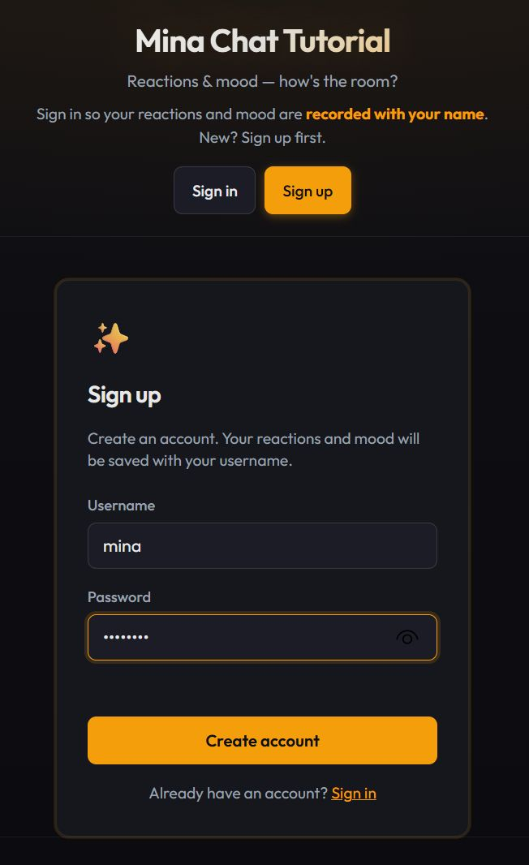
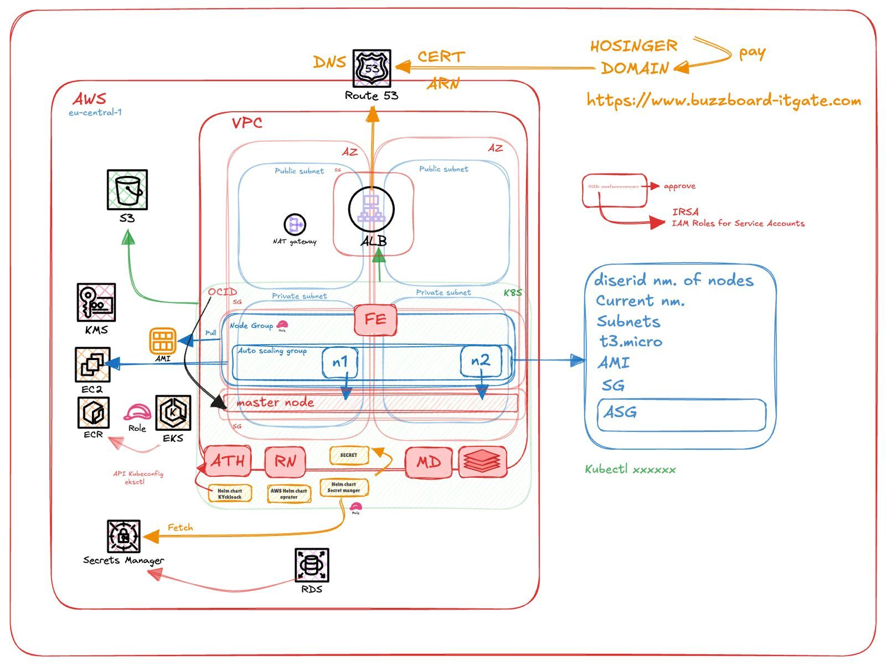
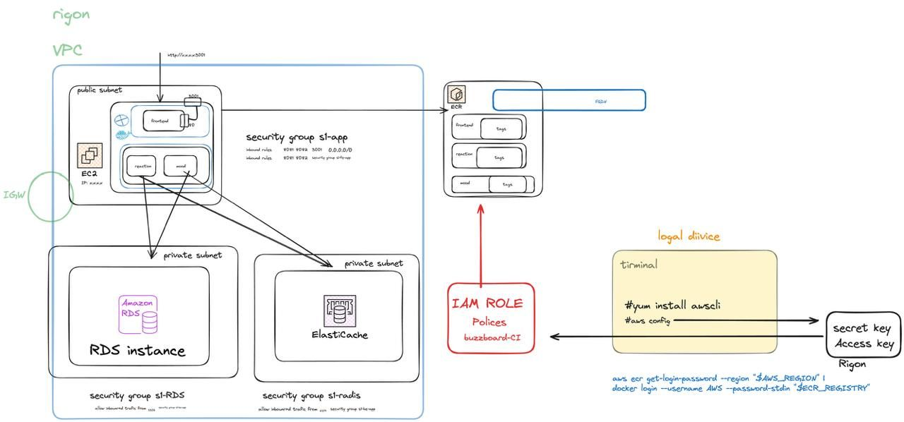
FLAGSHIP PROJECT
Mina Chat Tutorial — In the Field
End-to-end AWS architecture: VPC across two AZs, EKS node group, ALB, Route 53 + ACM cert, KMS, and Secrets Manager.
Service-level network diagram — frontend/reaction/mood containers pushed to ECR, with RDS and ElastiCache in private subnets behind an IAM role.
The live app: dark-themed sign-up screen for the Reaction Wall & Mood-of-the-Day features.
Mina John Emil
11

Slide 12
FLAGSHIP PROJECT
.NET Microservices Delivery Pipeline
github.com/mina-john-emil/.NET-Microservices-Sample-mina
14 Pods
45/45 Synced
9 Stages
microservices running 1/1 across the cluster
ArgoCD-managed Kubernetes resources
Jenkins pipeline, ~3m 38s average run
Orchestration
Packaging
14-pod e-commerce platform — Product, Basket, Order, Payment, Discount, and Identity services — deployed identically across OpenShift, KinD, and AKS.
A single Helm chart (helm/microservices) parameterizes image tags, NodePorts, and per-environment config in one values.yaml.
CI/CD
GitOps
Parallel Jenkins (9-stage declarative, ~3m 38s avg) and Azure DevOps pipelines automate Build → Test → Load-into-KinD → Deploy → Verify on every push.
ArgoCD keeps 45 resources auto-synced and Healthy — Deployments, Services, ConfigMaps, Secrets, and PVCs all tracked from Git.
Service Communication
Identity & Security
Ocelot API Gateways front the Web and Admin apps; services talk sync via gRPC (Basket → Discount) and async via RabbitMQ (CheckoutEvent fan-out).
Duende IdentityServer 6.2.3 issues OIDC/JWT tokens consumed by every downstream API, shared by both the Web and Admin frontends.
Mina John Emil
12

Slide 13
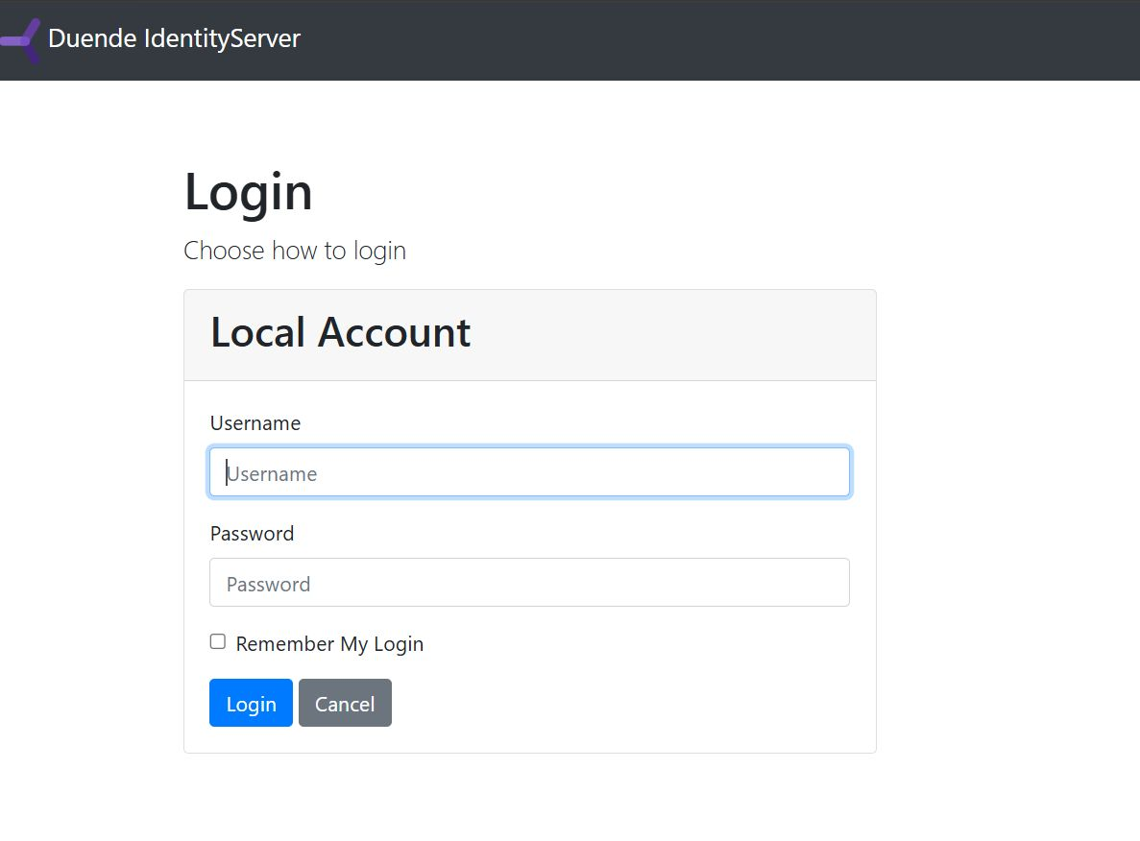
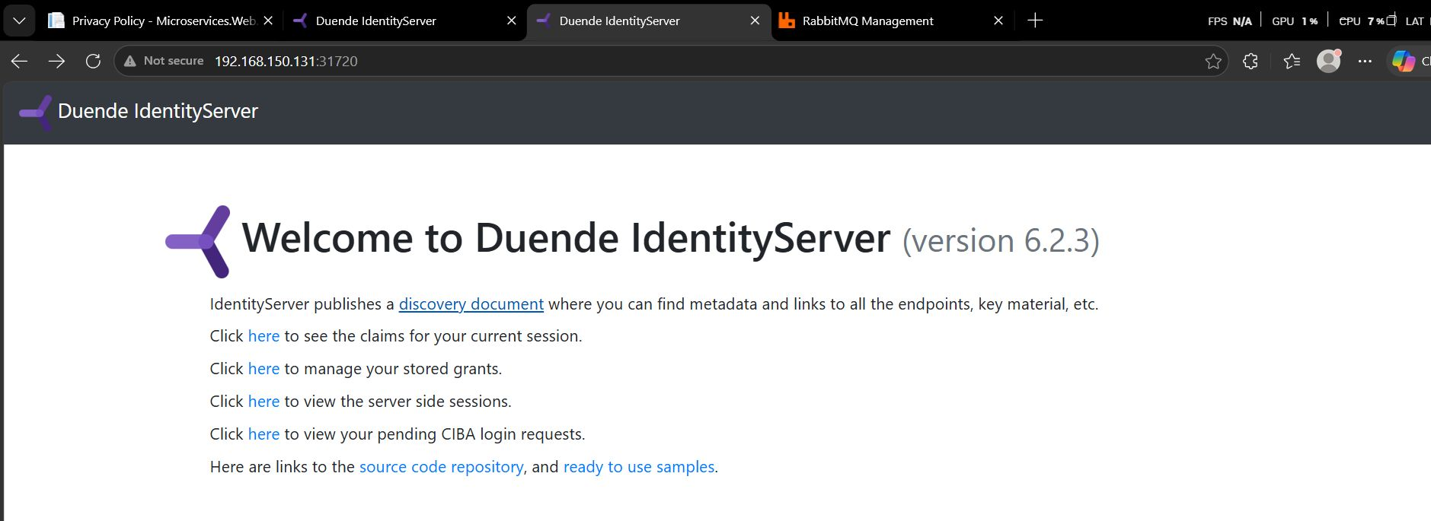
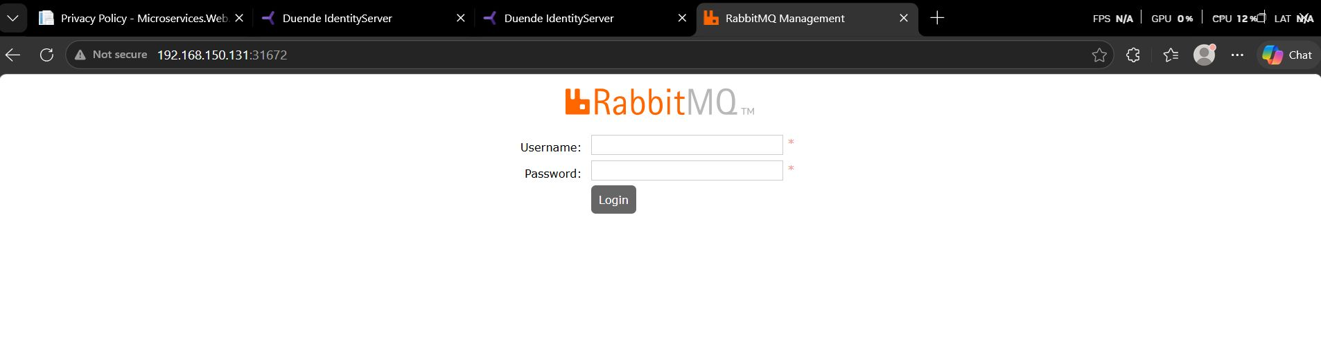
FLAGSHIP PROJECT
.NET Microservices — In the Field
Duende IdentityServer 6.2.3 running on Kubernetes (NodePort 31720) — the OIDC provider for every service.
The shared OIDC login screen used by both the Web and Admin frontends before reaching any protected route.
RabbitMQ Management UI (NodePort 31672) — the async message broker behind order and payment events.
Mina John Emil
13

Slide 14
TESTIMONIALS
What people are saying
Illustrative sample quotes for portfolio presentation purposes.
“
LINKEDIN COMMENTS — .NET MICROSERVICES PROJECT
Mina's 3-tier microservices project was one of the strongest in the DevOps track. He didn't just get Kubernetes running — he understood the Namespaces, NetworkPolicies, and GitOps sync behind it, and could explain every decision he made.
YA
Youssef Adel
Cloud & DevOps Engineer
Impressive pipeline design — parallel Jenkins and Azure DevOps stages plus a clean Argo CD sync across 45 resources. Production-grade work.
SM
Sara Mostafa
.NET Backend Developer
AS
Ashour Yasser
This is exactly how a microservices delivery pipeline should look. The Helm charts and environment configs are really well organized!
DevOps Instructor — IT-Gate Training Program
Mina John Emil
16

Slide 15
WHAT I CAN HELP WITH
1
CI/CD Pipeline Design
2
Kubernetes & GitOps
Build automated Build → Test → Deploy pipelines with Jenkins, Azure DevOps, or GitHub Actions.
Deploy and operate workloads on Kubernetes/OpenShift with Helm and Argo CD zero-touch delivery.
3
Cloud Migration
4
MLOps & AI Agents
Move workloads to AWS or Azure — EKS, ECR, RDS, networking, and cost-aware architecture.
Automate model deployment lifecycles and build LangChain-based agents with RAG.
Mina John Emil
14

Slide 16
GET IN TOUCH
Open to DevOps, MLOps, and cloud infrastructure roles.
The fastest way to reach me is email — happy to talk through any project above in more detail.
EMAIL
minajohn949@gmail.com
GITHUB
github.com/mina-john-emil
LINKEDIN
Mina John Emil
linkedin.com/in/mina-john-9201aa320
DevOps & MLOps Engineer
WhatsApp
let's build something reliable together.
+201211586256
LOCATION
Cairo, Egypt
Mina John Emil
15

