Slide 1




DIGITAL DESIGN PHASE · NTI
Secure UART Communication System
AES-128
Confidentiality
UART communication with hardware AES-128 encryption and CRC-16/XMODEM integrity checking
CRC-16/XMODEM
Data integrity
Prepared by
Mina Moawad · Mohammed Afifi · Hoda Ayman
UART
Presented to
Eng. Muhammed Salah
Serial communication
Notes:
Welcome. Our project is a secure UART communication system: a UART link with a hardware AES-128 encryption engine and a CRC-16/XMODEM error-detection engine, all written as RTL. Today we will walk through why we built it, what exists in the literature, how we designed and verified each block, the problems we hit, what we achieved and where it goes next.

Slide 2






ROADMAP
What we will cover
01
02
03
Motivation
Literature review
Development journey
Why we chose this project, and why it matters
Related work, and our edge with pros and cons
From architecture to verification with testbenches
04
05
06
Challenges and solutions
Summary of the outcome
Future work
Problems we faced, our approach and the results
What we got out of the project
Where the design goes next
Secure UART Communication System · NTI Digital Design Project
Notes:
The agenda follows the six points we were asked to cover: motivation, literature review, the development journey from architecture to verification, problems and solutions, the outcome, and future work.

Slide 3
PROJECT OVERVIEW
Project overview
A complete hardware communication and security datapath in Verilog/SystemVerilog RTL
Application
data
AES-128
Encryption
CRC-16/
XMODEM
UART
Transmitter
UART
Receiver
CRC check +
AES decrypt
Confidentiality
Integrity
Serial transport
Implemented
Future work
AES-128
CRC-16/XMODEM
UART 8-N-1
128-bit block and 128-bit key, 10 rounds, 128-bit ciphertext out.
16-bit checksum over the ciphertext. Polynomial 0x1021, init 0x0000.
1 start bit, 8 data bits LSB first, 1 stop bit. 9600 baud, 50 MHz clock.
Secure UART Communication System · NTI Digital Design Project
Notes:
Data goes in as plaintext, is encrypted by AES-128, a CRC-16 is computed over the ciphertext, and the 18-byte result is sent byte by byte through the UART. The dashed box on the right, decrypting and CRC-checking at the receiver, is what we list as future work; the UART receiver itself is implemented.

Slide 4




01 MOTIVATION
Why go beyond standard UART?
Standard UART only moves bytes. It does not protect them.
Data travels in the clear
OUR ANSWER
Plain UART sends application bytes as-is. Anyone who can read the line can read the data.
From basic communication to secure and error-aware communication
Errors can go unnoticed
UART has no acknowledgment or retransmission, so corrupted or truncated frames can be silently accepted.
AES-128 keeps the data confidential
CRC-16/XMODEM detects corrupted frames
Parity is not enough
A parity bit misses multi-bit burst errors that hit multi-byte frames.
start / busy / done keeps every stage in step
Secure UART Communication System · NTI Digital Design Project
Notes:
Reasons for choosing the project. A plain UART link has no confidentiality and no real error detection. We wanted to close both gaps directly in hardware, and at the same time practice coordinating three very different blocks: a serial protocol, a block cipher and an error-detection engine.

Slide 5

01 MOTIVATION
Importance and impact
Security in hardware
Reliable links
Reusable foundation
The cipher sits directly in the serial datapath, so protection does not depend on software running on a host processor.
CRC-16 lets the receiver detect accidental corruption, including burst errors, before data is accepted as valid.
Modular, parameterized RTL that can be verified block by block and used as a base for FPGA or ASIC work.
THE IMPACT
3
RTL blocks
in 1 datapath
One datapath that delivers three things: reliable serial transport, confidentiality and error detection, coordinated at the hardware level.
Secure UART Communication System · NTI Digital Design Project
Notes:
Why it matters. Putting the cipher and the checksum in hardware means the link is protected without involving a CPU. The design is modular and parameterized, so each block can be reused or ported to an FPGA or an ASIC flow.

Slide 6
02 LITERATURE REVIEW
Literature review
Work | What it shows | What we took from it
Basu, Kole & Rahaman (2012) [1] | AES embedded inside a UART module for secured serial transfer, instead of software on a host. | Put the cipher directly in the serial data path
Katkade & Phade (2016) [2] | AES for confidentiality on serial links, with the practical trade-offs on a low-resource interface. | Keep the cipher small and practical
Kala, Panda & Tanwar (2023) [3] | High-throughput, low-power AES-128 on FPGA. Pipelined vs iterative area/throughput trade-off. | Iterative core: one round datapath reused for all 10 rounds
Kinshuk et al. [4] | Fixed-key AES-128 block for secure UART transfer with a documented frame convention. | Ciphertext + CRC as the protected payload
UART + CRC prior work | CRC clearly beats parity alone for multi-byte frames hit by burst noise. | CRC-16/XMODEM (0x1021, init 0x0000) over the ciphertext
Secure UART Communication System · NTI Digital Design Project
Notes:
Four papers embed or evaluate AES on serial links, and prior UART-plus-CRC work shows that a CRC is far better than parity for burst errors. We took the idea of putting the cipher in the serial path, the iterative area-saving AES architecture, the ciphertext-plus-CRC frame convention, and the CRC-16/XMODEM parameter set.

Slide 7



02 LITERATURE REVIEW
Our edge: pros and cons
Our edge
Trade-offs and limits
Three independently verifiable RTL blocks (UART, AES, CRC) integrated in one system
Encryption path only: AES decryption is not implemented yet
Explicit start / busy / done handshake plus a top-level FSM: no stage consumes incomplete data
No formal frame format yet (sync, length, sequence number)
Iterative AES core reuses one round datapath, so it needs less area than an unrolled design
CRC detects accidental errors only. It is not authentication against an attacker
Verification built on standard reference vectors, e.g. CRC check value 0x31C3
Direct block encryption (no chaining mode); no post-synthesis timing, area or power numbers yet
Our contribution: coordinating UART, AES and CRC through an explicit handshake protocol, with a documented verification plan.
Secure UART Communication System · NTI Digital Design Project
Notes:
Our edge is the coordination: three blocks that can each be verified alone, joined by a clear start/busy/done protocol and a top-level FSM. The honest trade-offs: it is encryption-only for now, the frame format is minimal, CRC is not authentication, and we have not yet run post-synthesis timing, area or power analysis.

Slide 8




03 DEVELOPMENT JOURNEY
Our development journey
Design each block, verify it on its own, then integrate
1
2
3
4
5
6
Requirements
Architecture
UART
AES-128
CRC-16
Integration
Objectives, functional needs, configurable parameters
Transmit path, block roles, 18-byte frame
TX / RX FSMs, 8-N-1 at 9600 baud
Iterative FSM core, key expansion
Bit-serial engine, 128 cycles
Top-level FSM and handshakes
VERIFIED WITH
UART loopback
tb_AES_FSM
CRC testbench
tb_TOP_LEVEL
3 byte patterns
reset, latch, pulse, wait for done
3 reference vectors
AES to CRC hand-off
Secure UART Communication System · NTI Digital Design Project
Notes:
Our workflow was the same for every block: write the RTL, build a testbench, check the waveforms, and only then integrate. The following slides follow this order: architecture, UART, AES, CRC, integration.

Slide 9
03 DEVELOPMENT JOURNEY
System architecture and frame format
UART byte stream sent MSB first: AES ciphertext, then CRC (high byte, then low byte)
B0
B1
B2
B3
B4
B5
B6
B7
B8
B9
B10
B11
B12
B13
B14
B15
CRC
H
CRC
L
Ciphertext: 16 bytes (bits [127:120] = byte 0 ... [7:0] = byte 15)
CRC: 2 bytes
Stage | Input | Processing | Output
AES-128 | 128-bit plaintext + 128-bit key | Key expansion + 10 rounds | 128-bit ciphertext
CRC-16/XMODEM | Ciphertext block | Polynomial division, bit-serial | 16-bit CRC (144-bit with data)
Framing (top-level) | Ciphertext + CRC | Serialize MSB first into bytes | 18-byte UART stream
UART TX / RX | 8-bit byte + tx_en | Start + 8 data bits + stop; RX samples mid-bit | Serial line, recovered byte, done / err
Secure UART Communication System · NTI Digital Design Project
Notes:
The architecture is a transmit pipeline: AES, then CRC, then framing, then UART. The protected payload is 18 bytes: 16 bytes of ciphertext sent most-significant byte first, followed by the two CRC bytes, high byte then low byte. The top-level controller does the width conversion between 128-bit, 16-bit and 8-bit worlds.

Slide 10
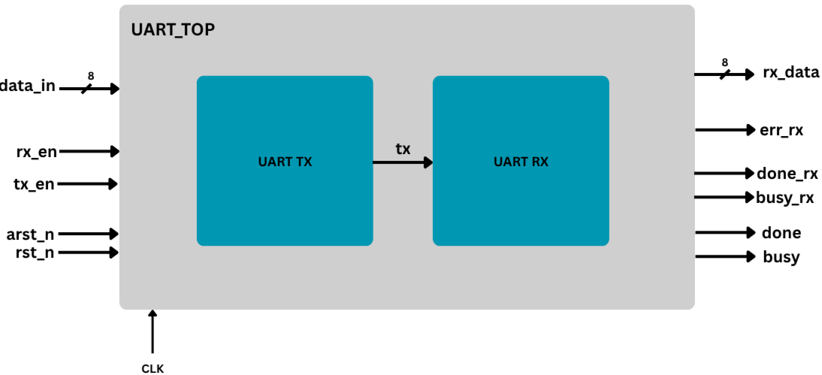
03 DEVELOPMENT JOURNEY
UART communication module
8-N-1
9600
frame format
baud rate (default)
50 MHz
10 bit
system clock
start + 8 data + stop
UART_TOP: transmitter and receiver, with tx looped to rx for verification
Status signals
busy: a byte is in flight, do not load another
done: pulse when a byte completes
err: invalid stop bit (framing error)
Reset inputs
rst: synchronous, active high
arst_n: asynchronous, active low
Secure UART Communication System · NTI Digital Design Project
Notes:
The UART is byte oriented, while AES works on 128 bits and the CRC returns 16 bits, so the top-level controller has to serialize everything into bytes. The UART uses the standard 8-N-1 frame at 9600 baud from a 50 MHz clock. busy stops a new byte from overwriting the one being sent; done lets the controller advance.

Slide 11
03 DEVELOPMENT JOURNEY
UART transmitter and receiver operation
Transmitter (FSM: IDLE, ON)
1
Idle
2
Load frame
3
Transmit
4
Complete
Wait in IDLE with the tx line held high.
Build the 10-bit frame {1, data, 0}: stop, 8 data bits, start.
Go to ON, assert busy, shift out one bit per baud tick, LSB first.
Clear busy, pulse done, reset the index and return to IDLE.
Receiver
1
Detect start
2
Mid-bit sample
3
Shift in
4
Validate stop
Watch rx in IDLE for a falling edge (high to low).
Wait 1.5 bit periods to land mid start bit, then 1 bit period per data bit.
Shift the 8 bits LSB first into the SIPO register on each tick.
Stop bit high: assert done. Stop bit low: enter ERR and assert err.
Sampling in the middle of each bit period makes the receiver robust against edge jitter.
Secure UART Communication System · NTI Digital Design Project
Notes:
Transmitter: two states, IDLE and ON. It builds a 10-bit frame and shifts one bit out per baud tick. Receiver: it detects the falling edge of the start bit, waits one and a half bit periods so it samples in the middle of the first data bit, then samples every bit period. If the stop bit is not high, it flags a framing error.

Slide 12
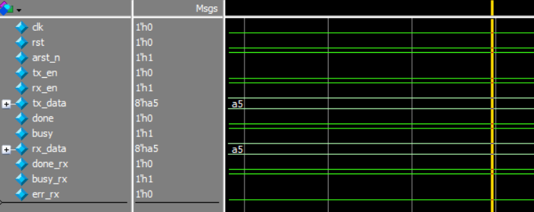
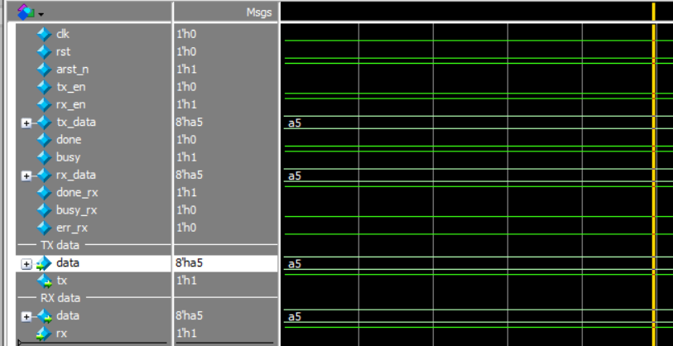
03 DEVELOPMENT JOURNEY
UART verification: loopback testbench
UART_TOP loopback at 50 MHz: TX feeds RX
Test | Input byte | Expected received
TEST 1 | 8'hA5 | 8'hA5
TEST 2 | 8'h55 | 8'h55
TEST 3 | 8'hFF | 8'hFF
Before completion
Why these patterns
A5 (10100101): mixed ones and zeros
55 (01010101): toggles on every bit
FF (11111111): all ones, so only the start bit falls
Waveform: tx_data = rx_data = A5, done_rx asserted, err_rx low
After the byte is received
Secure UART Communication System · NTI Digital Design Project
Notes:
The UART testbench loops the transmitter back into the receiver and sends three byte patterns: A5, 55 and FF. In the waveform you can see tx data and rx data both equal A5, done_rx asserted, and err_rx low.

Slide 13
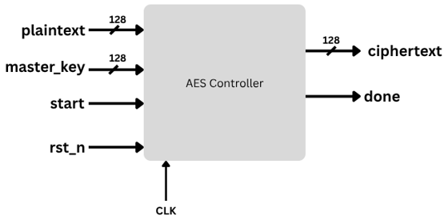
03 DEVELOPMENT JOURNEY
AES-128 encryption module
128-bit
128-bit
10 rounds
11 keys
plaintext block
master key
+ initial AddRoundKey
K0 to K10 from key expansion
ENCRYPTION FLOW
Initial
Rounds 1 to 9
Round 10
AddRoundKey (K0)
SubBytes
ShiftRows
MixColumns
AddRoundKey
SubBytes
ShiftRows
AddRoundKey
Round keys K1 to K9, one per round
Round key K10. MixColumns omitted
Secure UART Communication System · NTI Digital Design Project
Notes:
AES-128 takes a 128-bit block and a 128-bit key. The key schedule expands the master key into eleven round keys. There is an initial AddRoundKey, nine full rounds of SubBytes, ShiftRows, MixColumns and AddRoundKey, and a final round without MixColumns.

Slide 14


03 DEVELOPMENT JOURNEY
AES control FSM and iterative datapath
repeat x9
IDLE
LOAD
KEY_
EXPANSION
INITIAL_
ADD_KEY
ROUND_1
to ROUND_9
ROUND_10
DONE
wait for request
capture plaintext and key
generate round keys
plaintext XOR K0
full AES round
no MixColumns
register ciphertext
One round datapath, reused
Key expansion
Area versus latency
The same physical SubBytes, ShiftRows, MixColumns and AddRoundKey logic runs in all ten rounds under FSM control.
The 128-bit master key becomes eleven 128-bit round keys: K0 for the initial step, K1 to K10 for rounds 1 to 10.
Reuse minimizes hardware compared with a fully unrolled design, at the cost of more clock cycles per block.
Secure UART Communication System · NTI Digital Design Project
Notes:
The AES core is an FSM: IDLE, LOAD, KEY_EXPANSION, INITIAL_ADD_KEY, rounds one to nine, round ten without MixColumns, and DONE. The important design choice is an iterative datapath: one round of hardware reused ten times, trading extra cycles for a much smaller area than an unrolled design.

Slide 15
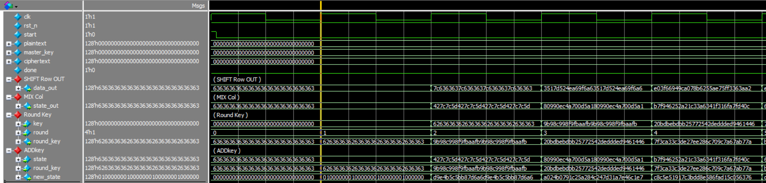
03 DEVELOPMENT JOURNEY
AES verification: testbench tb_AES_FSM
1
Reset phase
2
Data latching
3
Execution pulse
4
Completion sync
Inputs start at zero. rst_n is held low for two clock cycles, then released.
Plaintext and key are loaded across a clock edge with non-blocking assignments and a #1 delay.
start pulses high for one clock, moving the FSM from IDLE into the first AddRoundKey.
The testbench waits (wait(done)) until all 10 rounds finish and done rises for one cycle.
tb_AES_FSM waveform: round counter and the per-round SubBytes, ShiftRows, MixColumns and AddRoundKey signals
Secure UART Communication System · NTI Digital Design Project
Notes:
The AES testbench has four phases: reset, latching the plaintext and key with non-blocking assignments, a one-cycle start pulse, and waiting for done. The waveform shows the round counter stepping through the rounds and the intermediate SubBytes, ShiftRows, MixColumns and AddRoundKey signals.

Slide 16
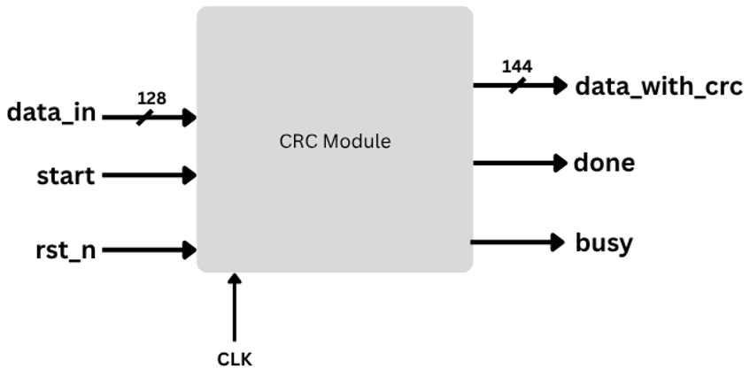
03 DEVELOPMENT JOURNEY
CRC-16/XMODEM module
Parameter | Value
Width | 16 bits
Polynomial | 0x1021 (x^16 + x^12 + x^5 + 1)
Initial value | 0x0000
RefIn / RefOut | False / False
XorOut | 0x0000
Check value | 0x31C3 for "123456789"
BIT-SERIAL ARCHITECTURE · one input bit per clock cycle
1
Capture
2
Feedback
3
Shift and XOR
4
Finish
Latch the 128-bit input while idle. CRC register starts at 0x0000, counter at 0.
Take input bits MSB first, from data_in[127]. feedback = CRC[15] XOR input bit.
Shift the CRC left. If feedback is 1, XOR the polynomial 0x1021.
After 128 cycles: done rises, busy falls, output is {data, CRC} = 144 bits.
Secure UART Communication System · NTI Digital Design Project
Notes:
The CRC engine implements CRC-16/XMODEM: polynomial 0x1021, initial value zero, no reflection, no final XOR. It is bit-serial: one bit per clock, so a 128-bit block takes 128 cycles and produces a 144-bit output made of the data followed by the 16-bit CRC. It is a single clocked process with no dedicated FSM.

Slide 17
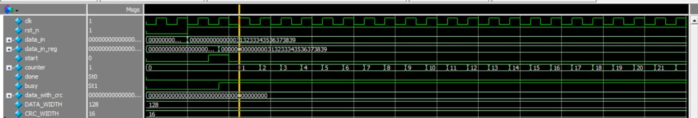
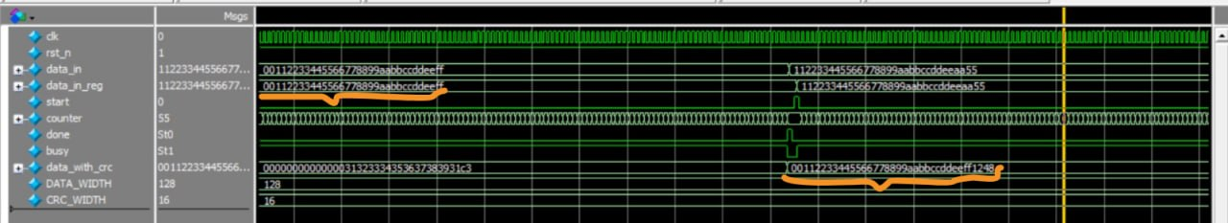
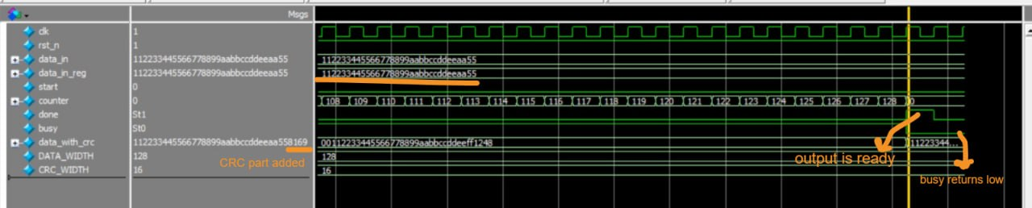
03 DEVELOPMENT JOURNEY
CRC verification: three test vectors
Test | 128-bit input | Expected | Match
1 | 00000000000000313233343536373839 | 0x31C3 | Yes
2 | 00112233445566778899AABBCCDDEEFF | 0x1248 | Yes
3 | 112233445566778899AABBCCDDEEAA55 | 0x8169 | Yes
Test 1: counter starts after start; input captured in data_in_reg
Test 2: result 0x1248 appended to the data
Test 1 embeds the standard ASCII string "123456789" (check value 0x31C3). All three match the waveforms and an independent software CRC-16/XMODEM.
Test 3: counter reaches 128, done rises, busy falls, result 0x8169
Testbench discipline
Apply reset, then wait until the module is idle before each new input
The engine starts by itself whenever busy is low, so timing matters
Wait for done, then compare data_with_crc[15:0] with the expected CRC
Secure UART Communication System · NTI Digital Design Project
Notes:
Three 128-bit vectors are used. The first ends with the ASCII string 1-2-3-4-5-6-7-8-9, whose standard CRC-16/XMODEM check value is 0x31C3. The waveforms show the counter running to 128, then done rising, busy falling, and the 16-bit CRC appended to the data.

Slide 18
03 DEVELOPMENT JOURNEY
Integration: top-level FSM
IDLE
AES_START
AES_WAIT
CRC_START
CRC_WAIT
wait for start
launch AES
wait for AES done
launch CRC
wait for CRC done
COMPLETE
UART_WAIT
UART_SEND
UART_LOAD
return to IDLE
report full frame
wait for byte done
request transmission
select next byte
UART_WAIT loops back to UART_LOAD until all 18 bytes are sent
start
busy = 1
done = 1
Assert only when the target block is idle and ready.
Block is working. Never overwrite its input or result registers.
Result is valid. Capture it and advance the controller.
Secure UART Communication System · NTI Digital Design Project
Notes:
The integration challenge is not the algorithms but moving data between blocks with different widths and different latencies. A nine-state top-level FSM launches AES, waits for done, launches CRC, waits for done, then feeds the 18 bytes to the UART one at a time, only when the UART is not busy. Three simple handshake rules keep this safe.

Slide 19
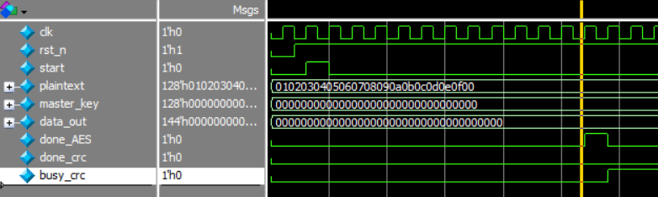
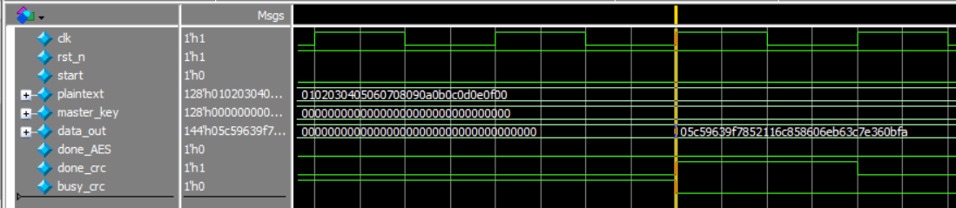
03 DEVELOPMENT JOURNEY
Integration verification
Top-level testbench: AES to CRC wrapper, signals start, done_AES, busy_crc, done_crc, data_out
1
start pulse
AES encrypts the plaintext block with the master key.
2
done_AES rises
The CRC engine starts by itself: busy_crc goes high.
Before the CRC completes: AES done, CRC busy
3
done_crc rises
data_out, 144 bits, holds the ciphertext followed by its CRC-16.
After the CRC completes: done_crc high, 144-bit data_out valid
Secure UART Communication System · NTI Digital Design Project
Notes:
This is the integration testbench for the AES-to-CRC wrapper. The handshake works as designed: when the AES asserts done, the CRC engine starts automatically, and when the CRC asserts done, the 144-bit output holds the ciphertext followed by the 16-bit CRC.

Slide 20


04 CHALLENGES AND SOLUTIONS
Challenges and solutions (1/2)
CHALLENGE
OUR APPROACH
RESULT
Mismatched data widths
The top-level controller serializes the 128-bit ciphertext MSB first into 16 bytes, then appends the CRC high byte and low byte.
A fixed 18-byte protected payload: 16 bytes ciphertext + 2 bytes CRC.
AES works on 128-bit blocks, the CRC produces 16 bits, the UART moves 8 bits at a time.
Multi-cycle blocks
A start / busy / done handshake on every block and a 9-state top-level FSM. Busy protection stops a byte being loaded while another is in flight.
In simulation done_AES triggers the CRC and done_crc releases the 144-bit output.
AES, CRC and UART each take many cycles. We cannot assume an output is ready just because we started the block.
UART receiver timing
Detect the falling edge, wait 1.5 bit periods to reach mid start bit, then sample every 1 bit period. Check the stop bit and raise err if it is low.
Loopback testbench recovers the sent byte (waveform: A5 in, A5 out, err low).
The receiver has no clock from the sender, so it must decide when to sample each bit.
Secure UART Communication System · NTI Digital Design Project
Notes:
Three integration and protocol problems. First, data widths: 128, 16 and 8 bits. Second, blocks that take many cycles. Third, the UART receiver, which has to sample in the middle of each bit. Each was solved with a specific mechanism, and each has evidence in the waveforms.

Slide 21


04 CHALLENGES AND SOLUTIONS
Challenges and solutions (2/2)
CHALLENGE
OUR APPROACH
RESULT
Ambiguous CRC variant
Fixed the exact parameters: poly 0x1021, init 0x0000, no reflection, XorOut 0. Checked against the standard string "123456789".
RTL returns 0x31C3, plus 0x1248 and 0x8169 on two more vectors. All match.
CRC-16/XMODEM and CRC-16/CCITT-FALSE share the polynomial and differ only in the initial value.
CRC restarts on its own
The testbench waits for idle before applying input, then waits for done before comparing data_with_crc[15:0].
Repeatable checks: counter reaches 128, done rises, busy falls.
The CRC engine starts by itself whenever busy is low, so input and result timing in the testbench matters.
AES area versus latency
An iterative FSM (IDLE, LOAD, KEY_EXPANSION, rounds, DONE) that reuses one round datapath for all ten rounds.
Compact core sequenced by the FSM, with a single-cycle done at the end.
A fully unrolled 10-round AES is large and has long combinational paths.
Secure UART Communication System · NTI Digital Design Project
Notes:
Three design and verification problems. The CRC variant confusion is solved by checking the standard 123456789 vector. The CRC auto-start behavior is handled in the testbench by waiting for idle and done. For AES we chose area over latency with an iterative FSM.

Slide 22
05 SUMMARY
Summary of the outcome
3
1
18 B
3 / 3
RTL blocks: UART, AES-128, CRC-16
integrated encrypt, CRC, transmit datapath
protected frame: 16 ciphertext + 2 CRC
CRC vectors match, incl. 0x31C3
What we got
WHAT WE LEARNED
UART transmitter and receiver, 8-N-1, with a loopback testbench
Integration is harder than the algorithms: widths and timing differ
Handshakes make multi-cycle blocks safe to chain
Standard test vectors give an objective pass or fail
Iterative AES-128 core with FSM control over 10 rounds
Bit-serial CRC-16/XMODEM engine checked against reference vectors
Integrated datapath with start / busy / done handshaking
Secure UART Communication System · NTI Digital Design Project
Notes:
The outcome: three RTL blocks and an integrated datapath. The protected frame is 18 bytes. The CRC engine matches all three reference vectors, including the standard 0x31C3. The biggest lessons: integration is harder than the algorithms, handshakes make multi-cycle blocks safe, and reference vectors give an objective check.

Slide 23

06 FUTURE WORK
Future work
Functionality
Implementation
Verification
AES decryption path for bidirectional secure communication
Optimize the S-box for the chosen FPGA or ASIC technology
Assertions and formal checks: busy exclusivity, state transitions
Formal frame format: synchronization, length, sequence number, explicit CRC coverage
Post-synthesis timing analysis: report area, power and maximum frequency
Randomized constrained verification with functional coverage
Receiver-side CRC error reporting and a retransmission policy
Next milestone: a complete bidirectional secure link with AES decryption, receiver-side CRC checking and retransmission.
Secure UART Communication System · NTI Digital Design Project
Notes:
Future work falls in three groups. Functionality: add AES decryption for a two-way link, define a formal frame with sync, length and sequence number, and add CRC error reporting with retransmission. Implementation: optimize the S-box and run post-synthesis timing, area and power analysis. Verification: add assertions and formal checks, plus randomized and coverage-driven testing.

Slide 24
Thank you
Questions and discussion
Secure UART Communication System: UART with hardware AES-128 encryption and CRC-16/XMODEM error detection
Mina Moawad · Mohammed Afifi · Hoda Ayman
Notes:
Thank you. We are happy to take questions.

