Slide 1
Employment Statistics
Jonathan Wu
Daniel Toohey
Mina Morcos
Darrell Collison

Slide 2
Introduction
For this project we sought to visualize the relation between unemployment rate, GDP, average hourly earnings, CPI, and productivity for the years 1999-2018.
During this time period there were two economic recessions in the US, in 2000 and 2008, referred to as the dot com bubble and the great recession, respectively.

Slide 3
Terms
CPI – an index of the variation in prices paid by typical consumers for retail goods and other items.
GDP – Gross Domestic Product
Multifactor Productivity – Output per combined inputs where combined inputs are Capital, Labor, Energy, Materials and Services.
Earnings – Average hourly wages excluding Supervisory roles.

Slide 4
Questions
1. Does GDP affect the unemployment rate in the US?
2. Have wages gone up along with increased productivity? (Are people being paid fairly for an increased workload)
3. How do average hourly earnings relate to Unemployment?
4. Do earnings increase with inflation as tracked by CPI?
5. Are the Year over Year rate changes the above factors better than the absolute data?

Slide 5
Data Sources
The data analyzed for this project was gathered from the following databases:
US Bureau of Labor Statistics (bls.gov)
Federal Reserve Bank of St. Louis (fred.stlouisfed.org)

Slide 6
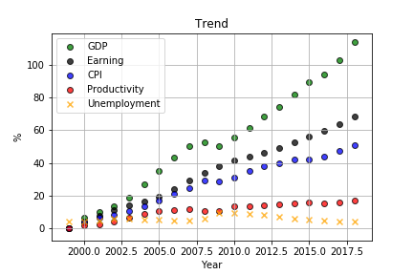
GDP, Earnings, CPI and Productivity

Slide 7
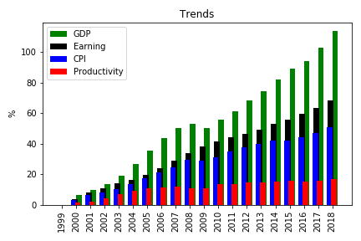

Slide 8
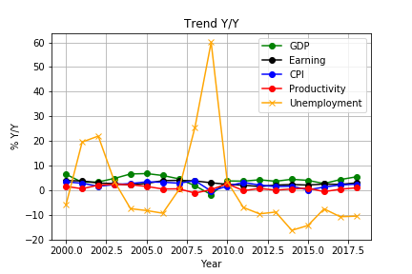
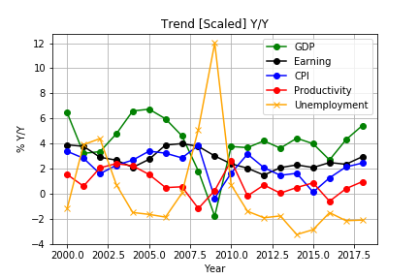
GDP, Earnings, CPI and Productivity (Y/Y)

Slide 9
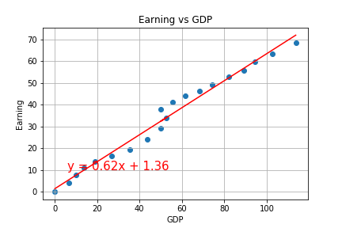
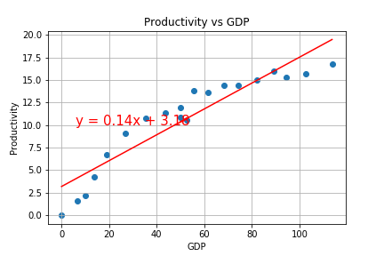
GDP

Slide 10
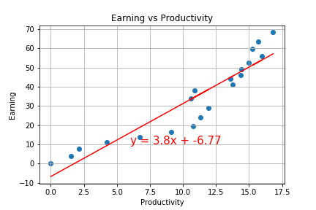
Earnings

Slide 11
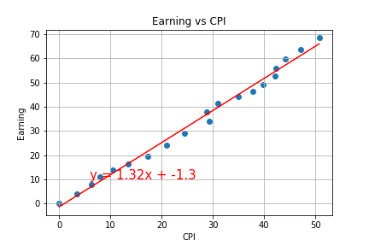
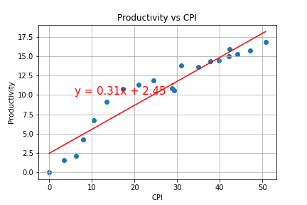
CPI

Slide 12
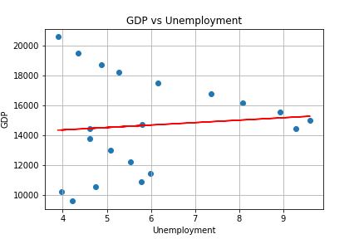
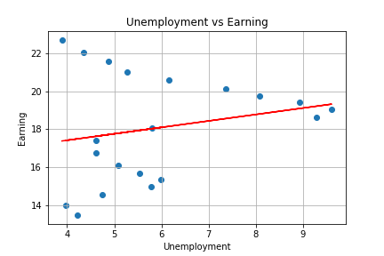
Unemployment

Slide 13
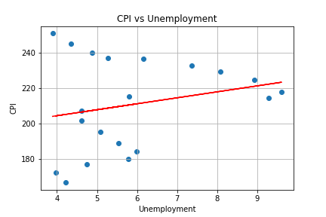
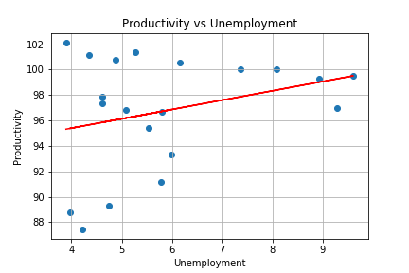

Slide 14
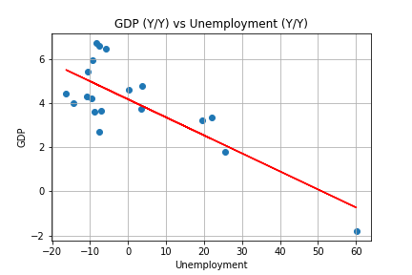
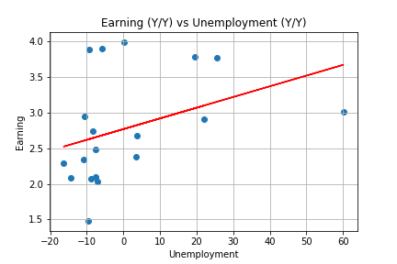
Unemployment Y/Y

Slide 15
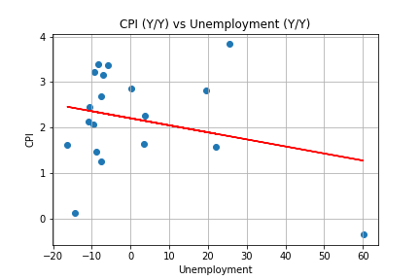
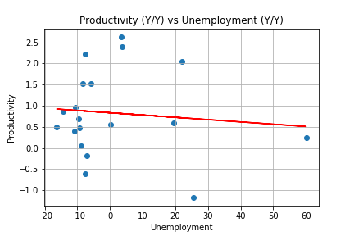

Slide 16

Code

Slide 17
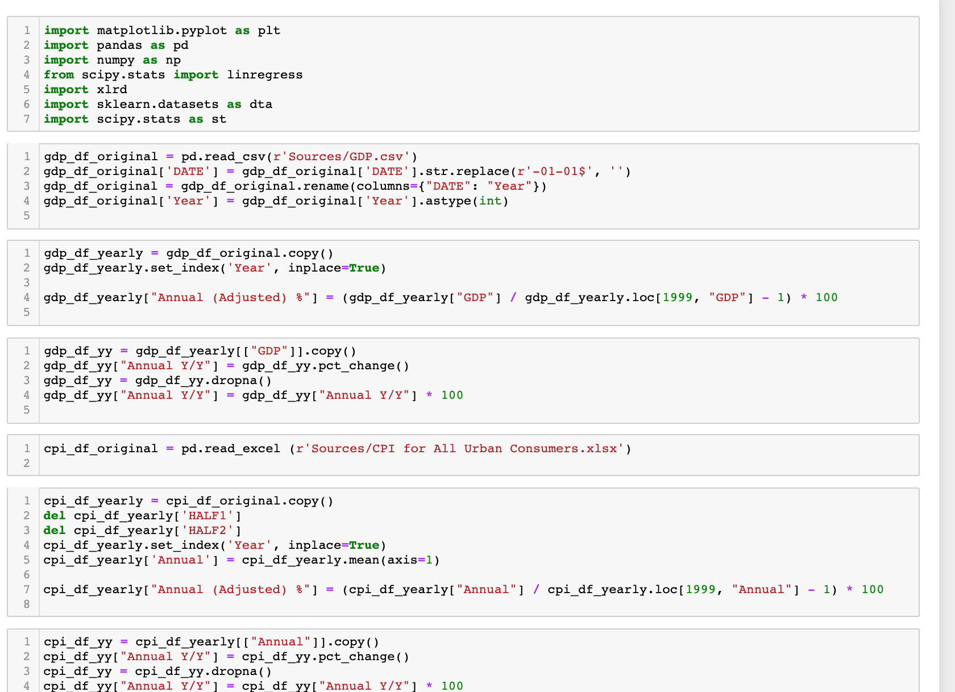

Slide 18
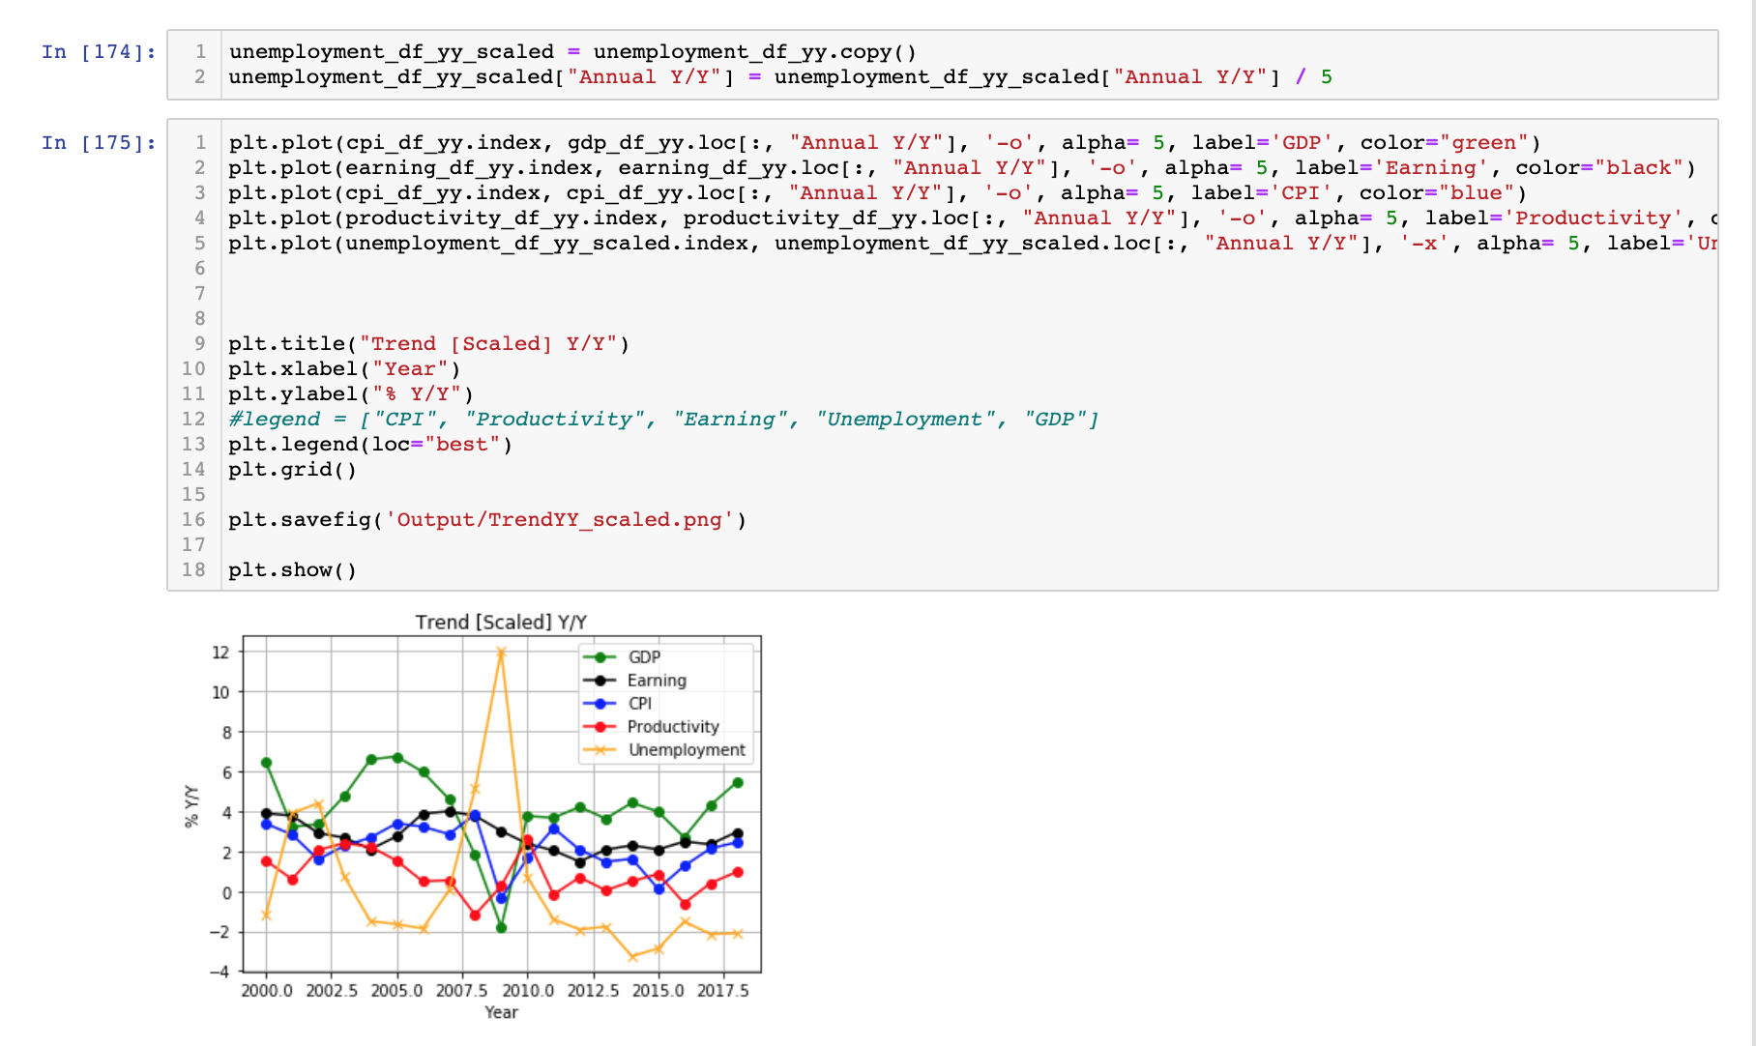

Slide 19
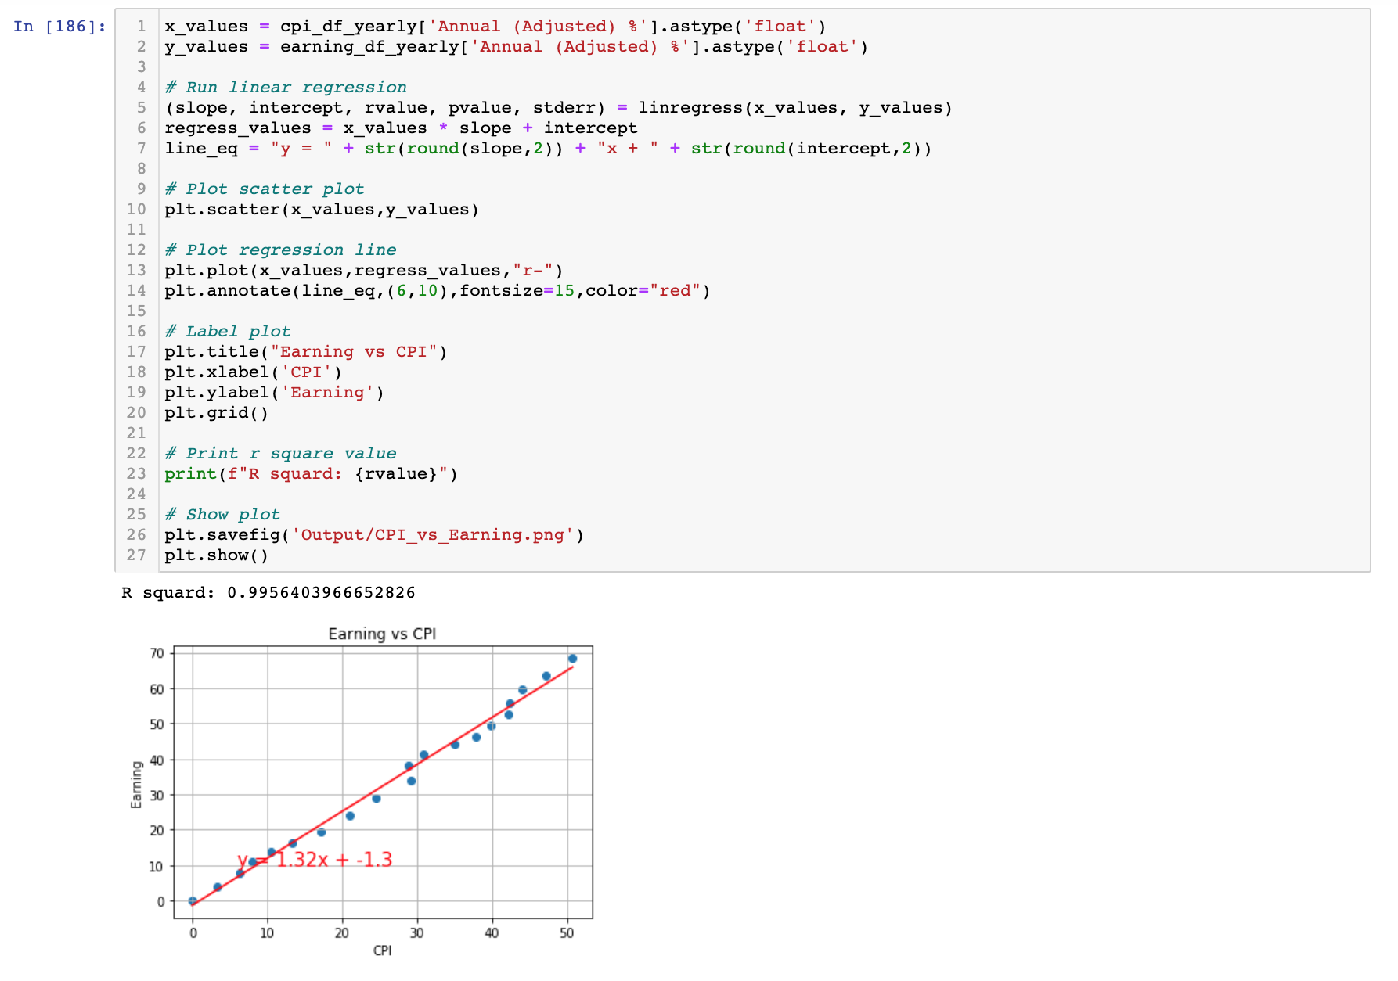

Slide 20
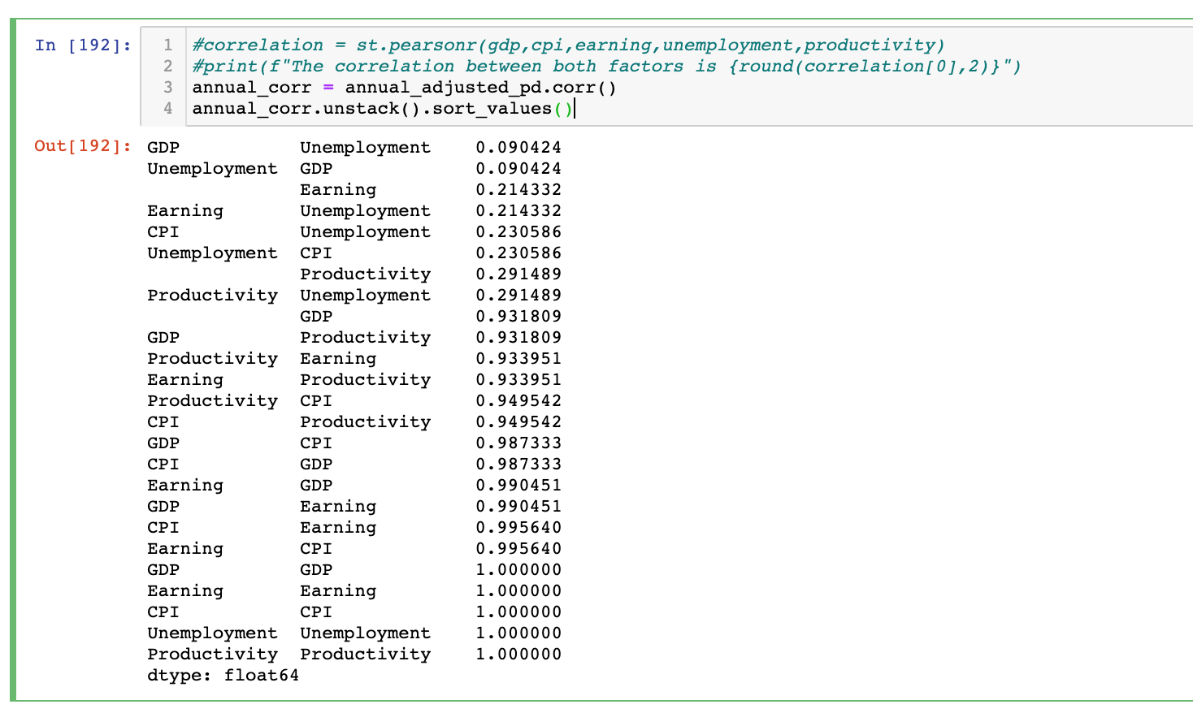

Slide 21
Results
After completing our data visualization, there seems to be no correlation between the unemployment rate and GDP, earnings, CPI or productivity.
There does however seem to be a correlation between productivity and earnings.
We also observed an increase in earnings that was greater than the rate of inflation.

Slide 22
Discussion
Some of our findings seem to be in contrast to conventional thinking, mainly the idea that earnings has been stagnant since the recent recession. This however could still be the case for the majority of American workers, since we observed an increase in the average hourly earnings that may be driven by top end earnings increase.
We also observed that the year over year change of these factors are a more closely correlated compared to the overall rate, probably due to the impact that time has on GDP.

Slide 23
Limitations
There are several limitations of these results, including the small size of our dataset, and the number of factors that we analyzed.
We also specifically chose the time period (1999-2018) due to the fact that we believed it contained many periods of the economic cycle, and this may have introduced bias in our findings.
Standard Regression limitations relating to the sensitivity of outliers and the possibility that there is a nonlinear relationship are also likely.

Slide 24
Future Work
After analyzing our results and drawing conclusions, we noticed several interesting observations that could be explored further in future visualization projects.
These include the movement of production that seems to precede GDP contraction. We believe that including a broader date range and more economic variables will enable us to make more accurate predictions.
We also intend on including the SAP 500 moving average as well as housing prices, in order to investigate the impact these factors have on both the stock and housing markets.
We also intend to analyze earning data in four cohorts to see if gains in average hourly earning is skewed by an increase in high end earning growth.

Slide 25
References
Gertner, Jon. The Rise and Fall of G.D.P. New York Times Magazine May 13, 2010.
Smith, Andrew. Totally Wired: On the Trail of the Great Dotcom Swindle. Simon & Schuster, 2012.
V.I. Keilis-Borok et al., Pattern of Macroeconomic Indicators Preceding the End of an American Economic Recession. Journal of Pattern Recognition Research, JPRR Vol.3 (1) 2008.

